Slide 1

Chapter 7
Reporting and interpreting cost of goods sold and inventory
McGraw-Hill/Irwin
Copyright © 2014 by The McGraw-Hill Companies, Inc. All rights reserved.
Notes:
Chapter 7: Reporting and Interpreting Cost of Goods Sold and Inventory

Slide 2

Understanding the Business
Provide sufficient quantities of high-quality inventory.
Primary Goals of Inventory Management
Minimize the costs of carrying inventory.
Notes:
The primary goals of inventory management are to have sufficient quantities of high-quality inventory available to serve customers’ needs while minimizing the costs of carrying inventory such as production, storage, obsolescence, and financing. Low quality inventory leads to customer dissatisfaction, returns, and decline in future sales. Also, purchasing or producing too few units can cause stock-outs that mean lost sales revenue and decreased customer satisfaction. Conversely, purchasing too many units increases storage costs as well as interest costs to finance the purchases. It may even lead to losses if the merchandise cannot be sold at normal prices.

Slide 3

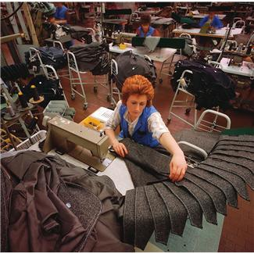


Items Included in Inventory
Merchandisers
Manufacturing
Merchandise Inventory
Raw Materials
Work in Process
Finished Goods
Notes:
Inventory is tangible property held for sale in the normal course of business or used in producing goods or services for sale.
Merchandisers (wholesale or retail businesses) hold merchandise inventory, which is goods (or merchandise) held for resale in the normal course of business. The goods usually are acquired in a finished condition and are ready for sale without further processing.
Manufacturing businesses hold three types of inventory:
Raw materials inventory: Items acquired for processing into finished goods. These items are included in raw materials inventory until they are used, at which point they become part of work in process inventory.
Work in process inventory: Goods in the process of being manufactured but not yet complete. When completed, work in process inventory becomes finished goods inventory.
Finished goods inventory: Manufactured goods that are complete and ready for sale

Slide 4
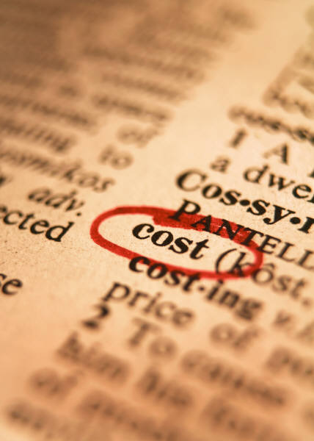
Costs Included in Inventory Purchases
The cost principle requires that inventory be recorded at the price paid or the consideration given.
Invoice Price
Freight-In
Inspection Costs
Preparation Costs
Any purchase returns and allowances and purchase discounts taken are subtracted.
Notes:
The cost principle requires that inventory be recorded at the price paid or the consideration given. Inventory cost includes the sum of the costs incurred in bringing an article to usable or salable condition and location. In addition to the invoice cost, other common costs included in inventory are freight costs, inspection costs, and preparation costs. Any purchase returns and allowances or purchase discounts taken are subtracted.
In general, the company should cease accumulating costs in inventory when the raw materials are ready for use or when the merchandise inventory is ready for shipment. Any additional costs related to selling the inventory (such as marketing costs and salaries) are incurred after the inventory is ready for use. So, they should be included in selling, general, and administrative expenses in the period they were incurred.

Slide 5
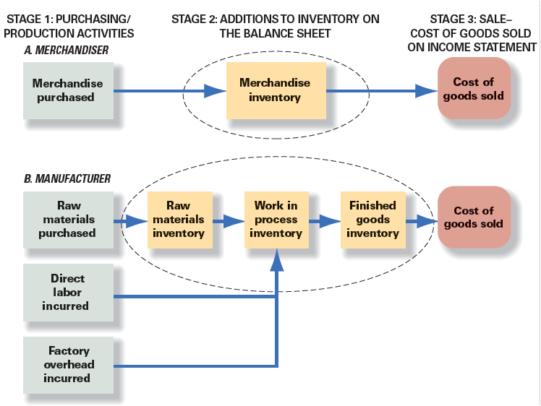
Flow of Inventory Costs
Notes:
A merchandiser purchases inventory that is in ready to sell condition. When merchandise inventory is purchased, the merchandise inventory account is increased. When the goods are sold, cost of goods sold is increased and merchandise inventory is decreased.
The flow of inventory for a manufacturer is more complex. First, a manufacturer purchases raw materials for use in making inventory. The items (and their costs) are included in raw materials inventory until they are used, at which point they become part of work in process inventory. As goods are manufactured, two other costs of manufacturing, direct labor and factory overhead, are also added. Direct labor refers to earnings of employees who work directly on the products being manufactured. Factory overhead includes manufacturing costs such as the costs of heat, light, and power to operate the factory. When the inventory is complete and ready for sale, the related amounts of work in process inventory are transferred to finished goods inventory. When the finished goods are sold, cost of goods sold is increased and finished goods inventory decreases.

Slide 6
Cost of Goods Sold equation
Beginning
Inventory
Purchases
for the Period
Goods Available
for Sale
(Inventory remaining)
(Inventory sold)
Ending Inventory
(Balance Sheet)
Cost of Goods Sold
(Income Statement)
Beginning inventory + Purchases = Goods Available for Sale
Goods Available for Sale – Ending inventory = Cost of goods sold
Notes:
Cost of goods sold is an expense account. Cost of goods sold is calculated by multiplying the number of units sold by their unit costs. Let’s examine the relationship between cost of goods sold on the income statement and inventory on the balance sheet. First, each accounting period is started with a stock of inventory called beginning inventory. During the accounting period, new purchases are added to inventory. The sum of the two amounts is the goods available for sale during that period. What remains unsold at the end of the period becomes ending inventory on the balance sheet. The portion of goods available for sale that is sold becomes cost of goods sold on the income statement. The ending inventory for one accounting period becomes the beginning inventory for the next period.
The relationships between these various inventory amounts are brought together in the cost of goods sold equation. Beginning inventory plus purchases equals goods available for sale. Goods available for sale minus ending inventory equals cost of goods sold.

Slide 7
Perpetual and periodic inventory systems
Perpetual
Periodic
Purchase transactions are recorded directly in an inventory account.
No up-to-date record of inventory is maintained during the year.
Sales require two entries to record: (1) the retail sale and (2) the cost of goods sold.
Sales require one entry to record the retail sale. Cost of goods sold is calculated.
Notes:
The amount of purchases for the period is always accumulated in the accounting system. The amount of cost of goods sold and ending inventory can be determined by using one of two different inventory systems: perpetual or periodic.
In a perpetual inventory system, purchase transactions are recorded directly in an inventory account. When each sale is recorded, a companion cost of goods sold entry is made, decreasing inventory and recording cost of goods sold. In a perpetual inventory system, a detailed record is maintained for each type of merchandise stocked, showing (1) units and cost of the beginning inventory, (2) units and cost of each purchase, (3) units and cost of the goods for each sale, and (4) units and cost of the goods on hand at any point in time. This up-to-date record is maintained on a transaction-by-transaction basis. Most modern companies could not survive without this information. As noted at the beginning of the chapter, cost and quality pressures brought on by increasing competition, combined with dramatic declines in the cost of computers, have made sophisticated perpetual inventory systems a requirement at all but the smallest companies. As a consequence, we will continue to focus on perpetual inventory systems throughout the book.
Under the periodic inventory system, no up-to-date record of inventory is maintained during the year. An actual physical count of the goods remaining on hand is required at the end of each period. The number of units of each type of merchandise on hand is multiplied by unit cost to compute the dollar amount of the ending inventory. Cost of goods sold is calculated at the end of the accounting period using the cost of goods sold equation. Because the amount of inventory is not known until the end of the period when the inventory count is taken, the amount of cost of goods sold cannot be reliably determined until the inventory count is complete. The primary disadvantage of a periodic inventory system is the lack of inventory information. Managers are not informed about low or excess stock situations.

Slide 8
Inventory Costing Methods
Inventory Costing Methods
Specific Identification
First-in, First-out (FIFO)
Last-in, First-out (LIFO)
Weighted Average
Total Dollar Amount of Goods Available for Sale
Inventory Costing Method
Ending Inventory
Cost of Goods Sold
Notes:
When inventory costs have changed during an accounting period, which inventory costs are treated as sold or remaining in inventory can turn profits into losses and cause companies to pay or save millions in taxes. So the question to answer is: What amount is recorded as cost of goods sold when inventory is sold? The answer depends on which specific goods we assume are sold.
Four generally accepted inventory costing methods are available determining cost of goods sold:
Specific Identification
First-in, First-out (FIFO)
Last-in, First-out (LIFO)
Weighted Average.
The four inventory costing methods are alternative ways to assign the total dollar amount of goods available for sale between ending inventory and cost of goods sold.

Slide 9
Specific Identification
When units are sold, the specific cost of the unit sold is added to cost of goods sold.
Notes:
Using the specific identification method, we know the specific cost of each unit that is sold. It is most commonly used in businesses that have low sales volume of high dollar items, like car dealerships, exclusive jewelry stores, and custom builders. The specific identification method is impractical when large quantities of similar items are stocked.

Slide 10
Cost Flow Assumptions
The choice of an inventory costing method is not based on the physical flow of goods on and off the shelves.
FIFO
LIFO
Weighted
Average
Notes:
The choice of an inventory costing method is not based on physical flow of goods on and off the shelves. That is why they are called cost flow assumptions.

Slide 11
First-In, First-Out Method
Cost of Goods Sold
Oldest Costs
Ending Inventory
Recent Costs
Notes:
When using first-in, first-out, we assign the older costs to the units sold. That leaves the more recent costs to be used to value ending inventory. In other words, the first-in, first-out method assumes that the first goods purchased (the first in) are the first goods sold.

Slide 12
First-In, First-Out method
This chart provides information about purchases for the Model A leather jacket inventory for Harley-Davidson. We will use this data throughout our inventory examples so we can compare our results at the end.
Additional Information: During the period Harley-Davidson sold four units and has three units remaining in ending inventory.
Notes:
Take a minute and review this chart for Model A leather jacket inventory for Harley-Davidson. We will use this data throughout our inventory examples so we can compare our results at the end.
There are three units in ending inventory and four units sold during the period. The beginning inventory of Model A leather jackets consists of two units purchased for $70 each. On January 12, Harley-Davidson purchased another four units for $80 each. Then, on January 14, one unit was purchased for $100 each. The beginning inventory plus purchases equals cost of goods available for sale, which totals to seven units with a total cost of $560.
During the period Harley-Davidson sold four units and has three units remaining in ending inventory.

Slide 13
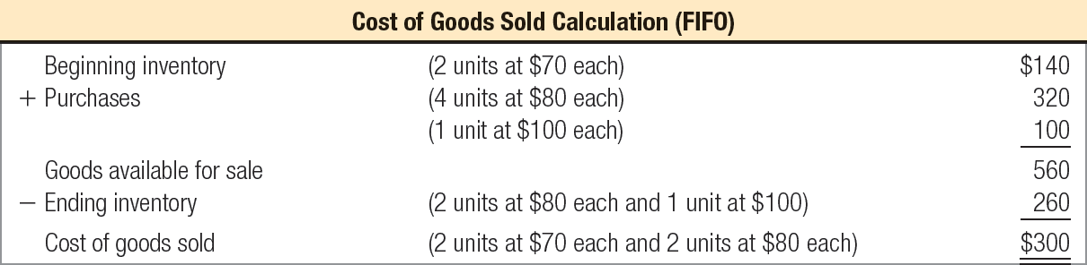
First-In, First-Out method
Jan. 12
Jan. 14
Cost of Goods Available for Sale
$560
Ending Inventory
$260
Cost of Goods Sold
$300
Notes:
First, let’s use the first-in, first-out method to determine the cost of the three units in ending inventory. Remember when we are using the first-in, first-out method, the costs of the most recent purchases are in ending inventory. So, let’s start with January 14 purchase and add units purchased until we account for the three units in ending inventory.
To determine the value of the ending inventory, start with the one unit from the January 14 purchase and keep adding layers of purchases until we reach three units in ending inventory. The ending inventory cost consists of one unit at $100 and two units at $80 each. The total cost of our ending inventory is $260.
Now we can start working on the cost of goods sold. Recall that we sold four units. Remember that when we use the first-in, first-out method the cost of the first items in (the oldest items) is allocated to cost of goods sold. As you can see, to determine the value of the cost of goods sold, we used the two units from the beginning inventory and then added two units from the January 12 purchase to account for the total four units sold. The cost of goods sold amounted to $300.

Slide 14
Last-In, First-Out method
Ending Inventory
Oldest Costs
Cost of Goods Sold
Recent Costs
Notes:
When using last-in, first-out, we assign the most recent costs to the units sold. That leaves the older costs to be used to value ending inventory. In other words, the last-in, first-out method assumes that the last goods purchased (the last in) are the first goods sold.

Slide 15
Last-In, First-Out method
This chart provides information about purchases for the Model A leather jacket inventory for Harley-Davidson. We will use this data throughout our inventory examples so we can compare our results at the end.
Additional Information: During the period Harley-Davidson sold four units and has three units remaining in ending inventory.
Notes:
Remember this data? We will use this data for the Model A leather jacket inventory for Harley-Davidson for the last-in, first-out example that follows.
There are three units in ending inventory and four units sold during the period. The beginning inventory of Model A leather jackets consists of two units purchased for $70 each. On January 12, Harley-Davidson purchased another four units for $80 each. Then, on January 14, one unit was purchased for $100 each. The beginning inventory plus purchases equals cost of goods available for sale, which totals to seven units with a total cost of $560.
During the period Harley-Davidson sold four units and has three units remaining in ending inventory.

Slide 16
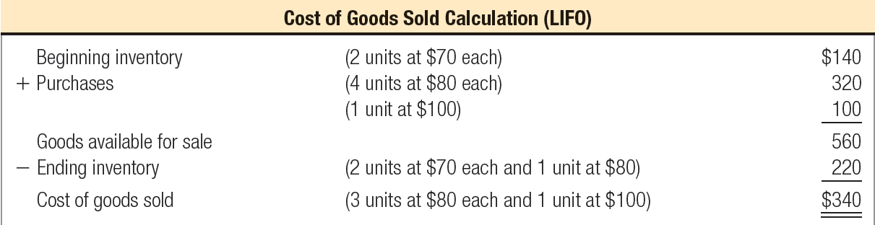
Last-In, First-Out method
Jan. 12
Jan. 14
Cost of Goods Available for Sale
$560
Ending Inventory
$220
Cost of Goods Sold
$340
Notes:
When using the last-in, first-out method, the costs of oldest purchases are in ending inventory. So, let’s start with the beginning inventory and add units purchased until we account for the three units in ending inventory.
To determine the value of the ending inventory, start with the beginning inventory and keep adding layers of purchases until we reach three units in ending inventory. The ending inventory cost consists of two units at $70 each and one unit at $80. The total cost of our ending inventory is $220.
Now we can start working on the cost of goods sold. Recall that we sold four units. Remember that when we use the last-in, first-out method the cost of the last items in (the most recent items) is allocated to cost of goods sold. As you can see, to determine the value of the cost of goods sold, we used the one unit from the January 14 purchase and then added three units from the January 12 purchase to account for the total four units sold. The cost of goods sold amounted to $340.

Slide 17
Average Cost Method
When a unit is sold, the average cost of each unit in inventory is assigned to cost of goods sold.
Cost of Goods Available for Sale
Number of Units Available for Sale
÷
Notes:
When using weighted average (also known as the average cost method), we assign the average cost of the goods available for sale to cost of goods sold. The average cost is determined by dividing the cost of goods available for sale by the number of units available for sale. The average cost method uses the weighted average unit cost of the goods available for sale for both cost of goods sold and ending inventory.

Slide 18
Average cost method
This chart provides information about purchases for the Model A leather jacket inventory for Harley-Davidson. We will use this data throughout our inventory examples so we can compare our results at the end.
Additional Information: During the period Harley-Davidson sold four units and has three units remaining in ending inventory.
Notes:
Here is the same data for the Model A leather jacket inventory for Harley-Davidson. We will use it for the average cost example that follows.
There are three units in ending inventory and four units sold during the period. The beginning inventory of Model A leather jackets consists of two units purchased for $70 each. On January 12, Harley-Davidson purchased another four units for $80 each. Then, on January 14, one unit was purchased for $100 each. The beginning inventory plus purchases equals cost of goods available for sale, which totals to seven units with a total cost of $560.
During the period Harley-Davidson sold four units and has three units remaining in ending inventory.

Slide 19
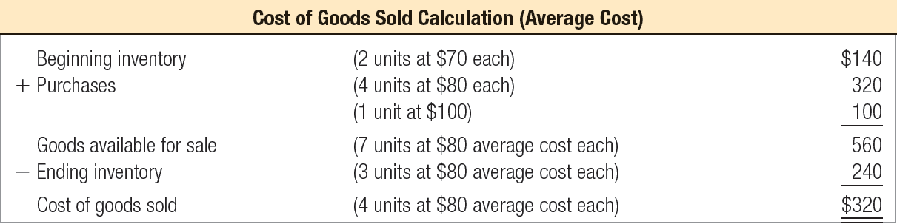
Average Cost Method
Cost of Goods Available for Sale
$560
Ending Inventory
$240
Cost of Goods Sold
$320
Notes:
The first thing we need to do when using the average cost method is to compute the weighted average cost of the items in inventory. We do this by dividing the cost of goods available for sale of $560 by the total units in inventory of seven. The average cost per unit is $80.
Once we know the average cost per unit is $80 we can easily compute the value for ending inventory and cost of goods sold. We compute the cost of ending inventory by multiplying three units times the average cost per unit of $80. The cost of the ending inventory is $240. We can also compute the cost of goods sold by multiplying four units times the average cost per unit of $80. The cost of goods sold is $320.

Slide 20
Perpetual inventory systems and cost flow assumptions in practice
FIFO inventory and cost of goods sold are the same whether computed on a perpetual or periodic basis.
As a consequence, companies that wish to report under LIFO convert the outputs of their perpetual inventory system to LIFO with an adjusting entry at the end of each period.
Accounting systems that keep track of the costs of individual items normally do so on a FIFO or average cost basis.
Notes:
You should have noted that, in our example, all inventory units were purchased before a sale was made and cost of goods sold recorded. In reality, most companies make numerous purchases and sales of the same inventory item throughout the accounting period. How can we apply our simple example to these circumstances given that companies normally employ perpetual inventory systems?
First, it is important to know that FIFO inventory and cost of goods sold are the same whether computed on a perpetual or periodic basis. Second, accounting systems that keep track of the costs of individual items normally do so on a FIFO or average cost basis, regardless of the cost flow assumption used for financial reporting. As a consequence, companies that wish to report under LIFO convert the outputs of their perpetual inventory system to LIFO with an adjusting entry at the end of each period. By waiting until the end of the period to calculate this LIFO adjustment, LIFO ending inventory and cost of goods sold are calculated as if all purchases during the period were recorded before cost of goods sold is calculated and recorded. In other words, our simple example of how to calculate cost of goods sold applies even though a company actually tracks the number of units bought and sold on a perpetual basis.

Slide 21
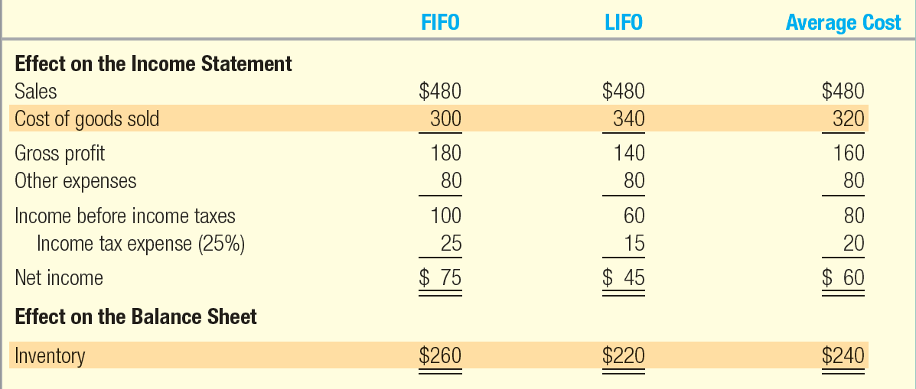
Financial statement effects of inventory costing methods
Notes:
Each of the four inventory costing methods is in conformity with GAAP and the tax law. To understand why mangers choose different methods under different circumstances, we must first understand their effects on the income statement and balance sheet.
This slide presents a comparison of the impact on the income statement of using the different inventory costing methods. Because prices change, inventory methods nearly always assign different cost amounts. Everything is the same in each example, except the amount of Ending Inventory and Cost of Goods Sold and the flow through effects on Income Before Income Taxes, Income Tax Expense, and Net Income.
In periods of rising prices, of the three cost flow assumption methods, first-in, first-out will provide the lowest Cost of Goods Sold amount. This is because it uses the older costs which tend to be lower to arrive at this amount. Last-in, first-out will provide the highest Cost of Goods Sold amount. This is because it uses the most recent costs which tend to be higher to arrive at this amount. Weighted Average will provide a Cost of Goods Sold amount that falls between first-in, first-out and last-in, first-out.
As you can see, the impact on net income is that first-in, first-out results in the highest net income, last-in, first-out results in the lowest net income and weighted average results in net income that falls in the middle of these two.

Slide 22

International Perspective
LIFO and International Comparisons
While U.S. GAAP allows companies to choose between FIFO, LIFO, and weighted average inventory methods, International Financial Reporting Standards (IFRS) currently prohibit the use of LIFO.
GAAP allows different inventory accounting methods to be used for different types of inventory items.
IFRS requires that the same method be used for all inventory items that have a similar nature and use.
These differences can create comparability problems when one attempts to compare companies across international borders.
Notes:
While U.S. GAAP allows companies to choose between FIFO, LIFO, and weighted average inventory methods, International Financial Reporting Standards (IFRS) currently prohibit the use of LIFO. GAAP allows different inventory accounting methods to be used for different types of inventory items and even for the same item in different locations. IFRS requires that the same method be used for all inventory items that have a similar nature and use. These differences can create comparability problems when one attempts to compare companies across international borders.

Slide 23
Financial Statement Effects of inventory Costing Methods
Advantages of Methods
First-In, First-Out
Last-In, First-Out
Weighted Average
Ending inventory approximates current replacement cost.
Better matches current costs in cost of goods sold with revenues.
Smoothes out effects of price changes.
Notes:
An advantage of weighted average is that it smoothes out effects in price changes that may occur during the period. First-in, first-out does better to value Ending Inventory at an approximate replacement cost. This is because first-in, first-out uses the most recent costs to value ending inventory. Last-in, first-out does better to match current costs in Cost of Goods Sold with current revenues. This is because last-in, first-out uses the most recent costs to determine Cost of Goods Sold.

Slide 24
Managers Choice of Inventory Methods
Net Income Effects
Managers prefer to report higher earnings for their companies.
Income Tax Effects
Managers prefer to pay the least amount of taxes allowed by law as late as possible.
LIFO Conformity Rule
If last-in, first-out is used to compute taxable income, it must also be used to calculate inventory and cost of goods sold for financial statements.
Notes:
What motivates companies to choose different inventory costing methods? Most managers choose accounting methods based on two factors:
Net income effects (managers prefer to report higher earnings for their companies).
Income tax effects (managers prefer to pay the least amount of taxes allowed by law as late as possible.)
Any conflict between the two motives is normally resolved by choosing one accounting method for external financial statements and a different method for preparing its tax return.
The choice of inventory costing method must also consider the Last-in, first-out Conformity Rule. This rule states that if last-in, first-out is used to compute taxable income, it must also be used to calculate inventory and cost of goods sold for financial statements.

Slide 25
Valuation at Lower of Cost or Market
Ending inventory is reported at the lower of cost or market (LCM).
Replacement Cost
The current purchase price for identical goods.
The company will recognize a “holding” loss in the current period rather than the period in which the item is sold.
This practice is conservative.
Notes:
Inventories should be measured initially at their purchase cost in conformity with the cost principle. When the goods remaining in ending inventory can be replaced with identical goods at a lower cost, however, the lower replacement cost should be used as the inventory valuation. Replacement cost is the current purchase price for identical goods. Lower of cost or market is a valuation method departing from the cost principle. It serves to recognize a loss when replacement cost or net realizable value drops below cost.
This departure from the cost principle is based on the conservatism constraint, which requires special care to avoid overstating assets and income. Under lower of cost or market, companies recognize a “holding” loss in the period in which replacement cost of an item drops, rather than in the period in which the item is sold. The holding loss is the difference between the purchase cost and the lower replacement cost. It is added to the cost of goods sold of the period.

Slide 26
Valuation at Lower of Cost or Market
(1,000 Intel chips × $50) = $50,000
Notes:
To illustrate, assume that Dell Computer had the following in the current period ending inventory. The 1,000 Intel chips should be recorded in the ending inventory at the current market value of $200 because it is lower than the cost of $250. Dell would make the journal entry illustrated that debits cost of goods sold for $50,000 and credits inventory for $50,000.
Since the market price of the disk drives of $110 is higher than the original cost of $100, no write-down is necessary. Recognition of holding gains on inventory is not permitted by generally accepted accounting principles.

Slide 27


Inventory Turnover
Average Inventory is . . .
(Beginning Inventory + Ending Inventory) ÷ 2
This ratio reflects how many times average inventory was produced and sold during the period. A higher ratio indicates that inventory moves more quickly thus reducing storage and obsolescence costs.
Notes:
As mentioned earlier, the primary goals of inventory management are to have sufficient quantities of high-quality inventory available to serve customers’ needs while minimizing the costs of carrying inventory. The inventory turnover ratio is an important measure of the company’s success in balancing these conflicting goals.
The inventory turnover ratio is calculated as cost of goods sold divided by average inventory. Average inventory is the beginning inventory plus the ending inventory divided by 2.
This ratio reflects how many times average inventory was produced and sold during the period. A higher ratio indicates that inventory moves more quickly thus reducing storage and obsolescence costs.

Slide 28

Average Days to sell inventory
This ratio reflects the average time in days it takes a company to produce and deliver inventory to its customers.
Notes:
This ratio reflects the average time in days it takes a company to produce and deliver inventory to its customers. Generally, a lower ratio is better as it indicates a quicker delivery cycle to customers.

Slide 29
Inventory Methods and Financial Statement Analysis
U.S. public companies using LIFO also report beginning and ending inventory on a FIFO basis in the financial statement notes if the FIFO values are materially different.
Notes:
Before meaningful comparisons can be made across companies, one company’s statements have to be converted to a comparable basis. For inventory comparisons, making such a conversion is eased by the requirement that U.S. public companies using last-in, first-out also report beginning and ending inventory on a first-in, first-out basis in the financial statement notes if the first-in, first-out values are materially different.
Review these computations that result in identifying the difference in cost of goods sold between last-in, first-out and first-in, first-out.
You can adjust the inventory amounts on the balance sheet to first-in, first-out by substituting the first-in, first-out values disclosed in the notes to the financials.

Slide 30
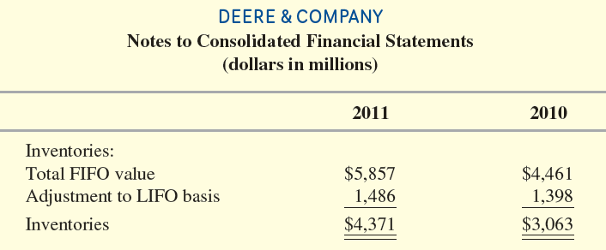
LIFO and Inventory turnover
For many LIFO companies, the inventory turnover ratio can be deceptive. Remember that, for these companies, the beginning and ending inventory numbers that make up the denominator of the ratio will be artificially small because they reflect old lower costs. Consider Deere & Co., manufacturer of John Deere farm, lawn, and construction equipment. Its inventory note lists the following values:
Notes:
For many LIFO companies, the inventory turnover ratio can be deceptive. Remember that, for these companies, the beginning and ending inventory numbers that make up the denominator of the ratio will be artificially small because they reflect old lower costs. Consider Deere & Co., manufacturer of John Deere farm, lawn, and construction equipment. Its inventory note lists the values in the table at the bottom of the screen.

Slide 31
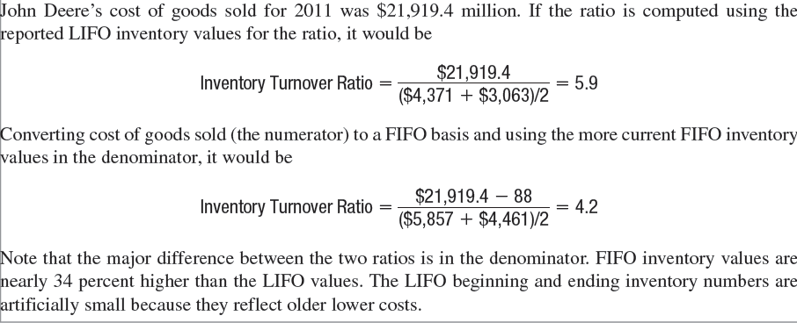
LIFO and Inventory turnover
Notes:
John Deere’s cost of goods sold for 2011 was $21,919.4 million. If the ratio is computed using the reported LIFO inventory values for the ratio, the ratio would be 5.9. Converting cost of goods sold (the numerator) to a FIFO basis and using the more current FIFO inventory values in the denominator results in a ratio of 4.2. Note that the major difference between the two ratios is in the denominator. FIFO inventory values are nearly 34 percent higher than the LIFO values. The LIFO beginning and ending inventory numbers are artificially small because they reflect older lower costs.

Slide 32
Internal Control of Inventory
Separation of inventory accounting and physical handling of inventory.
Storage in a manner that protects from theft and damage.
Limiting access to authorized employees.
Maintaining perpetual inventory records.
Comparing perpetual records to periodic physical counts.
Notes:
After cash, inventory is the asset second most vulnerable to theft. Efficient management of inventory is crucial to avoid stock outs and overstock situations. As a consequence, a number of control features focus on safeguarding inventories and providing up to date information for management decisions.
Key among these are:
Separation of responsibility for inventory accounting and physical handling of inventory.
Storage of inventory in a manner that protects from theft and damage.
Limiting access to inventory to authorized employees.
Maintaining perpetual inventory records.
Comparing perpetual records to periodic physical counts of inventory.

Slide 33
Errors in Measuring Ending Inventory
Notes:
Take a few minutes and review this chart. It shows the impact of inventory errors on the balance sheet and income statement. For example, if ending inventory is understated, assets on the balance sheet will be understated due to the understatement of the ending inventory balance. On the income statement, cost of goods sold will be overstated and gross profit will be understated, which will result in an understatement of net income. An understatement of net income will result in an understatement of retained earnings in the equity section on the balance sheet. You will need to work through the other possible inventory errors to see the effect on the current period’s balance sheet and income statement.

Slide 34
Inventory and Cash Flows
Add
Decrease in Inventory
Increase in Accounts Payable
Net Income
Cash Flows from Operations
Increase in Inventory
Decrease in Accounts Payable
Subtract
Notes:
When companies expand production to meet increases in demand, this increases the amount of inventory reported on the balance sheet. A change in inventories can have a major effect on a company’s cash flow from operations. Cost of goods sold on the income statement may be more or less than the amount of cash paid to suppliers during the period. Since most inventory is purchased on credit, reconciling cost of goods sold with cash paid to suppliers requires consideration of the changes in both the Inventory and Accounts Payable accounts.
When a net decrease in inventory for the period occurs, sales are greater than purchases and, thus, the decrease must be added in computing cash flows from operations.
When a net increase in inventory for the period occurs, sales are less than purchases and, thus, the increase must be subtracted in computing cash flows from operations.
When a net decrease in accounts payable for the period occurs, payments to suppliers are greater than new purchases and, thus, the decrease must be subtracted in computing cash flows from operations.
When a net increase in accounts payable for the period occurs, payments to suppliers are less than new purchases and, thus, the increase must be added in computing cash flows from operations.

Slide 35
Supplement A: LIFO Liquidations
When a LIFO company sells more inventory than it purchases or manufactures, items from beginning inventory become part of cost of goods sold.
This is called a LIFO liquidation.
When inventory costs are rising, these lower cost items in beginning inventory produce a higher gross profit, higher taxable income, and higher taxes when they are sold.
Notes:
Supplement A: LIFO Liquidations
When a LIFO company sells more inventory than it purchases or manufactures, items from beginning inventory become part of cost of goods sold. This is called a LIFO liquidation.
When inventory costs are rising, these lower cost items in beginning inventory produce a higher gross profit, higher taxable income, and higher taxes when they are sold.
Companies must disclose the effects of LIFO liquidations in the notes when they are material.
Many companies avoid LIFO liquidations and the accompanying increase in tax expense by purchasing sufficient quantities of inventory at year-end to ensure that ending inventory quantities are greater than or equal to beginning inventory quantities.

Slide 36
Supplement b: FIFO and LIFO cost of goods sold
FIFO
Same COGS under periodic or perpetual.
LIFO
Different COGS under periodic or perpetual.
Perpetual LIFO is complex and costly to maintain in practice.
In periods of rising prices, periodic LIFO has higher COGS and less taxes.
Companies keep perpetual inventory records on a FIFO basis and then make an end-of-period adjusting entry to convert inventory on the balance sheet and cost of goods sold on the income statement to a LIFO basis.
Notes:
Supplement B: FIFO and LIFO Cost of Goods Sold under Periodic versus Perpetual Inventory Systems
The purpose of this supplement is to compare the calculation of FIFO and LIFO cost of goods sold under a periodic versus a perpetual inventory system. As we noted in the chapter, calculations of FIFO cost of goods sold will always be the same under both systems, and thus, result in no difference in taxable income. However, calculations of LIFO cost of goods sold will usually differ in a manner that causes the company to pay higher income taxes when inventory costs are rising if it uses the perpetual computation.
Under LIFO, when costs are rising, the periodic calculation will always produce the same or a higher value for cost of goods sold than the perpetual calculation. This higher value under LIFO periodic will result in a lower amount for income before taxes. This added tax savings under LIFO periodic is one reason we rarely see LIFO perpetual in practice. The other reason relates to the complexity and cost of the calculations under LIFO perpetual. Even if a company’s perpetual inventory information system is sophisticated enough to instantaneously record the arrival of new inventory, it is unlikely that it will have sufficient information concerning invoice pricing, returns, allowances, and discounts to instantaneously compute a unit cost for those goods. Also, consider the number of calculations of goods available for sale that would have to be made by a company that has numerous sales and purchases of many different inventory items. This makes it very costly or impossible for most companies to apply LIFO using a perpetual calculation. Instead, companies keep perpetual inventory records on a FIFO basis and then make an end-of-period adjusting entry using the periodic calculation to convert both inventory on the balance sheet and cost of goods sold on the income statement to a LIFO basis.

Slide 37
Supplement C: Additional Issues in Measuring Purchases
Purchase returns and allowances are a reduction in the cost of purchases associated with unsatisfactory goods.
A purchase discount is a cash discount received for prompt payment of an account.
Notes:
Supplement C: Additional Issues in Measuring Purchases
Purchase returns and allowances are a reduction in the cost of purchases associated with unsatisfactory goods.
Returned goods require a reduction in the cost of inventory purchases and the recording of a cash refund or a reduction in the liability to the vendor.
Purchase discounts are provided to customers as a incentive for them to pay early.

Slide 38
Supplement C: Additional Issues in Measuring Purchases
Credit Period
Terms
Time
Due
Discount Period
Full amount
less discount
Full amount due
2/10,n/30
Purchase or Sale
Number of Days Discount Is Available
Credit
Period
Discount Percent
Notes:
The credit period is the normal period of time the company allows for customers to extend their account receivable, typically 30 or 60 days. The discount period is a much shorter period of time, typically 10 or 15 days. If payment is received during the discount period, a discount may be taken. Purchases paid for within the discount period reduce the Inventory account for the amount of the cash discount received.
If payment is made after the discount period expires, then the full payment is due on or before the end of the credit period.
Purchase discount terms are typically written in a shorthand form as shown on this slide. This particular discount term would be read as “two ten net thirty.”
The first number represents the discount percentage.
The second number represents the discount period.
The letter “n” stands for the word net.
The last number represents the entire credit period.
In this case, if the customer pays within 10 days, then a 2% discount may be taken. If not, then the full amount is due within 30 days.

Slide 39

End of Chapter 7
Notes:
End of chapter 7.

