Slide 1

Chapter 5
Communicating and Interpreting accounting information
McGraw-Hill/Irwin
Copyright © 2014 by The McGraw-Hill Companies, Inc. All rights reserved.
Notes:
Chapter 5: Communicating and Interpreting Accounting Information.

Slide 2
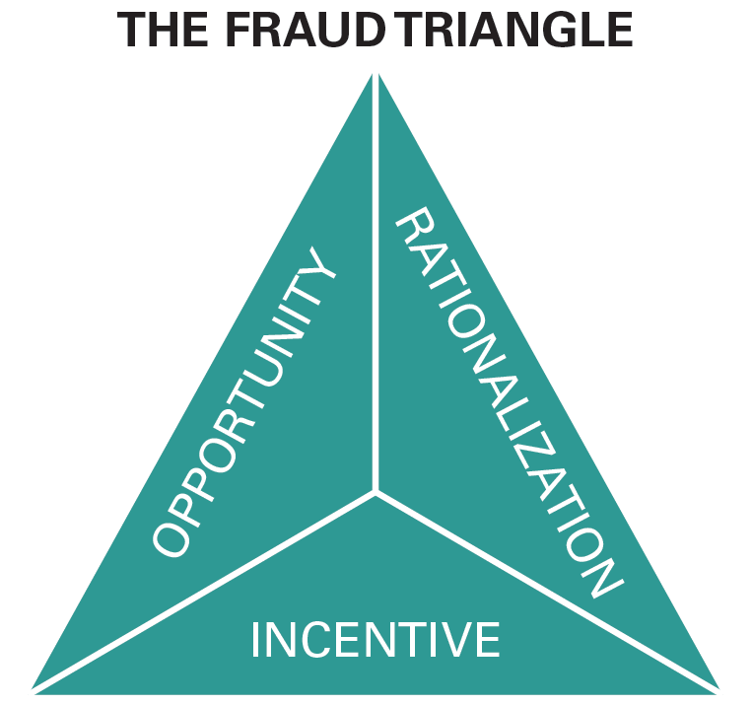
Understanding the business
Corporate Governance:
Procedures to ensure that the company is managed in the interest of the shareholders
Sarbanes-Oxley Act:
A law which strengthens financial reporting and corporate governance for public companies.
5-2
Notes:
Most businesses invest in corporate governance: procedures designed to ensure that the company is managed in the interests of the shareholders. Much of the corporate governance system is aimed at ensuring integrity in the financial reporting process.
The extreme accounting scandals at Le-Nature’s (discussed in Chapter 1), Enron, and WorldCom caused their stock to become worthless. In an attempt to restore investor confidence, Congress passed the Public Accounting Reform and Investor Protection Act (the Sarbanes-Oxley Act ), which strengthens financial reporting and corporate governance for public companies.
Three conditions are necessary for financial statement fraud to occur. There must be: (1) an incentive to commit fraud, (2) the opportunity to commit fraud, and (3) the ability to rationalize the misdeed. These conditions make up what antifraud experts call the fraud triangle. A good system of corporate governance is designed to address these conditions.

Slide 3
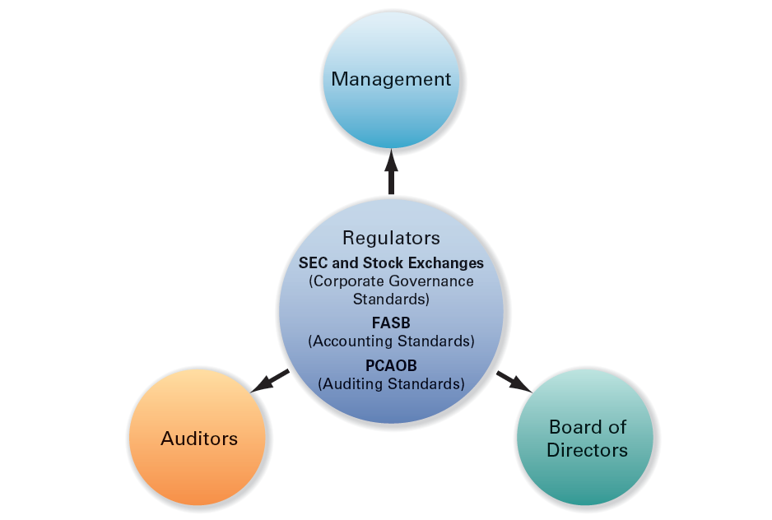
Players in the Accounting
Communication Process
5-3
Notes:
This graphic identifies the major players involved in ensuring the integrity of the financial reporting process. They include management, regulators, auditors, and the board of directors.

Slide 4
Regulators
Securities and Exchange Commission
Protects investors and maintain the integrity of the securities market.
Financial Accounting Standards Board
Sets Generally Accepted Accounting Standards (GAAP).
Public Company Accounting Oversight Board
Sets auditing standards for independent auditors (CPAs) of public companies.
5-4
Notes:
The mission of the U.S. Securities and Exchange Commission (SEC) is to protect investors and maintain the integrity of the securities markets. As part of this mission, the SEC oversees the work of the Financial Accounting Standards Board (FASB) that sets generally accepted accounting principles (GAAP), and the Public Company Accounting Oversight Board (PCAOB) that sets auditing standards for independent auditors (CPAs) of public companies.

Slide 5
Managers
Managers are responsible for the information in the financial statements and disclosures.
Chief Executive Officer (CEO): highest officer of the company
Chief Financial Officer (CFO): highest officer associated with the financial and accounting side of the business
Accounting staff prepare the details of the reports and also bear professional responsibility for the accuracy of the information.
5-5
Notes:
The primary responsibility for the information in the financial statements and related disclosures lies with management, specifically, the highest officer in the company often called the chief executive officer (CEO), and the highest officer associated with the financial and accounting side of the business, often called the chief financial officer (CFO).
At all public companies, the CEO and CFO must personally certify that:
Each report filed with the Securities and Exchange Commission does not contain any untrue material statement or omit a material fact and fairly presents in all material respects the financial condition, results of operations, and cash flows of the company.
There are no significant deficiencies and material weaknesses in the internal controls over financial reporting.
They have disclosed to the auditors and audit committee of the board any weaknesses in internal controls or any fraud involving management or other employees who have a significant role in financial reporting.
Executives who knowingly certify false financial reports are subject to a fine of $5 million and a 20-year prison term. The accounting staff also bear professional responsibility for the accuracy of this information, although their legal responsibility is smaller.

Slide 6

Board of Directors (Audit Committee)
Board of Directors
The board of directors is elected by the stockholders to represent their interests.
Board of Directors (Audit Committee)
The audit committee of the board of directors is responsible for maintaining the integrity of the company’s financial reports.
5-6
Notes:
The board of directors is elected by the stockholders to represent their interests and its audit committee is responsible for maintaining the integrity of the company’s financial reports.
The board of directors oversees the Chief Executive Officer and other senior management. The audit committee of the board, which must be composed of nonmanagement (independent) directors with financial knowledge, is responsible for ensuring that processes are in place for maintaining the integrity of the company’s accounting, financial statement preparation, and financial reporting. It is responsible for hiring the company’s independent auditors. They meet separately with the auditors to discuss management’s compliance with their financial reporting responsibilities.

Slide 7

Auditors
Independent Auditors
Follow established auditing standards to assess the fairness of the financial statements and related presentations
An unqualified, or clean, opinion states that the financial statements are fair presentations in all material respects in conformity with GAAP.
Unqualified Opinion
5-7
Notes:
The SEC requires publicly traded companies to have their statements and their control systems over the financial reporting process audited by an independent registered public accounting firm (independent auditor) following auditing standards established by the PCAOB. Many privately owned companies also have their statements audited. By signing an unqualified (or clean) audit opinion, a CPA firm assumes part of the financial responsibility for the fairness of the financial statements and related presentations. This opinion, which adds credibility to the statements, is also often required by agreements with lenders and private investors. Subjecting the company’s statements to independent verification reduces the risk that the company’s financial condition is misrepresented in the statements. As a result, rational investors and lenders should lower the rate of return (interest) they charge for providing capital.

Slide 8
Information Intermediaries: Information Services and Financial Analysts
Information Intermediaries
Most investors rely on company websites, information services, and financial analysts to gather and analyze information
Companies actually file their SEC forms electronically through the EDGAR (Electronic Data Gathering and Retrieval) Service, which is sponsored by the SEC.
Financial analysts receive accounting reports and other information about the company from electronic information services. They also gather information through conversations with company executives and visits to company facilities and competitors. The results of their analyses are combined into analysts’ reports.
5-8
Notes:
Most investors rely on company websites, information services, and financial analysts to gather and analyze information. Companies actually file their SEC forms electronically through the EDGAR (Electronic Data Gathering and Retrieval) Service, which is sponsored by the SEC. Most companies also provide direct access to their financial statements and other information over the Web.

Slide 9
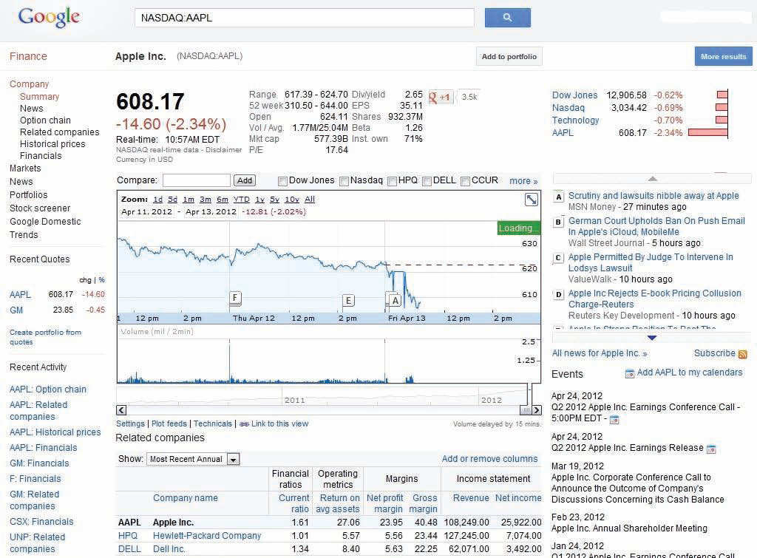





Information Services: Real world excerpt
5-9
Notes:
Information services have become the primary tool for professional analysts who use them to analyze competing firms. Information services are also an important source of information for job seekers. Potential employers expect job applicants to demonstrate knowledge of their companies during an interview, and electronic information services are an excellent source of company information. Consider the information on competitors, financial statements, news articles, upcoming events, and financial ratios that are available about Apple, Inc. from the Google Finance website.

Slide 10
Users: Institutional and Private Investors, Creditors, and Other
Institutional Investors
Includes pension, mutual, endowment and other funds that invest on the behalf of others
Private Investors
Individuals who purchase shares in companies
Lenders or Creditors
Suppliers, banks, commercial credit companies, and other financial institutions that lend money to companies
5-10
Notes:
Institutional investors include pension funds; mutual funds; and endowment, charitable foundation, and trust funds. These institutional stockholders usually employ their own analysts who also rely on the information intermediaries just discussed. Institutional shareholders control the majority of publicly traded shares of U.S. companies.
Private investors include large individual investors such as the venture capitalists who originally invested directly in Apple, as well as small retail investors who buy shares of publicly traded companies through brokers such as Fidelity. Retail investors normally lack the expertise to understand financial statements and the resources to gather data efficiently. They often rely on the advice of information intermediaries or turn their money over to the management of mutual and pension funds (institutional investors).
Lenders, or creditors, include suppliers, banks, commercial credit companies, and other financial institutions that lend money to companies. Lending officers and financial analysts in these organizations use the same public sources of information.

Slide 11

The Disclosure Process:
SEC Regulation FD
SEC regulation FD, for “Fair Disclosure,” requires that companies provide all investors equal access to all important company news.
Managers and other insiders are also prohibited from insider trading, trading their company’s shares based on nonpublic (insider) information so that no party benefits from early access.
5-11
Notes:
The accounting communication process includes more steps and participants than one would envision in a world in which annual and quarterly reports are simply mailed to shareholders. SEC regulation FD, for “Fair Disclosure,” requires that companies provide all investors equal access to all important company news. Managers and other insiders are also prohibited from trading their company’s shares based on nonpublic (insider) information so that no party benefits from early access.

Slide 12
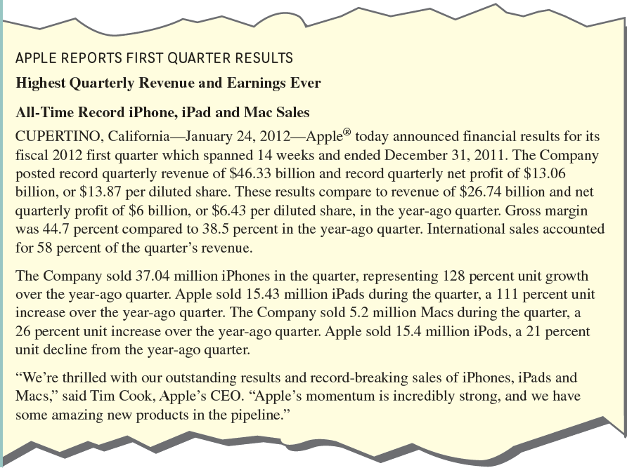
The Disclosure Process:
Press Releases
A press release is a written public news announcement normally distributed to major news services.
5-12
Notes:
To provide timely information to external users and to limit the possibility of selective leakage of information, Apple and other public companies announce quarterly and annual earnings through a press release as soon as the verified figures (audited for annual and reviewed for quarterly earnings) are available. A typical earnings press release includes key financial figures followed by management’s discussion of the results and condensed income statements and balance sheets, which will be included in the formal report to shareholders, distributed after the press release.

Slide 13
The Disclosure Process:
Annual Reports and Form 10-K
Annual reports normally include:
  Four basic financial statements.
  Related notes (footnotes).
  Report of Independent Accountants (Auditor’s Opinion) if the statements are audited.
The Form 10-K is the annual report that publicly traded companies must file with the SEC.
5-13
Notes:
For privately held companies, annual reports are relatively simple documents photocopied on white bond paper. They normally include only the following:
1. Four basic financial statements: income statement, balance sheet, stockholders’ equity or retained earnings statement, and cash flow statement.
2. Related notes (footnotes).
3. Report of Independent Accountants (Auditor’s Opinion) if the statements are audited.
The annual reports of public companies filed on Form 10-K are significantly more elaborate mainly because of additional SEC reporting requirements.

Slide 14
A closer look at Financial statement formats and notes
Three additional characteristics of financial statements and the related disclosures that make them more useful:
Comparative financial statements. To allow users to compare performance from period to period, companies report financial statement values for the current period and one or more prior periods.
Additional subtotals and classifications in financial statements. You should not be confused when you notice slightly different statement formats used by different companies.
Additional disclosures. Most companies present voluminous notes that are necessary to understand a company’s performance and financial condition.
5-14
Notes:
The financial statements shown in previous chapters provide a good introduction to their content and structure. In this section, we will discuss three additional characteristics of financial statements and the related disclosures that are designed to make them more useful to investors, creditors, and analysts:
Comparative financial statements. To allow users to compare performance from period to period, companies report financial statement values for the current period and one or more prior periods.
Additional subtotals and classifications in financial statements. You should not be confused when you notice slightly different statement formats used by different companies.
Additional disclosures. Most companies present voluminous notes that are necessary to understand a company’s performance and financial condition.

Slide 15
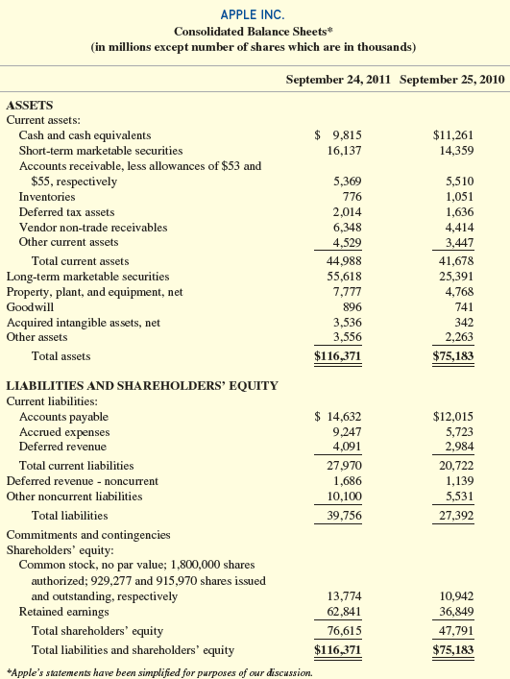
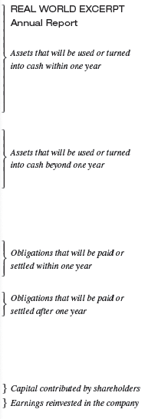
Classified Balance Sheet
5-15
Notes:
The classified balance sheet is often presented for two years to ease comparisons over time. The statement classifications (current vs. noncurrent assets and current vs. noncurrent liabilities) play a major role in our discussions of ratio analysis (e.g., the current ratio in Chapter 2). Apple’s balance sheet contains intangible assets (discussed in Chapter 8) that have no physical existence and a long life. Examples are patents, trademarks, copyrights, franchises, and goodwill from purchasing other companies. Most intangibles (except goodwill, trademarks, and other intangibles with indefinite lives) are amortized as they are used in a manner similar to the depreciation of tangible assets. Goodwill is a more general intangible asset representing the excess of the price paid for another company over the value of its identifiable assets. It is discussed in more detail in Chapter 8.
Also recall our discussion of deferred revenues from Chapter 4. These are liabilities created when customers pay for goods or services before the company delivers them. In Apple’s balance sheet, deferred revenues show up in two places: current liabilities and noncurrent liabilities. They both relate primarily to product warranties that Apple includes with its products. The deferred revenues related to repairs Apple expects to provide during the next year are classified as current. Those that relate to repairs to be provided in later years are classified as noncurrent. When you first look at a new set of financial statements, try not to be confused by differences in terminology. When interpreting line items you have never seen before, be sure to consider their description and their classification.

Slide 16
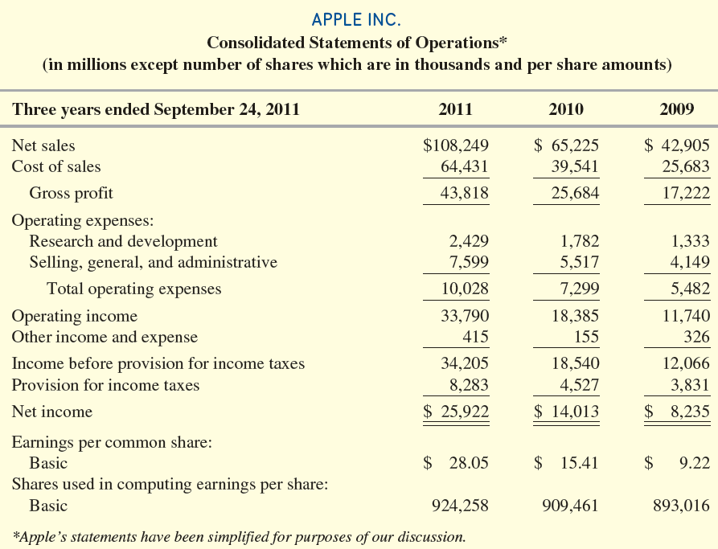
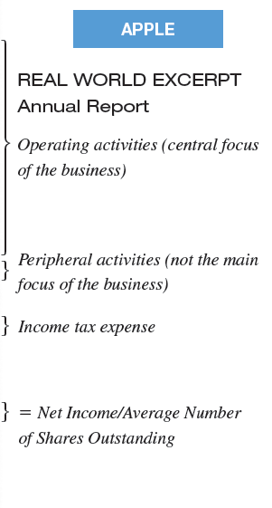
Classified Income Statement
5-16
Notes:
Apple’s 2011 consolidated income statement presents the income statement followed by earnings per share for three years as required by the SEC. Apple’s income statement includes the subtotal Gross Profit (gross margin), which is the difference between net sales and cost of goods sold. It is important to note that regardless of whether a company reports a gross profit subtotal, the income statement presents the same information. Another subtotal— Operating Income (also called Income from Operations)—is computed by subtracting operating expenses from gross profit. Nonoperating (other) Items are revenues, expenses, gains, and losses that do not relate to the company’s primary operations. Examples include interest income, interest expense, and gains and losses on the sale of fixed assets and investments. These nonoperating items are added to or subtracted from income from operations to obtain Income before Income Taxes, also called Pretax Earnings. At this point, Provision for Income Taxes (Income Tax Expense) is subtracted to obtain Net Income.
Finally, earnings per share is reported.

Slide 17
Nonrecurring Items
Income statements report nonrecurring items separately because they are not useful in predicting the future income of a corporation.
  Nonrecurring Items
  Discontinued operations
  Extraordinary items
5-17
Notes:
Income statements report nonrecurring items separately because they are not useful in predicting the future income of a corporation. Nonrecurring items that companies may report on their income statements are:
1. Discontinued operations
2. Extraordinary items
When a major component of a business is sold or abandoned, income or loss from that component earned before the disposal, as well as any gain or loss on disposal, are included as discontinued operations. Extraordinary items are gains or losses incurred that are both unusual and infrequent in occurrence.

Slide 18

Earnings Per Share
*If there are preferred dividends, the amount is subtracted from Net Income in the numerator.
5-18
Notes:
Earnings per share is calculated by dividing net income available to common shareholders by the weighted average number of shares outstanding during the reporting period. Net income available to common shareholders is equal to net income less dividends on preferred stock, if any.

Slide 19

Gross Profit Percentage
5-19
Notes:
The gross profit percentage is calculated by dividing gross profit by net sales. Gross profit is equal to Net Sales minus Cost of Goods Sold. The gross profit percentage measures a company’s ability to charge premium prices and produce goods and services at low cost. All other things equal, a higher gross profit results in higher net income.

Slide 20
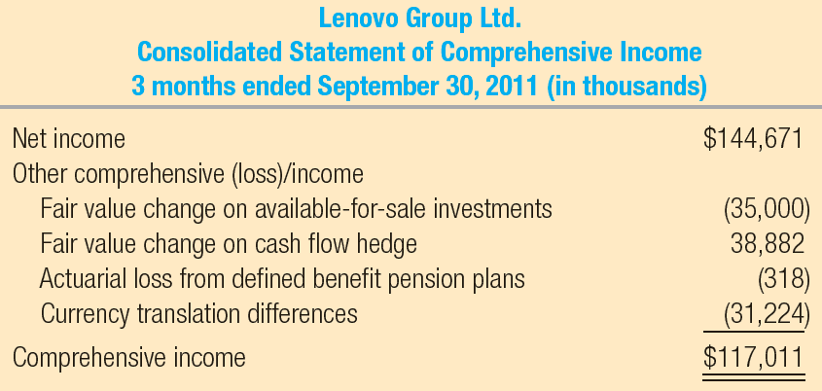
Statement of Comprehensive income
5-20
Notes:
Both the FASB and IASB require an additional statement entitled the Statement of Comprehensive Income which can be presented separately or in combination with the income statement. When presented separately, the statement starts with Net Income, the bottom line of the income statement. Following this total would be the components of other comprehensive income. The Net Income and other comprehensive income items are then combined to create a total called Comprehensive Income (the bottom line for this statement). Apple’s competitor Lenovo Group Ltd., maker of ThinkPad computers, presented the following in a recent quarterly report. Other comprehensive income items include fair value changes on certain investment securities, which are discussed in Appendix A, as well as other items discussed in more advanced accounting classes.

Slide 21
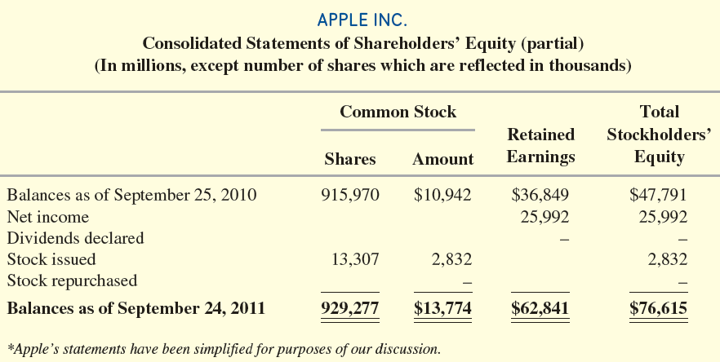
Statement of stockholders’ equity
5-21
Notes:
The statement of stockholders’ (shareholders’) equity reports the changes in each of the company’s stockholders’ equity accounts during the accounting period. The statement has a column for each stockholders’ equity account and one for the effect on total stockholders’ equity. The first row of the statement starts with the beginning balances in each account, which correspond to the prior year’s balances on the balance sheet. Each row that follows lists each event that occurred during the period that affected any stockholders’ equity accounts. Apple reported net income of $25,992 for the year, which increases retained earnings. Apple declared no dividends. Had it done so, the amount would have been subtracted from retained earnings. Apple issued 13,307 shares of common stock during the year and received $2,832 million for the issuance. Note that the number of shares and the dollar amount are both listed. It is important not to confuse them. If Apple had repurchased and retired shares, the number of shares and dollar amount would have been subtracted from common stock. The final row lists the ending balances in the accounts, which correspond to the ending balances on the balance sheet.

Slide 22
Statement of Cash Flows
The Statement of Cash Flows is divided into three sections.
Cash Flows from Operating Activities.
Cash Flows from Investing Activities.
Cash Flows from Financing Activities.
We will examine the indirect method of preparing the statement. This format begins with a reconciliation of net income on an accrual basis to cash flows from operations.
5-22
Notes:
We introduced the three cash flow statement classifications in prior chapters:
Cash Flows from Operating Activities. This section reports cash flows associated with earning income.
Cash Flows from Investing Activities. Cash flows in this section are associated with the purchase and sale of productive assets (other than inventory) and investments in other companies.
Cash Flows from Financing Activities. These cash flows are related to financing the business through borrowing and repaying loans from financial institutions, stock (equity) issuances and repurchases, and dividend payments.
The first section, Cash Flows from Operating Activities, can be reported using either the direct or indirect method. The indirect method presents a reconciliation of net income on an accrual basis to cash flows from operations. The Operating Activities section prepared using the indirect method helps the analyst understand the causes of differences between a company’s net income and its cash flows.

Slide 23
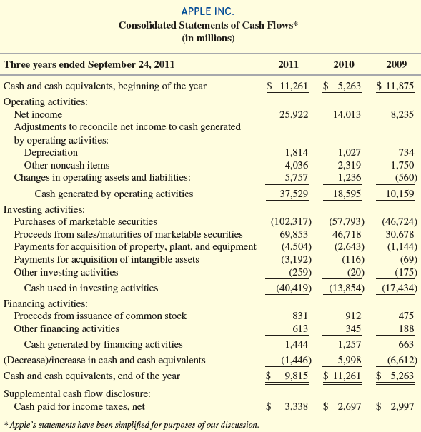
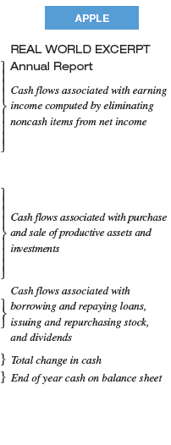
Statement of cash flows
5-23
Notes:
The three cash flow statement classifications are clearly identified.
Cash Flows from Operating Activities.
Cash Flows from Investing Activities.
Cash Flows from Financing Activities.
The first section is reported using the indirect method, which presents a reconciliation of net income on an accrual basis to cash flows from operations.
As we cover different portions of the income statement and balance sheet in more detail in Chapters 6 through 11, we will also discuss the relevant sections of the cash flow statement. Then we discuss the complete cash flow statement in detail in Chapter 12.

Slide 24
Notes to Financial Statements
Descriptions of the key accounting rules applied to the company’s statements.
Additional detail supporting reported numbers.
Relevant financial information not disclosed on the statements.
5-24
Notes:
The notes to financial statements provide the reader with additional details to facilitate their analysis of financial statements. Notes include three types of information:
1. Descriptions of the key accounting rules applied to the company’s statements.
2. Additional detail supporting reported numbers.
3. Relevant financial information not disclosed on the statements.

Slide 25
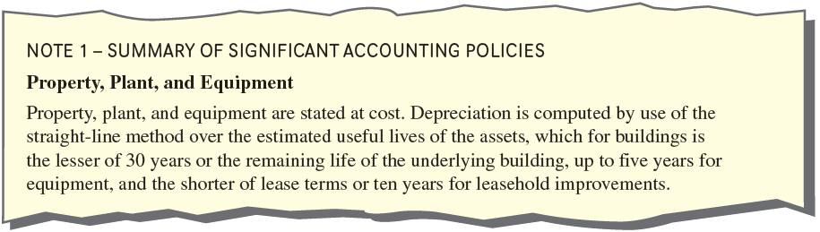
Accounting Rules Applied in the Company’s Statements
The first category of notes, typically one of the first notes to the financial statements, is a statement of significant accounting policies.
5-25
Notes:
The first category of notes, typically one of the first notes, is a summary of significant accounting policies. As you will see in your study of subsequent chapters, generally accepted accounting principles (GAAP) permit companies to select from alternative methods for measuring the effects of transactions. The summary of significant accounting policies tells the user which accounting methods the company has adopted. Without an understanding of the various accounting methods used, it is impossible to analyze a company’s financial results effectively.

Slide 26
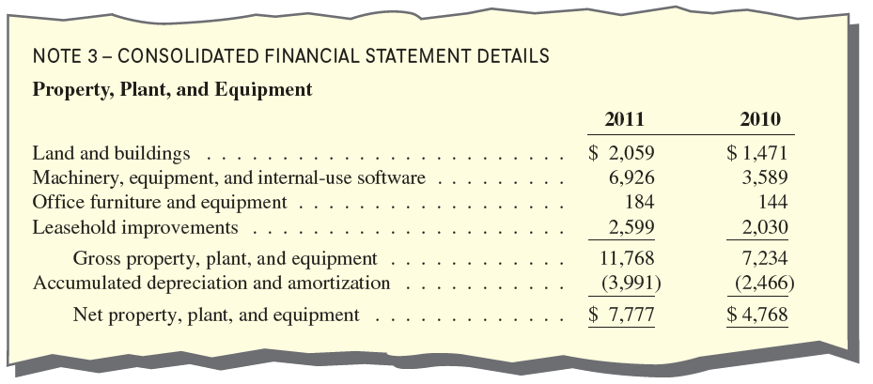
Additional Detail Supporting
Reported Numbers
The second category of notes provides supplemental information concerning the data shown on the financial statements.
5-26
Notes:
The second category of notes provides supplemental information concerning the data shown on the financial statements. Among other information, these notes may show revenues broken out by geographic region or business segment, describe unusual transactions, and/or offer expanded detail on a specific classification. For example, in Note 3, Apple indicates the makeup of property, plant, and equipment presented on the balance sheet.

Slide 27
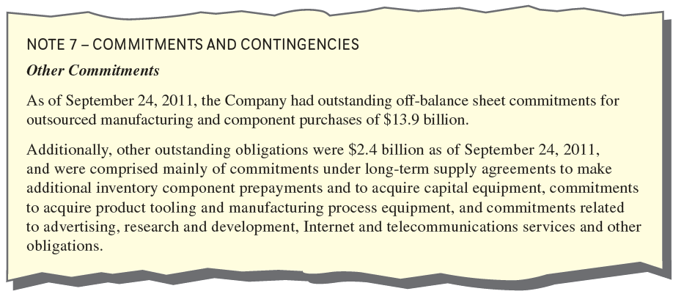
Relevant Financial Information Not Disclosed on the Statements
The final category includes information that impacts the company financially but is not shown on the statements.
5-27
Notes:
The final category includes information that impacts the company financially but is not shown on the statements. Examples include information on legal matters and contractual agreements that do not result in an asset or liability on the balance sheet. In Note 7, Apple disclosed the details of its commitments under supply agreements, which total over $15 billion and are not shown as a liability on the balance sheet.

Slide 28
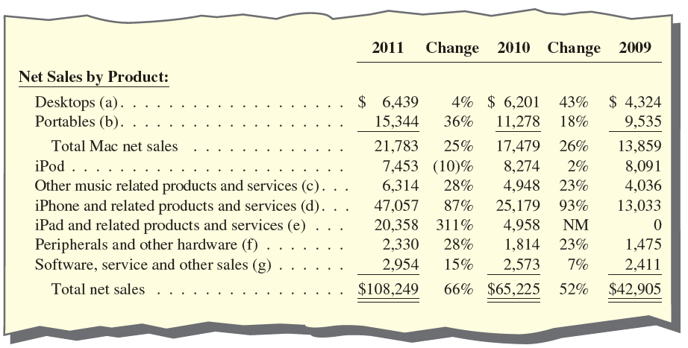
Voluntary disclosures
GAAP and SEC regulations set the minimum level of required disclosures. Many companies provide additional information.
.
5-28
Notes:
GAAP and SEC regulations set only the minimum level of required financial disclosures. Many companies provide important disclosures beyond those required. For example, in its annual report, 10-K, and recent earnings press release, Apple discloses sales by major product category, which helps investors track the success of new products.

Slide 29

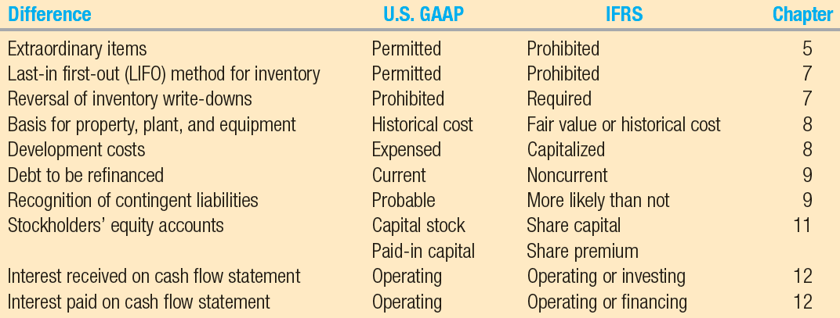
Differences in Accounting Methods acceptable under ifrs and u.s. gaap
Many countries have adopted international financial reporting standards (IFRS) issued by the International Accounting Standards Board (IASB). IFRS are similar to U.S. GAAP, but there are several important differences. The FASB and IASB are working together to eliminate these and other differences.
5-29
Notes:
Financial accounting standards and disclosure requirements are adopted by national regulatory agencies. Many countries, including the members of the European Union, have adopted international financial reporting standards (IFRS) issued by the International Accounting Standards Board (IASB). IFRS are similar to U.S. GAAP, but there are several important differences. Here is a chart showing some of the differences between U.S. GAAP and IFRS rules, along with the chapter in which these issues will be addressed. The FASB and IASB are working together to eliminate these and other differences.

Slide 30

Return on Assets (ROA) Analysis
*(In complex calculations, interest expense (net of tax) and minority interest
are added back to net income.
†(Beginning Total Assets + Ending Total Assets) ÷ 2
5-30
Notes:
In its broadest measure, return on assets (ROA) is calculated by dividing net income by average total assets. Remember that average total assets is the beginning asset balance plus the ending asset balance divided by two.
Return on assets measures how much the firm earned for each dollar of investment. It is a general measure of profitability and management effectiveness, independent of financing strategy. Firms with higher ROA are doing a better job of selecting and managing investments, all other things equal. Since it is independent of the source of financing (debt vs. equity), it can be used to evaluate performance at any level within the organization. It is often computed on a division-by-division or product line basis and used to evaluate division or product line managers’ relative performance.

Slide 31
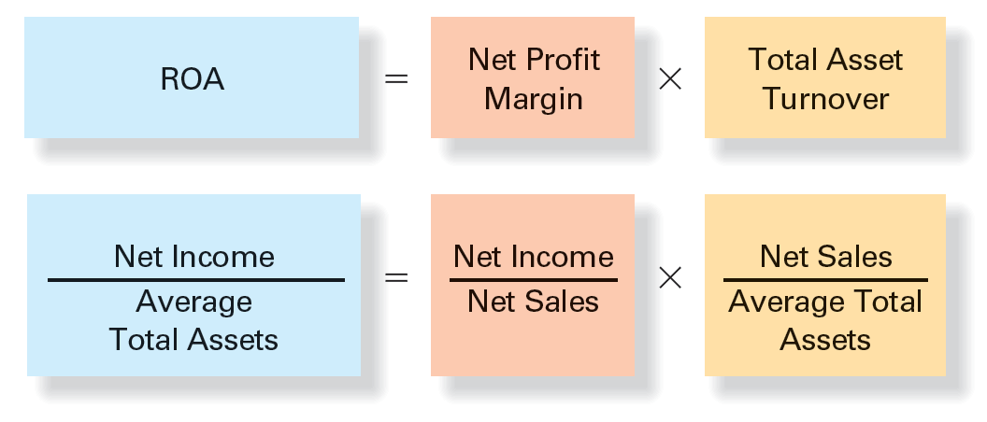
ROA Profit Driver Analysis and business strategy
5-31
Notes:
Effective analysis requires understanding why ROA differs both from prior levels and from those of its competitors. ROA profit driver analysis (also called ROA decomposition or DuPont analysis ) breaks down ROA into two factors. These factors are often called profit drivers or profit levers because they describe the two ways that management can improve ROA. They are measured by two key ratios:
1. Net profit margin equals Net Income divided by Net Sales. It measures how much of every sales dollar is profit. It can be increased by
a. Increasing sales volume.
b. Increasing sales price.
c. Decreasing cost of goods sold and operating expenses.
2. Total asset turnover equals Net Sales divided by Average Total Assets. It measures how many sales dollars the company generates with each dollar of assets (efficiency of use of assets). It can be increased by
a. Centralizing distribution to reduce inventory kept on hand.
b. Consolidating production facilities in fewer factories to reduce the amount of assets necessary to generate each dollar of sales.
These two ratios report on the effectiveness of the company’s operating and investing activities, respectively.

Slide 32

How Transactions affect ratios
Three-step Process
Journalize the transaction to determine its effects on various accounts.
Determine which accounts belong to the financial statement subtotals or totals in the numerator (top) and denominator (bottom) of the ratio and the direction of their effects.
Evaluate the combined effects from step 2 on the ratio.
5-32
Notes:
Apple and other companies know that investors and creditors follow their key financial ratios closely. Changes in ROA and its components can have a major effect on a company’s stock price and interest rates that lenders charge. As a consequence, company managers closely follow the effects of their actual and planned transactions on these same key financial ratios. We have already learned how to determine the effects of transactions on key subtotals on the income statement and balance sheet (gross profit, current assets, etc.). So we are only one step away from being able to compute the effects of transactions on ratios. The following three-step process will help you do so:
1. Journalize the transaction to determine its effects on various accounts, just as we did in Chapters 2 through 4.
2. Determine which accounts belong to the financial statement subtotals or totals in the numerator (top) and denominator (bottom) of the ratio and the direction of their effects.
3. Evaluate the combined effects from step 2 on the ratio.

Slide 33
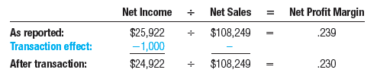
How Transactions affect ratios
Example 1: Apple incurred an additional $1,000 in research and development expense paid for in cash. What would be the effect on the net profit margin ratio?
The journal entry would be:
Note that the transaction would decrease the numerator Net Income, and have no effect on the denominator Net Sales. The ratio was .239. It would decrease to .230 as follows.
5-33
Notes:
Let’s try an example. What would be the effect of the following transaction on key ratios (ignoring taxes)? What if only the numerator or denominator is affected?
Example 1: Apple incurred an additional $1,000 in research and development expense paid for in cash. What would be the effect on the net profit margin ratio?
Note that the transaction would decrease the numerator Net Income, and have no effect on the denominator Net Sales. The ratio was .239. It would decrease to .230.

Slide 34
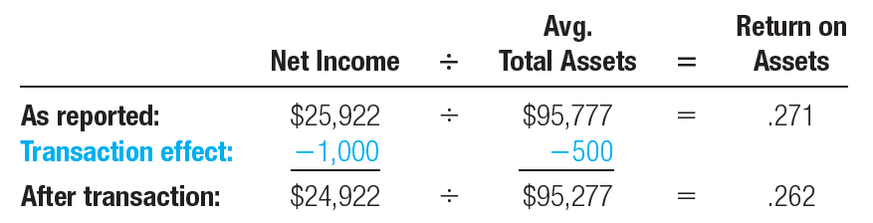
How Transactions affect ratios
Example 2: Consider the same transaction in Example 1. What would be the effect on the return on assets ratio?
Note that the transaction would decrease the numerator Net Income by $1,000. It would also decrease the ending total assets by $1,000, but have no effect on beginning total assets. So the denominator, average total assets, would only decrease by $500.
The ratio was .271. It would decrease as follows:
5-34
Notes:
Let’s try another example. What would be the effect on ROA for the same transaction?
Note that the transaction would decrease the numerator Net Income by $1,000. It would also decrease the ending total assets by $1,000, but have no effect on beginning total assets. So the denominator, average total assets, would only decrease by $500. The ratio was .271. It would decrease to .262.
This example illustrates a second general point about the effect of transactions on ratios. If a transaction affects the numerator by more than it affects the denominator, or if it affects the denominator by more than it affects the numerator, focus only on the larger effect and the effects in the table above still hold.

Slide 35
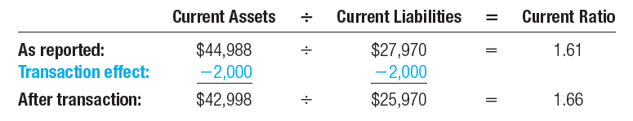
How Transactions affect ratios
Example 3: Apple paid $2,000 of accounts payable in cash. What would be the effect on the current ratio?
The journal entry would be:
Note that the transaction would decrease the numerator, Current Assets, and the denominator, Current Liabilities, by the same amount. The ratio was 1.61. It would increase to 1.66.
5-35
Notes:
What if the numerator and denominator are affected by the same amount?
Example 3: Apple paid $2,000 of accounts payable in cash (all numbers in millions). What would be the effect on the current ratio?
Note that the transaction would decrease the numerator, Current Assets, and the denominator, Current Liabilities, by the same amount. The ratio was 1.61. It would increase to 1.66.

Slide 36

End of Chapter 5
5-36
Notes:
End of chapter 5.

