Slide 1

Chapter 2
Investing and financing decisions and the Accounting System
McGraw-Hill/Irwin
Copyright © 2014 by The McGraw-Hill Companies, Inc. All rights reserved.
Notes:
Chapter 2: Investing and Financing Decisions and the Accounting System

Slide 2
Understanding the Business
To understand amounts appearing
on a company’s balance sheet we
need to answer these questions:
What
business
activities cause
changes in
the balance
sheet?
How do
specific
activities
affect each
balance?
How do
companies
keep track of
balance sheet
amounts?
Notes:
The “fast-casual” segment of the $1.7 trillion restaurant industry generates more than $23 billion in sales annually. What identifies a restaurant as fast-casual? Typically, customers still order at the register as in a fast-food restaurant, but there are usually no drive-thru options and the food is made to order and served in modern and upscale surroundings. Checks typically range between $8 and $16. The largest fast-casual restaurant chain is Chipotle Mexican Grill, followed by Panera Bread Company. Franchising is common in chain restaurants.
The largest restaurant to use franchising is Subway, with over 37,000 restaurants—all franchised. Franchising involves selling the right to use or sell a product or service to another. This is an easy way for someone to start his or her own business because the franchisor (the seller, such as Panera Bread) often provides site location, design, marketing, and management training support in exchange for initial franchise fees and ongoing royalty fees usually based on weekly sales. At Panera Bread, for example, only 48 percent of the stores are company-owned.
In this chapter we will focus on Chipotle Mexican Grill. Unlike most restaurant chains, Chipotle does not franchise the business. All restaurants are company-owned. Before we can adequately prepare a balance sheet, we must know what activities caused changes in it. Additionally, we have to know how specific activities affect each balance. Finally, we need to know how the company tracks balance sheet amounts.
In this chapter, we focus on some typical asset acquisition activities (often called investing activities), along with related financing activities, such as borrowing funds from creditors or selling stock to investors to provide the cash necessary to acquire the assets. We examine those activities that affect only balance sheet amounts. Operating activities that affect both the income statement and the balance sheet are covered in Chapters 3 and 4.

Slide 3
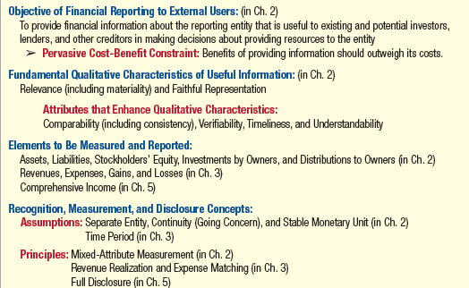
The Conceptual Framework
Notes:
Qualitative Characteristics of Useful Information
For accounting information to be useful, it must be relevant and be a faithful representation. Relevant information is capable of influencing decisions by allowing users to assess past activities and/or predict future activities. To be reported, the information should also be material in amount depending on the nature of the item and company. Faithful representation requires that the information be complete, neutral, and free from error. Comparability, verifiability, timeliness, and understandability are qualitative characteristics that enhance the usefulness of information that is relevant and faithfully represented. For example, our discussions of ratio analysis will emphasize the importance of comparing ratios for the same company over time, as well as with those of competitors. Such comparisons are valid only if the information is prepared on a consistent and comparable basis. These characteristics of useful information guide the FASB in deciding what financial information should be reported.
Recognition and Measurement Concepts
Before we discuss accountants’ precise definitions for the elements of the balance sheet, we should consider three assumptions and a measurement concept that underlie much of our application of these definitions. First we make the separate-entity assumption, which states that each business’s activities must be accounted for separately from the activities of its owners, all other persons, and other entities. This means, for example, that, when an owner purchases property for personal use, the property is not an asset of the business. Second, under the continuity assumption (sometimes called the going-concern assumption ), unless there is evidence to the contrary, we assume that the business will continue operating into the foreseeable future, long enough to meet its contractual commitments and plans. This means, for example, that if there was a high likelihood of bankruptcy, then its assets should be valued and reported on the balance sheet as if the company were to be liquidated (that is, discontinued, with all of its assets sold and all debts paid). Under the stable monetary unit assumption, each business entity accounts for and reports its financial results primarily in terms of the national monetary unit (e.g., dollars in the United States, yen in Japan, and euros in Germany), without any adjustment for changes in purchasing power (e.g., inflation).
Qualitative Characteristics of Useful Information For accounting information to be useful, it must be relevant and be a faithful representation.
Relevant information is capable of influencing decisions by allowing users to assess past activities and/or predict future activities. To be reported, the information should also be material in amount depending on the nature of the item and company. Faithful representation requires that the information be complete, neutral, and free from error.
Comparability, verifiability, timeliness, and understandability are qualitative characteristics that enhance the usefulness of information that is relevant and faithfully represented. For example, our discussions of ratio analysis will emphasize the importance of comparing ratios for the same company over time, as well as with those of competitors. Such comparisons are valid only if the information is prepared on a consistent and comparable basis. These characteristics of useful information guide the FASB in deciding what financial
information should be reported.
Recognition and Measurement Concepts
Before we discuss accountants’ precise definitions for the elements of the balance sheet, we should consider three assumptions and a measurement concept that underlie much of our application of these definitions. First we make the separate-entity assumption, which states that each business’s activities must be accounted for separately from the activities of its owners, all other persons, and other entities. This means, for example, that, when an owner purchases property for personal use, the property is not an asset of the business. Second, under the continuity assumption (sometimes called the going-concern assumption ), unless there is evidence to the contrary, we assume that the business will continue operating into the foreseeable future, long enough to meet its contractual commitments and plans. This means, for example, that if there was a high likelihood of bankruptcy, then its assets should be valued and reported on the balance sheet as if the company were to be liquidated (that is, discontinued, with all of its assets sold and all debts paid). Under the stable monetary unit assumption, each business entity accounts for and reports its financial results primarily in terms of the national monetary unit (e.g., dollars in the United States, yen in Japan, and euros in Germany), without any adjustment for changes in purchasing power (e.g., inflation).

Slide 4
Elements of the balance sheet
A = L + SE
(Assets)
(Liabilities)
(Stockholders’ Equity)
Economic resources with probable future benefits owned or controlled by the entity. Measured by the historical cost principle.
Probable debts or obligations (claims to a company’s resources) that result from a company’s past transactions and will be paid with assets or services. Entities that a company owes money to are called creditors.
The financing provided by the owners and by business operations. Often referred to as contributed capital.
Notes:
Assets are economic resources with probable future benefits owned or controlled by an entity as a result of past transactions. In other words, they are the acquired resources the entity can use to operate in the future. To be reported, assets must have a measurable, verifiable value, usually based on the purchase price.
Liabilities are probable debts or obligations (claims to a company’s resources) that result from a company’s past transactions and will be paid with assets or services. Entities that a company owes money to are called creditors.
Stockholders’ equity (also called owners’ equity or shareholders’ equity) is the financing provided by the owners and by business operations. Owner-provided cash (and sometimes other assets) is referred to as contributed capital. Owners invest in the business and receive shares of stock as evidence of ownership.

Slide 5
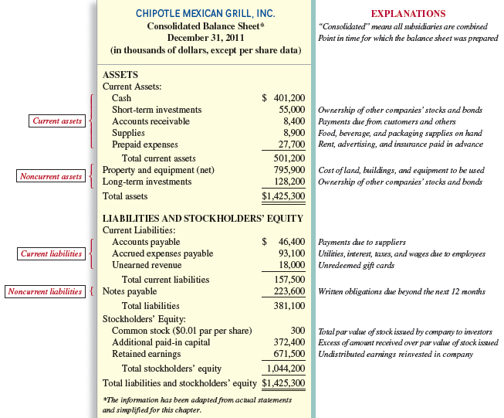
Notes:
The balance sheet is a “snap shot” at any given point in time of the company’s assets, liabilities, and stockholders’ equity. Balance sheets may be prepared monthly, quarterly, or annually. Most companies list assets in order of liquidity, or how soon an asset is expected by management to be turned into cash or used. Current assets are those resources that Chipotles will use or turn into cash within one year (the next twelve months). Note that inventory is always considered a current asset, regardless of how long it takes to produce and sell the inventory. Chipotles current assets include Cash, Short-term Investments, Accounts Receivable, Supplies, Prepaid Expenses. These are typical titles utilized by most entities.
All other assets are considered long term (or noncurrent). That is, they are to be used or turned into cash beyond the coming year. For Chipotle’s these assets include Long-Term Investments, Property and Equipment (net of amounts used in the past).
Just as assets are reported in order of liquidity, liabilities are usually listed on the balance sheet in order of maturity (how soon an obligation is to be paid). Current liabilities are obligations that will be settled by providing cash, goods, or services within the coming year. Chipotle’s balance sheet includes liabilities. Current liabilities include Accounts Payable, Accrued Expenses Payable, and Unearned Revenue. Noncurrent liabilities, including Notes Payable.
Owner-provided cash (and sometimes other assets) is referred to as contributed capital. Contributed capital is usually composed of Common Stock and Additional Paid-in Capital. Owners who invest (or buy stock) in a company hope to benefit from their investment in two ways: receipts of dividends, which are a distribution of a company’s earnings (a return on the shareholders’ investment), and gains from selling the stock for more than they paid (known as capital gains). Earnings that are not distributed to the owners but instead are reinvested in the business by management are called retained earnings.

Slide 6
What business activities cause changes in the financial Statement amounts?
Nature of Business Transactions
External Events: Exchanges between entity and one or more parties.
  Ex: Purchase of a machine from a supplier.
Internal Events: Events that are not exchanges between parties but that have a direct and measurable effect on the entity.
  Ex: Using up insurance paid in advance.
Notes:
Most transactions with external parties involve exchanges where the business entity gives up something and receives something in return. Accounting focuses on certain events that have an economic impact on the entity. Those events that are recorded as part of the accounting process are called transactions.
As the definitions of assets and liabilities indicate, only economic resources and debts resulting from past transactions are recorded on the balance sheet. Transactions include two types of events:
External events: These are exchanges of assets, goods, or services by one party for assets, services, or promises to pay (liabilities) by one or more other parties. Examples include the purchase of a machine from a supplier, sale of merchandise to customers, borrowing cash from a bank, and investment of cash in the business by the owners.
Internal events: These include certain events that are not exchanges between the business and other parties but nevertheless have a direct and measurable effect on the entity. Examples include using up insurance paid in advance and using buildings and equipment over several years.

Slide 7
Accounts
An organized format used by companies to accumulate the dollar effects of transactions.
Cash
Inventory
Notes Payable
Equipment
Notes:
In the process of accounting we use accounts to help us organize information about various transactions. These transactions can be both external and internal.

Slide 8
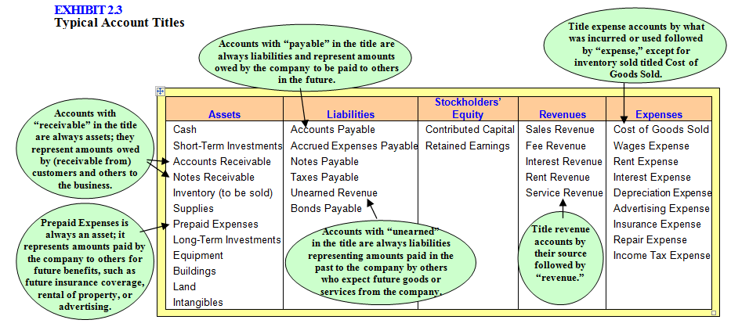
Typical Account Titles
A chart of accounts lists all account titles and their unique numbers.
Notes:
This slide lists various account titles that are quite common and are used by most companies. The exhibit also provides special notes to help you in learning account titles. When you are completing assignments and are unsure of an account title, refer to this listing for help.
To facilitate the recording of transactions, each company establishes a chart of accounts, a list of all account titles and their unique numbers. The accounts are usually organized by financial statement element, with asset accounts listed first, followed by liability, stockholders’ equity, revenue, and expense accounts in that order. Every company creates its own chart of accounts to fit the nature of its business activities.

Slide 9
Principles of Transaction Analysis
Every transaction affects at least two
accounts (duality of effects).
The accounting equation must remain in
balance after each transaction.
A = L + SE
(Assets)
(Liabilities)
(Stockholders’ Equity)
Notes:
Transaction analysis is the process of studying a transaction to determine its economic effect on the entity in terms of the accounting equation (also known as the fundamental accounting model). As accountants, every transaction we deal with affects at least two accounts. As we record the transactions we must make sure that the accounting equation remains in balance.

Slide 10
Balancing the Accounting Equation
Step 1: Ask--What was received and what was given?
  Identify the accounts (by title) affected and make sure at least two accounts change.
  Classify them by type of account. Was each account an asset (A), a liability (L), or a stockholders’ equity (SE)?
  Determine the direction of the effect. Did the account increase [+] or decrease [-]?
Step 2: Verify--Is the accounting equation in balance?
  Verify that the accounting equation (A = L + SE).
Notes:
The accounting equation must remain in balance after each transaction. That is, total assets (resources) must equal total liabilities and stockholders’ equity (claims to resources). If all correct accounts have been identified and the appropriate direction of the effect on each account has been determined, the equation
should remain in balance.

Slide 11
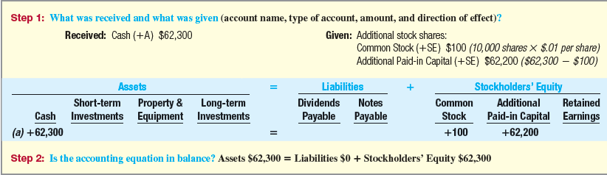
Analyzing chipotle’s Transactions
(a) Chipotle issued 10,000 additional shares of common stock, receiving $62,300 in cash from investors.
=
+
$62,300
0
$62,300
A = L + SE
Notes:
Chipotle’s engages in the following events during the first quarter of 2012. Account titles are from that balance sheet, and remember that, for simplicity, all amounts are in thousands of dollars.
Chipotle’s first transaction (lettered a) is to issue 10,000 of additional common stock to new investors for cash. The two accounts affected were the cash account, an asset, that increases by $62,300, and contributed capital, an equity account, that also increases by the same amount.
The common stock account increases by $100 (10,000 shares times $0.01 par value per share). Additional paid-in capital increases by the difference of $62,200.

Slide 12
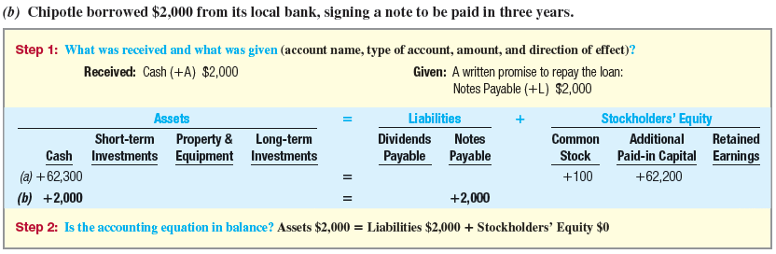
Analyzing chipotle’s Transactions
=
+
$64,300
$2,000
$62,300
A = L + SE
Notes:
Events (a) and (b) are financing transactions. Companies that need cash for investing purposes (to buy or build additional facilities) often seek funds by selling stock to investors as in event (a) or by borrowing from creditors as in event (b). Notice that the accounting equation is in balance after the identification and classification of the accounts involved in the transactions.

Slide 13
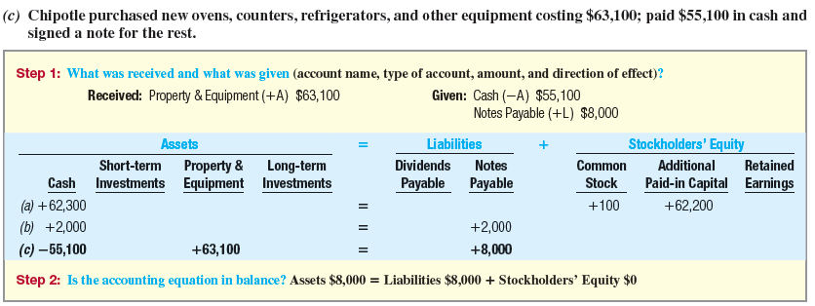
Analyzing chipotle’s Transactions
=
+
$72,300
$10,000
$62,300
A = L + SE
Notes:
For entry c, Chipotle’s purchases new ovens, counters, refrigerators, and other equipment costing $63,100, paying $55,100 in cash and signing a two-year note for the balance. In this transaction there are three accounts involved: (1) Cash, an asset that decreases by $55,100, (2) Equipment, an asset that increases by $63,100, and (3) Notes Payable, a liability that increases by $8,000. The accounting equation remains in balance with total assets of $72,300, and total liabilities and stockholders’ equity of $72,300.

Slide 14
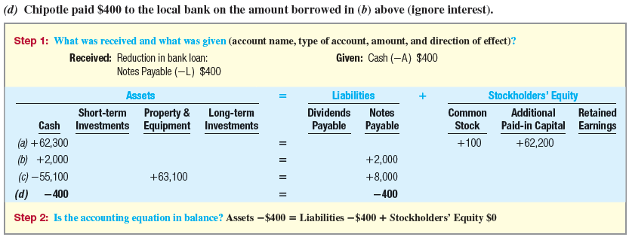
Analyzing chipotle’s Transactions
$71,900
=
$9,600
+
$62,300
A = L + SE
Notes:
In transaction d, Chipotle pays $400 to its bank on the amount borrowed in transaction (b) above (ignore interest). Both the Cash account (an assets) and Notes Payable (a liability) are decreased by $400.

Slide 15
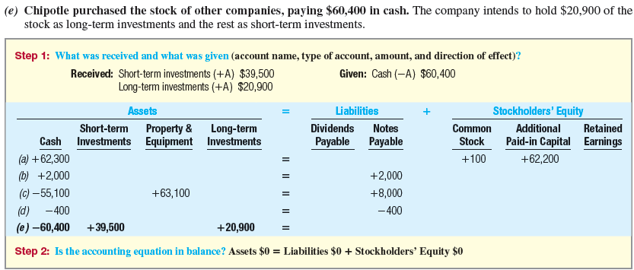
Analyzing chipotle’s Transactions
$71,900
=
$9,600
+
$62,300
A = L + SE
Notes:
In transaction e, Chipotle purchases the stock of other companies as a long-term investment, paying $60,400 in cash. Of the total paid, $39,500 is considered a short-term investment by management and the remainder, $20,900, is considered a long-term investment. The Cash account (an assets) decreased by $60,400, while the short-term investment (an asset increased by $39,500), and the long-term investments (an asset increased by $20,900). Because we are exchanging one asset (Cash) for another asset (Short-term, and Long-term investments), there is no change in the total assets, liabilities and stockholders’ equity.

Slide 16
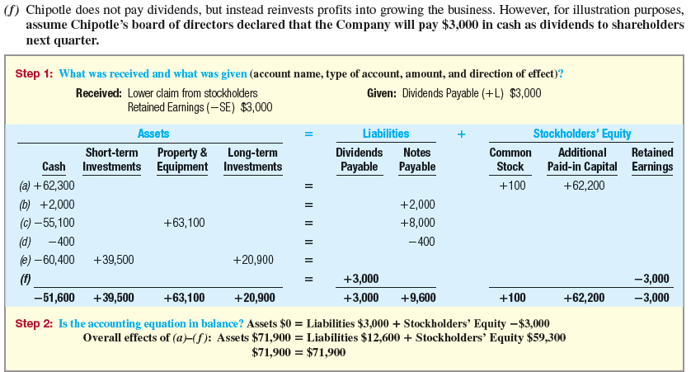
Analyzing chipotle’s Transactions
$71,900
=
$12,600
+
$59,300
A = L + SE
Notes:
In transaction f, the board of directors of Chipotle declares that the Company will pay $3,000 in cash dividends to shareholders next month.
Retained Earnings represent the profits available to shareholders. When a company’s board of directors declares a cash dividend, Retained Earnings is reduced. Thus, the company experiences a reduction in the profits it has available to distribute to shareholders. On the other hand, until the dividends are paid, they are considered a liability (Dividends Payable). When the dividend is paid to stockholders, the Dividend Payable account is removed. After the identification and classification of the transaction, the accounting equation is still in balance. This transaction did not impact the asset side of the equation.

Slide 17
The Accounting Cycle
Start of new period
During the Period
(Chapters 2 and 3)
Analyze transactions
Record journal entries in the general journal
Post amounts to the general ledger
At the End of the Period
(Chapter 4)
Prepare a trial balance to determine if debits equal credits
Adjust revenues and expenses and related balance sheet
accounts (record in journal and post to ledger)
Prepare a complete set of financial statements and disseminate
it to users
Close revenues, gains, expenses, and losses to Retained Earnings (record in journal and post to ledger)
Notes:
For most organizations, recording the effects of transactions and keeping track of account balances in the manner just presented is impractical. To handle the multitude of daily transactions that business generates, companies establish accounting systems, usually computerized, that follow a cycle. The accounting cycle, illustrated on this slide, highlights the primary activities performed during the accounting period to analyze, record, and post transactions. In Chapters 2 and 3, we will illustrate these activities during the accounting period. In Chapter 4, we will complete the accounting cycle by discussing and illustrating activities at the end of the accounting period to adjust the records, prepare financial statements, and close the accounting records.

Slide 18
How Do Companies Keep Track of Account Balances?
General Journal
General Ledger
T-accounts
A = L + SE
Notes:
During the accounting period, transactions that result in exchanges between the company and other external parties are analyzed and recorded in the general journal in chronological order, and the related accounts are updated in the general ledger. These formal records are based on two very important tools used by accountants: journal entries and T-accounts. From the standpoint of accounting systems design, these analytical tools are a more efficient way to reflect the effects of transactions, determine account balances, and prepare financial statements. As future business managers, you should develop your understanding and use of these tools in financial analysis. For those studying accounting, this knowledge is the foundation for an understanding of the accounting system and future accounting coursework.

Slide 19
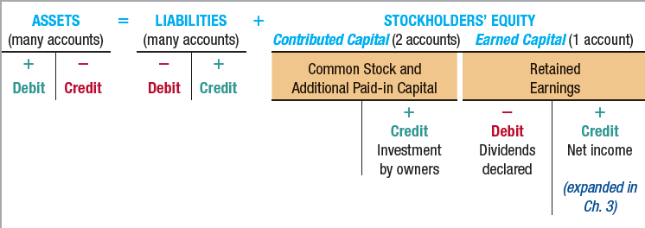
Transaction Analysis Model
T-Account (Any account)
debit | credit
“T-account” is merely a shorthand term for the entire ledger account. The T-account has a left side, called the debit side, and a right side, called the credit side.
Notes:
Throughout this course we are going to use the T-account as a tool to represent a ledger account. “T-account” is merely a shorthand term for the entire ledger account. The T-account has a left side, called the debit side, and a right side, called the credit side.
As we saw earlier, transaction effects increase and decrease assets, liabilities, and stockholders’ equity. To reflect the direction of these effects efficiently, we need to structure the transaction analysis model. As shown on this slide, the critical structural factor is the following: The increase symbol + is located on the left side of the T for accounts on the left side of the accounting equation (assets) and on the right side of the T for accounts on the right side of the equation (liabilities and stockholders’ equity).
From this transaction analysis model, we can observe the following:
Asset accounts increase on the left (debit) side; they have debit balances. It would be highly unusual for an asset account, such as Inventory, to have a negative (credit) balance.
Liability and stockholders’ equity accounts increase on the right (credit) side, creating credit balances.
The words debit and credit have no specific meaning other than that they represent a left and right side of the ledger account.

Slide 20
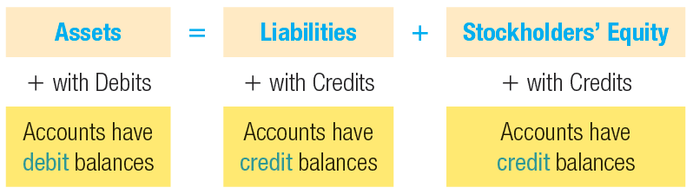

Summary
Notes:
To remember which accounts debits increase with debit effects and which accounts credits increase credit effects, recall that a debit (left) increases asset accounts because assets are on the left side of the accounting equation (A = L + SE). Similarly, a credit (right) increases liability and stockholders’ equity accounts because they are on the right side of the accounting equation. The graphic on this slide summarizes how debits and credits impact assets, liabilities, and stockholders’ equity accounts.

Slide 21
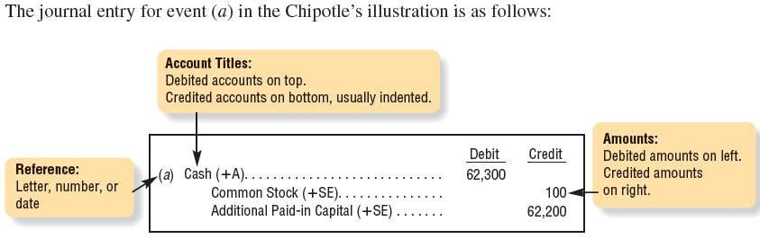
Analytical Tool: The Journal Entry
Notes:
For the typical general journal entries the debited accounts are written first with the amounts placed in the column labeled “Debit”. The credited accounts are written below the debits and are usually indented in a manual system and the amounts placed in the column labeled “Credit”. It is useful to include a date or some form of reference for each transaction.

Slide 22
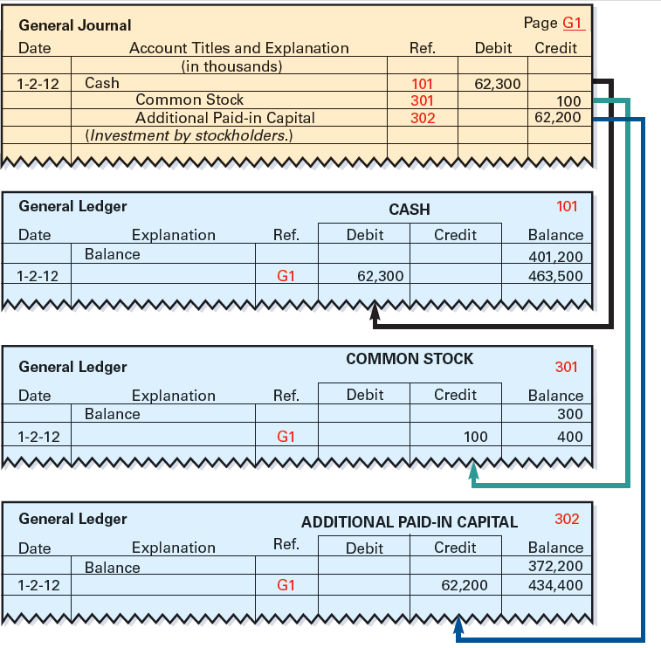
Posting Transaction Effects
Notes:
Recall our first transaction where Chipotle’s issued 10,000 of additional common stock to new investors for cash. We first record this transaction in the general journal. We debit, or increase, the cash account for $62,300 and credit, additional paid-capital for $100 (10,000 shares times $0.01 par value per share). Finally, we credit Additional-paid in capital for $62,200.
Posting involves the moving of the accounting information from the general journal to the general ledger. Remember that the general ledger shows the balance for each account in the chart of accounts. In the manual accounting system used by some small organizations, the ledger is often a three-ring binder with a separate page for each account. In a computerized system, accounts are stored on a disk. The posting process was tedious when done by hand, but is very quickly completed when done with the aid of a computer.

Slide 23
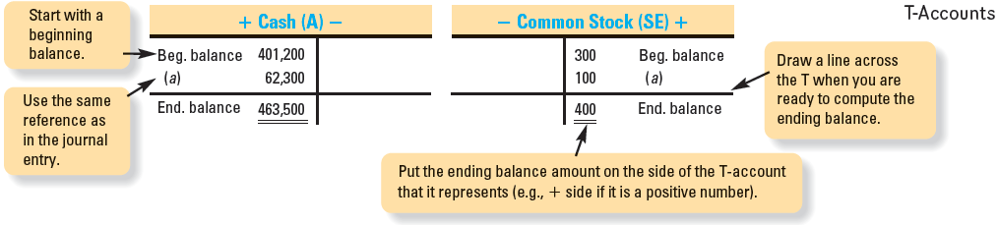
The T-Account
After journal entries are prepared, the accountant posts (transfers) the dollar amounts to each account affected by the transaction.
Notes:
One very useful tool for summarizing the transaction effects and determining the balances for individual accounts is a T-account, a simplified representation of a ledger account. On this slide we show the T-account for Cash and Common Stock. The beginning balances are carried forward from the previous period and are placed into the accounts for illustrative purposes only.

Slide 24
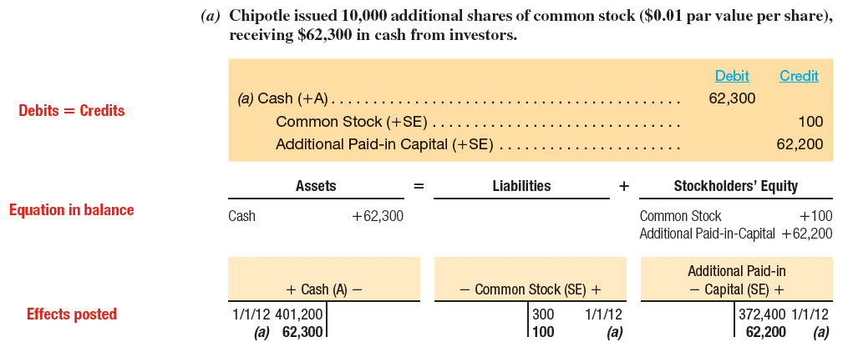
Transaction Analysis Illustrated
Notes:
Recall our first transaction where Chipotle issued 10,000 of additional common stock to new investors for cash. We first record this transaction in the general journal. We debit, or increase, the cash account for $62,300 and credit, Common Stock for $100 (10,000 shares times $0.01 par value per share). Finally, we credit Additional-paid in capital for $62,200.
Next we must make sure the accounting equation is in balance. Look at step (2) to see that we are in balance.
Moving the accounting information from the journal to the ledger is called posting and we observed the process on the previous slide.

Slide 25
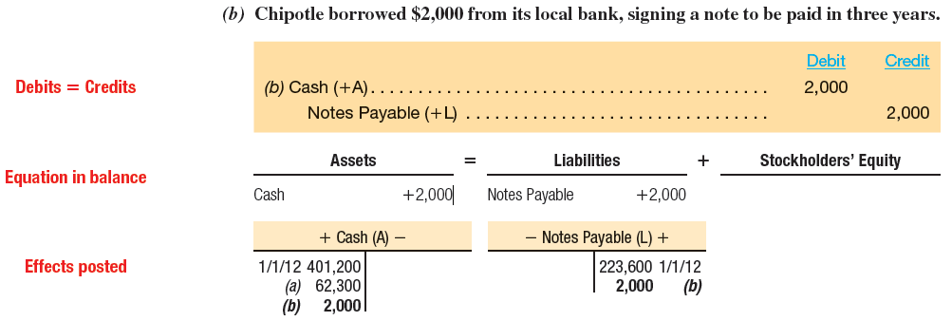
Transaction Analysis Illustrated
Notes:
Our second transaction was to borrow $2,000 from the local bank, signing a not to be paid in three years. Make sure you look through the journal entry carefully, checking to make sure the equation is in balance with the T-accounts, and finally posting to the general ledger accounts. All the other accounts of Chipotle may be analyzed in the same manner shown on the previous slides.

Slide 26
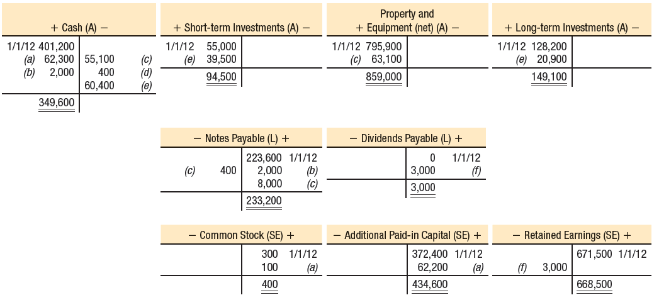
Transaction Analysis Illustrated
After analyzing all transactions from (a) though (f) the balance in our T-accounts will appear as follows:
Notes:
After analyzing all transactions from (a) though (f), the balance in our T-accounts will appear as shown above. Remember, the beginning balances are carried forward from the previous period and are shown here for illustrative purposes.

Slide 27
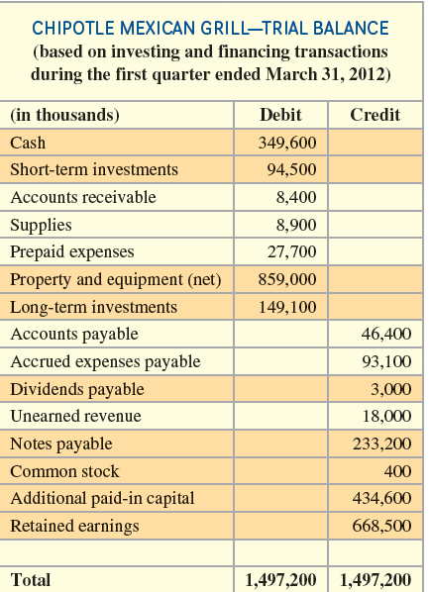
Trial balance
The trial balance is a listing of all accounts in the general ledger. The purpose of the trial balance is to make sure the debits and credits are equal before we prepare the balance sheet.
Notes:
The trial balance is a listing of all accounts in the general ledger. The purpose of the trial balance is to make sure the debits and credits are equal before we prepare the balance sheet.

Slide 28
Classified Balance Sheet
In a classified balance sheet assets and liabilities are classified into two categories – current and noncurrent.
Current assets are those to be used or turned into cash within the upcoming year, whereas noncurrent assets are those that will last longer than one year.
Current liabilities are those obligations to be paid or settled within the next 12 months with current assets.
Notes:
In a classified balance sheet, assets and liabilities are classified into two categories – current and noncurrent. Current assets are those to be used or turned into cash within the upcoming year, whereas noncurrent assets are those that will last longer than one year. Current liabilities are those obligations to be paid or settled within the next 12 months with current assets.

Slide 29
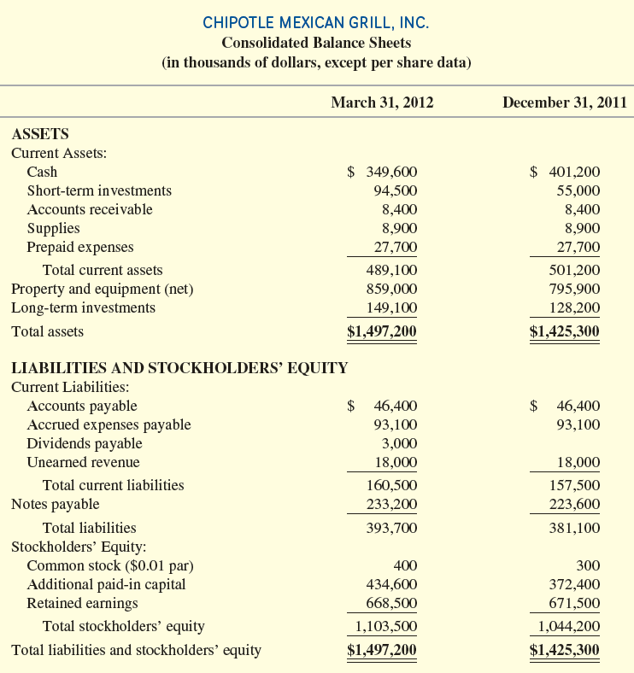
Classified Balance Sheet
k
Notes:
The assets and liabilities are classified into two categories: current and noncurrent. Current assets are those to be used or turned into cash within the upcoming year, whereas noncurrent assets are those that will last longer than one year. Current liabilities are those obligations to be paid or settled within the next 12 months with current assets.
Dollar signs are indicated at the top and bottom of the asset section and top and bottom of the liabilities and shareholders’ equity section. More than that tends to look messy.
The statement includes comparative data. That is, it compares the account balances at December 31, 2011, with those at March 31, 2012. When multiple periods are presented, the most recent balance sheet amounts are usually listed on the left.
Unlike Chipotle, most companies do not provide a total liabilities line on the balance sheet. To determine total liabilities on those statements, add total current liabilities and each of the noncurrent liabilities.

Slide 30
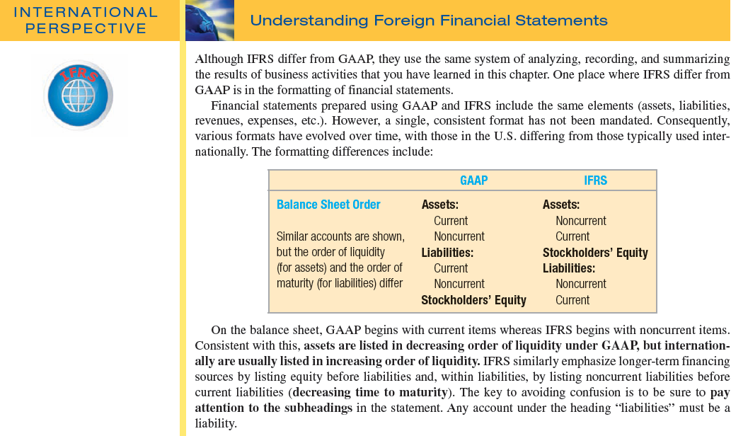
Notes:
Although IFRS differ from GAAP, they use the same system of analyzing, recording, and summarizing the results of business activities that you learned. One place where IFRS differ from GAAP is in the formatting of financial statements.
Although financial statements prepared using GAAP and IFRS include the same elements (assets, liabilities, revenues, expenses, etc.), a single, consistent format has not been mandated. Consequently, various formats have evolved over time, with those in the U.S. differing from those typically used internationally. The formatting differences include those identified on this slide.
Of the differences listed, balance sheet order is the most striking. GAAP begins with current items whereas IFRS begins with noncurrent items. Consistent with this, assets are listed in decreasing order of liquidity under GAAP, but internationally are usually in increasing order of liquidity. IFRS similarly emphasize longer-term financing sources by listing equity before liabilities and, within liabilities, by listing noncurrent liabilities before current liabilities (decreasing time to maturity). The key to avoiding confusion is to pay attention to the subheadings in the statement. Any account under the heading “liabilities” must be a liability.

Slide 31
Key Ratio Analysis
Current
Ratio
Current Assets
Current Liabilities
=
The 2011 current ratio for Chipotle:
$501,200
$157,500
=
3.182
The current ratio for Chipotle shows a high level of liquidity, well above 1.0, and the ratio has varied slightly around the 3.1 level since 2009. Chipotle has high growth strategies requiring cash to fund expansion.
Notes:
Users of financial information compute a number of ratios in analyzing a company’s past performance and financial condition as input in predicting its future potential. How ratios change over time and how they compare to the ratios of the company’s competitors or industry averages provide valuable information about a company’s strategies for its operating, investing, and financing activities.
Creditors and security analysts use the current ratio to measure the ability of the company to pay its short-term obligations with short-term assets. Generally, the higher the ratio, the more cushion a company has to pay its current obligations if future economic conditions take a downturn. However, a company with a high current ratio might still have liquidity problems if the majority of its current assets consist of slow-moving inventory.
The primary causes for the overall decrease were a decrease in inventories (a current asset) and an increase in debt due in the current period (a current liability) for stock repurchases and restaurant acquisitions as part of its growth strategy. In some cases, analysts would be concerned about both the level and trend, but the situation is understandable when considering the nature of the business. The current ratio for Chipotle is consistent with company’s aggressive growth policy.

Slide 32
Focus on Cash Flows
Companies report cash inflows (+) and outflows (-) over a period in their statement of cash flows.
Notes:
Recall from Chapter 1 that companies report cash inflows and outflows over a period in their statement of cash flows. This statement categorizes all transactions that affect cash into three categories: operating, investing, and financing activities.
Operating activities are covered in Chapter 3.
Investing activities include buying and selling noncurrent assets and investments.
Financing activities include borrowing and repaying debt including short-term bank loans, issuing and repurchasing stock, and paying dividends.
When cash is involved, these activities are reported on the Statement of Cash Flows. (When cash is not included in the transaction, such as when a building is acquired with a long-term mortgage note payable, there is no cash effect to include on the statement of cash flows. You must see cash in the transaction for it to affect the Statement of Cash Flows.) In general, the effects (new cash inflows and outflows) of such activities are as shown on this slide.

Slide 33

End of Chapter 2
Notes:
End of chapter 2.

