Slide 1

Chapter 9
Reporting and interpreting Liabilities
McGraw-Hill/Irwin
Copyright © 2014 by The McGraw-Hill Companies, Inc. All rights reserved.
Notes:
Chapter 9: Reporting and Interpreting Liabilities

Slide 2
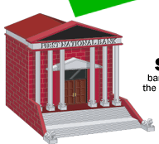
Understanding the Business
The acquisition of assets is financed from two sources:
Debt
Funds from creditors
Equity
Funds from owners
Notes:
Businesses finance acquisition of their assets from two sources: funds supplied by creditors (debt) and funds provided by owners (equity). The mixture of debt and equity a business uses is called its capital structure. In addition to selecting a capital structure, management can select from a variety of sources from which to borrow money.

Slide 3
Understanding the Business
Debt is considered riskier than equity.
Interest is a legal obligation.
Creditors can force bankruptcy.
Notes:
What factors do managers consider when they borrow money? Two key factors are risk and cost. From the firm’s perspective, debt capital is more risky than equity because payments associated with debt are a company’s legal obligations. If a company cannot meet a required debt payment (either principal or interest), creditors may force the company into bankruptcy and require a sale of assets to satisfy the debt.

Slide 4
Liabilities Defined and Classified
Defined as probable debts or obligations of the entity that result from past transactions, which will be paid with assets or services.
Maturity = 1 year or less
Maturity > 1 year
Current Liabilities
Noncurrent Liabilities
Notes:
Liabilities are probable debts or obligations that result from past transactions, which will be paid with assets or services. Current liabilities are short-term obligations that will be paid within the current operating cycle or within one year of the balance sheet date, whichever is longer. Noncurrent liabilities include all other liabilities.

Slide 5
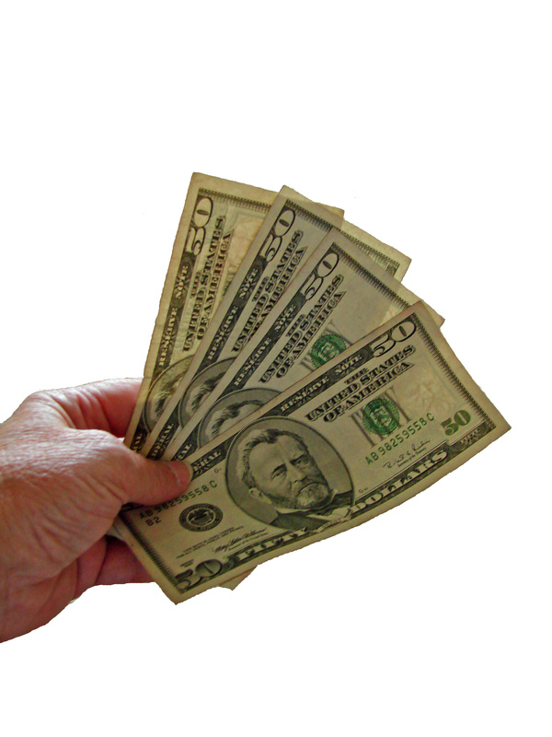
Liabilities Defined and Classified
Liabilities are recorded at their current cash equivalent, which is the cash amount a creditor would accept to settle the liability immediately.
Notes:
When a liability is first recorded, it is measured in terms of its current cash equivalent, which is the cash amount a creditor would accept to settle the liability immediately.

Slide 6
Liquidity
Liquidity is the ability to pay current obligations.
Working Capital
Current Assets
– Current Liabilities
Working capital is a margin of safety that ensures a company can meet its short-term obligations.
Notes:
Liquidity is the ability to pay current obligations. A number of financial measures are useful in determining liquidity, including the current ratio (discussed in chapter 2) and the dollar amount of working capital. Working capital is defined as current assets minus current liabilities and is a margin of safety that ensures a company can meet its short-term obligations.
Working capital management involves a delicate balance. On one hand, working capital provides liquidity and a margin of safety. On the other hand, excess money tied up in a checking account or inventory is not productive because it does not generate profits.

Slide 7
Current Liabilities
Notes:
Here is a summary of some common current liabilities.
Accounts payable, also known as trade accounts payable, are obligations to pay for goods and services used in the basic operating activities of the business.
Accrued liabilities, also known as accrued expenses, are obligations related to expenses that have been incurred but have not been paid at the end of the accounting period.
Notes payable are obligations due supported by a formal written contract.
Deferred revenues, also known as unearned revenues, are obligations arising when cash is received prior to the related revenue being earned.

Slide 8
Accounts Payable Turnover
Cost of Goods Sold ÷ Average Accounts Payable
Measures how quickly management is paying trade accounts.
A high accounts payable ratio normally suggests that a company is paying its suppliers in a timely manner.
The ratio can be stated more intuitively by dividing it into the
number of days in a year:
Average Age of Payables = 365 Days ÷ Turnover Ratio
Notes:
The accounts payable turnover ratio measures how quickly management is paying trade accounts. A high accounts payable ratio normally suggests that a company is paying its suppliers in a timely manner. The accounts payable turnover ratio is computed as follows: Cost of Goods Sold ÷ Average Accounts Payable.
The ratio can be stated more intuitively by dividing it into the number of days in a year: Average Age of Payables = 365 Days ÷ Turnover Ratio.

Slide 9




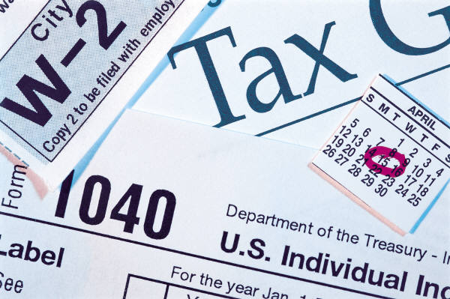
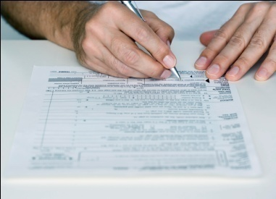

Payroll Taxes
Gross Pay
Net Pay
Less Deductions:
Social Security Tax
Medicare Tax
Federal Income Tax
State and Local Income Taxes
Voluntary Deductions
Notes:
All payrolls are subject to a variety of taxes including federal, state, and local income taxes, Social Security taxes, and federal and state unemployment taxes. Employees pay some of these taxes and employers pay others. Employers are required to withhold income taxes for each employee. The amount of income tax withheld is recorded by the employer as a current liability between the date of the deduction and the date the amount is remitted to the government. The Social Security taxes paid by employees are called FICA taxes because they are required by the Federal Insurance Contributions Act. These taxes are imposed in equal amounts on both the employee and the employer. Effective January 1, 2013, the Social Security tax rate was 6.2% on the first $113,700. In addition, a separate 1.45% Medicare tax applies to all income. In addition to these federal taxes, employers also withhold any state and local income taxes that may be applicable. Many employers also offer programs where employees can request amounts be withheld from their compensation and remitted to the designated authority, such as retirement plans, medical insurance plans, and charity organizations. All items withheld from an employee’s compensation create current liabilities for the employer.

Slide 10
Notes Payable
A note payable specifies an annual interest rate associated with the borrowing.
  To the lender, interest is a revenue.
  To the borrower, interest is an expense.
Interest = Principal × Interest Rate × Time
When computing interest for one year, “Time” equals 1. When the computation period is less than one year, then “Time” is a fraction.
Notes:
When a company borrows money, a formal written contract is usually prepared. Obligations supported by these contracts are called notes payable. A note payable specifies the amount borrowed, the date by which it must be repaid, and the annual interest rate associated with the borrowing.
To calculate interest, three variables must be considered: the principal, the annual interest rate, and the time period for the loan. The interest formula is principal times interest rate times time. When computing interest for one year, “Time” equals 1. When the computation period is less than one year, then “Time” is a fraction.

Slide 11

Notes Payable
Starbucks borrows $100,000 for 2 months at an annual interest rate of 12%. Compute the interest on the note for the loan period.
Notes:
Starbucks borrows $100,000 for 2 months at an annual interest rate of 12%. Compute the interest on the note for the loan period.
Remember the computation is principal of $100,000 times interest rate of 12% times time of 2 months out of 12 months. So, the interest for the 2 month loan period is $2,000.

Slide 12

International Perspective—IFRS
Refinanced Debt: Current or Noncurrent?
Instead of repaying a debt from current cash, a company may refinance it either by negotiating a new loan agreement with a new maturity date or by borrowing money from a new creditor and repaying the original creditor.
US GAAP and IFRS differ with respect to the timing of the refinancing.
Under GAAP, the ability to refinance must be in place before the financial statements are issued.
In the case of IFRS, the actual refinancing must take place by the balance sheet date.
Notes:
Instead of repaying a debt from current cash, a company may refinance it either by negotiating a new loan agreement with a new maturity date or by borrowing money from a new creditor and repaying the original creditor. If a company intends to refinance a currently maturing debt and has the ability to do so, should the debt be classified as a current or a long-term liability? Remember that analysts are interested in a company’s current liabilities because those liabilities will generate cash outflows in the next accounting period. If a liability will not generate a cash outflow in the next accounting period, GAAP require that it not be classified as current.
US GAAP and IFRS differ with respect to the timing of the refinancing. In the case of IFRS, the actual refinancing must take place by the balance sheet date. Under GAAP, the ability to refinance must be in place before the financial statements are issued.

Slide 13
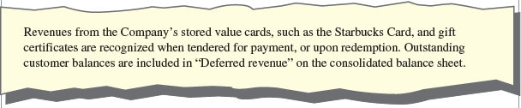
Deferred Revenues
Revenues that have been collected but not earned.
Deferred revenues are reported as a liability because cash has been collected but the related revenue has not been earned by the end of the accounting period.
Notes:
In most business transactions, cash is paid after the product or service has been delivered. In some cases, cash is paid before delivery. You have probably paid for magazines that you will receive at some time in the future. The publisher collects money for your subscription in advance, before the magazine is published. When a company collects cash before the related revenue has been earned, the cash is called deferred revenues. The popular Starbucks card permits customers to pay in advance for their coffee. The advantage for the customer is convenience at the point of sale. The advantage for the company is that Starbucks is able to collect and use cash before customers actually buy the product. The Starbucks report shows that the company has collected $449.3 million from customers prior to providing them with coffee and explains the amount with the note shown on this slide.
Under the revenue principle, revenue cannot be recorded until it has been earned. Deferred revenues are reported as a liability because cash has been collected but the related revenue has not been earned by the end of the accounting period. The obligation to provide services or goods in the future still exists. These obligations are classified as current or long-term, depending on when they must be satisfied.

Slide 14
Estimated Liabilities
Contingent liabilities are potential liabilities that are created as a result of a past event.
The probabilities of occurrence are defined in the following manner:
  Probable—the chance that the future event or events will occur is high.
  Reasonably possible—the chance that the future event or events will occur is more than remote but less than likely.
  Remote—the chance that the future event or events will occur is slight.
Notes:
Contingent liabilities are potential liabilities that are created as a result of a past event. A contingent liability may or may not become a recorded liability depending on future events. A situation that produces a contingent liability also causes a contingent loss.
Whether a situation produces a recorded or a contingent liability depends on two factors: the probability of a future economic sacrifice and the ability of management to estimate the amount of the liability. The table on this slide illustrates the possibilities. For example, a contingent liability that is reasonably possible should be disclosed in the notes to the financial statement, whether it can be estimated or not.
The probabilities of occurrence are defined in the following manner:
Probable—the chance that the future event or events will occur is high.
Reasonably possible—the chance that the future event or events will occur is more than remote but less than likely.
Remote—the chance that the future event or events will occur is slight.

Slide 15
International Perspective—IFRS
It’s a Matter of Degree
The assessment of future probabilities is inherently subjective but both US GAAP and IFRS provide some guidance.
Under GAAP, “probable” has been defined as likely which is interpreted as having a greater than 70% chance of occurring.
In the case of IFRS, probable is defined as more likely than not which would imply more than a 50% chance of occurring.
This difference means that companies reporting under IFRS would record a liability when other companies reporting under GAAP would report the same event as a contingency.
Notes:
The assessment of future probabilities is inherently subjective but both US GAAP and IFRS provide some guidance. Under GAAP, “probable” has been defined as likely which is interpreted as having a greater than 70% chance of occurring. In the case of IFRS, probable is defined as more likely than not which would imply more than a 50% chance of occurring. This difference means that companies reporting under IFRS would record a liability when other companies reporting under GAAP would report the same event as a contingency.

Slide 16

Working Capital Management
Working Capital = Current Assets – Current Liabilities
Changes in working capital accounts are important to managers and analysts because they have a direct impact on cash flows from operating activities reported on the statement of cash flows.
Notes:
Working capital is defined as the dollar difference between current assets and current liabilities. Working capital is important to both managers and financial analysts because it has a significant impact on the health and profitability of a company. If a business has too little working capital, it runs the risk of not being able to meet its obligations to creditors. On the other hand, too much working capital may tie up resources in unproductive assets and incur additional costs. Excess inventory, for example, ties up dollars that could be invested more profitably elsewhere in the business and incurs additional costs associated with storage and deterioration.
Changes in working capital accounts are also important to managers and analysts because they have a direct impact on cash flows from operating activities reported on the statement of cash flows.

Slide 17
Long-Term Liabilities
Maturity = 1 year or less
Maturity > 1 year
Current Liabilities
Noncurrent Liabilities
Creditors often require the borrower to pledge specific assets as security for long-term liabilities.
Notes:
Long-term liabilities are all of the entity’s obligations not classified as current liabilities. Creditors often require the borrower to pledge specific assets as security for long-term liabilities.

Slide 18

Long-Term Notes Payable and Bonds
Relatively small debt needs can be filled from single sources.
Banks
Insurance Companies
Pension Plans
Notes:
Companies can raise long-term debt capital directly from a number of financial service organizations including banks, insurance companies, and pension plans. Raising debt from one of these organizations is known as private placement. This type of debt is often called a note payable, which is a written promise to pay a stated sum at one or more specified future dates called the maturity dates.

Slide 19
Long-Term Notes Payable and Bonds
Significant debt needs are often filled by issuing bonds to the public.
Bonds
Cash
Notes:
In many cases, a company’s need for debt capital exceeds the financial ability of any single creditor. In these situations, the company may issue publicly traded debt called bonds. Bonds will be discussed in detail in the next chapter.

Slide 20
International Perspective
Borrowing in Foreign Currencies
Companies may elect to borrow in foreign markets
  To lessen exchange rate risk.
  Because interest rates often are low in other countries.
For reporting purposes, accountants must convert, or translate, foreign debt into U.S. dollars.
Assume that Starbucks borrowed 1 million pounds (£). For the Starbucks annual report, the accountant must use the conversion rate as of the balance sheet date, which we assume was £1.00 to $1.50.
£1,000,000 × $1.50 = $1,500,000
Starbucks would report the debt at $1,500,000 on their financial statements.
Notes:
Many companies with foreign operations elect to finance those operations with foreign debt to lessen exchange rate risk. This type of risk exists because the relative value of each nation’s currency varies on virtually a daily basis. Even if a company does not have international operations, it may elect to borrow in foreign markets. Interest rates often are low in countries experiencing a recession. These situations give corporations the opportunity to borrow at a lower cost.
For reporting purposes, accountants must convert, or translate, foreign debt into U.S. dollars. Conversion rates for all major currencies are published in most newspapers. To illustrate foreign currency translation, assume that Starbucks borrowed 1 million pounds (£). For the Starbucks annual report, the accountant must use the conversion rate as of the balance sheet date, which we assume was £1.00 to $1.50. The dollar equivalent of the debt is $1,500,000 (£1,000,000 × $1.50). The dollar equivalent of foreign debt may change if the conversion rate changes even without any additional borrowings or repayments.

Slide 21
Lease Liabilities
Operating Lease
Capital
Lease
Short-term lease; No liability or asset recorded
Long-term lease; Meets one of 4 criteria; Results in recording an asset and a liability
Capital Lease Criteria
Lease term is 75% or more of the asset’s expected economic life.
Ownership of the asset is transferred to the lessee at the end of the lease.
Lease permits lessee to purchase the asset at a price that is lower than its fair market value.
The present value of the lease payments is 90% or more of the fair market value of the asset when the lease is signed.
Notes:
When a company leases an asset on a short-term basis, the agreement is called an operating lease. No liability is recorded when an operating lease is created. Instead, a company records rent expense as it uses the asset.
For a number of reasons, a company may prefer to lease an asset on a long-term basis rather than purchase it. This type of lease is called a capital lease. In essence, a capital lease contract represents the purchase and financing of an asset even though it is legally a lease agreement. Capital leases are accounted for as if an asset had been purchased by recording an asset and a liability. Let’s look a the specific criteria identified by generally accepted accounting principles to distinguish between an operating lease and a capital lease.
If the lease meets any of the following criteria, it is considered a capital lease:
Lease term is 75% or more of the asset’s expected economic life.
Ownership of the asset is transferred to the lessee at the end of the lease.
Lease permits lessee to purchase the asset at a price that is lower than its fair market value.
The present value of the lease payments is 90% or more of the fair market value of the asset when the lease is signed.

Slide 22
Present Value Concepts
$1,000 invested today at 10%.
In 1 year it will be worth $1,100.
In 5 years it will be worth $1,610!
Money can grow over time because it can earn interest.
Notes:
The concept of present value (PV) is based on the time value of money. Quite simply, money received today is worth more than money to be received one year from today (or at any other future date) because it can be used to earn interest. If you invest $1,000 today at 10 percent, you will have $1,100 in one year. In contrast, if you receive $1,000 one year from today, you will lose the opportunity to earn the $100 in interest revenue. The difference between the $1,000 and the $1,100 is the interest that can be earned during the year.
The value of money changes over time because money can earn interest.

Slide 23
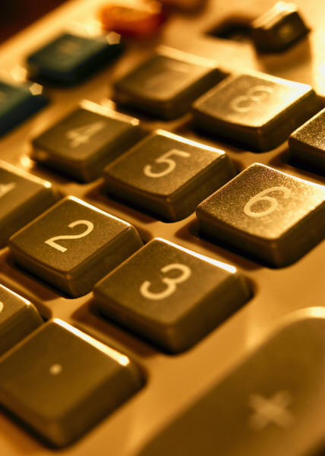
Present Value Concepts
The growth is a mathematical function of four variables:
The value today (present value).
The value in the future (future value).
The interest rate.
The time period.
Notes:
The growth is a mathematical function of four variables:
The value today (present value).
The value in the future (future value).
The interest rate.
The time period.
Most analysts use present value tables, calculators, or Excel to solve time value of money problems. We will use the present value tables in our illustrations. An explanation of how to use Excel is included in the supplement to this chapter.

Slide 24
Present Value of a Single Amount
The present value of a single amount is the worth to you today of receiving that amount some time in the future.
Present Value
Future Value
Interest compounding periods
Today
Future
Notes:
The present value of a single amount is the worth to you today of receiving that amount some time in the future. For instance, you might be offered an opportunity to invest in a debt instrument that would pay you $10,000 in three years. Before you decided whether to invest, you would want to determine the present value of the instrument.

Slide 25
Present Value of a Single Amount
How much do we need to invest today at 10% interest, compounded annually, if we need $1,331 in three years?
a. $1,000.00
b. $ 990.00
c. $ 751.30
d. $ 970.00
The required future amount is $1,331.
i = 10% & n = 3 years
Using the present value of a single amount table, the factor is 0.7513.
$1,331 × 0.7513 = $1,000 (rounded)
Notes:
How much do we need to invest today at 10% interest, compounded annually, if we need $1,331 in three years?
How did you do? We need $1,000 dollars. Using the present value of a single amount table, we find the factor for 10% and 3 periods, which is 0.7513. We then multiply this factor times the future value of $1,331 to arrive at a present value of $1,000. So, if we invest $1,000 today at 10% for 3 years, we will have $1,331 at the end of the 3 years.

Slide 26
Present Values of an Annuity
An annuity is a series of consecutive equal periodic payments.
Today
Notes:
Instead of a single payment, many business problems involve multiple cash payments over a number of periods. An annuity is a series of consecutive payments characterized by
An equal dollar amount each interest period.
Interest periods of equal length (year, half a year, quarter, or month).
An equal interest rate each interest period.
Examples of annuities include monthly payments on an automobile or home, yearly contributions to a savings account, and monthly pension benefits.

Slide 27
Present Values of an Annuity
What is the value today of a series of payments to be received or paid out in the future?
Payment 1
Payment 2
Payment 3
Present Value
Interest compounding periods
Today
Notes:
The present value of an annuity is the value now of a series of equal amounts to be received (or paid out) for some specified number of periods in the future. It is computed by discounting each of the equal periodic amounts. A good example of this type of problem is a retirement program that offers employees a monthly income after retirement.

Slide 28
Present Values of an Annuity
What is the present value of receiving $1,000 each year for three years at an interest rate of 10%, compounded annually?
a. $3,000.00
b. $2,910.00
c. $2,700.00
d. $2,486.90
The consecutive equal payment amount is $1,000.
i = 10% & n = 3 years
Using the present value of an annuity table, the factor is 2.4869.
$1,000 × 2.4869 = $2,486.90
Notes:
What is the present value of receiving $1,000 each year for three years at an interest of 10%, compounded annually?
The present value is $2,486.90. Using the present value of an annuity table, we find the factor for 10% and 3 periods, which is 2.4869. We then multiply this factor times the annuity payments of $1,000 to arrive at a present value of $2,486.90. So, if we invest $2,486.90 today at 10% for 3 years, we can receive payments of $1,000 each of the next 3 years.

Slide 29

Accounting Applications of Present Values
On January 1, 2014, Starbucks bought some new delivery trucks. The company signed a note agreeing to pay $200,000 on December 31, 2015. The market interest rate for this note is 12%.
Let’s prepare the journal entry to record the purchase.
Notes:
On January 1, 2014, Starbucks bought some new delivery trucks. The company signed a note agreeing to pay $200,000 on December 31, 2015. The market interest rate for this note is 12%. What is the present value of this note?
Using the present value of a single amount table, we find the factor for 12% and 2 periods, which is 0.7972. We then multiply this factor times the future value of $200,000 to arrive at a present value of $159,440.
Let’s prepare the journal entry to record the purchase.

Slide 30
Accounting Applications of Present Values
Present Value × Interest Rate = Interest
$159,440 × 12% = $19,133
December 31, 2014
Notes:
On January 1, Starbucks will debit delivery trucks and credit notes payable for the present value of the note, $159,440.
At the end of the accounting period, Starbucks will calculate interest expense as principal times interest rate times time. In this case, time is one full year, so it is 1. Starbucks will record interest expense of $19,133 with a debit and will credit notes payable for the same amount. The credit to notes payable increases the liability toward the maturity value of $200,000.

Slide 31
Accounting Applications of Present Values
Now, let’s look at the journal entries at
December 31, 2015.
Present Value × Interest Rate = Interest
($159,440 + $19,133) × 12% = $21,429
Notes:
Here are the journal entries at December 31, 2015, the end of the second year. The first entry records the interest expense for the year. The second entry records the repayment of the note.

Slide 32
Supplement A: Present Value Computations Using Excel
Notes:
Supplement A: Present Value Computations Using Excel
Most present value problems in business are solved with calculators or Excel spreadsheets. Using Excel to solve a present value of a single amount problem, you can use the formula identified on this slide: =Payment/(1 + i)^n. In this formula, payment is the cash payment made at some point in the future, i is the interest rate each period, and n is the number of periods in the problem.
The formula for computing the present value of an annuity is a little more complicated than the present value of a single payment. As a result, Excel has been programmed to include the formula so that you do not have to enter it yourself. To compute the present value of an annuity in Excel, select a cell and click on the insert function button fx. In the drop down menu, under the Select Category heading, pick "Financial" and scroll down under Select Function and click on "PV." In the new drop down box, enter the specific information for your problem and click "OK."

Slide 33
Supplement B: Deferred Taxes
Exist because of timing differences caused by reporting revenues and expenses according to GAAP on a company’s income statement and according to the Internal Revenue Code on the tax return.
Deferred Taxes
Timing differences that cause deferred income taxes and will reverse, or turn around, in the future.
Temporary Differences
Notes:
Supplement B: Deferred Taxes
Most companies report a large long-term liability called deferred taxes. Deferred tax items exist because of timing differences caused by reporting revenues and expenses according to generally accepted accounting principles on a company’s income statement and according to the Internal Revenue Code on the tax return.
Temporary differences are timing differences that cause deferred income taxes and will reverse, or turn around, in the future.

Slide 34
Supplement C: Future Value Concepts
Future value is the sum to which an amount will increase as the result of compound interest.
How much will an amount today be worth in the future?
Present Value
Interest compounding periods
Future Value
Today
Notes:
Supplement C: Future Value Concepts
Future value problems are similar to present value problems in the sense that they are both based on the time value of money. As we saw earlier, a present value problem determines the current cash equivalent of an amount to be received in the future. In comparison, a future value is the sum to which an amount will increase as the result of compound interest.

Slide 35
Future Value of a Single Amount
If we invest $1,000 today earning 10% interest, compounded annually, how much will it be worth in three years?
a. $1,000
b. $1,010
c. $1,100
d. $1,331
The invested amount is $1,000.
i = 10% & n = 3 years
Using the future value of a single amount table, the factor is 1.331.
$1,000 × 1.331 = $1,331
Notes:
If we invest $1,000 today earning 10% interest, compounded annually, how much will it be worth in three years?
Did you remember this problem? We worked it as a present value problem in some earlier slides. The future value is $1,331. Using the future value of a single amount table, we find the factor for 10% and 3 periods, which is 1.331. We then multiply this factor times the present value of $1,000 to arrive at a future value of $1,331.

Slide 36
Future Value of an Annuity
Equal payments are made each period.
The payments and interest accumulate over time.
Payment 1
Payment 2
Payment 3
Interest compounding periods
Today
Notes:
Recall that an annuity is a series of consecutive payments characterized by an equal dollar amount each interest period, interest periods of equal length, and an equal interest rate each period.
If you are saving money for some purpose, such as a new car or a trip to Europe, you might decide to deposit a fixed amount of money in a savings account each month. The future value of an annuity computation will tell you how much money will be in your savings account at some point in the future.
The future value of an annuity includes compound interest on each payment from the date of payment to the end of the term of the annuity. Each new payment accumulates less interest than prior payments, only because the number of periods remaining in which to accumulate interest decreases.

Slide 37
Future Value of an Annuity
If we invest $1,000 each year at an interest rate of 10%, compounded annually, how much will we have at the end of three years?
a. $3,000
b. $3,090
c. $3,300
d. $3,310
The annual investment amount is $1,000.
i = 10% & n = 3 years
Using the future value of an annuity table, the factor is 3.3100.
$1,000 × 3.3100 = $3,310
Notes:
If we invest $1,000 each year at an interest rate of 10%, compounded annually, how much will we have at the end of three years?
The future value is $3,310. Using the future value of an annuity table, we find the factor for 10% and 3 periods, which is 3.3100. We then multiply this factor times the annuity payments of $1,000 to arrive at a future value of $3,310.

Slide 38

End of Chapter 9
Notes:
End of chapter 9.

