Slide 1

Chapter 12
statement of Cash Flows
McGraw-Hill/Irwin
Copyright © 2014 by The McGraw-Hill Companies, Inc. All rights reserved.
Notes:
Chapter 12: Statement of Cash Flows

Slide 2
Understanding the Business
Positive cash flows permit a company to . . .
Pay dividends to owners.
Expand its operations.
Take advantage of market opportunities.
Replace needed assets.
Wall Street analysts consider cash flow an important indicator of a company’s financial health.
Notes:
Clearly, net income is important, but cash flow is also critical to a company’s success. Positive cash flow permits a company to expand operations, replace worn assets, take advantage of new investment opportunities, and pay dividends to its owners. Both managers and analysts need to understand the various sources and uses of cash that are associated with business activity. The statement of cash flows focuses attention on a firm’s ability to generate cash internally, its management of current assets and current liabilities, and the details of its investments and its external financing. Wall Street analysts consider cash flow an important indicator of a company’s financial health. Some Wall Street analysts go so far as to say “cash flow is king.”

Slide 3
Classifications of the Statement of Cash Flows
Cash
Cash Equivalents
Currency
Short-term, highly liquid investments.
Readily convertible into cash.
So near maturity that market value is unaffected by interest rate changes (i.e., original maturities of less than 3 months).
Notes:
Basically, the statement of cash flows explains how the amount of cash on the balance sheet at the beginning of the period became the amount of cash reported at the end of the period. For purposes of this statement, the definition of cash includes cash and cash equivalents. Cash equivalents are short-term, highly liquid investments that are both
1. Readily convertible to known amounts of cash, and
2. So near to maturity there is little risk that their value will change if interest rates change.
Generally, only investments with original maturities of three months or less qualify as cash equivalents under this definition. Examples of cash equivalents are Treasury bills (a form of short-term U.S. government debt), money market funds, and commercial paper (short-term notes payable issued by large corporations).

Slide 4
Classifications of the Statement of Cash Flows
Cash inflows and outflows directly related to earnings from normal operations.
Operating Activities
Cash inflows and outflows related to the acquisition or sale of productive facilities and investments in the securities of other companies.
Investing Activities
Cash inflows and outflows related to external sources of financing (owners and creditors) for the enterprise.
Financing Activities
Notes:
The statement of cash flows reports cash inflows and outflows in three broad categories: operating activities, investing activities, and financing activities.
The operating activities section reports the cash inflows and outflows directly related to earnings from normal operations.
The investing activities section reports the cash effects of the acquisition and disposition of assets (other than inventory and cash equivalents).
The financing activities section reports the cash effects of the sale or repurchase of shares, the issuance or repayment of debt securities, and the payment of cash dividends.
We will discuss each of these sections in more detail in the next few slides.

Slide 5
CASH INFLOWS
Operating Activities
Investing Activities
Financing Activities
Sale of operational assets
Sale of investments
Collections of loans
Issuance of stock
Issuance of bonds and notes
Cash received from revenues
Business
Cash paid for expenses
Purchase of operational assets
Purchase of investments
Loans to others
Payment of dividends
Repurchase of stock
Repayment of debt
CASH OUTFLOWS
Notes:
Many decisions benefit from information about the company’s underlying cash flow process. Cash continually flows into and out of an active business. This graphic illustrates several examples of cash inflows and outflows classified as operating, investing and financing activities. Take a few minutes to review these examples before we take a closer look at each section.

Slide 6
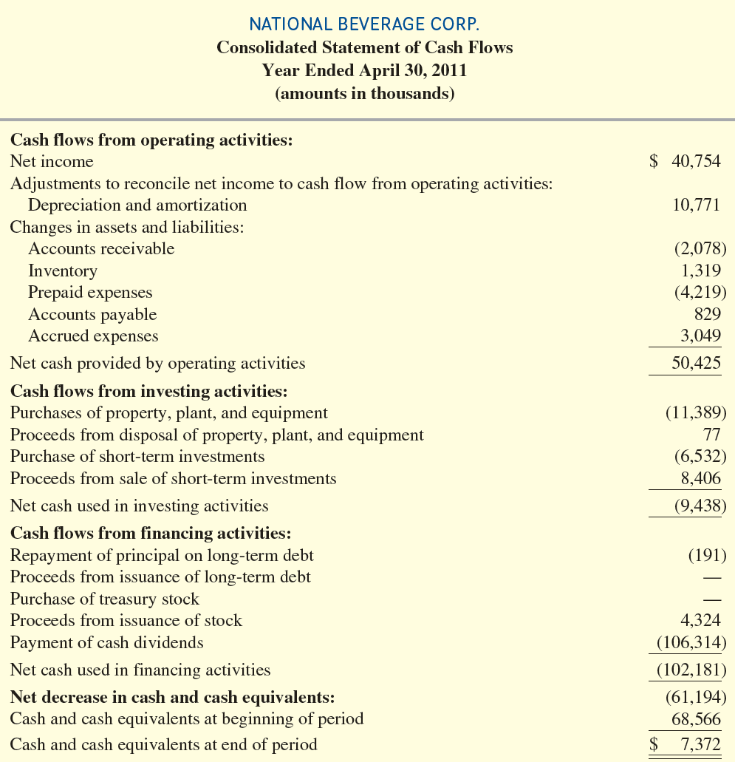

This ending cash balance should agree with the balance sheet.
Notes:
The statement of cash flows reports cash inflows and outflows in three broad categories: (1) operating activities, (2) investing activities, and (3) financing activities. In addition to the three sections (operating, investing, and financing), there is also a cash reconciliation at the bottom of the statement. The ending cash balance on the statement of cash flows should agree with the cash balance on the balance sheet.

Slide 7
Direct Method vs. Indirect Method
Two Formats for Reporting Operating Activities
Direct Method
Indirect Method
Reports the cash effects of each operating activity
Starts with accrual net income and converts to cash basis
Note that no matter which format is used, the same amount of net cash flows from operating activities is generated.
Notes:
There are two acceptable formats for presenting the cash flows from operating activities, the first section on the statement of cash flows. The direct method reports components of cash flows from operating activities as gross receipts and gross payments. The indirect method adjusts net income to obtain cash flows from operating activities. Note that no matter which format is used, the same amount of net cash flows from operating activities is generated.
National Beverage uses the indirect method. The indirect method is used by almost 99% of large U.S. companies.

Slide 8
Cash Flows from Operating Activities
Inflows
Cash received from:
Customers
Dividends and interest on investments
+
Cash Flows from Operating Activities
Outflows
Cash paid for:
Purchase of goods for resale and services (electricity, etc.)
Salaries and wages
Income taxes
Interest on liabilities
_
Notes:
Cash flows from operating activities are cash inflows and outflows directly related to earnings from normal operations. Cash inflows include cash received from customers and dividends and interest on investments in other companies. Cash outflows include cash paid for purchases of goods for resale and services, salaries and wages, income taxes and interest on liabilities. The cash flows in this section are illustrated in the examples in this slide.

Slide 9

Cash Flows from Investing Activities
Inflows
Cash received from:
Sale or disposal of property, plant and equipment
Sale or maturity of investments in securities
+
Cash Flows from Investing Activities
Outflows
Cash paid for:
Purchase of property, plant and equipment
Purchase of investments in securities
_
Notes:
Cash flows from investing activities are cash inflows and outflows related to the acquisition or sale of productive facilities and investments in the securities of other companies. Included in this classification are cash payments to acquire property, plant and equipment, and investment in securities of other companies. When these assets later are sold, any cash receipts from their disposition also are classified as investing activities. The cash flows in this section are illustrated in the examples in this slide.

Slide 10

Cash Flows from Financing Activities
Inflows
Cash received from:
Borrowings on notes, mortgages, bonds, etc. from creditors
Issuing stock to owners
+
Cash Flows from Financing Activities
Outflows
Cash paid for:
Repayment of principal to creditors (excluding interest, which is an operating activity)
Repurchasing stock from owners
Dividends to owners
_
Notes:
Cash flows from financing activities are cash inflows and outflows related to external sources of financing (owners and creditors) for the enterprise. Included in this classification are cash inflows from borrowings on notes, mortgages, bonds and other debts from creditors and from proceeds from the issuance of stock. Subsequent transactions related to these financing transactions, such as a buyback of stock, the repayment of debt, and the payment of cash dividends to shareholders, also are classified as financing activities. The cash flows in this section are illustrated in the examples in this slide.

Slide 11
RELATIONSHIPS TO THE BALANCE SHEET AND THE INCOME STATEMENT
Information needed to prepare a statement of cash flows:
Comparative Balance Sheets.
Income Statement.
Additional details concerning
selected accounts.
Notes:
Preparing and interpreting the cash flow statement requires an analysis of balance sheet and income statement accounts that relate to the three sections of the cash flow statement. Preparers must analyze the numbers recorded in the accounts under the accrual method and adjust them to a cash basis. To prepare a statement of cash flows, preparers need comparative balance sheets, a complete income statement, and additional details concerning selected accounts where the total change amount in an account balance during the year does not reveal the underlying nature of the cash flows.

Slide 12
RELATIONSHIPS TO THE BALANCE SHEET AND THE INCOME STATEMENT
Δ Cash = Δ Liabilities + Δ Stockholders’ Equity − Δ Noncash Assets
Derives from . . .
Assets = Liabilities + Stockholders’ Equity
Notes:
The change in cash equals the change in liabilities plus the change in stockholders’ equity minus the change in noncash assets. Thus any transaction that changes cash must be accompanied by a change in liabilities, stockholders’ equity, or noncash assets. The next slide provides more detail on this concept.

Slide 13
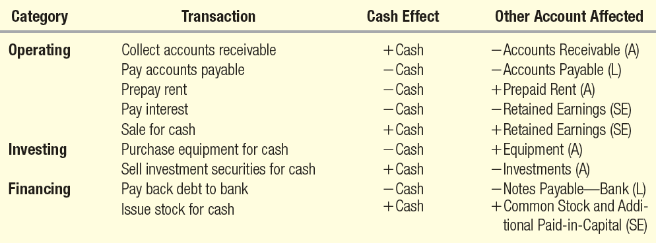

RELATIONSHIPS TO THE BALANCE SHEET AND THE INCOME STATEMENT
Notes:
This exhibit illustrates the relationship for selected cash transactions and other accounts that are affected. For example, when a company collects cash on an accounts receivable, cash increases and the noncash asset accounts receivable decreases. Take a minute and review the relationships highlighted on this slide.

Slide 14
Reporting and interpreting cash Flows from Operating Activities
The indirect method adjusts net income by eliminating noncash items.
+/- Changes in current assets and current liabilities.
Cash Flows from Operating Activities: Indirect Method
Net Income
+ Losses and - Gains
+ Noncash expenses such as depreciation and amortization.
Notes:
Because virtually all U.S. companies choose the indirect method, we discuss the indirect method here and the direct method in Supplement A at the end of the chapter. Remember that the indirect method starts with net income and converts it to cash flows from operating activities. This involves adjusting net income for the differences in the timing of accrual basis net income and cash flows, as shown by the items in the yellow boxes on this slide.

Slide 15
Reporting and interpreting cash Flows from Operating Activities
Use this table when adjusting Net Income to Operating Cash Flows using the indirect method.
Notes:
This table summarizes how to adjust net income for changes in current assets and current liabilities. If a current asset account has increased, the increase would be subtracted from accrual basis net income. Similarly, if a current asset account has decreased, the decrease would be added to accrual basis net income. For liabilities, increases are added to and decreases are subtracted from accrual basis net income.

Slide 16
Adjustment for Gains and Losses
Transactions that cause gains and losses should be classified on the statement of cash flows as operating, investing, or financing activities, depending on their dominate characteristics. For example, if the sale of equipment produced a gain, it would be classified as an investing activity.
Gains
Gains must be subtracted from net income to avoid double counting the gain.
Losses
Losses must be added to net income to avoid double counting the loss.
Notes:
Transactions that cause gains and losses should be classified on the statement of cash flows as operating, investing, or financing activities, depending on their dominate characteristics. For example, if the sale of equipment produced a gain, it would be classified as an investing activity.
Gains must be subtracted from net income to avoid double counting the gain.
Losses must be added to net income to avoid double counting the loss.

Slide 17
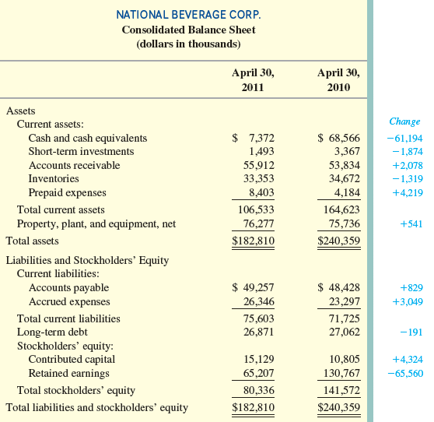
Notes:
Use the financial statements for National Beverage Corp. on the next two slides and prepare the statement of cash flows for the year ended April 30, 2011. Here are the 2010 and 2011 balance sheets for National Beverage. The account changes have already been calculated in the last column for us.

Slide 18
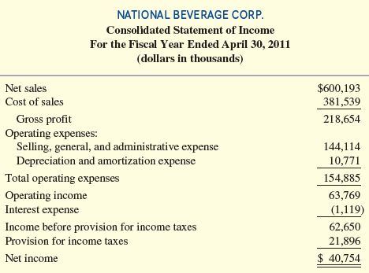
The Statement of Cash Flows will begin with net income from the Income Statement.
Notes:
Here is the 2011 income statement for National Beverage Corp. We will use the indirect method so we will start our statement of cash flows with the net income reported on this income statement.

Slide 19
Step 1
Adjust net income for depreciation and amortization expense.
Notes:
Step one is to adjust net income for depreciation and amortization expense. We can find these amounts on the income statement.

Slide 20
Step 2
Adjust net income for changes in
current assets and current liabilities.
Notes:
Step two is to adjust net income for changes in current assets and current liabilities. The changes in these accounts were calculated on the balance sheet a few slides earlier.

Slide 21
Notes:
We use this table to help remember whether to add or subtract the change in the current asset and current liability accounts.

Slide 22
Interpreting Cash Flows from Operating Activities
A common rule of thumb followed by financial and credit analysts is to avoid firms with rising net income but falling cash flow from operations.
Investors will not invest in a company if they do not believe that cash generated from operations will be available to pay them dividends or expand the company.
Creditors will not lend money if they do not believe that cash generated from operations will be available to pay back the loan.
Notes:
The operating activities section of the cash flow statement focuses attention on the firm’s ability to generate cash internally through operations and its management of current assets and current liabilities (also called working capital). Most analysts believe that this is the most important section of the statement because, in the long run, operations are the only source of cash. That is, investors will not invest in a company if they do not believe that cash generated from operations will be available to pay them dividends or expand the company. Similarly, creditors will not lend money if they do not believe that cash generated from operations will be available to pay back the loan. For example, many dot.com companies crashed when investors lost faith in their ability to turn business ideas into cash flows from operations.
A common rule of thumb followed by financial and credit analysts is to avoid firms with rising net income but falling cash flow from operations. Rapidly rising inventories or receivables often predict a slump in profits and the need for external financing. A true understanding of the meaning of the difference requires a detailed understanding of its causes.

Slide 23

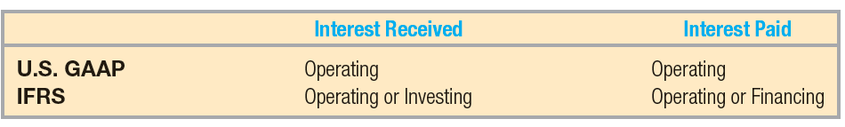
International Perspective—IFRS
Classification of Interest on the Cash Flow Statement
U.S. GAAP and IFRS differ in the cash flow statement treatment of interest received and interest paid.
These differences are currently on the agenda of the joint FASB/IASB financial statement presentation project.
Notes:
U.S. GAAP and IFRS differ in the cash flow statement treatment of interest received and interest paid. Under U.S. GAAP, interest paid and received are both classified as operating cash flows, because the related revenue and expense enter into the computation of net income. This makes it easier to compare net income to cash flow from operations. It also benefits the financial statement user by ensuring comparability across companies. IFRS, on the other hand allows interest received to be classified as either operating or investing and interest paid as operating or financing. This recognizes that interest received results from investing activities and interest paid, like dividends paid, are payments to providers of financing. However, the alternative classifications may be confusing to financial statement readers. These differences are currently on the agenda of the joint FASB/IASB financial statement presentation project.

Slide 24
Quality of Income Ratio
Quality of Income Ratio
Cash Flow from Operating Activities
Net Income
=
In general, this ratio measures the portion of income that was generated in cash. All other things equal, a higher quality of income ratio indicates greater ability to finance operating and other cash needs from
operating cash inflows.
Notes:
The quality of income ratio is computed as cash flow from operating activities divided by net income.
The quality of income ratio measures the portion of income that was generated in cash. All other things equal, a higher quality of income ratio indicates greater ability to finance operating and other cash needs from operating cash inflows. A higher ratio also indicates that it is less likely that the company is using aggressive revenue recognition policies to increase net income, and therefore is less likely to experience a decline in earnings in the future. When this ratio does not equal 1.0, analysts must establish the sources of the difference to determine the significance of the findings.

Slide 25
Notes:
Now, let’s focus on preparing the investing section of the statement of cash flows. Here are the 2010 and 2011 balance sheets for National Beverage that we looked at earlier. The investing accounts are short-term investments and equipment.

Slide 26
We must report individually the cash used to purchase equipment and the cash proceeds received from the sale of equipment.
Notes:
The balance sheet indicates that property, plant, and equipment increased by $541 during the year. However, if you had access to additional company information, you would discover that the company actually purchased $11,389 of new equipment and sold old equipment for its book value of $77. This is offset by $10,771 in depreciation expense (as noted in the operating activities section). In the investing section, we need to show the total amount spent on purchasing equipment.

Slide 27
Although short-term investments is a current asset, it is reported in the investing section on the statement of cash flows.
Notes:
National Beverage’s records also indicate that it purchased $6,532 in short-term investments during the year for cash, which is an investing cash outflow. The company also sold short-term investments for $8,406, an amount equal to their net book value. Together, these investing items explain the $1,874 decrease in short-term investments reported on the balance sheet.

Slide 28
Capital Acquisitions Ratio
Capital Acquisitions Ratio
Cash Flow from Operating Activities
Cash Paid for Property, Plant,
and Equipment
=
In general, this ratio reflects the portion of purchases of property, plant and equipment financed from operating activities. A high ratio indicates less need for outside financing for current and future expansions.
Notes:
The capital acquisition ratio is computed as cash flow from operating activities divided by cash paid for property, plant, and equipment.
The capital acquisitions ratio reflects the portion of purchases of property, plant, and equipment financed from operating activities (without the need for outside debt or equity financing or the sale of other investments or fixed assets). A high ratio indicates less need for outside financing for current and future expansion. It benefits the company because it provides the company opportunities for strategic acquisitions, avoids the cost of additional debt, and reduces the risk of bankruptcy that comes with additional leverage (see Chapter 10).

Slide 29
Free Cash Flow
Free Cash Flow = Cash Flow from Operating Activities – Dividends – Capital Expenditures
In general, this measures a firm’s ability to pursue long-term investment opportunities.
Notes:
Free cash flow is computed as cash flow from operating activities minus dividends minus capital expenditures.
Any positive free cash flow is available for additional capital expenditures, investments in other companies, and mergers and acquisitions without the need for external financing or reductions in dividends to shareholders. While free cash flow is considered a positive sign of financial flexibility, it also can represent a hidden cost to shareholders. Sometimes managers use free cash flow to pursue unprofitable investments just for the sake of growth or to obtain perquisites (such as fancy offices and corporate jets) that do not benefit the shareholders. In these cases, the shareholders would be better off if free cash flow were paid as additional dividends or used to repurchase the company’s stock on the open market.

Slide 30
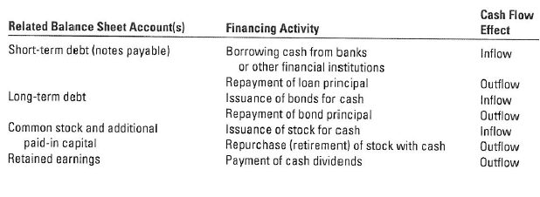

Reporting Cash Flows from Financing Activities
Notes:
Financing activities are associated with generating capital from creditors and owners. This section of the cash flow statement reflects changes in two current liabilities: notes payable to financial institutions (often called short-term debt) and current maturities on long-term debt, as well as changes in long-term liabilities and stockholders’ equity account. These balance sheet accounts relate to the issuance and retirement of debt and stock and the payment of dividends.

Slide 31
Notes:
Here are the 2010 and 2011 balance sheets for National Beverage that we looked at earlier.
National Beverage does not have any short-term debt owed to financial institutions, nor does it have any long-term debt with current maturities.
Analysis of changes in the balance sheet shows that long-term debt, contributed capital, and retained earnings changed during the period.

Slide 32
Cash used to repay long-term debt.
Notes:
During 2011, the company repaid $191 in principal on long-term debt. There were no additional borrowings on long-term debt.

Slide 33
Cash proceeds from the issuance of common stock to employees.
Notes:
National Beverage’s change in contributed capital resulted from two decisions. National Beverage did not repurchase any outstanding stock during the year, but the company did issue common stock to employees and others for $4,324 in cash, which is a financing cash inflow. This accounts for the $4,324 increase in contributed capital (the sum of common stock and additional paid-in capital).

Slide 34
Retained earnings decreased by $65,560 due to the combined effect of $40,754 of income and $106,314 in dividends.
Notes:
Finally, retained earnings should be analyzed. Retained earnings rise when income is earned and fall when dividends are declared and paid. National Beverage earned $40,754 in income and paid $106,314 in dividends during 2011, resulting in a decrease in retained earnings of $65,560 and an ending balance of $65,207.

Slide 35
Interpreting Cash Flows from FINANCING Activities
The long-term growth of a company is normally financed from three sources: internally generated funds, the issuance of stock, and money borrowed on a long-term basis.
The statement of cash flows shows how management has elected to fund its growth. This information is used by analysts who wish to evaluate the capital structure and growth potential of a business.
Notes:
The long-term growth of a company is normally financed from three sources: internally generated funds (cash from operating activities), the issuance of stock, and money borrowed on a long-term basis. As we discussed in Chapter 10, companies can adopt a number of different capital structures (the balance of debt and equity). The financing sources that management uses to fund growth will have an important impact on the firm’s risk and return characteristics. The statement of cash flows shows how management has elected to fund its growth. This information is used by analysts who wish to evaluate the capital structure and growth potential of a business.

Slide 36
Completing the Statement and Additional Disclosures
Three Required Disclosures
Reconciliation of net income to cash flow from operations
Noncash investing and financing activities
Cash paid for interest and income taxes
Notes:
As you can see, when the net increase or decrease in cash and cash equivalents is added to the cash and cash equivalents taken from the beginning of the period balance sheet, it equals the cash and cash equivalents amount reported on the end of the period balance sheet. Companies also must provide two other disclosures related to the statement of cash flows. If the company uses the direct method for computing cash flow from operations, it must present the reconciliation of net income to cash flow from operations.
Certain transactions are important investing and financing activities but have no cash flow effects. These are called noncash investing and financing activities. For example, the purchase of a $100,000 building with a $100,000 mortgage given by the former owner does not cause either an inflow or an outflow of cash. As a result, these noncash activities are not listed in the three main sections of the statement of cash flows. However, supplemental disclosure of these transactions is required, in either narrative or schedule form. National Beverage’s statement of cash flows does not list any noncash investing and financing activities. However, when Continental Airlines purchases airplanes, the manufacturer provides some of the financing for those purchases. These amounts are disclosed at the bottom of its statement of cash flows.
Companies that use the indirect method of presenting cash flows from operations also must provide two other figures: cash paid for interest and cash paid for income taxes. These are normally listed at the bottom of the statement or in the notes.

Slide 37
Supplement A: Reporting Cash Flows from Operating Activities—Direct Method
Notes:
Supplement A: Reporting Cash Flows from Operating Activities—Direct Method
The direct method presents a summary of all operating transactions that result in either a debit or a credit to cash. It is prepared by adjusting each item on the income statement from an accrual basis to a cash basis. This slide summarizes the way to adjust income statement items to a cash basis. For example, when sales are recorded, accounts receivable increases, and when cash is collected, accounts receivable decreases. Thus, to convert sales revenue from the accrual basis to the cash basis we would add a decrease in accounts receivable or subtract an increase in accounts receivable. Take a minute and review the other computations on this slide.

Slide 38
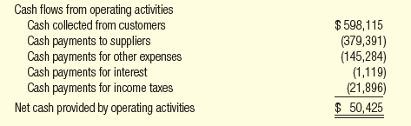
Supplement A: Reporting Cash Flows from Operating Activities—Direct Method
Remember that when we prepared the operating section using the indirect method, we also arrived at net cash inflow of $50,425.
Notes:
This is the operating activities section of the statement of cash flows for National Beverage Corp. prepared using the direct method. Notice that the net cash provided by operating activities of $50,425 is the same as that derived using the indirect method.

Slide 39
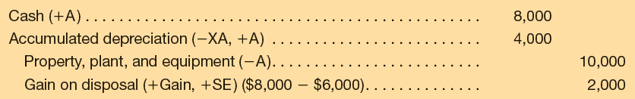
Supplement B: Adjustments for Gains and Losses on Sale of Long-term Assets: Indirect Method
Property, plant, and equipment with an original cost of $10,000 and accumulated depreciation of $4,000 is sold for $8,000 cash.
Because the gain was included in the computation of income, it is necessary to remove (subtract) the $2,000 gain from the Operating Activities section of the statement to avoid double counting.
Notes:
Chapter Supplement B: Adjustments for Gains and Losses on Sale of Long-term Assets: Indirect Method
As noted earlier, the operating activities section of the statement prepared using the indirect method may include an adjustment for gains and losses on sale of long-term assets reported on the income statement. As discussed in Chapter 8, when property, plant, and equipment with an original cost of $10,000 and accumulated depreciation of $4,000 is sold for $8,000 cash, the following entry is made: debit cash $8,000, debit accumulated depreciation $4,000, credit equipment $10,000, and credit gain on disposal $2,000.
The cash inflow of $8,000 is an investing cash inflow, but the reported gain of $2,000 was also shown on the income statement. Because the gain was included in the computation of income, it is necessary to remove (subtract) the $2,000 gain from the Operating Activities section of the statement to avoid double counting.

Slide 40
Supplement c: T-Account Approach (Indirect Method)
Based on the idea that changes in cash must equal the sum of the changes in all other balance sheet accounts. we can use T-accounts to analyze cash flows as follows:
Prepare a single large T-account to represent the changes that have taken place in cash, subdivided into the three sections of the cash flow statement.
Prepare additional T-accounts for all noncash balance sheet accounts, entering the beginning and ending balance in each noncash balance sheet T-Account.
Enter the transactions affecting cash in each noncash balance sheet T-account and in the proper section of the cash T-account until all changes in noncash balance sheet accounts have been account for.
Notes:
Based on the idea that changes in cash must equal the sum of the changes in all other balance sheet accounts, we can use T-accounts to analyze cash flows as follows:
Prepare a single large T-account to represent the changes that have taken place in cash, subdivided into the three sections of the cash flow statement.
Prepare additional T-accounts for all noncash balance sheet accounts, entering the beginning and ending balance in each noncash balance sheet T-Account.
Enter the transactions affecting cash in each noncash balance sheet T-account and in the proper section of the cash T-account until all changes in noncash balance sheet accounts have been account for.

Slide 41
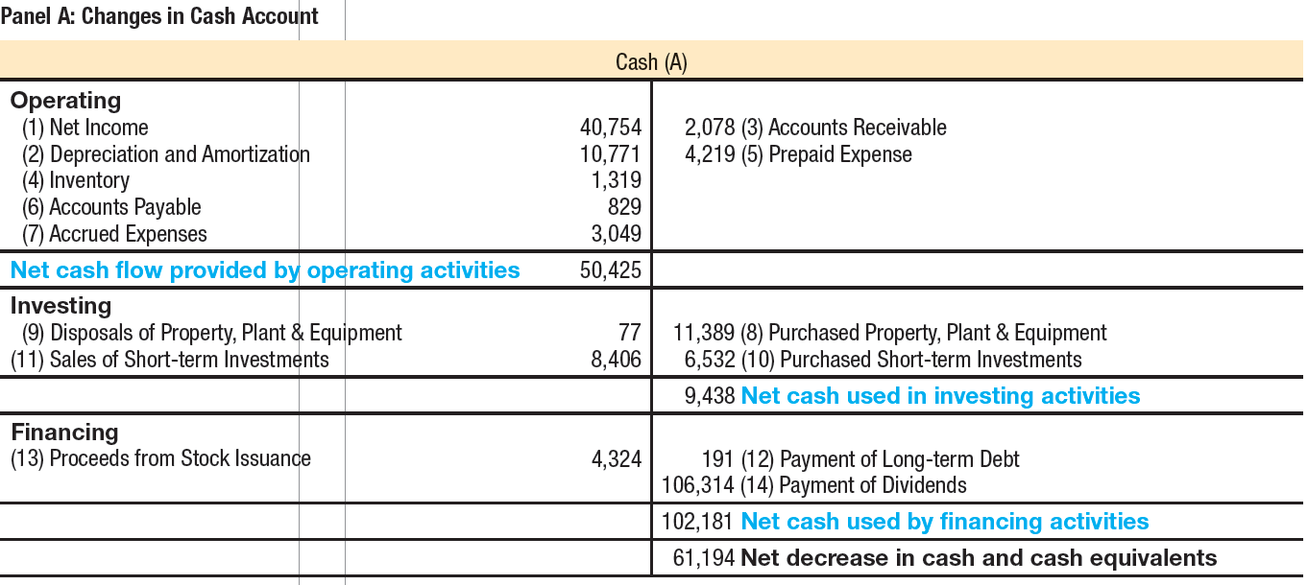
Supplement c: T-Account Approach (Indirect Method)
Notes:
Here is the cash balance sheet T-account for National Beverage Corp. The T-account for cash shows increases in cash as debits and decreases in cash as credits. Notice how each major section of the T-Account matches the three major sections of the statement of cash flows: operating activities, investing activities, and financing activities. Also, notice how each change in the cash T-account has a number referencing the change in the noncash balance sheet T-accounts on the next slide.

Slide 42
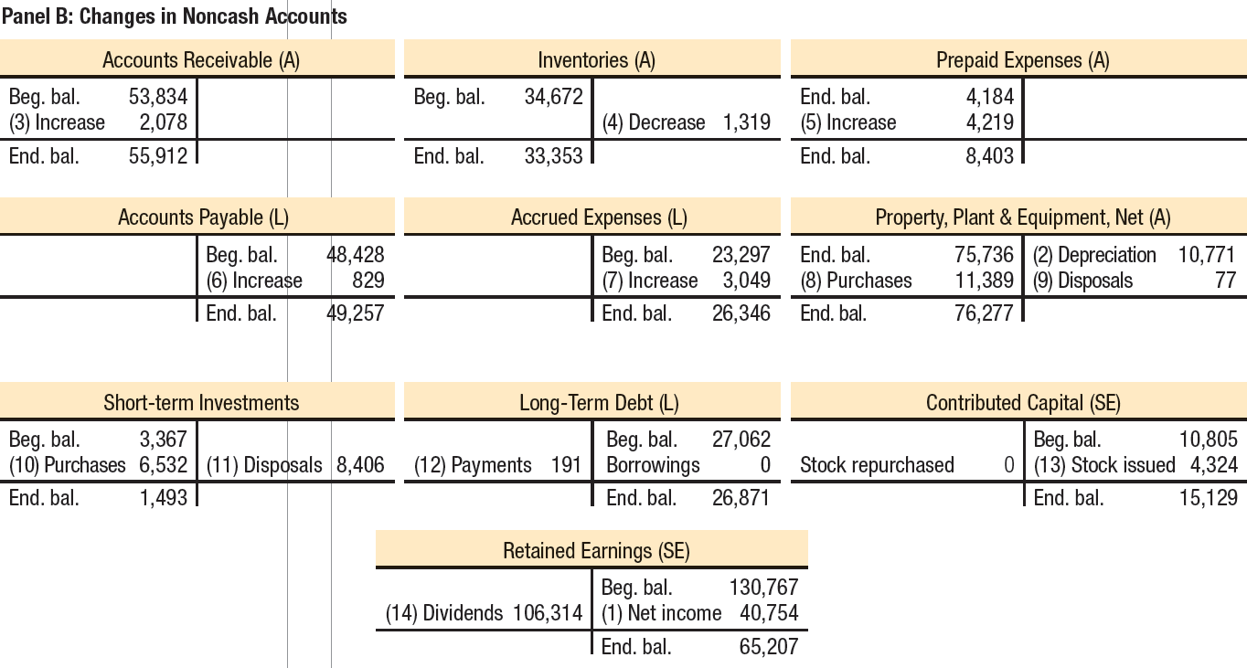
Supplement c: T-Account Approach (Indirect Method)
Notes:
Here are the noncash balance sheet T-accounts for National Beverage Corp. Notice how each change in the noncash balance sheet T-accounts has a number referencing the change in the cash T-account on the preceding slide.

Slide 43

End of Chapter 12
Notes:
End of chapter 12.

