Slide 1

Chapter 6
Reporting and Interpreting Sales Revenue, Receivables, and Cash
McGraw-Hill/Irwin
Copyright © 2014 by The McGraw-Hill Companies, Inc. All rights reserved.
Notes:
Chapter 6: Reporting and Interpreting Sales Revenue, Receivables and Cash

Slide 2
Accounting for net Sales Revenue
The revenue realization principle requires that
revenues be recorded when earned.
Goods have been delivered or services have been rendered.
There is persuasive evidence of an arrangement for customer payment.
Price is fixed or determinable.
Collection is
reasonably assured.
Notes:
The revenue realization principle requires that revenues be recorded when earned. Revenues are considered to be earned when the following conditions are met:
1. Goods have been delivered or services have been rendered.
2. There is persuasive evidence of an arrangement for customer payment.
3. The price for the goods or services is fixed or determinable.
4. Collection from the customer is reasonably assured.

Slide 3

Credit Card Sales to Consumers
Companies accept credit cards for several reasons:
To increase sales.
To avoid costs of providing credit directly to customers.
To avoid losses due to bad checks.
To avoid losses due to fraudulent credit card sales.
To receive payment quicker.
When credit card sales are made, the company must pay the credit card company a fee for the service it provides.
Notes:
Companies accept credit cards for several reasons:
To increase sales.
To avoid costs of providing credit directly to customers.
To avoid losses due to bad checks.
To avoid losses due to fraudulent credit card sales.
To receive payment quicker.
When credit card sales are made, the company must pay the credit card company a fee for services provided by the credit card company. In our example, the credit card company charges the company of fee of three percent of credit card sales revenue.

Slide 4
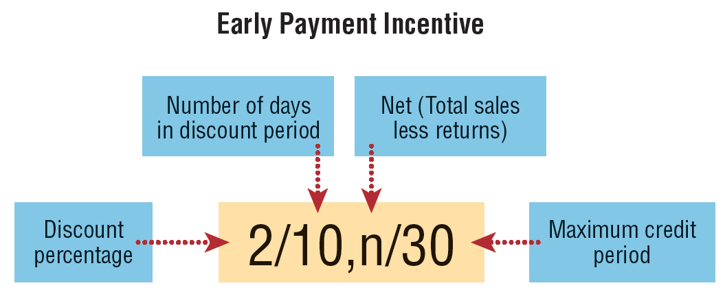
Sales Discounts to Businesses
When customers purchase on open account, they may be offered a sales discount to encourage early payment.
Read as: “Two ten, net thirty”
Notes:
Customers, purchasing on open account, are sometimes offered a sales discount to encourage early payment. The sales discount terms are typically written as this slide shows. This particular discount term would be read as “two ten, net thirty.”
The first number represents the discount percentage, 2 percent.
The second number represents the discount period, 10 days.
The letter “n” stands for the word net, the total sales less any returns.
The last number represents the maximum days in the credit period.
In this case, if the customer pays within 10 days, then a 2 percent discount may be deducted from the invoice amount. If not, then the net amount is due within 30 days.

Slide 5
To Take or Not to Take the Discount, That is the Question
With discount terms of 2/10,n/30, a customer
saves $2 on a $100 purchase by paying
on the 10th day instead of the 30th day.
Amount Saved
Amount Paid
Interest Rate for 20 Days =
$2
$98
Interest Rate for 20 Days =
= 2.04%
Annual Interest Rate =
365 Days
20 Days
× 2.04% = 37.23%
Notes:
With discount terms of 2/10,n/30, a customer saves $2 on a $100 purchase by paying by the 10th day instead of the 30th day. If not paid until the thirtieth day, the customer has incurred $2 of interest on a $98 debt for twenty days. The annualized interest rate for the decision to defer payment for 20 days is 37.23 percent. Even if the customer had to borrow money to be able to pay in time to take the discount, as long as the interest rate is less than 37 percent, the money should be borrowed to avoid paying 37 percent interest.

Slide 6
Sales Returns and Allowances
Customers have a right to return unsatisfactory or damaged merchandise and receive a refund or an adjustment to their bill. Such returns are often accumulated in a separate account called Sales Returns and Allowances.
Damaged Merchandise
Returned Merchandise
Notes:
Customers have a right to return unsatisfactory or damaged merchandise and receive a refund or an adjustment to their bill. Such returns are often accumulated in a separate account called Sales Returns and Allowances and must be deducted from gross sales revenue in determining net sales.

Slide 7
Reporting Net Sales
Companies record credit card discounts,
sales discounts, and sales returns and allowances separately to allow management
to monitor these transactions.
Notes:
Companies record credit card discounts, sales discounts, and sales returns and allowances separately to allow management to monitor these transactions. Credit card discounts, sales discounts, and sales returns and allowances are deducted from sales revenue in the income statement to arrive at net sales.

Slide 8
Measuring and Reporting Receivables
Accounts receivable are created when companies have sales to customers on open accounts.
Notes receivable are written promises from another party to pay with specified terms.
Trade receivables are amounts owed to the business for credit sales of goods or services.
Nontrade receivables are amounts owed to the business for other than business transactions.
Balance Sheet Classifications
Current (short term)
Noncurrent (long term)
Notes:
Receivables may be classified in three ways.
First, they may be classified as either an Account Receivable or a Note Receivable. An account receivable is created when companies allow customers to purchase merchandise on an open account and the customer promises to pay the company in the future for the purchase. A note receivable is a promise, in writing, that requires another party to pay the company a specified amount, at a specified date, with a stated amount of interest.
Receivables may also be classified as either trade receivables or nontrade receivable. Trade receivables are amounts owed to the business for credit sales of goods or services. Nontrade receivables are amounts owed to the business for other than business transactions. For example, personal loans to employees are nontrade receivables.
Also, on a classified balance sheet, receivables must be presented as either current (short-term) or noncurrent (long-term) based on when the cash is expected to be collected.

Slide 9
Accounting for Bad Debts
Bad debts result from credit customers who will not pay the amount they owe, regardless of collection efforts.
Bad Debt Expense
Record in same accounting period.
Matching Principle
Sales Revenue
Most businesses record an estimate of the bad debt expense with an adjusting entry at the end of the accounting period.
Allowance Method
Notes:
When a company extends credit to customers, it knows that some of these customers will not pay their debts. The expense matching principle requires recording of bad debt expense in the same accounting period in which the related sales are made. This presents an important accounting problem. A company may not learn which particular customers will not pay until the next accounting period. So, at the end of the period of sale, the company normally does not know which customers’ accounts receivable are bad debts.
This problem is resolved by using the allowance method to measure bad debt expense. The allowance method is based on estimates of the expected amount of bad debts. Most businesses record an estimate of the bad debt expense with an adjusting entry at the end of the accounting period.

Slide 10
Recording Bad Debt Expense Estimates
Deckers estimated bad debt expense for 2011 to be $75,995. Prepare the adjusting entry.
Contra-asset account
Bad debt expense is normally classified as a selling expense and is closed at year-end.
Notes:
Bad debt expense is the expense associated with estimated uncollectible accounts receivable. An adjusting journal entry at the end of the accounting period records the bad debt estimate.
For the year ended December 31, 2011, Deckers estimated Bad Debt Expense to be $75,995. In the adjusting entry, Deckers debits bad debt expense and credits Allowance for Doubtful Accounts for $75,995.
Bad debt expense is included in the category “Selling” expenses on the income statement. It decreases net income and stockholders’ equity. Allowance for Doubtful Accounts, a contra-asset, is subtracted from the balance of the asset accounts receivable on the balance sheet.

Slide 11

Writing Off Specific Uncollectible Accounts
When it is clear that a specific customer’s account receivable will be uncollectible, the amount should be removed from the Accounts Receivable account and charged to the Allowance for Doubtful Accounts.
Deckers’ total write-offs for 2011 were $68,075.
Prepare a summary journal entry for these write-offs.
Notes:
Throughout the year, when it is determined that a customer will not pay its debts (e.g., due to bankruptcy), the write-off of that individual bad debt is recorded through a journal entry. Now that the specific uncollectible customer account receivable has been identified, it can be removed with a credit. At the same time, the related estimate is no longer needed in the contra-asset Allowance for Doubtful Accounts, which is removed by a debit.
When using the allowance method, we write off the specific uncollectible accounts to Allowance for Doubtful Accounts by debiting Allowance for Doubtful Accounts and crediting Accounts Receivable for $68,075.

Slide 12
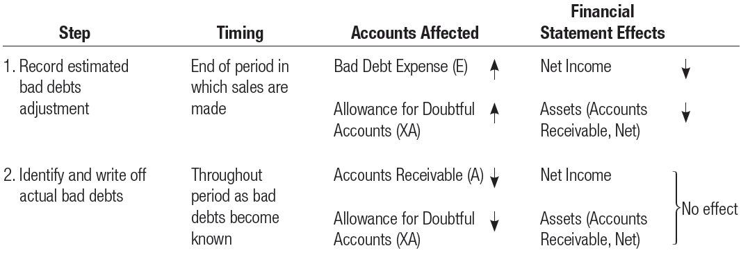
Summary of the Accounting Process
Accounting for bad debts is a two step process.
Notes:
It is important to remember that accounting for bad debts is a two-step process:
1. Record the estimated bad debts adjustment.
2. Identify and write off actual bad debts.

Slide 13
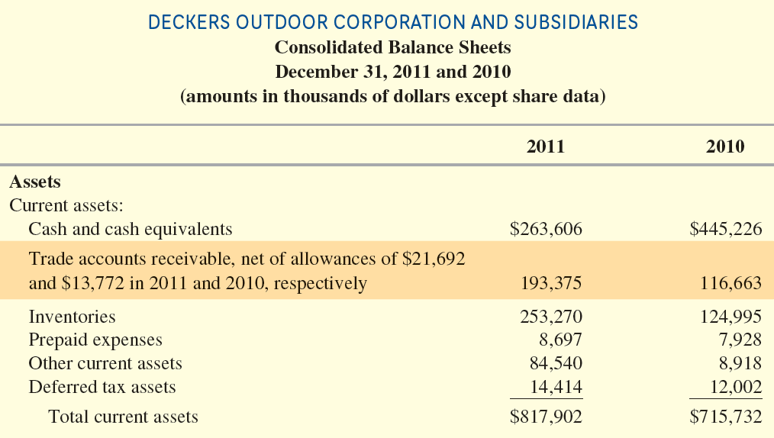
Reporting Accounts receivable and bad debts
Notes:
Analysts who want information on Deckers' receivables will find Accounts Receivable, net of allowance for doubtful accounts (the net book value), of $193,375 and $116,663 for 2011 and 2010, respectively, reported on the balance sheet. Deckers reports the balance in the Allowance for Doubtful Accounts ($21,692 in 2011 and $13,772 in 2010) within the account title.

Slide 14

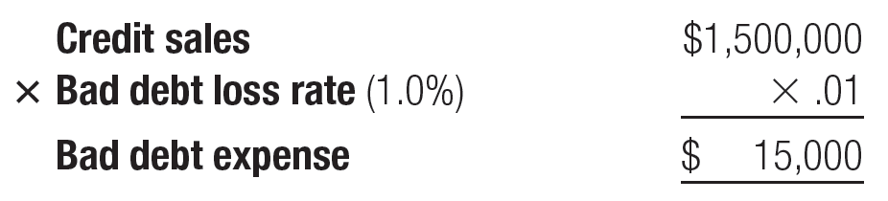
Estimating Bad Debts ─
Percentage of Credit Sales Method
Bad debt percentage is based on historical percentage of credit sales that result in bad debts.
Notes:
The bad debt expense amount recorded in the end-of-period adjusting entry often is estimated based on either (1) a percentage of total credit sales for the period or (2) an aging of accounts receivable. Both methods are acceptable under GAAP and are widely used.
The percentage of credit sales method bases bad debt expense on the historical percentage of credit sales that result in bad debts. The average percentage of credit sales that result in bad debts can be computed by dividing total bad debt losses by total credit sales. A company that has been operating for some years has sufficient experience to project probable future bad debt losses.
For example, if we assume that, during the year 2012, Deckers expected bad debt losses of 1.0 percent of credit sales, and its credit sales were $1,500,000, it would estimate the current year’s bad debt expense as $15,000.

Slide 15
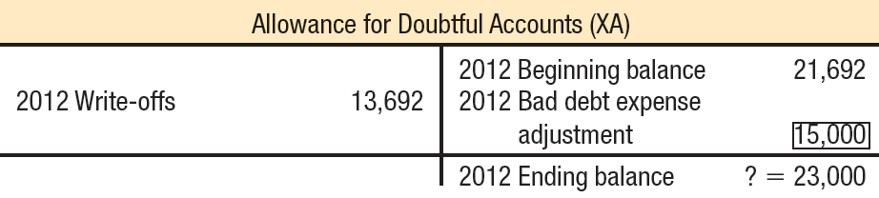
Estimating Bad Debts ─
Percentage of Credit Sales Method
The focus of the percentage of credit sales method is on determining the amount to record on the income statement as Bad Debt Expense.
Notes:
The focus of the percentage of credit sales method is on determining the amount to record on the income statement as bad debt expense. The calculated amount of $15,000 would be directly recorded as a debit to Bad Debt Expense and a credit to Allowance for Doubtful Accounts in the current year.
Notice that when we examine the Allowance for Doubtful Accounts, the amount of the bad debt expense adjusting entry increases the account with a credit entry to the account. The ending balance for the account must be calculated.

Slide 16

Estimating Bad Debts ─
aging of accounts receivable
The focus of the aging of accounts receivable method is on determining the desired balance in the Allowance for Doubtful Accounts on the balance sheet.
Notes:
The aging of accounts receivable method relies on the fact that, as accounts receivable become older and more overdue, it is less likely that they will be collected. For example, a receivable that was due in 30 days but has not been paid after 120 days is less likely to be collected, on average, than a similar receivable that remains unpaid after 45 days. The focus of the aging of accounts receivable method is on determining the desired balance in the Allowance for Doubtful Accounts on the balance sheet.

Slide 17
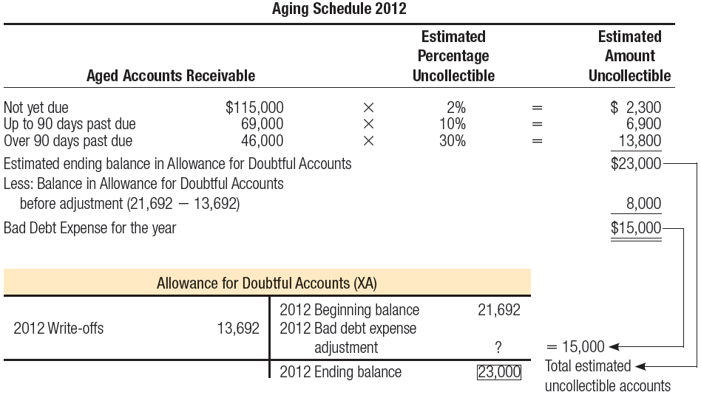
Estimating Bad Debts ─
aging of accounts receivable
Notes:
For example, Deckers split its assumed 2012 ending balance in accounts receivable into three age categories. Then individual customer accounts receivable are examined and sorted into the three age categories. Based on prior experience, management would then estimate the probable bad debt loss rates for each category: for example, not yet due, 2 percent; 1 to 90 days past due, 10 percent; over 90 days, 30 percent.
The aging schedule would result in an estimate of total uncollectible amounts of $23,000, the estimated ending balance that should be in the Allowance for Doubtful Accounts. From this, the adjustment to record Bad Debt Expense (and an increase in Allowance for Doubtful Accounts) for 2012 would be computed as $15,000.

Slide 18
Control over accounts receivable
Practices That Can Help Minimize Bad Debts
Require approval of customers’ credit by a person independent of the sales and collections functions.
Age accounts receivable periodically and contact customers with overdue payments.
Reward both sales and collections personnel for speedy collections.
Notes:
Many managers forget that extending credit will increase sales volume, but unless the related receivables are collected, they do not add to the bottom line. Companies that emphasize sales without monitoring the collection of credit sales soon find much of their current assets tied up in accounts receivable. The following practices can help minimize bad debts:
1. Require approval of customers’ credit history by a person independent of the sales and collections functions.
2. Age accounts receivable periodically and contact customers with overdue payments.
3. Reward both sales and collections personnel for speedy collections so that they work as a team.

Slide 19
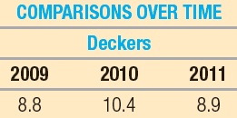



Receivables Turnover
This receivables turnover ratio measures how many times average receivables are recorded and collected for the year.
Deckers 2011
Notes:
To assess the effectiveness of overall credit-granting and collection activities, managers and analysts often compute the receivables turnover ratio.
The receivables turnover ratio reflects how many times average trade receivables are recorded and collected during the period. The higher the ratio, the faster the collection of receivables. A higher ratio benefits the company because it can invest the money collected to earn interest income or reduce borrowings to reduce interest expense. Overly generous payment schedules and ineffective collection methods keep the receivables turnover ratio low. Analysts and creditors watch this ratio because a sudden decline may mean that a company is extending payment deadlines in an attempt to prop up lagging sales or is even recording sales that will later be returned by customers.
Many managers and analysts compute the related number average collection period or average days sales in receivables, which is equal to 365 divided by the Receivables Turnover Ratio. It indicates the average time it takes a customer to pay its accounts. For Deckers, the amount would be computed as 41.0 days for 2011.

Slide 20

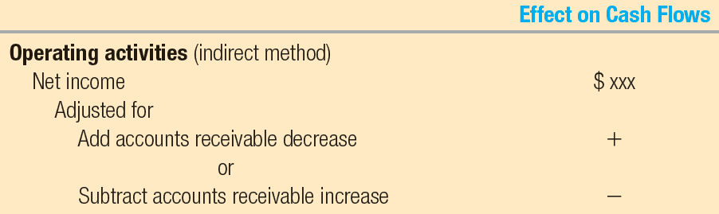
Focus on Cash Flows
Add Decrease in Accounts Receivable
Sales
Revenue
Cash Collected from Customers
Subtract Increase in Accounts Receivable
Excerpt from Cash Flow Statement
Notes:
When there is a decrease in accounts receivable for the year, cash collections from customers are more than sales revenue. When there is an increase in accounts receivable for the year, cash collections from customers are less than sales revenue.
Using the indirect method of preparing the cash flow from operating activities portion of the statement of cash flows, we add a decrease in accounts receivable to reported net income. Using the indirect method of preparing the cash flow from operating activities portion of the statement of cash flows, we subtract an increase in accounts receivable from reported net income.

Slide 21
Cash and Cash Equivalents
Money
Checks
Cash
Money Orders
Bank Drafts
Cash Equivalents
Certificates of Deposit
T-Bills
Notes:
Cash is defined as money or any instrument that banks will accept for deposit and immediate credit to a company’s account, such as a check, money order, or bank draft. Cash equivalents are investments with original maturities of three months or less that are readily convertible to cash and whose value is unlikely to change (that is, they are not sensitive to interest rate changes). Typical instruments included as cash equivalents are bank certificates of deposit and Treasury bills that the U.S. government issues to finance its activities.

Slide 22
Cash management
Cash Management Procedures
Accurate accounting so that reports of cash flows and balances may be prepared.
Controls to ensure
that enough cash is available to meet current operating needs, maturing liabilities, and unexpected emergencies.
Prevention of the accumulation of excess amounts of idle cash.
Notes:
Many businesses receive a large amount of cash, checks, and credit card receipts from their customers each day. Anyone can spend cash, so management must develop procedures to safeguard the cash it uses in the business. Effective cash management involves more than protecting cash from theft, fraud, or loss through carelessness. Other cash management responsibilities include:
1. Accurate accounting so that reports of cash flows and balances may be prepared.
2. Controls to ensure that enough cash is available to meet current operating needs, maturing liabilities, and unexpected emergencies.
3. Prevention of the accumulation of excess amounts of idle cash. Idle cash earns no revenue. Therefore, it is often invested in securities to earn a return until it is needed for operations.

Slide 23
Internal Control of Cash
Internal control refers to policies and procedures designed to:
Safeguard assets.
Provide reasonable assurance on the reliability of financial records.
Provide reasonable assurance on the effectiveness and efficiency of operations.
Provide reasonable assurance on the compliance with laws and regulations.
Cash is the asset most vulnerable to theft and fraud.
Notes:
The term internal controls refers to the process by which a company safeguards its assets and provides reasonable assurance regarding the reliability of the company’s financial reporting, the effectiveness and efficiency of its operations, and its compliance with applicable laws and regulations. Controls that ensure the accuracy of the financial records are designed to prevent inadvertent errors and outright fraud. Because internal control increases the reliability of the financial statements, it is reviewed by the outside independent auditor.
Because cash is the asset most vulnerable to theft and fraud, a significant number of internal control procedures should focus on cash. You have already observed internal control procedures for cash, although you may not have known it at the time. At most movie theaters, one employee sells tickets and another employee collects them. Having one employee do both jobs would be less expensive, but that single employee could easily steal cash and admit a patron without issuing a ticket. If different employees perform the tasks, a successful theft requires the participation of both.

Slide 24
Internal Control of Cash
Separate jobs of receiving cash and disbursing cash.
Separation
of Duties
Separate procedures of accounting for cash receipts and cash disbursements.
Separate the physical handling of cash and all phases of the accounting function.
Require that all cash receipts be deposited in a bank daily.
Require separate approval of the purchases and the actual cash payments.
Policies and Procedures
Assign responsibilities for cash payment approval and check-signing to different individuals.
Require monthly reconciliation of bank accounts with the cash accounts on the company’s books.
Notes:
Effective internal control of cash should include the following:
1. Separation of duties.
a. Complete separation of the jobs of receiving cash and disbursing cash.
b. Complete separation of the procedures of accounting for cash receipts and cash disbursements.
c. Complete separation of the physical handling of cash and all phases of the accounting function.
2. Prescribed policies and procedures.
a. Require that all cash receipts be deposited in a bank daily. Keep any cash on hand under strict control.
b. Require separate approval of the purchases and the actual cash payments. Prenumbered checks should be used. Special care must be taken with payments by electronic funds transfers since they involve no controlled documents (checks).
c. Assign the responsibilities for cash payment approval and check-signing or electronic funds transfer transmittal to different individuals.
d. Require monthly reconciliation of bank accounts with the cash accounts on the company’s books.

Slide 25
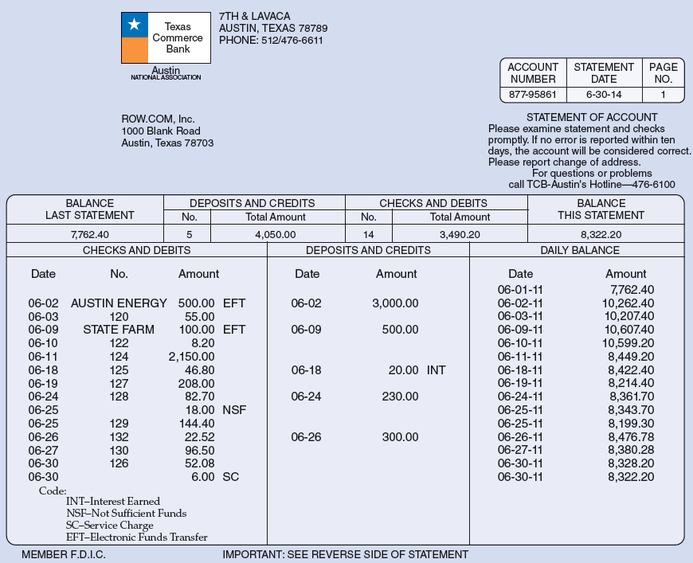
Content of a bank statement
Interest Earned (INT)
Electronic Funds Transfer (EFT)
Not Sufficient Funds (NSF)
Service Charge (SC)
Notes:
Proper use of the bank accounts can be an important internal cash control procedure. Each month, the bank provides the company with a bank statement that lists (1) each paper or electronic deposit recorded by the bank during the period, (2) each paper or electronic check cleared by the bank during the period, and (3) the balance in the company’s account. The bank statement also shows the bank charges or deductions (such as service charges) made directly to the company’s account by the bank.
A few items may need explanation.
The code for electronic funds transfers is EFT. When a company uses electronic payments, it records these items on the company’s books in the same manner as a paper check.
Notice that listed in the Checks and Debits column there is a deduction coded NSF. This entry refers to a check for $18 received from a customer, but when processed through banking channels to the customer’s bank, the account did not have sufficient funds to cover the check. This type of check often is called an NSF check (not sufficient funds). This will now be a receivable for the company.
Notice the item coded SC in the Checks and Debits column. This is the code for bank service charges code for bank service charges. This amount will need to recorded as an expense.
Notice the INT code in the Deposits and Credits column. This indicates interest earned based on the bank paying interest on checking account balances. This amount must be recorded by the company as Interest Income.

Slide 26
Need for Reconciliation
Explains the difference between cash reported on bank statement and cash balance on company’s books.
Reasons:
Timing Differences
  Transactions recorded in the books but not shown on the bank statement.
  Transactions shown on the bank statement but not recorded in the books.
Errors in Recording Transactions
Outstanding Checks
Bank Service Charges
Interest Earned
Deposits in Transit
NSF Checks
Errors
Notes:
A bank reconciliation is the process of comparing (reconciling) the ending cash balance in the company’s records and the ending cash balance reported by the bank on the monthly bank statement. Usually, the ending cash balance as shown on the bank statement does not agree with the ending cash balance shown by the related Cash ledger account on the books of the company.
Why are the balances different on the bank statement and on the cash ledger?
Most of the difference exists because of timing differences in the recording of transactions.
a) Some transactions affecting cash were recorded in the books of the company but were not shown on the bank statement.
b) Some transactions were shown on the bank statement but had not been recorded in the books of the company.
2. Some of the difference may also be caused by errors in recording transactions.
The most common causes of differences between the ending bank balance and the ending
book balance of cash are as follows:
1. Outstanding checks.
2. Deposits in transit.
3. Bank service charges.
4. NSF checks.
5. Interest earned.
6. Errors.

Slide 27
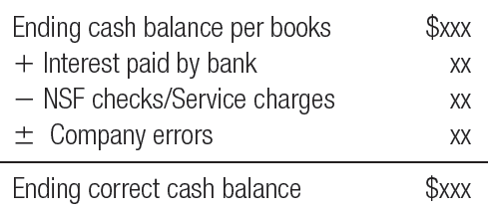
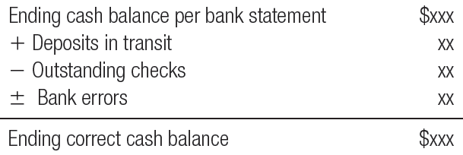

Bank Reconciliation illustrated
General Format of Bank Reconciliation
Notes:
The general format of a bank reconciliation consists of two sections. In one section, the ending cash balance per the books is adjusted to determine the ending correct cash balance. In the other section, the cash balance per the bank statement is adjusted to determine the ending correct cash balance. The final correct cash balances in both sections should be equal.
In the first section, the reconciliation starts with the cash balance in the ledger and adjusts it for items such as interest earned, NSF checks, bank service charges, and any errors made by the company.
In the second section, the reconciliation starts with the cash balance on the bank statement and adjusts it for outstanding checks, deposits in transit, and errors made by the bank.

Slide 28
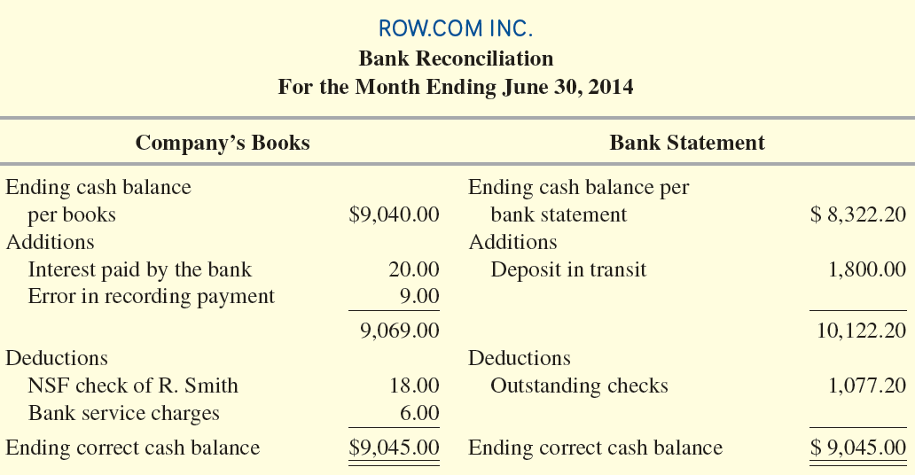
Bank Reconciliation illustrated
Example of a Bank Reconciliation
Notes:
Consider a bank reconciliation prepared by ROW.COM for the month of June to reconcile the ending bank balance ($8,322.20) with the ending book balance ($9,040.00). On the completed reconciliation, the correct cash balance is $9,045.00. This correct balance is the amount that should be shown in the Cash account after the reconciliation.
These steps were completed to prepare the bank reconciliation:
Identify outstanding checks. This total appears on the reconciliation as a deduction from the bank account.
Identify deposits in transit. This amount appears on the reconciliation as an addition to the bank account.
Record bank charges and credits.
a. Interest received from the bank, $20—entered on the bank reconciliation as an addition to the book balance; it already has been included in the bank balance.
b. NSF check of R. Smith, $18—entered on the bank reconciliation as a deduction from the book balance; it has been deducted from the bank statement balance.
c. Bank service charges, $6—entered on the bank reconciliation as a deduction from the book balance; it has been deducted from the bank balance.
4. Determine the impact of errors. An electronic payment for $100 to pay an account payable was recorded in the company’s accounts as $109. Therefore, $9 must be added to the book cash balance on the reconciliation; the bank cleared the electronic payment for the correct amount, $100.
Note that the two sections of the bank reconciliation agree at a correct cash balance of $9,045.00.

Slide 29
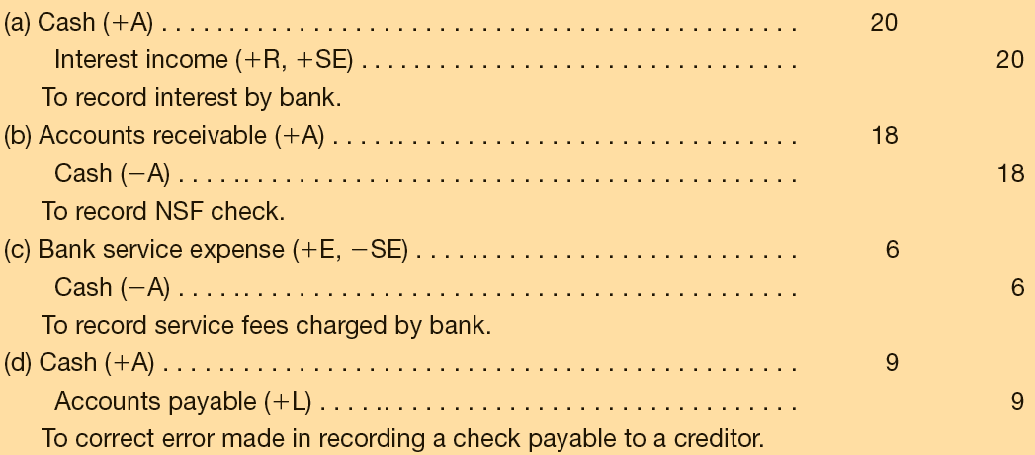
Bank Reconciliation illustrated
The bank reconciliation identifies previously unrecorded transactions or changes that are necessary to cause the company’s Cash account(s) to show the correct cash balance. Any transactions or changes on the company’s books side of the bank reconciliation need journal entries.
Notes:
A bank reconciliation accomplishes two major objectives:
It checks the accuracy of the bank balance and the company cash records, which involves developing the correct cash balance. The correct cash balance (plus cash on hand, if any) is the amount of cash that is reported on the balance sheet.
It identifies any previously unrecorded transactions or changes that are necessary to cause the company’s Cash account(s) to show the correct cash balance. Any transactions or changes on the company’s books side of the bank reconciliation need journal entries.
In this example, four journal entries based on the company’s books side of the bank reconciliation must be entered into the company’s records.

Slide 30
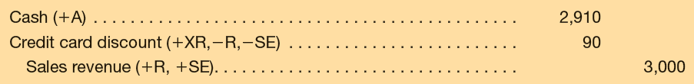

Chapter Supplement: Recording Discounts and Returns
Assume a credit card company is charging a 3 percent fee for its service and Deckers' Internet credit card sales are $3,000 for January 2.
Prepare the journal entry.
Notes:
In this chapter, both credit card discounts and cash discounts have been recorded as contra-revenues.
Assume a credit card company is charging a 3 percent fee for its service and Deckers' Internet credit card sales are $3,000 for January 2.
The sale would be recorded with a journal entry showing a debit to Cash, a debit to the Credit Card Discount, and a credit to Sales Revenue.

Slide 31
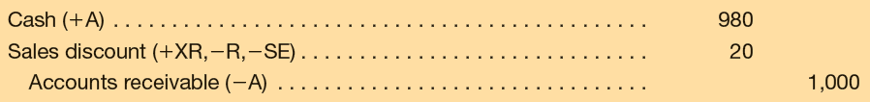
Chapter Supplement: Recording Discounts and Returns
Similarly, assume that credit sales of $1,000 are recorded with terms 2/10, n/30, and payment is made within the discount period.
Prepare the journal entries.
Notes:
Similarly, assume that credit sales of $1,000 are recorded with terms 2/10, n/30, and payment is made within the discount period. Deckers will make the following journal entries.
The sale would be recorded with journal entry showing a debit to Accounts Receivable and a credit to Sales Revenue.
The collection of cash would be recorded with a debit to Cash, a debit showing the Sales Discount, and a credit to Accounts Receivable.

Slide 32
Chapter Supplement: Recording Discounts and Returns
Sales returns and allowances should always be treated as a contra-revenue.
Assume that Fontana Shoes of Ithaca, New York, buys 40 pairs of sandals from Deckers for $2,000 on account. Before paying for the sandals, however, Fontana discovers that 10 pairs of sandals are not the color ordered and returns them to Deckers.
Prepare the journal entries.
Notes:
Sales returns and allowances should always be treated as a contra-revenue. Assume that Fontana Shoes of Ithaca, New York, buys 40 pairs of sandals from Deckers for $2,000 on account. Before paying for the sandals, however, Fontana discovers that 10 pairs of sandals are not the color ordered and returns them to Deckers.
The sale would be recorded with journal entry showing a debit to accounts receivable and a credit to sales revenue.
The return of 10 shoes would be recorded with a debit to sales returns and allowances, and a credit to accounts receivable.

Slide 33

End of Chapter 6
Notes:
End of chapter 6.

