Slide 1

Chapter 4
Adjustments, Financial statements, and the quality of earnings
McGraw-Hill/Irwin
Copyright © 2014 by The McGraw-Hill Companies, Inc. All rights reserved.
Notes:
Chapter 4: Adjustments, financial statements, and the quality of earnings. Managers of most companies understand the need to present financial information fairly so as not to mislead users. However, since end-of-period adjustments are the most complex portion of the annual recordkeeping process, they are prone to error. External auditors examine the company’s records on a test, or sample, basis. To maximize the chance of detecting any errors significant enough to affect users’ decisions, CPAs allocate more of their testing to transactions most likely to be in error.

Slide 2
Understanding the Business
Management is responsible for preparing . . .
Financial
Statements
High Quality = Relevance + Reliability
. . . useful to investors and creditors.
4-2
Notes:
Management bears the ultimate responsibility for the preparation of financial statements. High quality financial statements are those that are considered relevant and reliable to the user.

Slide 3
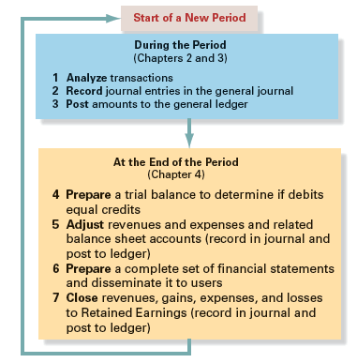
Accounting Cycle
4-3
Notes:
Here is another look at the accounting cycle that we previewed in the last chapter. In this chapter, we will devote a significant amount of time learning about adjusting entries.

Slide 4
Unadjusted Trial Balance
A listing of individual accounts, usually in financial statement order.
Ending debit or credit balances are listed in two separate columns.
Total debit account balances should equal total credit account balances.
4-4
Notes:
The trial balance is a listing of all of the account balances in our general ledger. The total of all debit balance accounts should equal the total of all credit balance accounts. When this occurs we can say that the books are in balance.

Slide 5
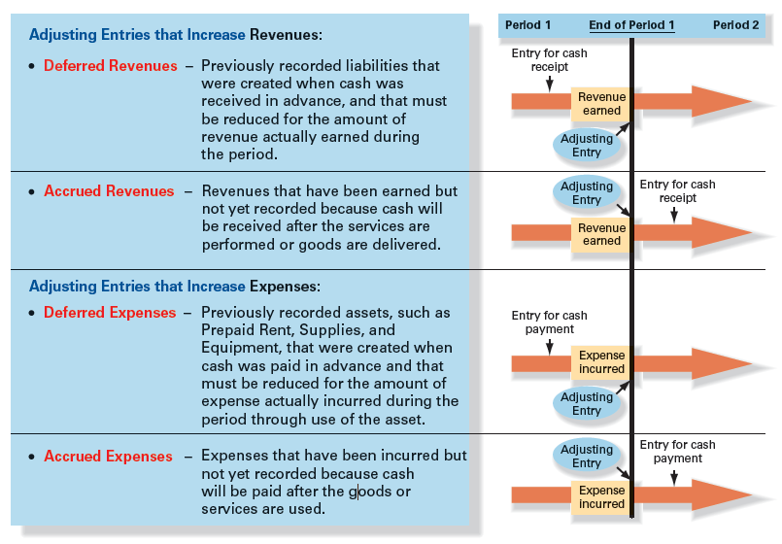
Four types of adjustments
4-5
Notes:
Four types of adjustments (two in which cash was already received or paid and two in which cash will be received or paid). Because of the timing of the cash receipts or payments, each of these types of adjustments involves two entries:
• One for the cash receipt or payment either before or after the end of the period.
• One for the adjustment to record the revenue or expense in the proper period (the adjusting entry).
ADJUSTING ENTRIES are entries necessary at the end of the accounting period to properly measure all revenues and expenses of that period.

Slide 6
Adjusting entries
How does the accounting system record revenues and expenses when one transaction is needed to record a cash receipt or payment and another transaction is needed to record revenue when it is earned or an expense when it is incurred? The solution to the problem created by such differences in timing is to record adjusting entries at the end of every accounting period, so that:
Revenues are recorded when they are earned (the revenue realization principle),
Expenses are recorded when they are incurred to generate revenue (the expense matching principle),
Assets are reported at amounts that represent the probable future benefits remaining at the end of the period, and
Liabilities are reported at amounts that represent the probable future sacrifices of assets or services owed at the end of the period.
Companies wait until the end of the accounting period to adjust their accounts in this way because adjusting the records daily would be very costly and time-consuming. Adjusting entries are required every time a company wants to prepare financial statements for external users.
4-6
Notes:
How does the accounting system record revenues and expenses when one transaction is needed to record a cash receipt or payment and another transaction is needed to record revenue when it is earned or an expense when it is incurred? The solution to the problem created by such differences in timing is to record adjusting entries at the end of every accounting period, so that:
Revenues are recorded when they are earned (the revenue realization principle),
Expenses are recorded when they are incurred to generate revenue (the expense matching principle),
Assets are reported at amounts that represent the probable future benefits remaining at the end of the period, and
Liabilities are reported at amounts that represent the probable future sacrifices of assets or services owed at the end of the period.
Companies wait until the end of the accounting period to adjust their accounts in this way because adjusting the records daily would be very costly and time-consuming. Adjusting entries are required every time a company wants to prepare financial statements for external users.

Slide 7
Adjustment process
In analyzing adjustments at the end of the period, there are three steps:
Step 1: Ask: Was revenue earned or an expense incurred that is not yet recorded?
If the answer is YES, credit the revenue account or debit the expense account in the adjusting entry.
Step 2: Ask: Was the related cash received or paid in the past or will it be received or paid in the future?
If cash was received in the past, a deferred revenue (liability) account was recorded in the past → Now, reduce the liability account that was recorded when cash was received.
If cash will be received in the future → Increase the receivable account to record what is owed by others to the company.
If cash was paid in the past, a deferred expense account was created in the past → Now reduce the asset account.
If cash will be paid in the future → Increase the payable account to record what is owed by the company to others.
Step 3: Compute the amount of revenue earned or expense incurred. Sometimes the amount is given or known, sometimes it must be computed, and sometimes it must be estimated.
4-7
Notes:
In analyzing adjustments at the end of the period, there are three steps:
Step 1: Ask: Was revenue earned or an expense incurred that is not yet recorded?
If the answer is YES, credit the revenue account or debit the expense account in the adjusting entry.
Step 2: Ask: Was the related cash received or paid in the past or will it be received or paid in the future?
If cash was received in the past, a deferred revenue (liability) account was recorded in the past → Now, reduce the liability account that was recorded when cash was received.
If cash will be received in the future → Increase the receivable account to record what is owed by others to the company.
If cash was paid in the past, a deferred expense account was created in the past → Now reduce the asset account.
If cash will be paid in the future → Increase the payable account to record what is owed by the company to others.
Step 3: Compute the amount of revenue earned or expense incurred. Sometimes the amount is given or known, sometimes it must be computed, and sometimes it must be estimated.

Slide 8
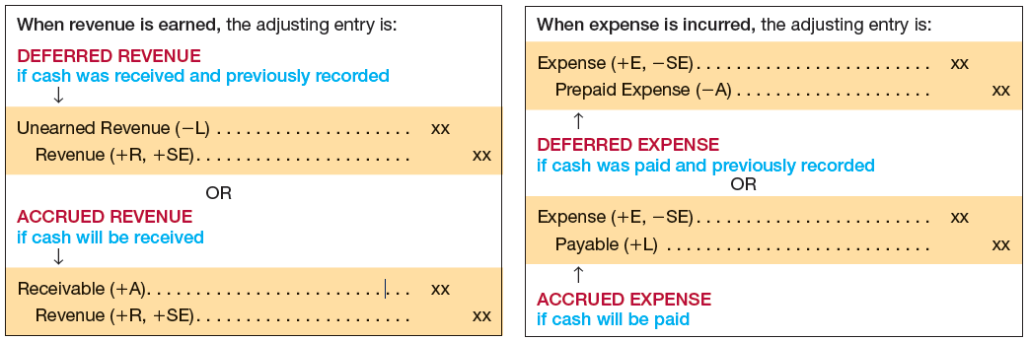
Summary
In summary, the pattern that results when the adjusting entry is recorded is as follows:
4-8
Notes:
In summary, the pattern that results when the adjusting entry is recorded is shown above.

Slide 9
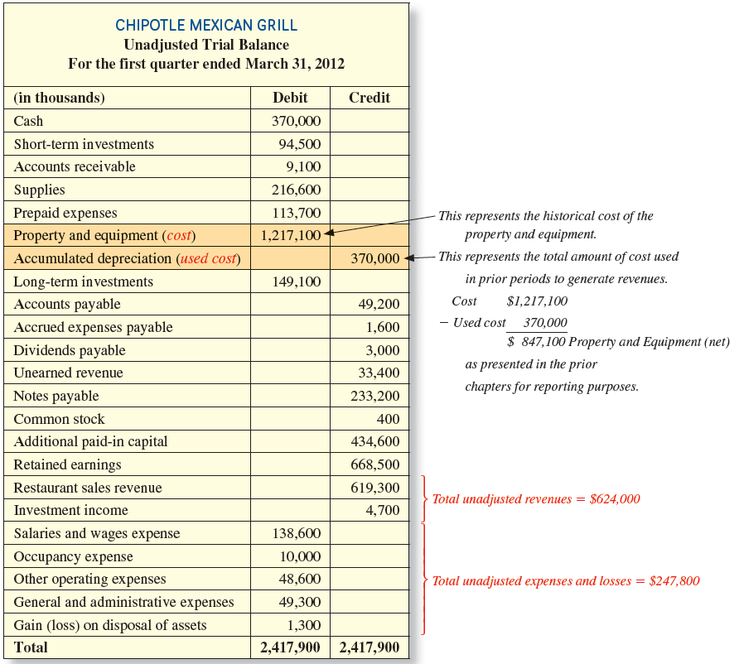
4-9
Notes:
Here is the unadjusted trial balance for Chipotle for the first quarter. We have shown of all the accounts. The type of e adjustments that may be required depend upon the facts. We usually report Property and Equipment net of Accumulated Depreciation. The reported amount is called net book value. Accumulated Depreciation accounts are called “contra” asset accounts. Contra accounts reduce the account to which they are related. In our case, Property and Equipment are reduced by Accumulated Depreciation to arrive at Net Book Value.

Slide 10
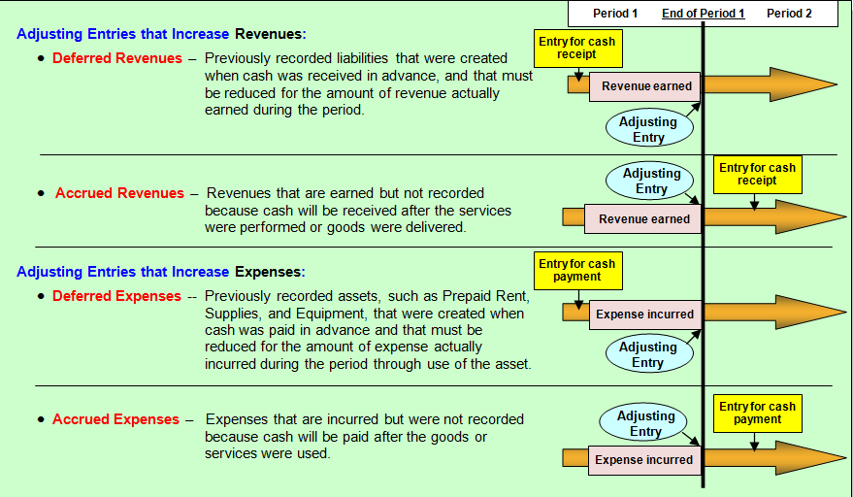
Types of Adjustments
4-10
Notes:
There are four types of adjustments. Two types of adjustments increase revenues and two types of adjustments increase expenses.
The first two types of adjusting entries increase revenues. Deferred Revenues represent previously recorded liabilities that were created when cash was received in advance, and that must be adjusted for the amount of revenue actually earned during the period. Accrued Revenues represent revenues that were earned but not recorded because cash was received after the services were performed or goods were delivered.
The next two types of adjustments increase expenses. Deferred Expenses represent previously recorded assets, such as prepaid rent, supplies, and equipment, that must be adjusted for the amount of expense actually incurred during the period through use of the asset. Accrued Expenses represent expenses that were incurred but were not recorded because cash was paid after the goods or services were received.

Slide 11
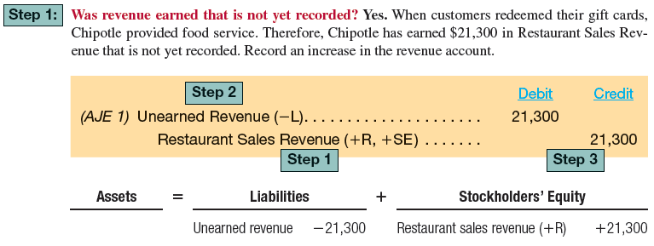
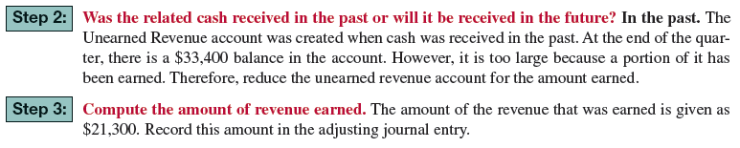
AJE unearned revenue
Complete Step 3
4-11
Notes:
Chipotle received cash last period from customers purchasing gift cards and recorded an increase in Cash and an increase in Unearned Revenue, a liability, to recognize the business’s obligation to provide future services to customers. During the first quarter of 2012, customers redeemed the gift cards for $21,300 in food service.

Slide 12
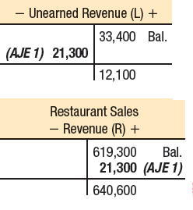
AJE 1 unearned revenue
4-12
Notes:
We must compute the amount of the revenue earned during the period. In our cash, the Unearned Revenue that was earned as revenue is $21,300. The adjusting entry is to debit, or decrease, the liability Unearned Revenue and credit the revenue account Restaurant Sales Revenue by $21,300.

Slide 13
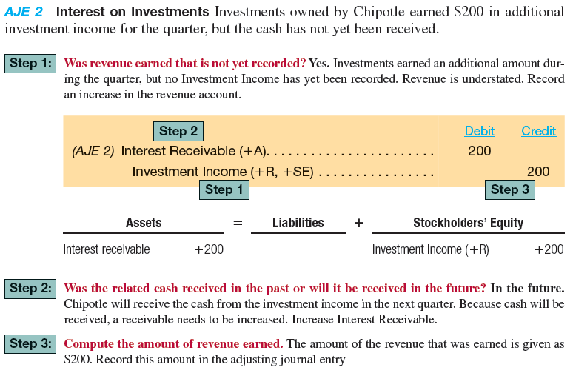
Aje 2 accrued Revenues
4-13
Notes:
Sometimes companies perform services or provide goods (that is, earn revenue) before customers pay. Because the cash that is owed for these goods and services has not yet been received and the customers have not yet been billed, the revenue that was earned may not have been recorded. Revenues that have been earned but have not yet been recorded at the end of the accounting period are called Accrued Revenues.

Slide 14
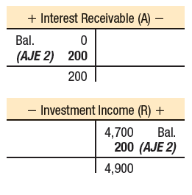
Aje 2 Accrued Revenues
4-14
Notes:
The final step is recording interest on Investments. Investments owned by Chipotle earned $200 in additional investment income for the quarter, but the cash has not yet been received. The entry is to record the Interest Receivable and Investment Income earned during the period.

Slide 15
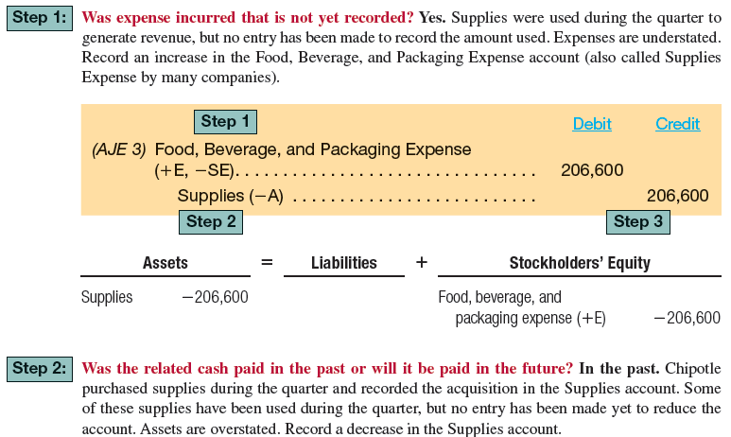
Aje 3 Deferred expenses
4-15
Notes:
Supplies include food, beverage, and paper products for Chipotle. At the end of the quarter, Chipotle counted $10,000 in supplies on hand, but the Supplies account indicated a balance of $216,600. We need to adjust the Supplies account to its proper balance of $10,000.

Slide 16

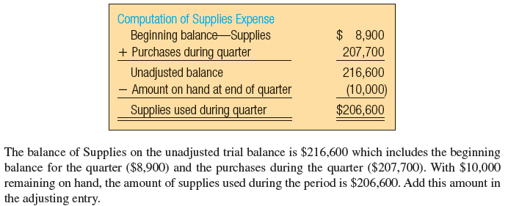
Aje 3 deferred expenses
4-16
Notes:
The adjusting journal entry to record supplies expense for the period is to debit Food, Beverage, and Packaging Expense (-E) for $206,000, and credit Supplies (-A) for the same amount.

Slide 17
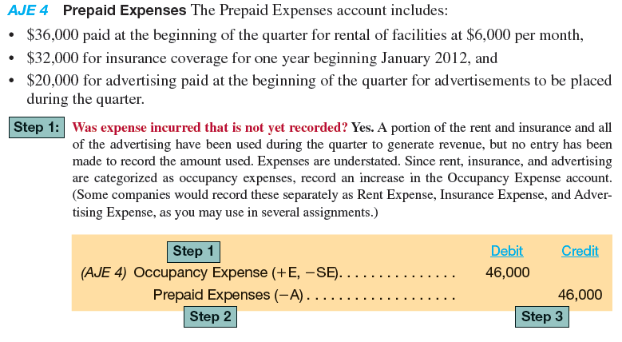
AJE 4 prepaid Expenses
4-17
Notes:
Prepaid expenses are amounts paid in advance of consumption. For Insurance Expense, the company paid in advance for a three-year fire insurance policy. The payment for the policy would initially be recorded as an asset and allocated to expense over the three-year period, usually monthly.

Slide 18
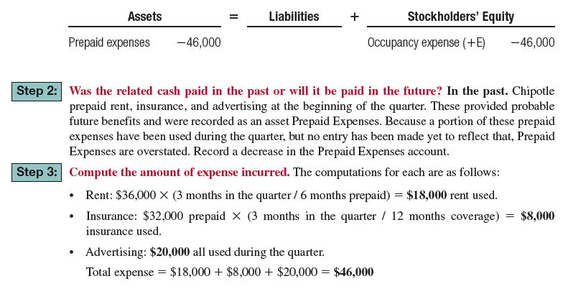
Aje 4 prepaid Expenses
4-18
Notes:
In our example, we have prepaid rent, insurance and advertising. All of these prepaid amount have difference amortization periods. The amortization period is the time over which the prepaid expense will be recorded as an expense. Our job is to determine the monthly expense recorded each accounting period.

Slide 19
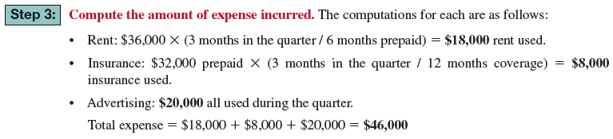
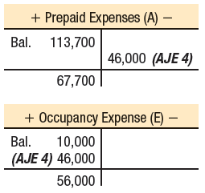
Aje 4 prepaid expenses
4-19
Notes:
The adjusting journal entry to record the prepaid expenses for the company includes a debit to Occupancy Expense for $46,000 and a credit to Prepaid Expenses for $46,000.

Slide 20

AJE 5 property and equipment
Purchase of Property
and Equipment
Use of Property
(Depreciation)
Declining Book Value
(Cost – Accumulates Depreciation)
Timeline
4-20
Notes:
Unlike supplies, which are purchased and then used over a relatively short period, buildings and equipment represent deferred expenses that will be used over many years.
Property and equipment accounts increase by the cost of the assets when they are acquired and decrease by the cost of the assets when they are sold. However, these assets are also used over time to generate revenue. A part of their cost should be expense in each of the same periods the asset is used to produce revenue (the expense matching principle). Accountants say that buildings and equipment depreciate over time as they are used. In accounting, depreciation is an allocation of an asset’s cost over its estimated useful life to the organization.

Slide 21
Aje 5 property and equipment
To keep track of the asset’s historical cost, the amount that has been used is not subtracted directly from the asset account. Instead, it is accumulated in a new kind of account called a contra-account. Contra-accounts are accounts that are directly linked to another account, but with an opposite balance. For Property and Equipment, the contra-account for the total cost used to date is called Accumulated Depreciation. This is the first of several contra accounts you will learn throughout the text. We will designate contra-accounts with an X in front of the type of account to which it is related. For example, this first contra-account will be shown as Accumulated Depreciation (XA).
4-21
Notes:
To keep track of the asset’s historical cost, the amount that has been used is not subtracted directly from the asset account. Instead, it is accumulated in a new kind of account called a contra-account. Contra-accounts are accounts that are directly linked to another account, but with an opposite balance. For Property and Equipment, the contra-account for the total cost used to date is called Accumulated Depreciation. This is the first of several contra accounts you will learn throughout the text. We will designate contra-accounts with an X in front of the type of account to which it is related. For example, this first contra-account will be shown as Accumulated Depreciation (XA).

Slide 22
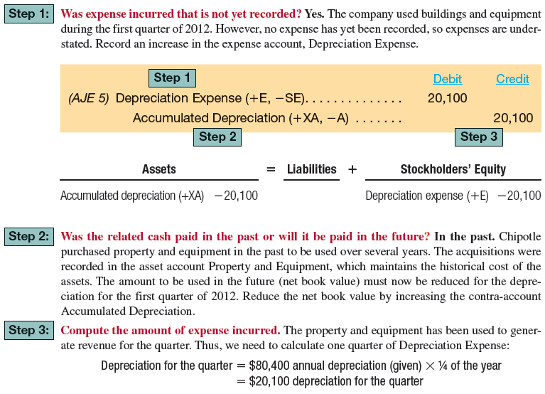
Aje 5 property and equipment
4-22
Notes:
Until we learn how to calculate depreciation expense, we will give you the amount of depreciation estimated by the company for the period. Chipotle estimates depreciation to be $80,400 per year.

Slide 23
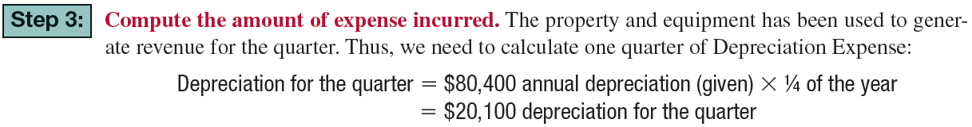
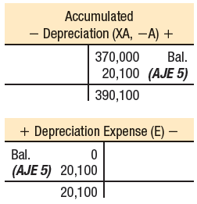
Aje 5 property and equipment
4-23
Notes:
The adjusting journal entry for the quarter is a debit to Depreciation Expense for $20,100 ($84,400 divided by 4), and credit, the contra asset account, Accumulated Depreciation for the same amount.

Slide 24
Aje 6 accrued expenses
Numerous expenses are incurred in the current period without being paid for until the next period. Common examples include Salaries Expense for the wages owed to employees, Utilities Expense for the water, gas, and electricity used during the period, and the Interest Expense incurred on debt. These accrued expenses accumulate (accrue) over time but are not recognized until the end of the period in an adjusting entry.
4-24
Notes:
Numerous expenses are incurred in the current period without being paid for until the next period. Common examples include Salaries Expense for the wages owed to employees, Utilities Expense for the water, gas, and electricity used during the period, and the Interest Expense incurred on debt. These accrued expenses accumulate (accrue) over time but are not recognized until the end of the period in an adjusting entry.

Slide 25
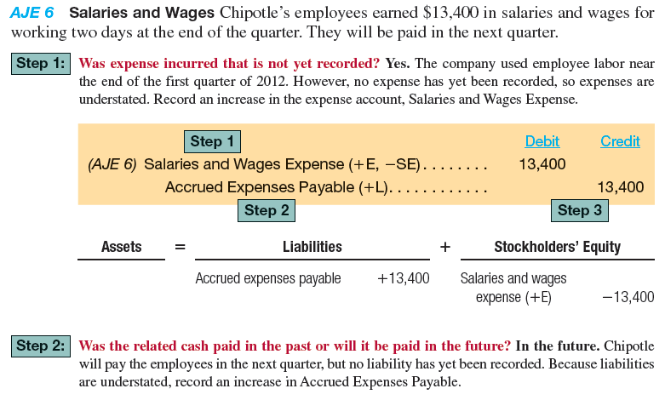
Aje 6 accrued expenses
4-25
Notes:
Chipotle’s employees earned $13,400 in salaries and wages for working two days at the end of the quarter. Here is an analysis of the treatment of the accrued expenses.

Slide 26
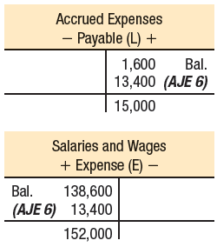
Aje 6 accrued expenses
4-26
Notes:
The adjusting journal entry is to debit Salaries and Wages Expense for $13,400, and credit Accrued Expenses Payable for the same amount.

Slide 27

AJE 7 Interest on debt
Chipotle owed $233,200 in notes payable during the quarter. There are two components when borrowing (or lending) money: principal (the amount borrowed or loaned) and interest (the cost of borrowing or lending). The average interest rate on Chipotle’s borrowings is 7.7 percent. Notes Payable (the principal) was recorded properly when the money was borrowed. Its balance does not need to be adjusted. However, interest expense is incurred by Chipotle over time as the money is used.
4-27
Notes:
Chipotle owed $233,200 in notes payable during the quarter. There are two components when borrowing (or lending) money: principal (the amount borrowed or loaned) and interest (the cost of borrowing or lending). The average interest rate on Chipotle’s borrowings is 7.7 percent. Notes Payable (the principal) was recorded properly when the money was borrowed. Its balance does not need to be adjusted. However, interest expense is incurred by Chipotle over time as the money is used.

Slide 28
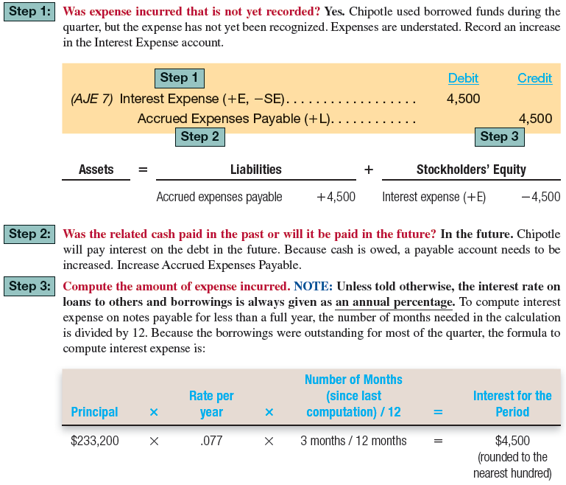
4-28
Notes:
Chipotle used borrowed funds during the quarter, but the interest expense associated with this borrowing has not yet been recognized. Until we prepare the adjusting entry, expenses are understated. The calculation of interest during the period is shown at the bottom of the screen. Chipotle borrowed $233,200, and must recognize interest for the quarter (3 months). We calculate the amount by multiplying the principal amount ($233,200) times the interest rate (7.7 percent) times the time period (3 months divided by 12 months).

Slide 29
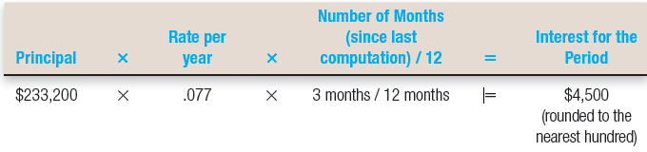
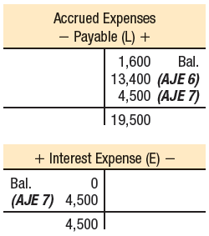
Aje 7 interest on debt
4-29
Notes:
Adjusting journal entry number 7 includes a debit to Interest Expense for $4,500, and a credit to Accrued Expenses Payable for $4,500.

Slide 30
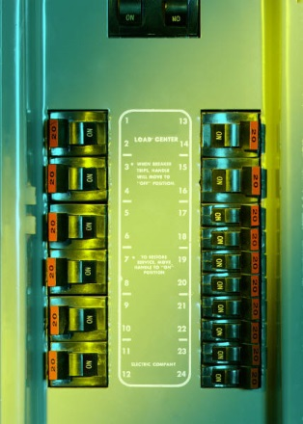

Aje 8 utilities
Most organizations receive utility bills after using utility services such as electricity, natural gas, and telephone. Chipotle received a utility bill for $4,400 for usage during the quarter. The bill will be paid next quarter.
4-30
Notes:
Most organizations receive utility bills after using utility services such as electricity, natural gas, and telephone. Chipotle received a utility bill for $4,400 for usage during the quarter. The bill will be paid next quarter.

Slide 31
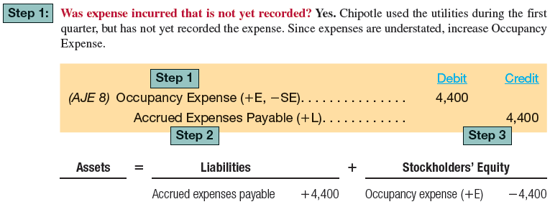
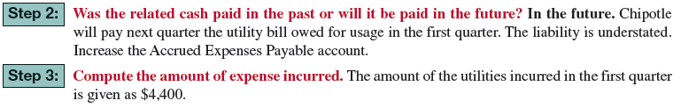
Aje 8 utilities
4-31
Notes:
Utilities are usually used before they are paid for. Just think of your electric bill. You probably use electricity every day, but only pay for it monthly.

Slide 32
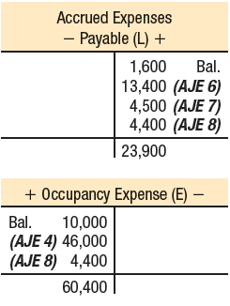
Aje 8 utilities
4-32
Notes:
The adjusting journal entry to record utilities is a debit Occupancy Expense for $4,400, and a credit Accrued Expenses Payable for $4,400. We fully expect to pay the utility costs in the following quarter.

Slide 33

Aje 9 income taxes
The final adjusting entry is to record the accrual of income taxes that will be paid in the next quarter. This requires computing adjusted pretax income—the balances in the revenue and expense accounts from the unadjusted trial balance plus the effect of all of the other adjustments.
4-33
Notes:
The final adjusting entry is to record the accrual of income taxes that will be paid in the next quarter. This requires computing adjusted pretax income—the balances in the revenue and expense accounts from the unadjusted trial balance plus the effect of all of the other adjustments.

Slide 34
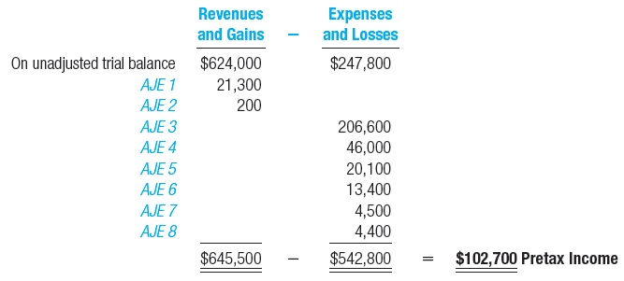
Aje 9 income taxes
Chipotle estimated a tax rate of 38.9 percent for the quarter, with the taxes due to be paid next quarter.
4-34
Notes:
We have presented the computation of Pretax Income with an estimated 38.9 percent income tax rate.

Slide 35
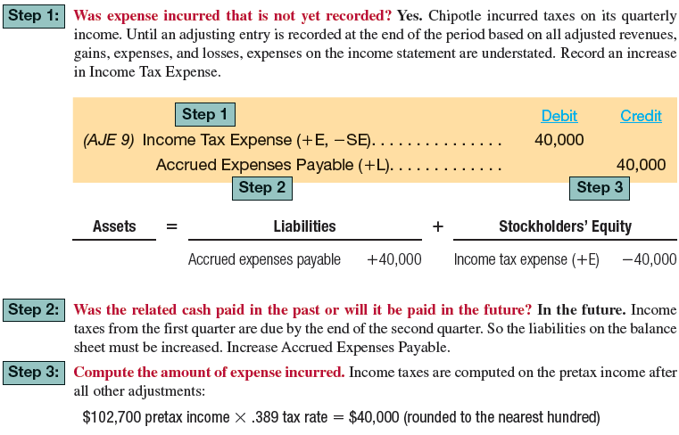
Aje 9 income taxes
4-35
Notes:
Notice that income taxes are rounded to the nearest hundred dollars. In our example, income taxes are due in the quarter following the quarter in which the revenue was earned. Pretax income earned in the first quarter of the year are due in the second quarter of the year.

Slide 36

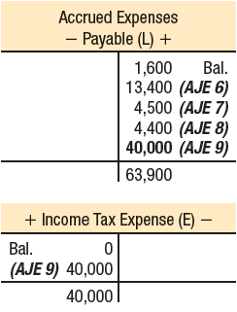
Aje 9 income taxes
4-36
Notes:
The adjusting journal entry to record estimated income taxes for the period is to debit Income Tax Expense for $40,000, and credit Accrued Expenses Payable for $40,000.

Slide 37
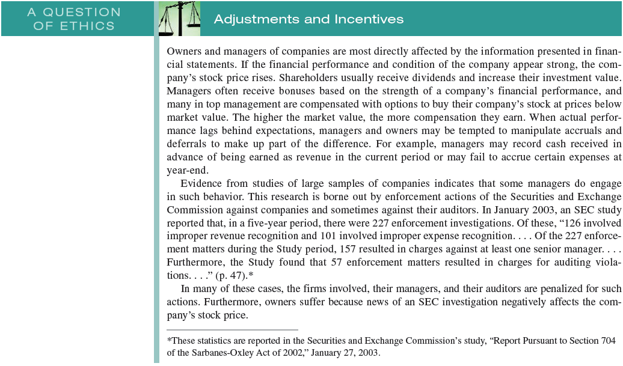
A question of ethics
4-37
Notes:
Owners and managers of companies are most directly affected by the information presented in financial statements. If the financial performance and condition of the company appear strong, the company’s stock price rises. Shareholders usually receive dividends and increase their investment value. Managers often receive bonuses based on the strength of a company’s financial performance, and many in top management are compensated with options to buy their company’s stock at prices below market value. The higher the market value, the more compensation they earn. When actual performance lags behind expectations, managers and owners may be tempted to manipulate accruals and deferrals to make up part of the difference. For example, managers may record cash received in advance of being earned as revenue in the current period or may fail to accrue certain expenses at year-end. Evidence from studies of large samples of companies indicates that some managers do engage in such behavior. This research is borne out by enforcement actions of the Securities and Exchange Commission against companies and sometimes against their auditors. In January 2003, an SEC study reported that, in a five-year period, there were 227 enforcement investigations. Of these, “126 involved improper revenue recognition and 101 involved improper expense recognition... Of the 227 enforcement matters during the Study period, 157 resulted in charges against at least one senior manager... Furthermore, the Study found that 57 enforcement matters resulted in charges for auditing violations...” In many of these cases, the firms involved, their managers, and their auditors are penalized for such actions. Furthermore, owners suffer because news of an SEC investigation negatively affects the company’s stock price.

Slide 38
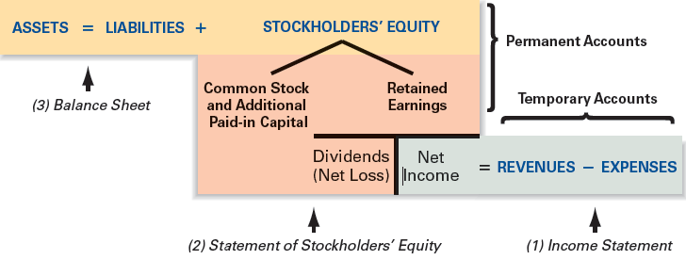
Preparing Financial Statements
4-38
Notes:
Before we prepare a complete set of financial statements, let’s update the trial balance to reflect the adjustments. This will provide us with adjusted balances for the financial statements.
In terms of naming financial statements, most companies use the Statement of Stockholders’ Equity rather than the Statement of Retained Earnings. The Statement of Stockholders’ Equity explains the changes in Retained Earnings as well as changes in other Stockholders’ Equity accounts. Once we complete the adjusted trial balance we can begin the process of preparing the financial statements. We know that we begin the process of preparing the financial statements with the income statement.

Slide 39
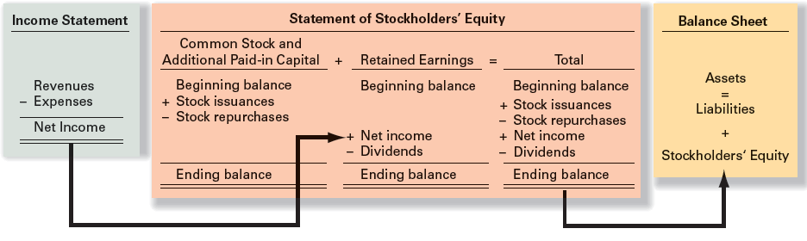

Relationships of financials
4-39
Notes:
Prior to preparing closing entries (which we will explain later) we must prepare the Income Statement first because income flows into the Statement of Stockholders’ Equity. The Statement of Stockholders’ Equity must be completed before we can prepare the Balance Sheet because Stockholders’ Equity is part of the Balance Sheet.

Slide 40
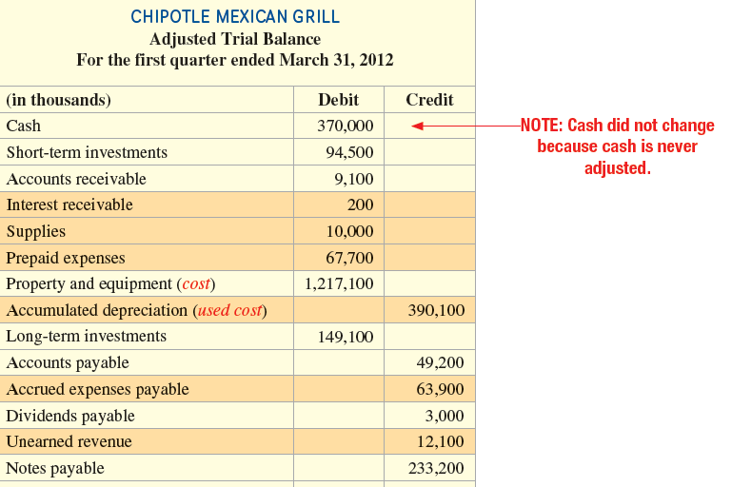
Adjusted Trial Balance
(through liabilities)
4-40
Notes:
Presented above is the partial adjusted trial balance though liabilities. On the next screen, we will show the remainder of the adjusted trial balance. Notice that the Cash account does not change because is it never adjusted.

Slide 41
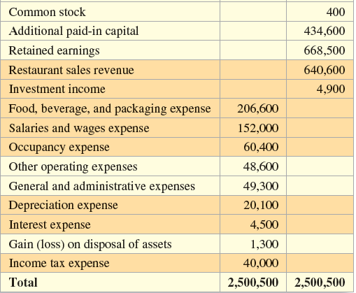
Adjusted Trial Balance
(through stockholders’ equity and income)
4-41
Notes:
Notice that the debits and credit are equal on the adjusted trial balance. The income and expense accounts as well as income taxes appear below stockholders’ equity.

Slide 42
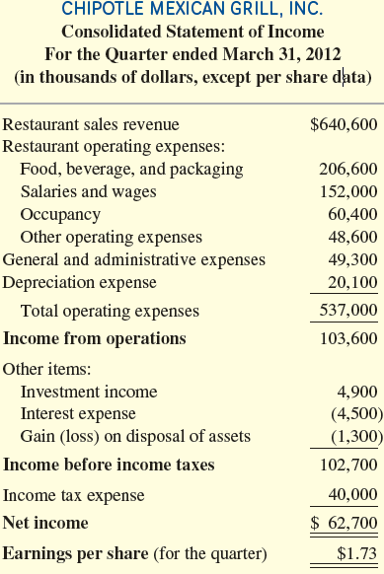
Income
Statement
This is the income statement drawn from the adjusted trial balance. Refer back to the adjusted trial balance and trace the income statement numbers forward. Notice that gains and losses are reported in the Other Items section of the statement.
4-42
Notes:
This is the income statement drawn from the adjusted trial balance. Refer back to the adjusted trial balance and trace the income statement numbers forward. Notice that gains and losses are reported in the Other Items section of the statement.
Operating income, a significant measure of performance, was $103,600 for the quarter. Earnings per share are $1.73 cents for the quarter and we will discuss the computation of this amount in more detail on the following screen.

Slide 43
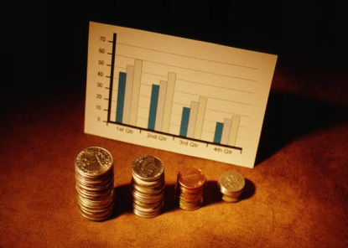
Earnings Per Share
You will note that the earnings (EPS) ratio is reported on the income statement. It is widely used in evaluating the operating performance and profitability of a company.
Earnings
Per
Share
=
Net Income
Average Number of Common Shares Outstanding**
during the Period
**Outstanding shares are those that are currently held by the shareholders.
4-43
Notes:
EPS is the only ratio required to be disclosed on the statement or in the notes to the statements. The actual computation of the ratio is quite complex and appropriate for more advanced accounting courses. For this course, the denominator is the average number of shares outstanding (number at the beginning of the period plus the number at the end of the period, divided by two) divided into net income.

Slide 44
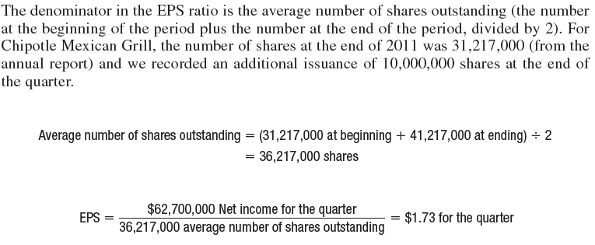
Earnings Per Share
4-44
Notes:
EPS is the only ratio required to be disclosed on the statement or in the notes to the statements. The actual computation of the ratio is quite complex and appropriate for more advanced accounting courses. For this course, the denominator is the average number of shares outstanding (number at the beginning of the period plus the number at the end of the period, divided by two) divided into net income.

Slide 45
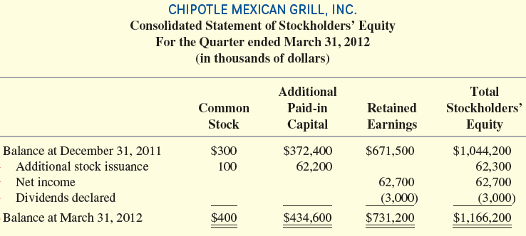
Statement of Stockholders’ Equity
The final total from the income statement, net income, is carried forward to the Retained Earnings column of the statement of stockholders’ equity. To this, the additional elements of the statement are added. Dividends declared and an additional stock issuance are also included in the statement:
4-45
Notes:
The final total from the income statement, net income, is carried forward to the Retained Earnings column of the statement of stockholders’ equity. To this, the additional elements of the statement are added. Dividends declared and an additional stock issuance are also included in the statement.

Slide 46
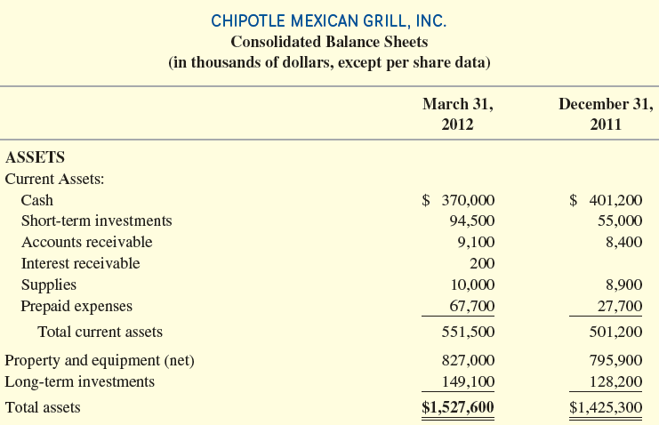
Balance Sheet
(through total assets)
4-46
Notes:
This partial Balance Sheet for Chipotle shows the asset section. On the next screen we will see the remainder of the Balance Sheet. You will notice that the contra-asset account, Accumulated Depreciation, has been subtracted from the Property and Equipment account to reflect net book value (or carrying value). Also recall that assets are listed in order of liquidity, and liabilities are listed in order of due dates. Current assets are those used or turned into cash within one year (as well as inventory). Current liabilities are obligations to be paid with current assets within one year. Chipotle’s management decided to present the balances at the end of 2011 and the balances at the end of the first quarter of 2012.

Slide 47
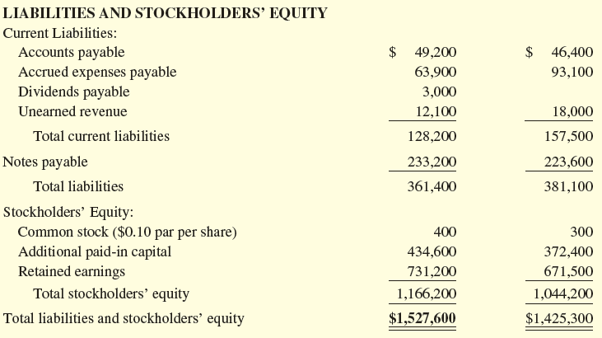
Balance Sheet
(through total liabilities and stockholders’ equity)
4-47
Notes:
This is a partial Balance Sheet for Chipotle that goes through liabilities and stockholders’ equity. The total of liabilities and stockholders’ equity is equal to total assets from the previous screen. The balance sheet is in balance. Notice that total stockholders’ equity on the balance sheet ties to the Statement of Stockholders’ Equity.

Slide 48
Focus on Cash Flows
As presented in the previous chapters, the statement of cash flows explains the difference between the ending and beginning balances in the Cash Account on the balance sheet during the accounting period. Put simply, the cash flow statement is a categorized list of all transactions of the period that affected the Cash account. The three categories are operating, investing, and financing activities. Since no adjustments made in this chapter affected cash, the cash flow categories identified on the Cash T-account at the end of Chapter 3 remain the same. Many standard financial analysis texts warn analysts to look for unusual deferrals and accruals when they attempt to predict future periods’ earnings. They often suggest that wide disparities between net income and cash flow from operations are a useful warning sign.
4-48
Notes:
As presented in the previous chapters, the statement of cash flows explains the difference between the ending and beginning balances in the Cash Account on the balance sheet during the accounting period. Put simply, the cash flow statement is a categorized list of all transactions of the period that affected the Cash account. The three categories are operating, investing, and financing activities. Since no adjustments made in this chapter affected cash, the cash flow categories identified on the Cash T-account at the end of Chapter 3 remain the same. Many standard financial analysis texts warn analysts to look for unusual deferrals and accruals when they attempt to predict future periods’ earnings. They often suggest that wide disparities between net income and cash flow from operations are a useful warning sign.

Slide 49
Focus on Cash Flows
Disclosures
Cash interest paid.
Cash income taxes paid.
A schedule of significant noncash investing and financing transactions.
4-49
Notes:
For complete disclosure, companies are required to provide supplemental information on the statement itself or in the notes to the financial statements. These disclosures must include:
Cash interest paid during the period.
Cash taxes paid during the period.
A supplemental schedule showing significant noncash investing and financing transactions. For example, if the company issued common stock to purchase a building, the transaction would not involve cash, but must be disclosed because it involves both a financing and investing activity.

Slide 50

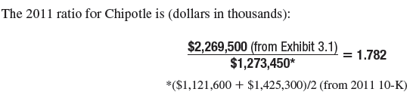
Total asset turnover Ratio
The ratio helps us determine how efficient management is in using assets (its resources) to generate sales.
4-50
Notes:
The total asset turnover ratio measures the sales generated per dollar of assets. A high asset turnover ratio signifies efficient management of assets; a low asset turnover ratio signifies less efficient management. A company’s products or services and business strategy contribute significantly to its asset turnover ratio. However, when competitors are similar, management’s ability to control the firm’s assets is vital in determining its success. Stronger financial performance improves the asset turnover ratio.
Creditors and security analysts use this ratio to assess a company’s effectiveness at controlling both current and noncurrent assets. In a well-run business, creditors expect the ratio on a quarterly basis to fluctuate due to seasonal upswings and downturns. For example, as inventory is built up prior to a heavy sales season, companies need to borrow funds. The asset turnover ratio declines with this increase in assets. Eventually, the season’s high sales provide the cash needed to repay the loans. The asset turnover ratio then rises with the increased sales.

Slide 51

Closing the Books
Closing entries:
Transfer net income (or loss) to Retained Earnings.
Establish a zero balance in each of the temporary accounts to start the next accounting period.
Even though the balance sheet account balances carry forward from period to period, the income statement accounts do not.
4-51
Notes:
All balance sheet accounts (referred to as permanent or real accounts) are carried forward from one period to the next. For example, the ending Cash balance of the prior accounting period is the beginning Cash balance of the next accounting period. The Income Statement account balances do not. Income Statement accounts are often referred to as temporary accounts because they cover a period of time and at the beginning of the next period start over with a zero balance.
On the other hand, revenue, expense, gain, and loss accounts are used to accumulate data for the current accounting period only; they are called temporary or nominal accounts.
At the end of each period, the balances in the temporary (income statement) accounts are transferred, or closed, to the Retained Earnings account by recording a closing entry. A closing entry has two purposes:
transfers balances in temporary accounts to Retained Earnings and
establishes zero balances in temporary accounts.

Slide 52
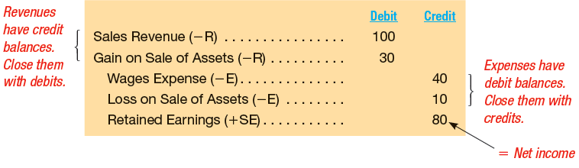
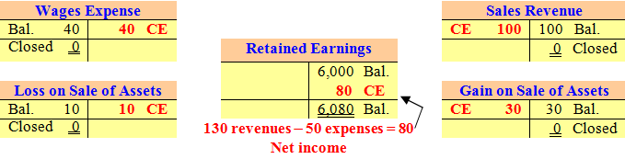
Closing the Books
Here is an example of the closing.
4-52
Notes:
We created a short example with one revenue, one gain, one expense, and one loss to illustrate the closing entry. Sales revenue has a normal credit balance, so to close the account to zero, we debit Sales Revenue for $100. In addition, we close Gain on Sale of Assets with a debit because the account has a normal credit balance. Expenses have a normal debit balance, so to close the account to zero, we credit Wages Expenses for $40. Loss on Sale of Assets also has a debit balance and is closed with a credit of $10.
After all revenues, gains, expenses, and losses are closed we have transferred net income of $80 to Retained Earnings. In addition, all temporary accounts have a zero balance. We have accomplished the two purposes of the closing process.

Slide 53
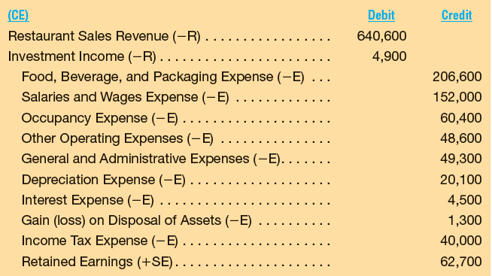
Closing Entries for chipotle
4-53
Notes:
Here is the closing entry for Chipotle. Notice that revenue accounts are closed with a debit (to zero out the accounts), and expense accounts are closed with a credit (to close out these accounts). The difference between revenues and expenses is net income and it is closed to Stockholders’ Equity.

Slide 54
Post-Closing Trial Balance
After the closing process is complete, all income statement accounts have a zero balance. These accounts are then ready for recording revenues and expenses in the new accounting period. The ending balance in Retained Earnings now is up-to-date (matches the amount on the balance sheet) and is carried forward as the beginning balance for the next period. As an additional step of the accounting information processing cycle, a post-closing trial balance should be prepared as a check that debits still equal credits and that all temporary accounts have been closed. The accounting cycle for the period is now complete.
4-54
Notes:
After the closing process is complete, all income statement accounts have a zero balance. These accounts are then ready for recording revenues and expenses in the new accounting period. The ending balance in Retained Earnings now is up-to-date (matches the amount on the balance sheet) and is carried forward as the beginning balance for the next period. As an additional step of the accounting information processing cycle, a post-closing trial balance should be prepared as a check that debits still equal credits and that all temporary accounts have been closed. The accounting cycle for the period is now complete.

Slide 55

End of Chapter 4
4-55
Notes:
End of chapter 4.

