Slide 1

Appendix E
Reporting and Interpreting
Investments in other corporations
McGraw-Hill/Irwin
Copyright © 2014 by The McGraw-Hill Companies, Inc. All rights reserved.
Notes:
Appendix E: Reporting and Interpreting Investments in Other Corporations

Slide 2
Understanding the Business
A company may invest in the securities of another company to:
Earn a return on idle funds. (passive investments)
Influence the other company’s policies and activities.
Control the other company.
Notes:
There are several reasons for a company to make investments in other companies. Some companies may wish to make passive investments of idle cash to receive a higher rate of return on their money. Many companies make investments for strategic or competitive reasons so that they might exercise influence over the other companies’ policies and activities. Finally, some companies buy a sufficient amount of another company to be able to control the other company.

Slide 3
Passive Investments in Debt and Equity Securities
Passive investments are made to earn a high rate of return on funds that may be needed for future purposes.
Investments in debt securities are always
considered passive investments.
The investor is not
interested in controlling
or influencing the other
company.
Equity security investments are presumed passive if the investing company owns less than 20% of the outstanding voting shares.
Notes:
Passive investments are made to earn a high rate of return on funds that may be needed for future purposes. Passive investments typically involve smaller sums of money than do the other types of investments that we will cover.
Investments in debt securities are always considered passive investments. In the absence of other information, investments in equity securities are presumed passive if the investing company owns less than 20 percent of the outstanding voting shares of the other company. In these instances, it is presumed that the investing company is not interested in controlling or influencing the other company

Slide 4
Investments in Stock for Significant Influence
Investments made with the intent of exerting significant influence over another corporation.
The ability of the investing company to have an important impact on the operating and financial policies of another company.
Significant
Influence
20% - 50%
outstanding shares
Notes:
Significant influence is presumed to occur when the investment ownership percentage reaches 20 percent. At that level of ownership, the investing company has the ability to have an important impact on the operating and financial policies of another company.

Slide 5
Investments in Stock for Control
Investments made with the intent to exert
control over another corporation.
The investing company has the ability to determine the operating and financial policies of another corporation.
Control
>50%
outstanding shares
Notes:
When the ownership percentage exceeds 50 percent, the investing company has control over the other company. At that point, significant influence has turned into the ability to actually determine the operating and financial policies of another corporation.

Slide 6
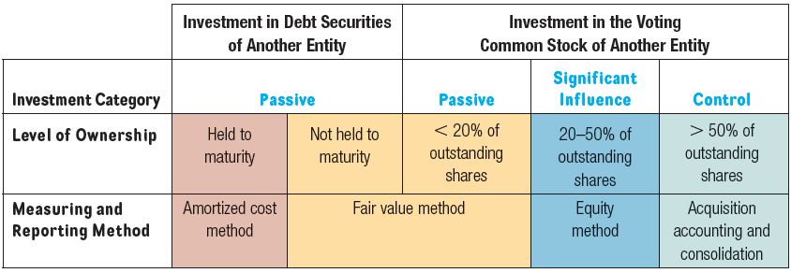
Types of Investments and Accounting Methods
The accounting method depends
on the type of security and the level
of ownership (influence).
Notes:
The method used to account for investments depends on the type of security (debt or equity) and, if the investment is in equity securities, the level of ownership (influence).
Investments in debt securities are always considered passive investments. When management plans to hold an investment in debt securities to its maturity date, the amortized cost method is used. When management plans to sell the investment in debt securities before the maturity date, the fair value method is used. In this case, the security is reported at its market value on the balance sheet date.
Passive investments in equity securities (less than 20 percent ownership) are also reported using the fair value method. Investments in the equity securities of another company resulting in an ownership percentage between 20 and 50 percent, are accounted for using the equity method.
Consolidated statements are prepared for investments in equity securities of another company that result in greater than 50 percent ownership. Consolidated statements combine the operations of the companies into a single set of statements.

Slide 7
Debt Held To Maturity: Amortized Cost Method
Record at cost on acquisition date.
Record interest received.
Amortize discount or premium.
Record principal received at maturity.
Notes:
Investments in debt securities are initially recorded at cost. Interest received from the investment is recorded as interest revenue. The investment may be acquired at a discount or premium to the maturity value. Discounts and premiums are amortized at the time of each interest receipt, bringing the carrying value of the debt security to the maturity value at the maturity date. At maturity, the investing company receives the maturity value of the debt security.

Slide 8

Debt Held To Maturity: Amortized Cost Method
On July 1, 2013, Washington Post paid the par value of $100,000 for 8 percent bonds that mature on June 30, 2018. The 8 percent interest is paid on each June 30 and December 31. Management plans to hold the bonds until maturity. Prepare the journal entry to record the investment.
Notes:
On July 1, 2013, Washington Post paid the par value of $100,000 for 8 percent bonds that mature on June 30, 2018. The 8 percent interest is paid on each June 30 and December 31. Management plans to hold the bonds until maturity.
Let’s prepare the journal entry to record the investment on July 1, 2013.
To record the investment, we debit Held-to-Maturity Investments and credit Cash for $100,000.

Slide 9

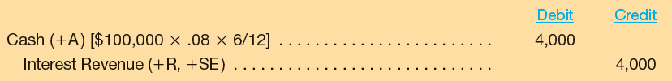
Debt Held To Maturity: Amortized Cost Method
The journal entry to record the receipt of interest on December 31 of the first year is . . .
Notes:
On December 31, 2013, we record the initial receipt of interest by debiting Cash and crediting Interest Revenue for $4,000. The amount is calculated by multiplying the $100,000 principal amount times 8 percent times 6 months over 12 months. The interest revenue would be the same each 6 months until maturity.

Slide 10


Debt Held To Maturity: Amortized Cost Method
The journal entry to record the receipt of
the principal payment at maturity is . . .
Notes:
On June 30, 2018, we debit Cash and credit Held-to-Maturity Investments for $100,000 to record the receipt of the principal at maturity.

Slide 11

Passive Investments: The Fair Value Method
Unrealized holding gains and losses are recorded.
Date of acquisition
Future measurement date
Investment is
initially recorded
at cost.
Investment carrying amount is adjusted to current market value.
Passive investments are reported at fair value because of relevance and measurability.
Notes:
Investments in debt securities, that are not to be held to maturity, and passive investments in equity securities are accounted for using the fair value method. The investment is initially recorded at its cost. Interest received on debt securities is recorded as interest revenue. Dividends received from the investment in equity securities are recorded as dividend revenue.
At each balance sheet date, the investment is adjusted to market value. As a result of the adjustment, unrealized holding gains and losses are recorded. Unrealized holding gains and losses may be reported in shareholders’ equity or in the income statement depending on the classification of the security.
Passive investments are reported at fair value for two reasons:
Relevance for predicting future cash flows.
Fair value is measurable as the current price of these securities are traded each day on established stock exchanges.

Slide 12
Classifying Passive Investments at Fair Value
NOTE: Realized gains and losses go on the Income Statement.
Notes:
Trading securities are debt or equity securities that are held primarily for resale. They are actively traded with the intent of generating short-term trading profits. Available for sale securities are debt or equity securities that are not actively traded, but are available for sale. Available for sale securities are held to earn a return on invested funds that may be needed for future operations. Both classifications of securities are adjusted to market value at the balance sheet date using an allowance account. This adjustment results in recording unrealized holding gains and losses.
For securities classified as trading securities, the unrealized holding gains and losses are reported on the income statement. For securities classified as available for sale securities, the unrealized holding gains and losses are reported in stockholders’ equity.
If a security in either classification is actually sold, a realized gain or loss is recorded. If the proceeds from the sale exceed the cost of the investment, a realized gain is recorded. When the proceeds are less than cost, a realized loss is recorded. Realized gains and losses are always reported on the income statement.

Slide 13
Available for Sale (AFS) Securities
On January 5, 2012, Washington Post acquires 15,000 of the 100,000 outstanding shares of INews on the open market at a cost of $10 per share. Washington Post has no influence over INews, and does not plan to sell the shares in the near future.
Should the acquired shares be classified as Trading Securities or Available for Sale Securities?
Washington Post does not plan to actively trade the shares. Instead, they will be held to earn a return on invested funds that may be needed for future operations. The shares should be classified as Available for Sale Securities.
Notes:
On January 5, 2012, Washington Post acquires 10,000 of the 100,000 outstanding shares of INews on the open market at a cost of $10 per share. Washington Post has no influence over INews, and does not plan to sell the shares in the near future.
Should the acquired shares be classified as Trading Securities or Available for Sale Securities?
Washington Post does not plan to actively trade the shares. Instead, they will be held to earn a return on invested funds that may be needed for future operations. The shares should be classified as Available for Sale Securities.

Slide 14

Available for Sale (AFS) Securities
The journal entry to record the investment is . . .
The investment may be a current asset or a noncurrent asset, depending on management’s intended holding period.
Notes:
The investment is recorded at cost with a debit to Investment in Available-for-Sale Securities. The amount is 15,000 shares times $10 per share equals $150,000. This investment may be a current asset or a noncurrent asset, depending on management’s intended holding period. If the investment had been classified as a trading security, it would be reported as a current asset. Trading securities are always current assets.

Slide 15

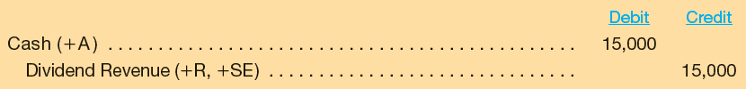
Available for Sale (AFS) Securities
Later in the year, Washington Post receives a $15,000 dividend from INews. Prepare the journal entry to record the dividend.
Notes:
Later in the year, Washington Post receives a $15,000 dividend from INews. Let’s prepare the journal entry to record the dividend receipt.
We debit Cash and credit Dividend Revenue for $15,000. Investment income is another acceptable account name for the dividend revenue.

Slide 16
Available for Sale (AFS) Securities
By December 31, 2012, Washington Post’s fiscal year-end, the market value of INews’ shares has dropped from $10 to $8 per share. How much has Washington Post’s portfolio value changed?
The journal entry to recognize the change in market value is . . .
Notes:
By December 31, 2012, Washington Post’s fiscal year-end, the market value of INews’ shares has dropped from $10 to $8 per share. How much has Washington Post’s portfolio value changed?
The decline in value is $30,000, calculated by subtracting the original cost of $150,000 from the market value of $120,000. The investment in INews is Washington Post’s only investment in securities available for sale, so the balance in the investment account at the beginning of the year, before the purchase of INews shares, was zero. Let’s record the decline in value with a journal entry.

Slide 17


Available for Sale (AFS) Securities
The unrealized holding loss is reported in the stockholders’ equity section of Washington Post’s balance
sheet as Other Comprehensive Income.
Notes:
For financial reporting purposes, the investment is shown on the balance sheet at market value. We must make an entry to adjust recorded cost to market value.
So, we debit Net Unrealized Gains and Losses on Available-for-Sale Securities and credit Investments in Available-for-Sale Securities for $30,000. The unrealized holding loss is reported in the stockholders’ equity section of Washington Post’s balance sheet as Other Comprehensive Income.

Slide 18

Available for Sale (AFS) Securities
On December 31, 2013, the market value of INews’ shares is $11 per share, an increase of $3 per share from December 31, 2012.
The journal entry to recognize the change in market value for 2013 is . . .
Notes:
On December 31, 2013, the market value of INews’ shares is $11 per share, an increase of $3 per share from December 31, 2012. How much has Washington Post’s portfolio value changed?
The increase in value is $45,000, calculated by subtracting the 2012 market value of $120,000 from the 2013 market value of $165,000. Let’s record the increase in value with a journal entry.
We debit Investments in Available-for-Sale Securities and credit Net Unrealized Gains and Losses on Available-for-Sale Securities for $45,000. The unrealized holding gain is reported in the stockholders’ equity section of Washington Post’s balance sheet as Other Comprehensive Income.

Slide 19
Available for Sale (AFS) Securities
Near the end of 2014, Washington Post sells all
15,000 shares of INews for $13 per share.
This amount will be
removed when the
sale entry is made.
Notes:
Near the end of 2014, Washington Post sells all 15,000 shares of INews for $13 per share. The gain on sale of the investment in INews is equal to the proceeds form the sale of $195,000 less the original cost of the investment, $150,000.
The net unrealized loss account has a $15,000 credit balance (gain) at the date of sale. This amount will be removed when the sale entry is made, resulting in a zero balance in the account, assuming the INews investment is Washington Post’s only investment. Let’s record the sale of INews with a journal entry.

Slide 20
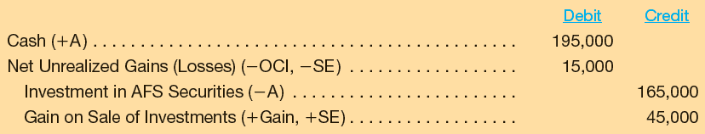
Available for Sale (AFS) Securities
The journal entry to record the 2014 sale of the INews investment is . . .
$150,000 – $30,000 + $45,000 = $165,000
Notes:
We debit Cash for $195,000 (15,000 shares sold @ $13 per share). The $15,000 credit balance in Net Unrealized Gains(Losses) is removed with a debit. The asset, Investments in Available-for-Sale Securities has a balance of $165,000 that is removed with a credit. The $165,000 balance is the original cost of $150,000 less the $30,000 unrealized loss in 2012, plus the $45,000 unrealized gain in 2013. Finally the gain on sale is recorded with a credit of $45,000.

Slide 21
Comparing Trading and Available for Sale Securities
Notes:
Here’ a convenient summary comparing the accounting for realized and unrealized gains for trading securities and available for sales securities.
Realized gains and losses, occurring when securities are actually sold, are reported in the income statement for both trading securities and available for sale securities.
Unrealized gains and losses on trading securities, resulting from year-end adjustments to market value, are reported in the income statement. Unrealized gains and losses on available for sale securities, resulting from year-end adjustments to market value, are reported in stockholders’ equity as other comprehensive income.

Slide 22
Key Ratio Analysis
Dividends and Interest Received
+ Change in Fair Value
Fair Value of Investments
(beginning of period)
Economic Return
from Investing
=
The economic return from investing ratio measures how much a company earns for each dollar of investment for a period. In general, a higher return indicates management is doing a better job selecting investments.
For the year 2012, Washington Post received $15,000 in
dividends from INews, and the fair value declined from $150,000
at the beginning of the year to $120,000 at the end of the year.
Notes:
The economic return from investing ratio provides a percentage of what was earned plus any realized and/or unrealized gains or losses on the portfolio. It is a measure of how much a company earns for each dollar of investment for a period. In general, a higher return indicates management is doing a better job selecting investments.
The ratio contains two types of returns in the numerator: dividends and interest received and the effect of the change in fair value, called the capital gain or loss. The change in fair value is considered earned whether or not the securities are sold as the opportunity to sell existed during the year.

Slide 23
Key Ratio Analysis
Dividends and Interest Received
+ Change in Fair Value
Fair Value of Investments
(beginning of period)
Economic Return
from Investing
=
For 2012
Economic Return
from Investing
$15,000 – $30,000
$150,000
=
= – 10%
Notes:
The economic return from investing in INews is a negative 10 percent for 2012. The $30,000 decline in fair value during the year more than offset the $15,000 received in dividends, resulting in a negative return for the year.

Slide 24
Investments For Significant Influence: Equity Method
The equity method is used when an investor can exert significant influence over an investee.
It is presumed that the investment
was made as a long-term investment.
Notes:
Now we are going to change the accounting for investments dramatically. We are going to assume a company has acquired enough equity securities in another company to exert significant influence over the operating policies of that company. Under these circumstances, the equity method of accounting for the investment is required.

Slide 25
Investments For Significant Influence: Equity Method
Unrealized holding gains and losses are not recorded.
Date of acquisition
Future measurement date
Investment is initially recorded at cost.
Investment carrying amount is adjusted for dividends received, and a percentage share of the investee’s income.
Notes:
So far we have studied the accounting for passive investments in debt and equity securities where the investing company (the investor) lacks significant influence or control over the other company (the investee). Now we will look at the accounting procedures using the equity method where the investor has significant influence over the investee. Generally, we associate significant influence with ownership of between 20 and 50 percent of the voting common stock of the investee.
Using the equity method, we will not record unrealized holding gains and losses. Instead, the investor’s carrying amount for the investment is adjusted for dividends received, and a percentage share of the investee’s income.

Slide 26
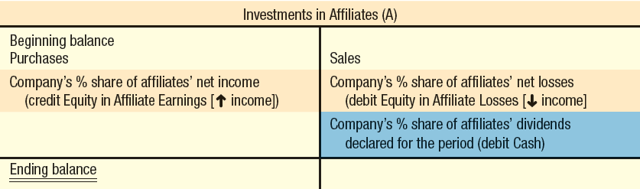

Investments For Significant Influence: Equity Method
Notes:
Using the equity method of accounting, the investor records the initial investment at cost. Each reporting period, the investor increases the balance in the investment account for the company’s proportionate share of the affiliate’s (investee’s) reported income. When dividends are received from the affiliate (investee), the investor reduces the balance in the investment account. This accounting may appear strange at first, but remember that the investor company can exert significant influence over the affiliate (investee), so special accounting is in order.
If the investee has a loss instead of income, the investor decreases the balance in the investment account for the company’s proportionate share of the affiliate (investee’s) reported loss.

Slide 27

Recording Investments under the Equity Method
At the beginning of 2013, Washington Post acquires a 40% interest in INews at a cost of $400,000. Prepare the journal entry to record Washington Post’s investment.
Notes:
At the beginning of 2013, Washington Post acquires a 40% interest in INews at a cost of $400,000. Let’s prepare the journal entry to record Washington Post’s investment.
On the date of acquisition, Washington Post will debit Investment in Affiliates and credit Cash for $400,000.
Now let’s look at the accounting treatment for the recognition of the investor’s proportionate share of the affiliate’s (investee’s) income.

Slide 28

Earnings of Affiliates
INews net income for 2013 is $500,000. Washington Post’s 40% share is $200,000. Record Washington Post’s share of the INews income.
Washington Post credits Equity in Affiliate Earnings (an income statement account) for its share of INews earnings.
Notes:
INews net income for 2013 year is $500,000. Washington Post’s 40% share is $200,000. Let’s prepare the journal entry to record Washington Post’s of the INews income.
Washington Post will debit, or increase, Investment in Affiliates and credit Equity in Affiliate Earnings for $200,000. The Equity in Affiliate Earnings from the investment in INews will appear on Washington Post’s income statement. Now let’s look at the accounting treatment for the receipt of dividends.

Slide 29
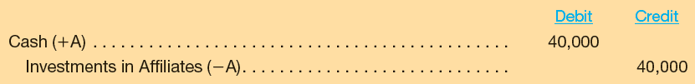
Dividends Received
During 2013, INews pays $100,000 in dividends, $40,000 (40%) of which goes to Washington Post. Record Washington Post’s receipt of the dividend.
Dividends are not revenue under the equity method. They are treated as a reduction of the investment account.
Notes:
During 2013, INews pays $100,000 in dividends. Washington Post’s 40% share is $40,000. Let’s prepare the journal entry to record Washington Post’s receipt of the dividend.
Washington Post will debit Cash and credit Investment in Affiliates for $40,000. Dividends are not revenue with the equity method. Under the equity method, we view the receipt of dividends as a return of a portion of the investment, so we reduce the investment account when dividends are received.

Slide 30
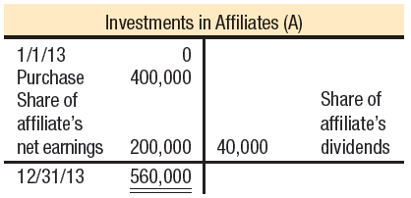
Investments For Significant Influence: Equity Method
Notes:
First, you see the general format for the investment account using the equity method that we saw earlier. Recall that the investor records the initial investment at cost. Each reporting period, the investor increases the balance in the investment account for the company’s proportionate share of the affiliate’s (investee’s) reported income (decreases for a loss). When dividends are received from the affiliate (investee), the investor reduces the balance in the investment account.
Next, you see the investment account for our Washington Post example showing an increase for the affiliate’s (investee’s) income, and a decrease for dividends received from the affiliate (investee).

Slide 31
Reporting Investments under the Equity Method
Reported on the balance sheet as a long-term asset,
originally at cost.
Account is increased by the proportional share of affiliate’s income.
Account is decreased by proportional share of affiliate’s losses and
by dividends received from the affiliate.
No adjustment to fair value at the end of the accounting period.
If sold, any
gain or loss is reported in the income statement as other income.
Notes:
The investments in affiliates account is reported on the balance sheet as a long-term asset, originally at its cost. In subsequent periods, the reported amount does not reflect either cost or fair value. Instead, the investment account is increased by the proportional share of the affiliate’s net income and is reduced by the amount of dividends received from the affiliate and the proportional share of the affiliate’s net losses.
At the end of the accounting period, the investment account is not adjusted to fair value as is done with investments in securities available for sale. When sold, the difference between the cash received and the book value of the investment is recorded as a gain or loss on the sale of the investment and is reported on the income statement in the other items section.

Slide 32
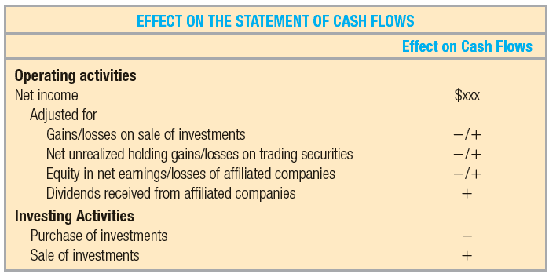
Focus on Cash Flows
Notes:
The purchase of investments made in securities of other companies results in a cash outflow. The sale of investments made in securities of other companies results in a cash inflow. These two cash flows are reported in the investing activities section of the statement of cash flows.
Several items relating to the accounting for investments are reported as adjustments to net income in the operating activities section of the statement of cash flows prepared using the indirect method. These adjustments to net income are:
A gain on sale of an investment is subtracted from net income.
A loss on sale of an investment is added to net income.
The equity in earnings of an investee is subtracted from net income.
Dividends received from an investee are added to net income.
Unrealized holding gains on trading securities are subtracted from net
income.
Unrealized holding losses on trading securities are added to net income.
Remember that unrealized holding gains and losses on securities available for sale are reported in stockholders’ equity, so an adjustment to income is unnecessary.

Slide 33
Controlling Interests: Mergers and Acquisitions
Clearing the 20% hurdle to gain influence . . .
Vaulting over the 50% mark to gain control!
Off and running with less than 20% . . .
Notes:
When an investor owns more that fifty percent of the voting common stock of the investee, the investor controls the investee. The investor continues to use the equity method of accounting for the investment, but at the end of the year the investor and investee financial statements are consolidated into one set of statements for both companies.

Slide 34

Controlling Interests: Mergers and Acquisitions
Horizontal
growth
Vertical integration
Synergy
Notes:
The principal reasons that an investor might acquire a controlling interest in an investee are for horizontal growth, vertical integration, and/or for synergy. Horizontal growth refers to acquisitions of companies at the same level in the channels of distribution. Vertical integration refers to acquisitions at a different level in the channels of distribution. Synergies occur when two companies realize cost savings or other benefits as a result of combined operations.

Slide 35

What Are Consolidated Statements?
The acquiring company is the
parent.
The company acquired is the
subsidiary.
Consolidated statements
combine two or more companies
into a single set of statements.
Any transactions between the parent and subsidiary must be eliminated when preparing consolidated financial statements.
Notes:
The investor is usually referred to as the parent company and the investee is usually referred to as the subsidiary company. Consolidated statements combine the operations of the companies into a single set of statements. In the process of consolidation, any transactions between the parent and subsidiary are eliminated.

Slide 36
Recording a Merger
Goodwill
Occurs when one
company buys
another company.
Only purchased
goodwill is an
intangible asset.
The amount by which the
purchase price exceeds the fair
market value of net assets acquired.
Notes:
Goodwill does not exist separate from the company itself. It represents the value of a company as a whole over and above its identifiable net assets. Goodwill may be attributed to many factors including good reputation, superior employees and management, good clientele, and good business location.
Only purchased goodwill is recognized. Purchased goodwill results when one company buys another company for a price that exceeds the fair value of the separate identifiable net assets acquired.

Slide 37
Recording a Merger
Washington Post paid $1,000,000 in cash to purchase all the stock of INews. Washington Post merged INews’ operations into its own operations, and INews ceased to exist as a separate entity. The following information is available at the date of acquisition:
Should Washington Post record goodwill?
Notes:
Washington Post paid $1,000,000 in cash to purchase all the stock of INews. Washington Post merged INews’ operations into its own operations, and INews ceased to exist as a separate entity. The following information is available at the date of acquisition:
Fair value of equipment, $350,000
Fair value of patents, $600,000
Total fair value of assets, $950,000
INews note payable, $100,000
Fair value of net assets, $850,000
Should Washington Post record goodwill?
Remember that goodwill results when one company buys another company for a price that exceeds the fair value of the separate identifiable net assets acquired. We know the purchase price is $1,000,000 and we know that the book values of the net assets total $850,000, but we don’t yet know the fair value of the net assets acquired.
Proceed to the next slide for fair value information.

Slide 38
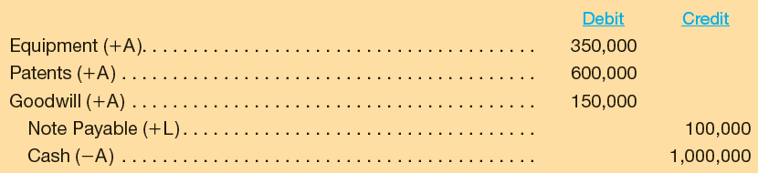
Recording a Merger
The journal entry to record the acquisition of INews is . . .
Notes:
Goodwill results when one company buys another company for a price that exceeds the fair value of the separate identifiable net assets acquired. The purchase price is $1,000,000 and the fair value of the net assets is $850,000, so Washington Post would record $150,000 of goodwill.
We record the acquisition at Washington Post’s cost by debiting Equipment for its fair value of $350,000, debiting Patents for fair value of $600,000, debiting Goodwill for $150,000, crediting Note Payable for $100,000, and crediting Cash for $1,000,000.

Slide 39
Recording a Merger
Goodwill
Not amortized.
Subject to assessment
for impairment of
value and may be
written down.
Notes:
Goodwill is not amortized. Each year we must test to see if there has been any impairment in the carrying value of the goodwill. If an impairment is determined to exist, we will reduce the goodwill account and recognize the loss in value.

Slide 40

Reporting for Combined Companies
The acquired company is merged into acquiring company.
The acquired and acquiring companies continue separate legal existences.
The acquiring company will treat the acquired assets and liabilities in the same manner as if they had been acquired individually
Consolidated financial statements are prepared which look the same as if the companies had been combined into one in a merger.
Notes:
After the merger with INews, Washington Post will treat the acquired assets and liabilities in the same manner as if they had been acquired individually. Washington Post will depreciate the $350,000 added to equipment over its remaining useful life and amortize the $600,000 for patents over their remaining useful life. However, goodwill is considered to have an indefinite life. As a consequence, it is not amortized, but, like all long-lived assets, goodwill is reviewed for possible impairment of value. Recording an impairment loss would increase expenses for the period and reduce the amount of goodwill on the balance sheet.
When a company acquires another, and both companies continue their separate legal existence, consolidated financial statements must be presented. The parent company is the company that gains control over the other company. The subsidiary company is the company that the parent acquires. When the parent buys 100 percent of the subsidiary, the resulting consolidated financial statements look the same as they would if the companies were combined into one in a simple merger as discussed above. The procedures involved in preparation of consolidated statements are discussed in advanced accounting courses.

Slide 41

End of appendix E
Notes:
End of appendix E.

