Slide 1

Chapter 3
Operating Decisions and the
Accounting System
McGraw-Hill/Irwin
Copyright © 2014 by The McGraw-Hill Companies, Inc. All rights reserved.
Notes:
Chapter 3: Operating Decisions and the Accounting System
As noted in the introduction of this chapter, Chipotle Mexican Grill’s philosophy of “Food with Integrity” guides its operating decisions. Food with Integrity entails finding and serving high-quality sustainably and organically raised food. It also includes showing respect for animals, the environment, and people involved in the operations.

Slide 2
Understanding the Business
How do business activities
affect the income statement?
How are these activities
recognized and measured?
How are these activities
reported on the
income statement?
3-2
Notes:
In this chapter we will discuss how business activities affect the income statement of a company. We will also look at how these activities are recognized, recorded and measured. Finally, we will look at the preparation of an income statement.

Slide 3
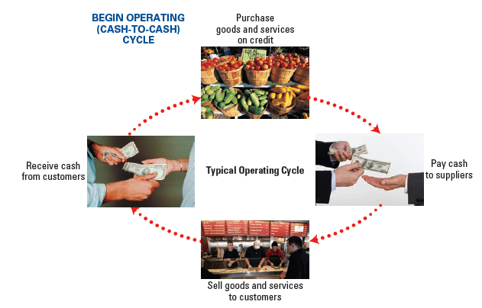
The Operating Cycle
3-3
Notes:
The operating cycle begins with the purchase or manufacture of a product for sale. When products are purchased from suppliers, those suppliers must be paid. After a sale has been made, the company must deliver the product or service to the customer. Many business sales are made on credit. If credit is extended, payment must be received from customers. Once the cash has been collected from customers, the business cycle begins all over again.
We never want to confuse the business operating cycle with the accounting cycle.
Companies (1) acquire inventory and the services of employees and (2) sell inventory or services to customers. The operating (or cash-to-cash) cycle begins when a company receives goods to sell (or, in the case of a service company, has employees work), pays for them, and sells to customers, then ends when customers pay cash to the company. The length of time for completion of the operating cycle depends on the nature of the business.

Slide 4
The Operating Cycle
Time Period: The long life of a company can be reported over a series of shorter time periods.
Recognition Issues: When should the effects of operating activities be recognized (recorded)?
Measurement Issues: What amounts should be recognized?
3-4
Notes:
We know that most successful companies operate for a very long period of time, and managers and investors need financial information on a timely basis. For accountants to provide this information, we have to divide the life of the business into relatively short, arbitrary time periods. We usually divide the life of a business into months, quarters, and annual time periods. When we establish these relatively short time periods, we create many measurement issues, for example, problems of revenue and expense recognition.

Slide 5

Elements on the Income Statement
Revenues
Increases in assets or settlement of liabilities from ongoing operations.
Expenses
Decreases in assets or increases in liabilities from ongoing operations.
Gains
Increases in assets or settlement of liabilities from peripheral transactions.
Losses
Decreases in assets or increases in liabilities from peripheral transactions.
3-5
Notes:
The income statement contains revenues, expenses, gains and losses.
Operating revenues result from the sale of goods or services. When Chipotle sells food to consumers it has earned revenue. When revenue is earned, assets, usually Cash or Accounts Receivables, often increase. Sometimes if a customer pays for goods or services in advance, a liability account, usually Unearned (or Deferred) Revenue, is created.
Expenses are decreases in assets or increases in liabilities from ongoing operations incurred to generate revenues during the period. Chipotle pays employees to make and serve food, uses electricity to operate equipment and light its facilities, advertises its products, and uses food and paper supplies. Without incurring these expenses, Chipotle could not generate revenues.
Gains (with an account called Gain on Sale of Assets) result in an increase in assets or decrease in liabilities from a peripheral transaction. Losses are decreases in assets or increases in liabilities from peripheral transactions.

Slide 6
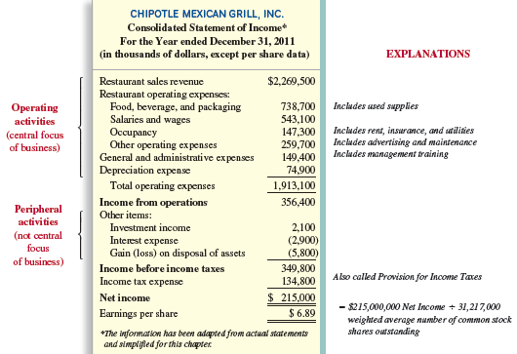
3-6
Notes:
Here is an income statement for Chipotle for the year ended December 31, 2011. Notice that the company separates it operating activities, that is, its normal revenues and expenses from selling food and beverages, from the peripheral activities that include investment income, interest expense, and loss due to restaurants sold. Income taxes are shown on a separate line. Most financial analysts concentrate on operating income because it represents the income earned from normal operations before taxes.

Slide 7
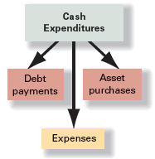
Operating expenses
An expenditure is any outflow of cash for any purpose, whether to buy equipment, pay off a bank loan, or pay employees their wages. Expenses are outflows or the using up of assets or increases in liabilities from ongoing operations incurred to generate revenues during the period. Therefore, not all cash expenditures are expenses, but expenses are necessary to generate revenues.
3-7
Notes:
An expenditure is any outflow of cash for any purpose, whether to buy equipment, pay off a bank loan, or pay employees their wages. Expenses are outflows or the using up of assets or increases in liabilities from ongoing operations incurred to generate revenues during the period. Therefore, not all cash expenditures are expenses, but expenses are necessary to generate revenues.

Slide 8

Restaurant Operating expenses
Food, Beverage, and Packaging Expense.
Salaries and Wages Expense.
Occupancy Expense.
Other Operating Expenses.
General and Administrative Expenses.
Depreciation Expense.
Income Tax Expense.
3-8
Notes:
Restaurant operating expenses include among other items:
Food, Beverage, and Packaging Expense.
Salaries and Wages Expense.
Occupancy Expense.
Other Operating Expenses.
General and Administrative Expenses.
Depreciation Expense.
Income Tax Expense.

Slide 9
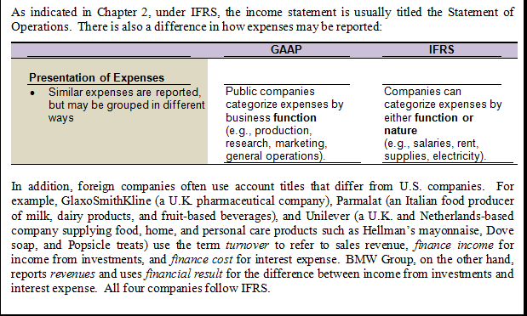
International Perspective
3-9
Notes:
Similar expenses are required to be reported but may be grouped in different ways. GAAP generally requires that expenses by classified by business function like production, marketing, etc. The IFRS permits companies to categorize expenses by either function or nature.

Slide 10
How Are Operating Activities Recognized and Measured?
Cash Basis
Revenue is recorded
when cash is received.
Expenses are recorded
when cash is paid.
3-10
Notes:
Companies that use the cash accounting basis recognize revenue at the time cash is received, and recognize expenses at the time cash is paid. Your financial performance is measured as the difference between your cash balance at the beginning of the period and the cash balance at the end of the period (that is, whether you end up with more or less cash). Many local retailers, medical offices, and other small businesses use cash basis accounting. A cash basis is not considered acceptable under generally accepted accounting principles.

Slide 11
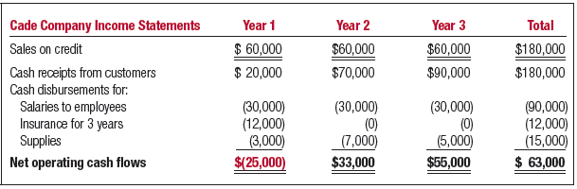
Cash basis accounting
Cade Company earns $60,000 from sales each year. Because the sales are on account, cash collections are spread over the period. Salaries are paid in full each year. Insurance was prepaid at the beginning of Year 1. Supplies were purchased on credit and used evenly during the three-year period. Performance over time appears uneven, when actually it is not.
3-11
Notes:
Companies that use the cash accounting basis recognize revenue at the time cash is received, and recognize expenses at the time cash is paid. When considering cash flows, your financial performance is measured as the difference between your cash balance at the beginning of the period and the cash balance at the end of the period (that is, whether you end up with more or less cash at the time the balance sheet is prepared).
Cade Company earns $60,000 from sales each year. Because the sales are on account, cash collections are spread over the period. Salaries are paid in full each year. Insurance was prepaid at the beginning of Year 1. Supplies were purchased on credit and used evenly during the three-year period. Performance over time appears uneven, when actually it is not.

Slide 12
How Are Operating Activities Recognized and Measured?
Accrual Accounting
Assets, liabilities, revenues, and expenses should be recognized when the transaction that causes them occurs, not necessarily when cash is paid or received.
Required by - Generally
Acceptable
Accounting
Principles
GAAP
3-12
Notes:
Generally accepted accounting principles require that assets, liabilities, revenues, and expenses be recognized when the transaction that causes them occurs. Generally accepted accounting principles require the use of the accrual method. In accrual basis accounting, revenues and expenses are recognized when the transaction that causes them occurs, not necessarily when cash is received or paid. That is, revenues are recognized when they are earned and expenses when they are incurred. The two basic accounting principles that determine when revenues and expenses are recorded under accrual basis accounting are the revenue principle and the matching principle.

Slide 13
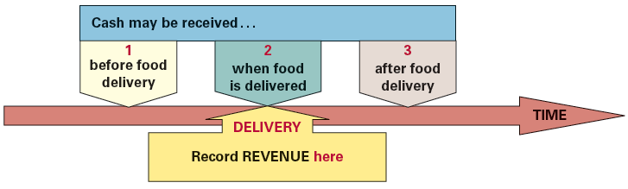
Revenue Realization Principle
Under the revenue realization principle
four criteria or conditions must normally be met for revenue to be recognized. If any of the following criteria are not met, revenue normally is not recognized and cannot be recorded.
Delivery has occurred or services have been rendered.
There is persuasive evidence of an arrangement for customer payment.
The price is fixed or determinable. There are no uncertainties as to the amount to be collected.
Collection is reasonably assured.
3-13
Notes:
Under the revenue realization principle, four criteria or conditions must normally be met for revenue to be recognized. If any of the following criteria are not met, revenue normally is not recognized and cannot be recorded.
Delivery has occurred or services have been rendered.
There is persuasive evidence of an arrangement for customer payment.
The price is fixed or determinable. There are no uncertainties as to the amount to be collected.
Collection is reasonably assured.

Slide 14
Revenue Principle
If cash is received before the company delivers goods or services, the liability account UNEARNED REVENUE is recorded.
Cash received before revenue is earned -
Cash
Received
Cash (+A) xxx
Unearned Revenue (+L) xxx
3-14
Notes:
Under the revenue principle, four criteria or conditions must normally be met for revenue to be recognized. If any of the following criteria is not met, revenue normally is not recognized and cannot be recorded.
Delivery has occurred or services have been rendered. The company has performed or substantially performed the acts promised to the customer by providing goods or services.
There is persuasive evidence of an arrangement for customer payment. In exchange for the company’s performance, the customer has provided cash or a promise to pay cash (a receivable).
The price is fixed or determinable. There are no uncertainties as to the amount to be collected.
Collection is reasonably assured. For cash sales, collection is not an issue since it is received on the date of the exchange. For sales on credit, the company reviews the customer’s ability to pay. If the customer is considered creditworthy, collecting cash from the customer is reasonably likely.
These conditions normally occur when the title, risks, and rewards of ownership have transferred to the customers. For most businesses, these conditions are met at the point of delivery of goods or services, regardless of when cash is received. In our case, cash was received before the goods or services were rendered to the customer, so no revenue is to be recognized. Rather we establish and Unearned Revenue account that is classified as a liability.

Slide 15
Revenue Principle
When the company delivers the goods or services, UNEARNED REVENUE is reduced and REVENUE is recorded.
Cash received before revenue is earned -
Cash
Received
Company Delivers
Cash (+A) xxx
Unearned Revenue (+L) xxx
Revenue will be recorded when earned.
Unearned Revenue (-L) xxx
Service Revenue (+R) xxx
3-15
Notes:
When the product is delivered or the service provided, revenue will be recorded. When the company delivers the goods or services, the liability, unearned revenue, is reduced, and the revenue account, service revenue, is increased.

Slide 16
Revenue Principle
When cash is received on the date the revenue is earned, the following entry is made:
Company Delivers
AND
Cash
Received
Cash (+A) xxx
Revenue (+R) xxx
3-16
Notes:
Cash can be received on the date the product is delivered or the services provided. The journal entry is to debit cash and credit revenue.

Slide 17
Revenue Principle
If cash is received after the company delivers goods or services, an asset ACCOUNTS RECEIVABLE is recorded.
Cash received after revenue is earned -
Company Delivers
Accounts Receivable (+A) xxx
Revenue (+R) xxx
3-17
Notes:
In many cases, cash is received after the goods are delivered or the services provided. In this example, we establish an asset account, accounts receivable. The journal entry is to debit accounts receivable and credit the revenue account to reflect the amount customers own us for goods already received.

Slide 18
Revenue Principle
When the cash is received the ACCOUNTS RECEIVABLE is reduced.
Cash received after revenue is earned -
Company Delivers
Cash
Received
Accounts Receivable (+A) xxx
Revenue (+R) xxx
Cash will be collected.
Cash (+A) xxx
Accounts Receivable (-A) xxx
3-18
Notes:
When the company collects cash from the customer, the receivable will be eliminated. When the cash is collected by the company the journal entry is to increase the asset account, cash, and decrease the asset account, accounts receivable.

Slide 19
Revenue Principle
Assets reflecting revenues earned but
not yet received in cash include . . .
3-19
Notes:
Here are three examples where revenue has been earned but cash has not yet been received.

Slide 20
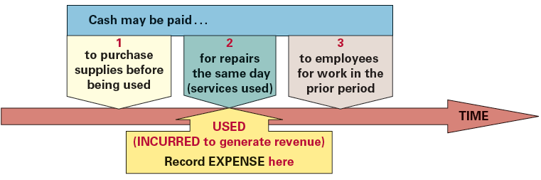
Expense Matching Principle
The expense matching principle requires that costs incurred to generate revenues be recognized in the same period—a matching of costs with benefits. For example, when Chipotle’s restaurants provide food service to customers, revenue is earned. The costs of generating the revenue include expenses that are recognized in the same period.
3-20
Notes:
The expense matching principle requires that costs incurred to generate revenues be recognized in the same period—a matching of costs with benefits. For example, when Chipotle’s restaurants provide food service to customers, revenue is earned. The costs of generating the revenue include expenses that are recognized in the same period.

Slide 21
expense Matching Principle
If cash is paid before the company receives goods or services, an asset account, PREPAID EXPENSE is recorded.
Cash is paid before expense is incurred -
$
Paid
Prepaid Expense (+A) xxx
Cash (-A) xxx
3-21
Notes:
If cash is paid before goods are received or services are provided, the company establishes a Prepaid Expense. A Prepaid Expense is an asset account. The journal entry on the date of the transaction is to debit Prepaid Expense and credit Cash.

Slide 22
expense Matching Principle
When the expense is incurred PREPAID EXPENSE is reduced and an EXPENSE is recorded.
Cash is paid before expense is incurred -
$
Paid
Expense
Incurred
Prepaid Expense (+A) xxx
Cash (-A) xxx
Expense will be recorded when incurred.
Expense (+E) xxx
Prepaid Expense (-A) xxx
3-22
Notes:
The expense will be recorded when incurred. After the expense has been incurred, the journal entry is to increase the Expense account and decrease the asset account, Prepaid Expense.

Slide 23
expense Matching Principle
When cash is paid on the date the expense is incurred, the following entry is made:
Expense
Incurred
AND
Cash
Paid
Expense (+E) xxx
Cash (-A) xxx
3-23
Notes:
Of course, the expense can be incurred on the same day cash is paid. In this case, the journal entry is to debit the Expense and credit Cash.

Slide 24
Expense Matching Principle
If cash is paid after the company receives goods or services, a liability PAYABLE is recorded.
Cash paid after expense is incurred -
Expense
Incurred
Expense (+E) xxx
Payable (+L) xxx
3-24
Notes:
When cash is paid after the company receives the goods or service, a liability account must be established. The journal entry is to debit an Expense account and credit a Liability account for the Payable.

Slide 25
Expense Matching Principle
When cash is paid the PAYABLE is reduced.
Cash paid after expense is incurred -
Expense
Incurred
Cash
Paid
Expense (+E) xxx
Payable (+L) xxx
Cash will be paid.
Payable (-L) xxx
Cash (-A) xxx
3-25
Notes:
When cash is actually paid, the journal entry is to debit or reduce the Payable and reduce the Cash account.

Slide 26
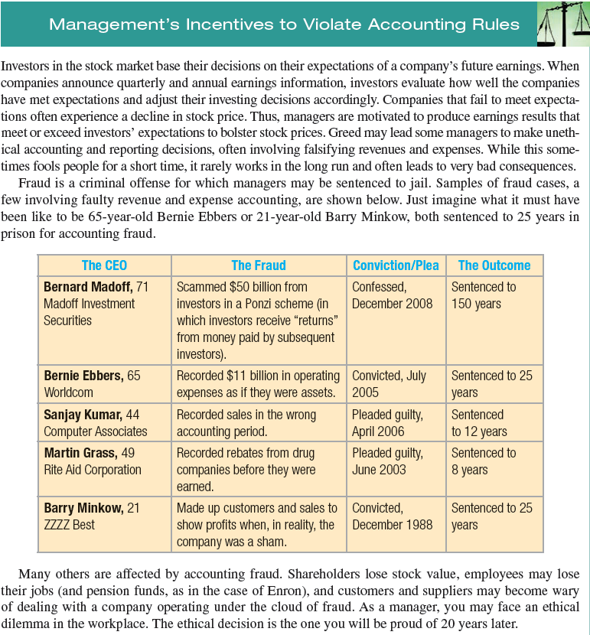
3-26
Notes:
Consider the unethical and illegal activities entered into by leaders at companies with little or no internal or external oversight.

Slide 27
Expanded Transaction Analysis Model
Assets = Liabilities + Stockholder’s Equity
ASSETS
LIABILITIES
Debit for Increase
Credit for Decrease
Debit for Decrease
Credit for Increase
Next, let’s see how Revenues and Expenses affect Retained Earnings.
CONTRIBUTED CAPITAL
RETAINED EARNINGS
Debit for Decrease
Credit for Increase
Debit for Decrease
Credit for Increase
3-27
Notes:
Here is the expanded transaction analysis model. We know that stockholders’ equity consists of contributed capital and retained earnings. Let’s see how revenues and expenses impact retained earnings.

Slide 28
Expanded Transaction Analysis Model
RETAINED EARNINGS
Dividends decrease Retained Earnings.
Net Income increases Retained Earnings.
Debit for Decrease
Credit for Increase
REVENUES
EXPENSES
Debit for Decrease
Credit for Increase
Debit for Increase
Credit for Decrease
3-28
Notes:
From our Statement of Retained Earnings we know that net income increases Retained Earnings. Revenues increase net income and Expenses decrease net income. Revenues show increases and decreases on the same sides of the T-account as retained earnings. A credit to the Revenue account increases revenue, a debit to the Revenue account decreases revenue. Because expenses reduce revenues in the calculation of net income, increases and decreases in Expense accounts are shown on the opposite sides when compared to revenue accounts. A debit to an Expense account represents an increase in expenses, a credit to an Expense account represents a decrease in expenses.

Slide 29
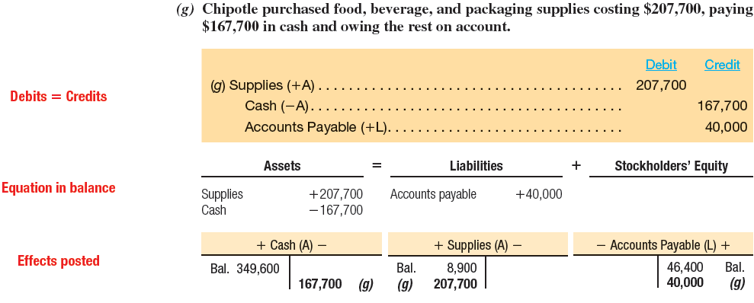
Analyzing chipotle’s transactions
You should notice that in each journal entry in which a revenue or expense is recorded, we insert ( + R, + SE) for revenues and ( + E, - SE) for expenses to emphasize the effect of the transaction on the accounting equation and to help you see that the equation remains in balance.
3-29
Notes:
In the previous chapter we completed transactions (a) through (f). In this chapter, we begin with transaction (g) to illustrate accounting for revenues and expenses.

Slide 30
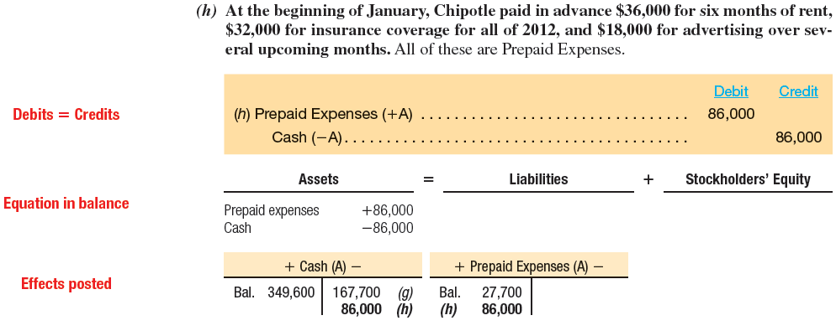

Analyzing chipotle’s Transactions
3-30
Notes:
At the beginning of January, Chipotle paid in advance $36,000 for six months of rent, $32,000 for insurance coverage for all of 2012, and $18,000 for advertising over several upcoming months. All of these are Prepaid Expenses.

Slide 31
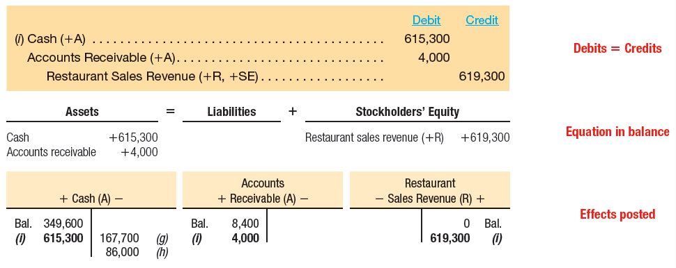
Analyzing chipotle Transactions
(i) During the first quarter, Chipotle sold food to customers for $619,300; $4,000 was sold to universities on account (to be paid next quarter) and the rest was received in cash in the stores.
3-31
Notes:
During the first quarter, Chipotle sold food to customers for $619,300; $4,000 was sold to universities on account (to be paid next quarter) and the rest was received in cash in the stores.

Slide 32
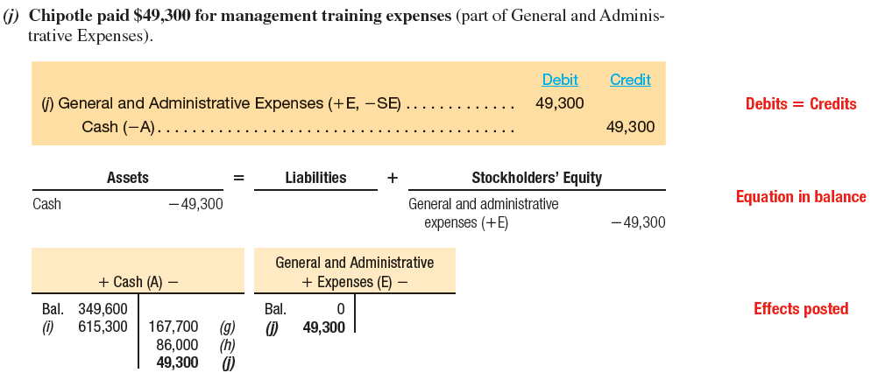

Analyzing Chipotle’s Transactions
3-32
Notes:
Chipotle paid $49,300 for management training expenses which is considered part of General and Administrative Expenses.

Slide 33
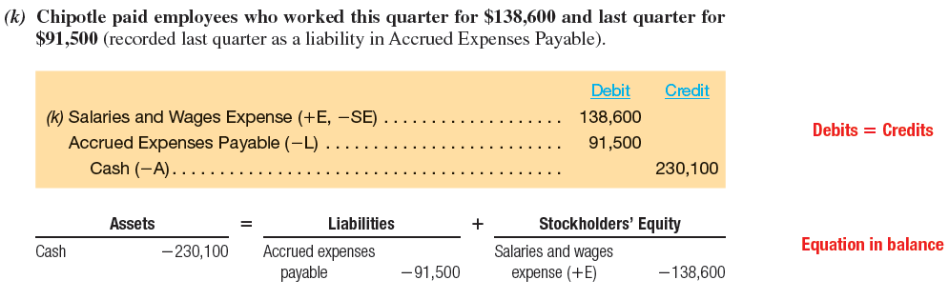
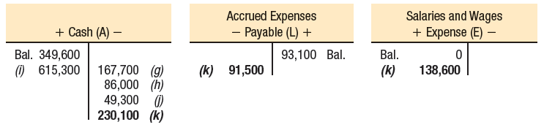


Analyzing Chipotle’s Transactions
3-33
Notes:
Chipotle paid employees who worked for the quarter for $138,600 and $91,500 for the last quarter. The company recorded $91,500 as an Accrued Expenses Payable for the liability to its workers.

Slide 34
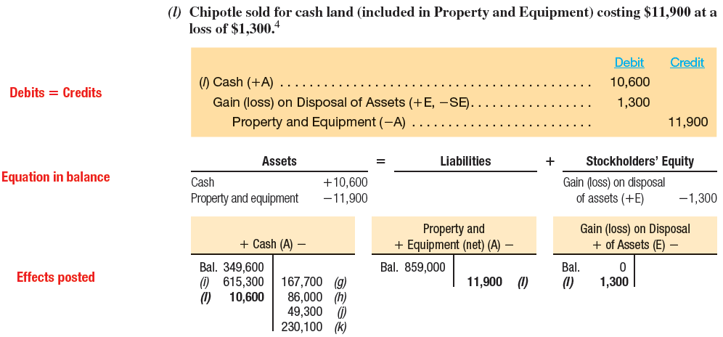

Analyzing Chipotle’s Transactions
3-34
Notes:
Chipotle sold for cash land, property and equipment, costing $11,900 for cash. This resulted in a loss of $1,300. Notice how we record the loss on the disposition of the property.

Slide 35
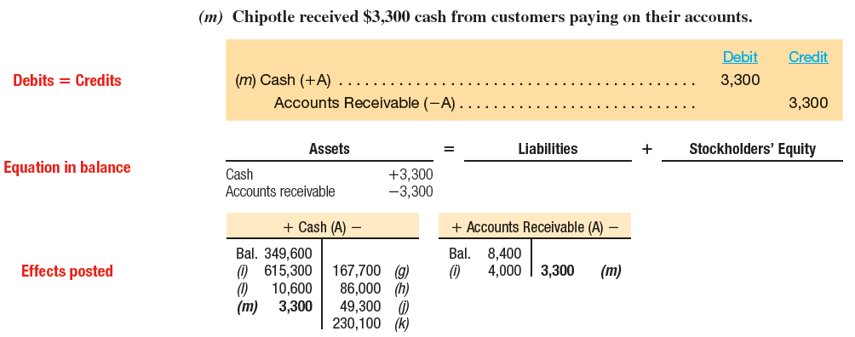

Analyzing Chipotle’s Transactions
3-35
Notes:
Chipotle received $3,300 cash from customers paying on their accounts.

Slide 36
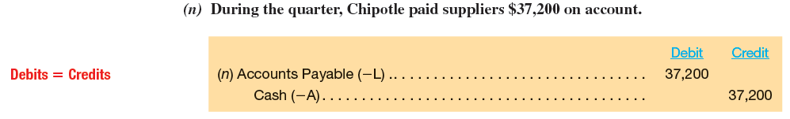
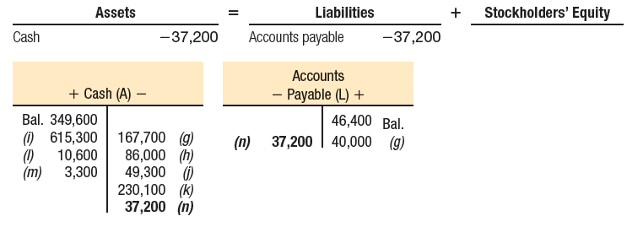
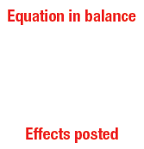

Analyzing Chipotle’s Transactions
3-36
Notes:
During the quarter, Chipotle paid suppliers $37,200 on account.

Slide 37
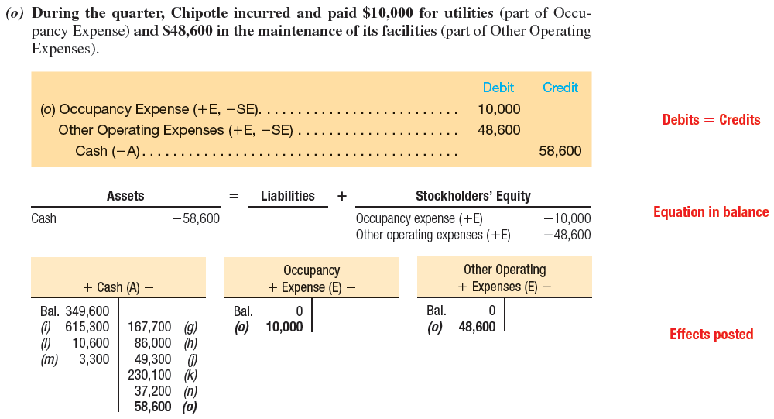
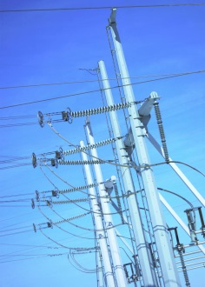
Analyzing Chipotle’s Transactions
3-37
Notes:
During the quarter, Chipotle incurred and paid $10,000 for utilities, considered part of Occupancy Expense, and $48,600 in the maintenance of its facilities, considered part of Other Operating Expenses.

Slide 38
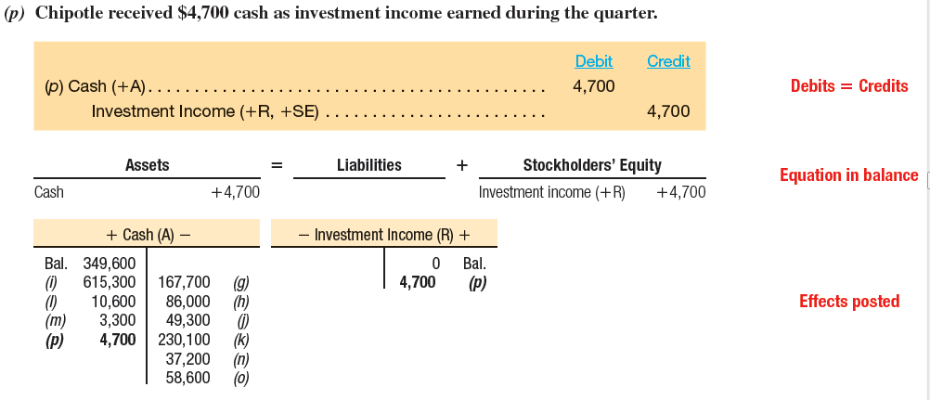

Analyzing Chipotle’s Transactions
3-38
Notes:
Chipotle received $4,700 cash as investment income earned during the quarter.

Slide 39
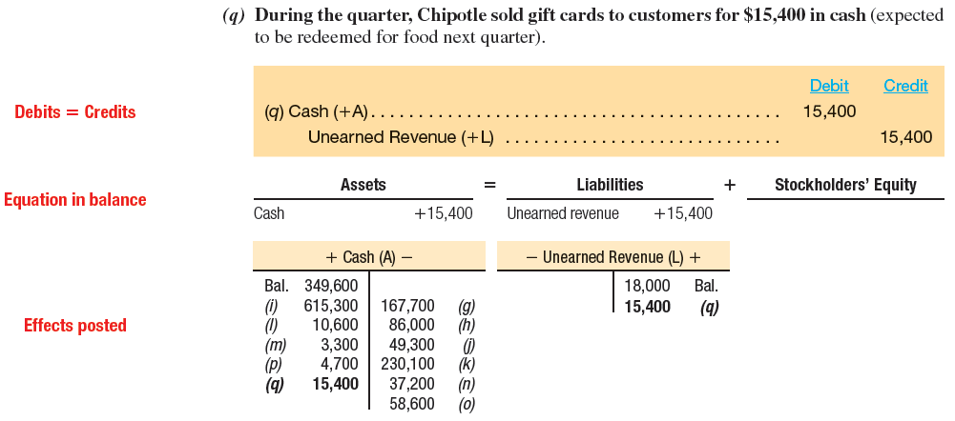

Analyzing Chipotle’s Transactions
3-39
Notes:
During the quarter, Chipotle sold gift cards to customers for $15,400 in cash. The cards are expected to be redeemed for food next quarter.

Slide 40
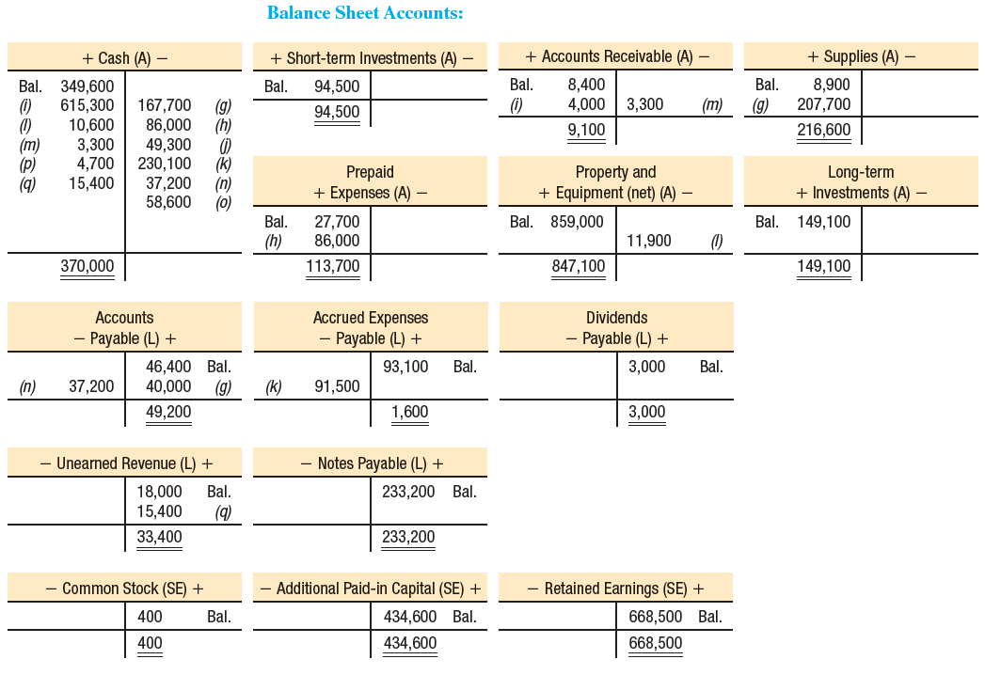
Chipotle’s Balance Sheet Accounts
3-40
Notes:
After posting all our transactions for the period, our balance sheet T-accounts will look like those shown above.

Slide 41
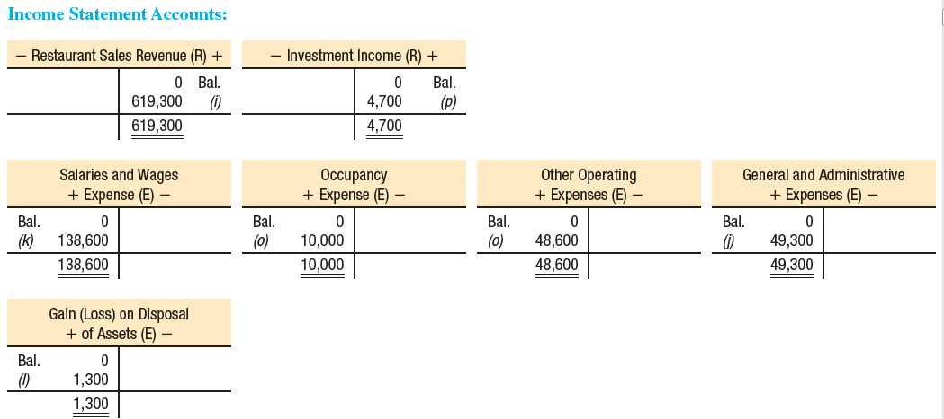
Chipotle’s income Statement Accounts
3-41
Notes:
After posting all our transactions for the period, our balance sheet T-accounts will look like those shown above.

Slide 42
How are Financial Statements Prepared and Analyzed?
Income
Statement
Revenues – Expenses = Net Income
Beginning Retained Earnings
+ Net Income
- Dividends Declared
Ending Retained Earnings
Statement of
Stockholders’
Equity
Balance
Sheet
Assets = Liabilities + Stockholders’ Equity
Contributed Capital
Retained Earnings
Statement
of Cash Flows
Change
in
Cash
=
Cash from Operating Activities
+ Cash from Investing Activities
+ Cash from Financing Activities
3-42
Notes:
The first statement we prepare is the income statement. The income statement shows revenues minus expenses.
The second financial statement we prepare is the statement of retained earnings. In preparing the statement of retained earnings, we start with beginning retained earnings, we add net income and subtract dividends declared to arrive at ending retained earnings.
The third financial statement we prepare is the balance sheet. The balance sheet shows assets, liabilities and stockholders’ equity. Stockholders’ equity is comprised of contributed capital and retained earnings.
The final statement we prepare is the statement of cash flows. The statement of cash flows determines the change in our cash balance during the period. The statement is divided into three major sections, cash from operating activities, cash from investing activities, and cash from financing activities.

Slide 43
How are Financial Statements Prepared and Analyzed?
Income
Statement
Revenues – Expenses = Net Income
Beginning Retained Earnings
+ Net Income
- Dividends Declared
Ending Retained Earnings
Statement of
Stockholders’
Equity
Balance
Sheet
Assets = Liabilities + Stockholders’ Equity
Contributed Capital
Retained Earnings
Cash
Statement
of Cash Flows
Change
in
Cash
=
Cash from Operating Activities
+ Cash from Investing Activities
+ Cash from Financing Activities
3-43
Notes:
We must prepare the Income Statement first because net income is needed before we can prepare the Statement of Retained earnings.
Next, we prepare the Statement of Retained Earnings because we need the ending balance in Retained Earning to show the proper balance in the stockholders’ equity section of the Balance Sheet. Recall that stockholders’ equity is composed of the sum of Contributed Capital and Retained Earnings.
Next, we prepare the Balance Sheet. We need the beginning and ending cash balance to prepare the fourth, and final statement, the Statement of Cash Flows. So the order of preparation of financial statements at the end of the accounting period is:
Income Statement,
Statement of Retained Earnings,
Balance Sheet, and finally
Statement of Cash Flows.

Slide 44
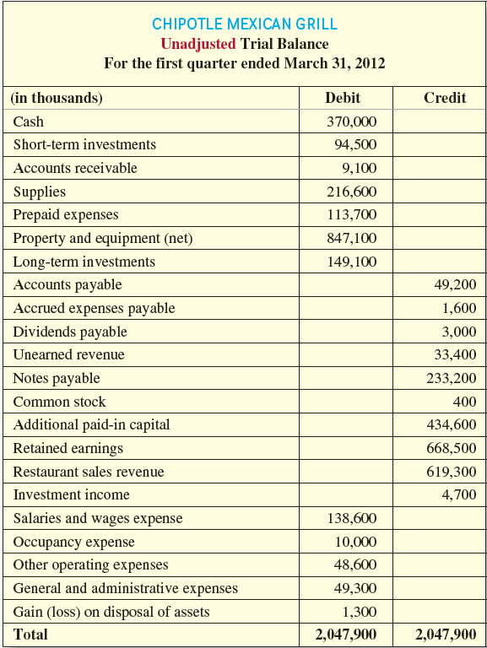
Trial balance
Debits and credits are equal after preparing the unadjusted trial balance.
3-44
Notes:
Before we consider creating any financial statements for Chipotle, we must first determine that the debits equal credits after all of the transactions illustrated above by generating a trial balance. Accounts are listed in financial statement order: assets, liabilities, stockholders’ equity, revenues/gains, and expenses/losses.

Slide 45
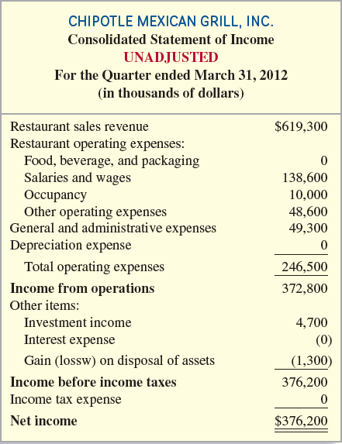
Income statement
The following classified income statement is presented to highlight the structure but note that, because it is based on unadjusted balances, it would not be presented to external users.
3-45
Notes:
The following classified income statement is presented to highlight the structure but note that, because it is based on unadjusted balances, it would not be presented to external users.

Slide 46

Net profit Margin
Net
Profit
Margin
Net Income
Net Sales (or Operating Revenues)*
=
* Net sales is sales revenue less any returns from customers and other reductions. For companies in the service industry, total operating revenues is equivalent to net sales.
The 2011 ratio for Chipotle using actual reported amounts is (dollars in thousands):
3-46
Notes:
Net profit margin measures how much of every sales dollar generated during the period is profit. A rising net profit margin signals more efficient management of sales and expenses. Differences among industries results from the nature of the products or services provided and the intensity of competition. Differences among competitors in the same industry reflect how each company responds to changes in competition (and demand for the product or service) and changes in managing sales volume, sales price, and costs. Financial analysts expect well-run businesses to maintain or improve their net profit margin over time.

Slide 47
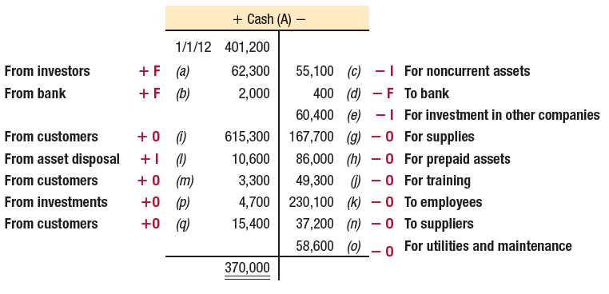
Focus on cash flows
Companies report cash inflows and outflows over a period of time in their statement of cash flows that is divided into three categories:
O - Operating activities primarily with customers and suppliers, and interest payments and earnings on investments.
I - Investing activities include buying and selling noncurrent assets and investments.
F - Financing activities include borrowing and repaying debt, including short-term bank loans, issuing and repurchasing stock, and paying dividends.
3-47
Notes:
Companies report cash inflows and outflows over a period of time in their statement of cash flows that is divided into three categories:
O - Operating activities primarily with customers and suppliers, and interest payments and earnings on investments.
I - Investing activities include buying and selling noncurrent assets and investments.
F - Financing activities include borrowing and repaying debt, including short-term bank loans, issuing and repurchasing stock, and paying dividends.

Slide 48

End of Chapter 3
3-48
Notes:
End of chapter 3.

