Slide 1
TECHNOLOGY IN ACTION

Slide 2
Chapter 10
Behind the Scenes: Software Programming
Notes:
In this behind-the-scenes chapter, we explore the stages of program development and survey the most popular programming languages.

Slide 3
Understanding Programming
Life Cycle of an Information System
Life Cycle of a Program
Notes:
In this section, several key concepts about understanding programming will be evaluated.

Slide 4
Life Cycle of an Information System
Objectives
10.1 Describe the importance of programming to both software developers and users.
10.2 Summarize the stages of the system development life cycle (SDLC).
Notes:
The two objectives involved in understanding the life cycle of an information system are:
Describe the importance of programming to both software developers and users.
Summarize the stages of the system development life cycle (SDLC).

Slide 5
Life Cycle of a Program
Objectives
10.3 Define programming and list the steps in the program development life cycle (PDLC).
10.4 Describe how programmers construct a problem statement from a description of a task.
10.5 Explain how programmers use flow control and design methodologies when developing algorithms.
Notes:
Three of the objectives involved in understanding the life cycle of a program are:
Define programming and list the steps in the program development life cycle (PDLC).
Describe how programmers construct a problem statement from a description of a task.
Explain how programmers use flow control and design methodologies when developing algorithms.

Slide 6
Life Cycle of a Program (cont.)
Objectives
10.6 Discuss the categories of programming languages and the roles of the compiler and the integrated development environment (IDE) in coding.
10.7 Identify the role of debugging in program development.
10.8 Explain the importance of testing and documentation in program development.
Notes:
The final three objectives involved in understanding the life cycle of a program are:
Discuss the categories of programming languages and the roles of the compiler and the integrated development environment (IDE) in coding.
Identify the role of debugging in program development.
Explain the importance of testing and documentation in program development.

Slide 7
Life Cycle of an Information System
Some tasks are complex
Require creative thought
Require human touch
Some tasks are candidates for automation
Repetitive
Work with electronic information
Follow a series of clear steps
Notes:
Every day we face a wide array of tasks. Some tasks are complex. These tasks require:
Creative thought
Human touch
But some tasks are candidates for automation with computers—automation achieved through programming:
Tasks that are repetitive
Those that work with electronic information
Those that follow a series of clear steps

Slide 8
Life Cycle of an Information System The Importance of Programming
A career in programming offers:
Plentiful jobs
Strong salaries
Telecommuting is often easy to arrange
Computer programs exist for many tasks
Programming is necessary when there is no existing software for the task
Basic knowledge of programming
Notes:
A career in programming offers many advantages:
Jobs are plentiful.
Salaries are strong.
Telecommuting is often easy to arrange.
If you can’t find an existing software product to accomplish a task, programming is mandatory.
Having a basic knowledge of programming enables you to add features that support your personal needs. If you plan to create custom applications from scratch, having a detailed knowledge of programming will be critical to the successful completion of your projects.

Slide 9
Life Cycle of an Information System System Development Life Cycle
System
Collection of pieces working to achieve a common goal
An information system includes:
Data
People
Procedures
Hardware
Software
Notes:
Generally speaking, a system is a collection of pieces working together to achieve a common goal. Your body, for example, is a system of muscles, organs, and other groups of cells working together.
An information system includes data, people, procedures, hardware, and software that help in planning and decision making. Information systems help run an office and coordinate online-purchasing systems and are behind database-driven applications used by Amazon and Netflix.

Slide 10
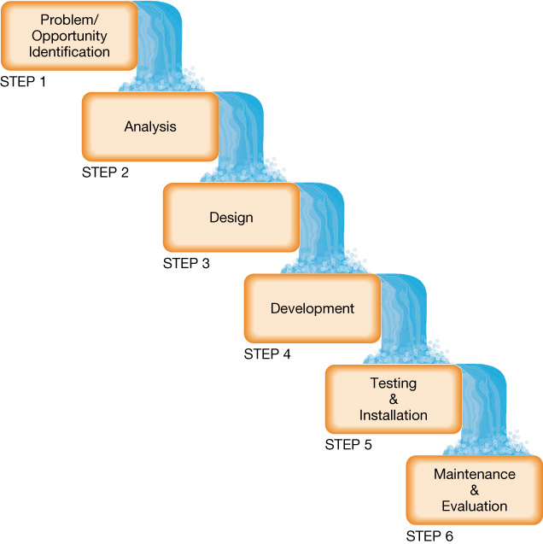
Life Cycle of an Information System System Development Life Cycle
Notes:
There are six steps in a System Development Life Cycle (SDLC) model.
Corporations form a development committee to evaluate proposals.
Analysts explore the problem, develop a program specification, define user requirements, and recommend a plan of action.
A plan using flowcharts and data-flow diagrams helps programmers.
Program development begins next.
Testing and installing the program ensure it works properly.
Program performance is monitored to determine whether the program is meeting the needs of end users.

Slide 11
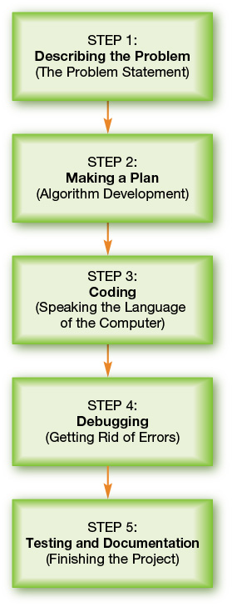
Life Cycle of a Program The Program Development Life Cycle
Notes:
The stages that programming projects follow are referred to as the Program Development Life Cycle (PDLC).
Programmers must develop a complete description of the problem.
The problem is translated into steps—known as an algorithm—that describe what the program must do.
The algorithm is translated into programming code.
The code is debugged as any errors are repaired.
The software is tested by programmers and users. Users are trained to use the program efficiently.

Slide 12
Life Cycle of a Program The Problem Statement
Necessary to solve problems
Interact with users
Programmers handle bad inputs through error handling
Problem statement includes testing plan
Does not cover every possible input but patterns of inputs
Notes:
The problem statement is a description of what tasks the program must accomplish and how it will execute those tasks and respond to unusual situations.
The goal is to have programmers interact with users.
Programmers must describe what the program should do if the input is invalid. This is referred to as error handling.
The testing plan can’t list every input. Instead, programmers identify categories of inputs, find an example, and specify what output must be generated.

Slide 13
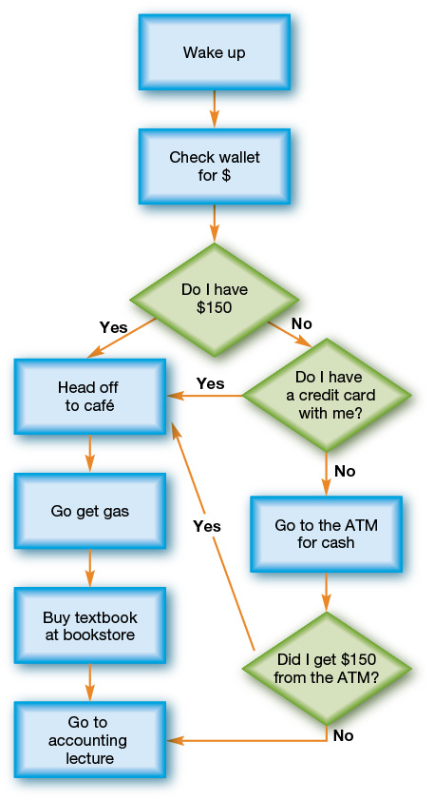
Life Cycle of a Program Algorithm Development
Developing detailed algorithm
Algorithms are limited
Algorithms represented through flowcharts
Provides visual representations of patterns
Notes:
Once programmers understand what the program must do, they can begin developing a detailed algorithm.
An algorithm is a series of steps that’s completely known. However, not all problems can be described as a fixed sequence of steps; some involve random and unpredictable events.
Programmers have several visual tools at their disposal to help them document the decision points and flow of their algorithms.
Flowcharts provide a visual representation of the patterns the algorithm comprises.

Slide 14
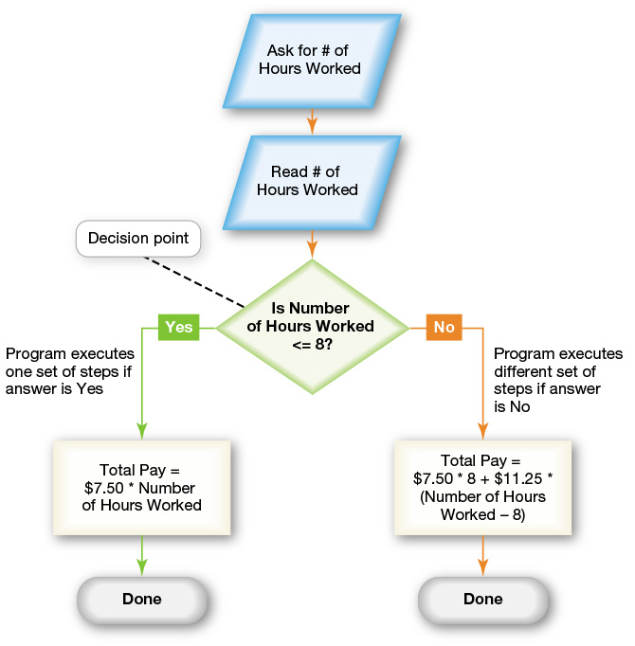
Life Cycle of a Program Algorithm Development
Flow Control
Programmers handle complex algorithms
List of choices
Decision points
Binary decisions
Loops
Notes:
Complex problems involve choices. Algorithms include decision points.
Binary decisions are questions that can be answered in either yes (true) or no (false).
Loops are when a question is asked. If the answer is yes, actions are performed. Once the actions have finished, the question is asked again, creating a loop. When the answer is no, the algorithm moves to the first step that follows the loop.

Slide 15
Life Cycle of a Program Algorithm Development
Design Methodology: Top-Down Design
Problem is broken into series of high-level tasks
Detailed subtasks created from high-level tasks
Continue until steps are close to programming language commands
Notes:
Top-down design is a systematic approach in which a problem is broken into a series of high-level tasks. In top-down design, programmers apply the same strategy repeatedly, breaking each task into successively more detailed subtasks.
They continue until they have a sequence of steps that are close to the types of commands allowed by the programming language they’ll use for coding.

Slide 16
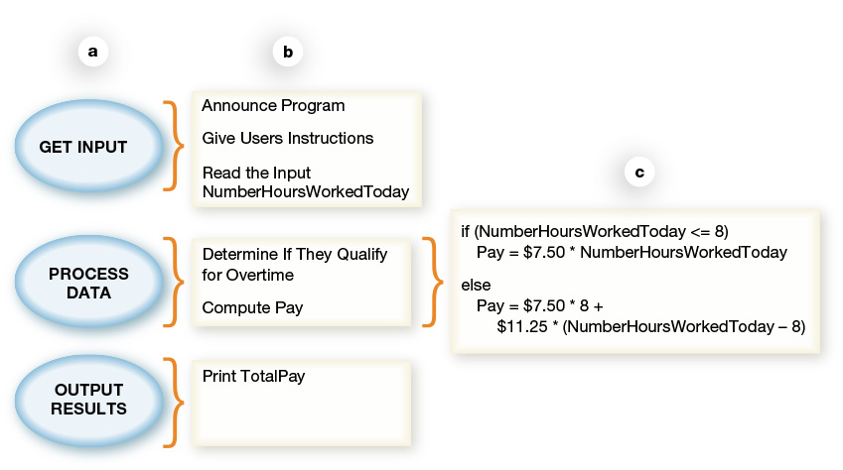
Life Cycle of a Program Algorithm Development
How top-down design is used in programming
Notes:
In this figure:
(a) A top-down design is applied to the highest level of tasks in our parking garage example,
(b) The tasks are further refined into subtasks, and
(c) Subtasks are refined into a sequence of instructions—an algorithm.

Slide 17
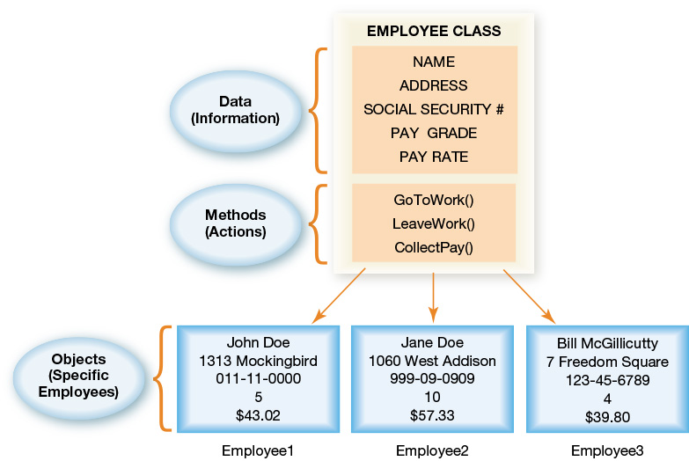
Life Cycle of a Program Algorithm Development
Here is an example of Design Methodology: Object Oriented Analysis
Notes:
In object-oriented analysis, programmers first identify all the categories of inputs the program is meant to solve. These categories are called classes.
Programmers may need to create several different examples of a class. Each of these examples is an object. In Figure 10.11, John Doe, Jane Doe, and Bill McGillicutty are each Employee objects (specific examples of the Employee class).

Slide 18
Life Cycle of a Program Coding
Coding: translating an algorithm into CPU instructions
Programmers move from algorithm to code by:
Identifying key pieces of information
Identifying the flow of each step
Converting the algorithm into specific programming language
Notes:
Once programmers create an algorithm, they select the best programming language for the problem and then translate the algorithm into that language. Translating an algorithm into a programming language is the act of coding.
Once programmers have an algorithm, they identify the key pieces of information the algorithm uses to make decisions.
Then they can begin converting the algorithm into computer code in a specific programming language.

Slide 19
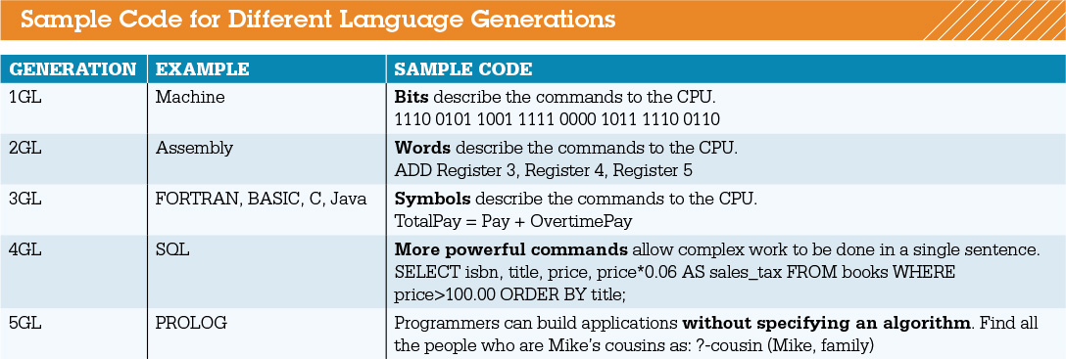
Life Cycle of a Program Coding
Programming language
A “code” for instructions CPU can perform
Languages use special words and strict rules
Allows control of CPU without knowing hardware details
Notes:
A programming language is a kind of “code” for the set of instructions the CPU knows how to perform. Computer programming languages use special words and strict rules so that programmers can control the CPU without having to know all of its hardware details.
Figure 10.15 shows small code samples of examples of each generation of language.

Slide 20
Life Cycle of a Program The Compiler
Code must be converted to 1s and 0s
Compiler creates an executable program
Some languages use an interpreter
Notes:
Compilation is the process by which code is converted into machine language—the language the CPU can understand (1s and 0s).
A compiler is a program that understands bot syntax and programming language and the exact structure of the CPU.
An interpreter translates the source code into an intermediate form, line by line. Each line is executed as it’s translated. The finished program runs faster than an interpreter.

Slide 21
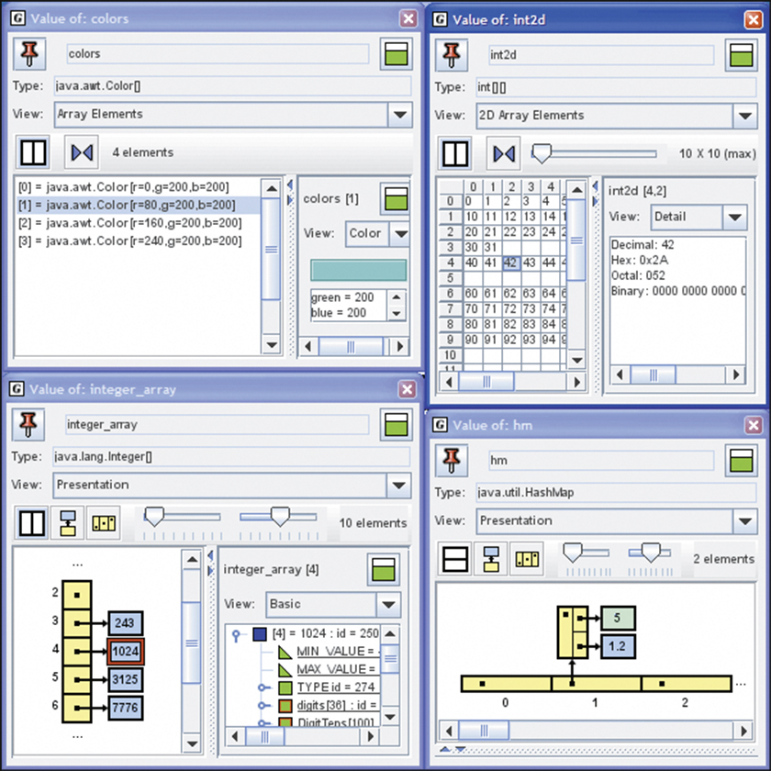
Life Cycle of a Program Integrated Development Environments
Integrated development environment (IDE) helps programmers write and test their programs
Notes:
An integrated development environment (IDE) is a developmental tool that helps programmers write and test their programs.
The jGRASP IDE is a free tool that helps the programmer visualize the code as it runs to help eliminate logical errors.

Slide 22
Life Cycle of a Program Debugging
Debugging
Finding and correcting errors
Testing plan helps programmers know program has solved the problem
Compilation errors
Improper syntax
Logical errors
Program runs but executes incorrectly
Notes:
The process of running the program over and over to find and repair errors and to make sure the program behaves in the way it should is termed debugging.
A complete testing plan includes sample inputs that exercise all the error handling required as well as all the processing paths.
A syntax error is a violation of the strict and precise programming language rules.
Logical errors in the problem are caught when the program executes.

Slide 23
Life Cycle of a Program Testing and Documentation
Internal testing
External testing
Solving problems after beta testing
Finishing the project
Release to manufacturers (RTM)
Documentation
General availability (GA)
Notes:
In internal testing, a group uses the program in every possible way.
In external testing, people like those who will use the software work with it.
Before commercial release, software is often provided in a beta version to test sites or to interested users.
Releasing to other manufacturers is called release to manufacturers (or RTM).
Documentation is created.
Finally, the product is in general availability (or GA) and can be purchased by the public.

Slide 24
Copyright
All rights reserved. No part of this publication may be reproduced, stored in a retrieval system, or transmitted, in any form or by any means, electronic, mechanical, photocopying, recording, or otherwise, without the prior written permission of the publisher. Printed in the United States of America.

