Slide 1
Topic:
Comparative
Advantage

Slide 2
Comparative Advantage: The Ideology
The WTO says that part of the rationale for its goal of "open trade" is comparative advantage.
Understanding the WTO, page 13.

Slide 3
Comparative Advantage: The Problem
But the WTO also admits that comparative advantage is "one of the most misunderstood" of economists' theories: Understanding the WTO, page 14.
On page 13, they cite Prof. Paul Samuelson (once the world's most famous economic educator, thanks to his textbook) as saying:
"Thousands of important and intelligent men ... have never been able to grasp the doctrine for themselves or to believe it after it was explained to them."
Something fishy is going on here!
Why can't intelligent people grasp it? What's up?

Slide 4
Skills developed by today's class
You will be able to distinguish two concepts.
Comparative advantage as an aspect of allocative efficiency.
Pure mathematical logic.
The theory that industry locates according to comparative advantage.
Empirical prediction of "invisible hand" theory.
You will be able to discuss "gains from trade."
Simple examples of teamwork.
Economists' theoretical diagrams.
Intuitive business logic.

Slide 5
The Logic of Allocative Efficiency

Slide 6
Everyday Examples of Allocating Resources
Examples
Team sports: assigning players to different positions on the field.
Housework: assigning family members to different chores.

Slide 7
Productivity: Algebraic Approach
Family Chores
 | Parent | Child | Total | Units
Meal output | 4 | 1 |  | per day
Laundry output | 40 | 30 |  | per day
Labor req per meal | 0.25 | 1.00 |  | in days
Labor req per laundry | 0.025 | 0.033 |  | in days
Input requirement is the algebraic inverse
of output productivity.

Slide 8
Assigning Resources to Tasks: Plan 1
 | Parent | Child | Total | Units
Meal output | 4 | 1 |  | per day
Laundry output | 40 | 30 |  | per day
Plan 1:
Time cooking | 80% | 100%
Time ironing | 20% | 0%
Meal output | 3.200 | 1.000 | 4.200
Laundry output | 8.000 | 0.000 | 8.000
Question:
Is this allocation of resources "efficient"
(in terms of output)?

Slide 9
Assigning Resources to Tasks: Alternative Plans
 | Parent | Child | Total | Units
Meal output | 4 | 1 |  | per day
Laundry output | 40 | 30 |  | per day
Plan 1:
Time cooking | 80% | 100%
Time ironing | 20% | 0%
Meal output | 3.200 | 1.000 | 4.200
Laundry output | 8.000 | 0.000 | 8.000
Plan 2:
Time cooking | 100% | 20%
Time ironing | 0% | 80%
Meal output | 4.000 | 0.200 | 4.200
Laundry output | 0.000 | 24.000 | 24.000

Slide 10
Allocative Inefficiency
 | Parent | Child | Total | Units
Meal output | 4 | 1 |  | per day
Laundry output | 40 | 30 |  | per day
Plan 1:
Time cooking | 80% | 100% |  | Inefficiency's "tell"
Time ironing | 20% | 0% |  | in red.
Meal output | 3.200 | 1.000 | 4.200
Laundry output | 8.000 | 0.000 | 8.000
Plan 2:
Time cooking | 100% | 20%
Time ironing | 0% | 80%
Meal output | 4.000 | 0.200 | 4.200
Laundry output | 0.000 | 24.000 | 24.000

Slide 11
Opportunity Cost
 | Parent | Child | Total | Units
Meal output | 4 | 1 |  | per day
Laundry output | 40 | 30 |  | per day
Labor req per meal | 0.25 | 1.00 |  | days per meal
Labor req per laundry | 0.025 | 0.033 |  | days per laundry unit
Opp Cost of a Meal | 10.0 | 30.0 |  | laundry output per meal
Opp Cost of Laundry | 0.100 | 0.033 |  | meals per unit of laundry output
Opportunity cost is the ratio of productivities.
Comparative advantage (in red) is the lower opportunity cost.

Slide 12
Comparative Advantage: The Definition
A producer has comparative advantage over another producer in a particular good if the first producer's opportunity cost is less (in terms of other goods that might be produced with the same resources).
Dimension: units of other outputs.
Contrast with absolute advantage: A producer has absolute advantage over another producer in a particular good if the first producer's physical input requirement is less.
Dimension: units of inputs.

Slide 13
Gains from Trade
No cross-border aspect to comparative advantage.
Suppose Parent and Child traded (bartered) instead of sharing.
Without either barter or sharing, each only consumes its own output and each has to produce both things.
Has the "tell" of allocative inefficiency.
Reallocating work efficiently and then bartering output raises total consumption of both things for both people.

Slide 14
Diagrammatic Approach
Diagrams as visual, spatial demonstrations of mathematical logic.
Suppy and demand curves.
The sum of odd numbers as a square.

Slide 15
Production Possibility Frontier (PPF)
Supply & Demand: "partial" equilibrium relative to one good.
PPF: "general" equilibrium for all goods.
Exposition shows two goods.
The "frontier":
Outside not possible.
Inside possible but inefficient.
On the frontier: both possible and efficient.

Slide 16
Intercept: Absolute productivity
Slope ("rise over the run"): Opportunity cost

Slide 17
Preferred Consumption Mix
"Autarky":
Each individual produces the preferred mix alone.
How can we show efficient allocations of effort?

Slide 18
Production Possibilities with Coordination
The frontier: both technical efficiency and allocative efficiency.
The graph
Intercepts = Both produce one good (or the other).
Slopes = Minima of the various producers' opportunity costs.
Exploiting comparative advantage.

Slide 19
Family PPF

Slide 20
"Seeing" Allocative Efficiency
Allocative efficiency
Southeast point: Both work on meals full-time.
Lower segment: Parent full-time in cooking and Child mixes activities.
Middle point: Each specializes according to comparative advantage.
Upper segment: Child full-time in laundry and Parent mixes activities.
Northwest point: Both do laundry full time.
Allocative inefficiency
Child works in the kitchen at the same time that Parent works in the laundry: inside the PPF.
Allocative efficiency moves towards specialization, and away from everyone doing everything.

Slide 22
Assigning Tasks: The Moral of the Story
Comparative advantage, in one of its two senses, is a purely logical rule for allocating resources to get maximum output.
"Allocative efficiency"
Every point on PPF must be reached via an efficient allocation of tasks.
People get to choose the output mix they choose — or "demand."

Slide 23
Comparative Advantage Version 2: A Theory Explaining Location of Industry

Slide 24
Transition: From Everyday Examples
Everyday Examples
Team sports: assigning roles to players.
Housework: assigning chores to children.
Question
What in these situations makes it easy to benefit from comparative advantage?
Answer: Coordination is easy and not controversial
Someone is in charge: coach, parent.
Results are shared: all the members of the winning team win.

Slide 25
To: The Commercial Economy
What about commercial firms?
Why would they coordinate?
Competitors, not members of a team.
How would they coordinate?
No one person is in charge of all of them.
Locations may be far from one another.
Are tasks (production of different goods and services) "allocated" efficiently among firms?

Slide 26
Economists' Answer: The Invisible Hand!
In economists' theory, yes.
Competition for profit has the same result as cooperation for mutual benefit.

Slide 27
Managing a Holding Company
Re-frame the family as a holding company that owns two corporations:
Parent Corp.
Child Corp.
Each corporation has $100 of inputs (instead of one day of work time).
Cost structures differ.
This exposition uses the equilibrium prices from "perfectly competitive" supply-demand interaction.

Slide 28
The Holding Company's Data
 | Parent Corp. | Child Corp.
Production cost per meal | $25.00 | $100.00
Production cost per unit laundry | $2.50 | $3.33
Output potential: meals | 4 | 1
Output potential: units of laundry | 40 | 30
Market price per meal |  |  | $200.00
Market price per unit laundry |  |  | $10.00
Profit per meal | $175.00 | $100.00
Profit per unit laundry | $7.50 | $6.67
Total profits with specialization in meals | $700.00 | $100.00
Total profits with specialization in laundry | $300.00 | $200.00

Slide 29
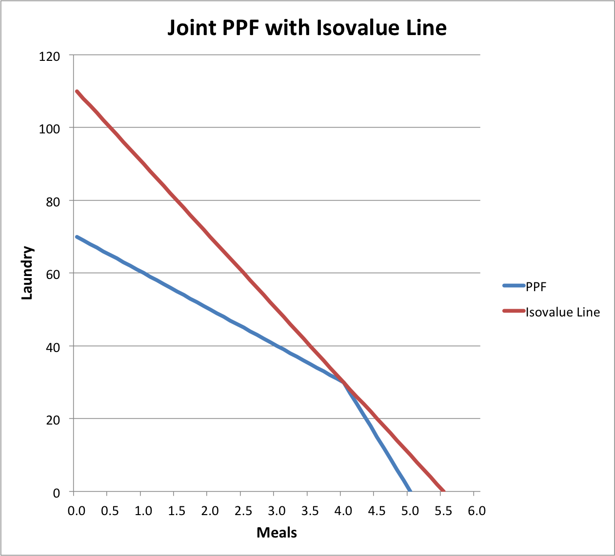
Slope of "Isovalue Line": price ratio

Slide 30
Diagrams for the Regional Case
"International trade" deals with large, separate regions containing many firms.
Can the PPF diagram be done in a way that represents this case more explicitly?
Yes.
See "Integrating Two Regions" slideshow.
More complex, but the same underneath.

Slide 31
The Intuitive Challenge
How can a producer with "comparative advantage" compete with a producer who has "absolute advantage" (in other words, lower cost)??

Slide 32
The Intuitive Answer: Prices, Profits, and Efficiency
Firms seek higher profits (not lower costs).
Profits result from both costs and revenues.
Revenues come from output prices.
Prices result from competition among firms.
Other firms may be less efficient in A, but if they are even less efficient in B, then if you produced A and they produced B, prices of B would be so high that you could make even more money by shifting to B.
That's comparative advantage.
It's allocatively efficient.
Firms only need to know what's profitable.

Slide 33
But Wait — What About Exchange Rates?
Don't exchange rates between currencies affect the price competition between firms in the different currency areas?
Will a change in exchange rates change the industry in which a region's firms have comparative advantage?
Let's check.

Slide 34
Global Economy At Two Different Exchange Rates
Globe has two regions that are sovereign countries that don't cooperate on currencies.
U.S. of Child has USD ($).
U.S. of Parent has EUR (€).
Goods (meals and laundry services) are tradable, so competition equalizes the prices of imports and local products.
Base case: €1.00 = $1.10.
Case 2: €1.00 = $1.20.

Slide 35
Specialization At Two Different Exchange Rates

Slide 36
Comparative Advantage At Two Different Exchange Rates
Note: Market dynamics push towards comparative advantage.
"Both Meals"? Laundry prices would shoot up, pushing producers back to comparative advantage.
Goods' and currency prices don't change proportionally? More expensive country runs out of money to buy from less expensive country, pushing prices back to proportionality.

Slide 37
Why Don't Prices & Exchange Rates Affect Comparative Advantage?
Comparative advantage is fully determined by physical productivities.
Pattern of demand (relative prices) determines what is produced out of those physical possibilities.
Currency exchange rate relates to financing.
Saving in one region finances extra consumption in the other: balance of trade surplus and deficit.
FX rate is driven by financial dynamics.
Wait for the module on this!

Slide 38
Summing Up: Economic Gains from Non-Discrimination
Aka, "gains from trade," or actually gains from having a larger number of more diverse firms able to supply the market.
Output rises due to allocative efficiency.
Greater variety of goods because a larger market accommodates them.
Productivity improvements from returns to scale.
Productivity improvements from increased competition.
(Plus non-economic gains, like reduced corruption.)

Slide 39
Is Economic Geography Explained by Comparative Advantage?
In some respects: Yes.
Firms from low-productivity regions are able to sell products in high-productivity regions.
For example, U.S. firms buy Bangladeshi textiles.
Why?
Prices have adjusted so that high-productivity regions make more money producing other things.

Slide 40
Is Economic Geography Explained by Comparative Advantage?
In important respects, No.
Commerce is highly active between regions that have similar endowments and productivity.
No inherent comparative advantage vis à vis one another.
Example:
South Carolina "imports" Hondas from Indiana, and Indiana "imports" BMWs from South Carolina.
(Note benefits of greater variety.)
Why does that occur? Is it beneficial?

Slide 41
Specialization: Smith vs. Ricardo?
A firm has two possible sources of specialization (not mutually exclusive).
Natural: special endowments, like location with special climate or geology (Ricardo's theory, or at least in the simplistic presentation).
Man-made: intentional specialization to raise productivity (Smith's theory).
Intensive development of skills and technology.
Outsource non-core tasks to other specialists.
Achieve economies of scale.

Slide 42
Scale of Production and Economic Geography
Positive returns to scale means:
Concentration of production in large firms.
Production in fewer locations.
Selling over wider areas.
Including across borders.
No returns to scale means:
Competition between many small firms.
Each region has firms in each industry.
Less interregional commerce.

Slide 43
How to Achieve Scale
For a firm:
Cartelize an industry.
Example: Standard Oil.
Invent a way to reach a larger market.
Example: Amazon vs. Barnes & Noble.
For a country:
Use "Complexity Theory" to identify an industry where you can achieve scale.
Reduce commercial barriers to become a better place for industry to locate.
Large-scale industry wants to source and sell in many markets, so it avoids places with barriers to commerce.

Slide 44
Complexity Theory
High productivity requires many branches of knowledge to work together.
An individual does not hold many branches of knowledge.
Ergo: high productivity requires many individuals to work together = large-scale production.
An example of "internal economies."

Slide 45
The Product Space
Each industry a dot on a page (a 2-dimensional space).
Distance between two dots shorter when more countries are successful exporters from both industries.
Successful export suggests presence of the necessary complex of factors.
Factors necessary for an industry maybe also useful for industry whose dot is neighboring.
Diversification of exports quicker to industries with dots neighboring existing industries' dots.

Slide 46
Exercise: Building an Industry
KOM textbook case of established region and potential low-cost entrant.
Exercise: communication between regions' firms to maybe do a deal.
Each team member think of an offer.
Each team select among draft offers.
Teams negotiate over the offers.
Report deals.
If no deal, report on offers.

Slide 47
Summing Up
Comparative advantage is reflected in everyday behavior.
Pure logic of allocative efficiency is simple.
"The Invisible Hand": the claim that industrial location is efficient.
Helpful to avoid some fallacies.
Ignores that comparative advantage can be built.
Building comparative advantage.
Scale: provide a large market.
This is the WTO's purpose.
Build on existing strengths, if possible.
Finance potentially lengthy establishment.

Slide 48
Skills developed by today's class
You will be able to distinguish two concepts.
Comparative advantage as an aspect of allocative efficiency.
Pure mathematical logic.
The theory that industry locates according to comparative advantage.
Empirical prediction of "invisible hand" theory.
You will be able to discuss "gains from trade."
Simple examples of teamwork.
Economists' theoretical diagrams.
Intuitive business logic.
Questions?

