Slide 1
Gains from Integrating
Regions:
Diagrammatic
Presentation

Slide 2
Indiana as Two Regions
Wabash River watershed in the north.
White River watershed in the center and south.

Slide 3
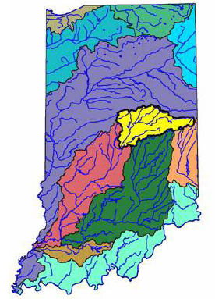
Indiana Watersheds
Wabash River: purple.
White River: yellow, red, green.

Slide 4
Regions' Allocation of Production: Two Goods
Focus on two of the goods produced in both regions.
Just call them 'A' and 'B' (apples and butter?).
Many producers, so PPFs look smooth.
Compare commercial equilibra.
Case 1: Regions are not in contact.
Case 2: Regions are economically integrated as "Indiana."

Slide 5
Regions with Differing Industrial Structure (PPFs)
B
B
A
A
Wabash Valley
White River Valley

Slide 6
Case 1: Separate Commercial Equilibria
B
B
A
A
Wabash Valley
White River Valley

Slide 7
Adding Up Outputs
B
B
A
White River Valley
A
Wabash Valley

Slide 8
Total Output Rectangle
B
B
A
White River Valley
A
Wabash Valley

Slide 9
Whaaa??
B
B
A
A
Wabash Valley
White River Valley

Slide 10
Adding Up the Same Outputs, Again –
Highlighting Price-Lines' Differing Slopes
White River Valley
B
B
A
Wabash Valley
A
Q: How can we use this presentation to illustrate changes in total outputs?

Slide 11
Case 2: Equilibrium in the Integrated Region
Contrasted with Initial Output Rectangles
White River Valley
A
B
B
A
Wabash Valley

Slide 12
Case 2: Equilibrium in the Integrated Region
Final Output Rectangles
White River Valley
A
B
B
A
Wabash Valley

Slide 13
"Little Rectangle" Gain from Integration
White River Valley
A
B
B
A
Wabash Valley

Slide 14
Commerce Allows Each Region to
Consume Some Output from the Other
White River Valley
A
B
B
A
Wabash Valley

Slide 15
Joint Hoosier PPF
B
Wabash Valley
White River Valley
Indiana
A

Slide 16
Hoosier Gains from Trade
B
Wabash Valley
White River Valley
Indiana
A

Slide 17
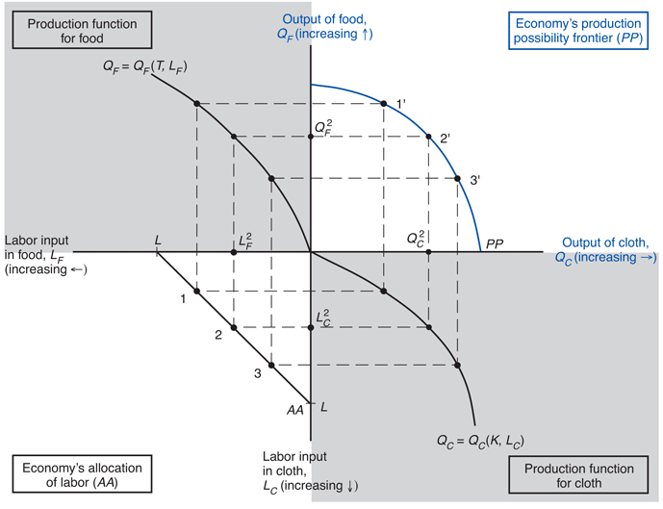
PPF Depends on "Production Functions"
Decreasing Returns Example from KOM, p. 56

Slide 18
Production Functions Depend on
Returns to Scale
Constant
Decreasing
Increasing

Slide 19
PPF from Production Functions:
Increasing Returns Example
B Output
B Prod Fn
PPF
Input for B
A Output
Input Supply
A Prod Fn
Input for A

Slide 20
Comparative Advantage with
Increasing Returns to Scale
B
B
A
A
Wabash Valley
White River Valley
Case 1: Not Integrated, Not Benefiting from Potential Returns to Scale

Slide 21
Increasing Returns to Scale:
Combined Output in Autarky
B
B
A
Wabash Valley
A
White River Valley

Slide 22
Increasing Returns to Scale:
Combined Output Benefiting from Comparative Advantage
White River Valley
B
A
A
B
Wabash Valley

