Slide 1
Topic:
Regional
Trade
Agreements
and
Income
Distribution

Slide 2
Skills developed by today's class
Knowledge areas:
Regional trade agreements
NAFTA
Jobs and Income distribution

Slide 3
Regional Trade Agreements

Slide 4
Varieties of RTAs
Border facilitation.
Especially for "intra-industry" trade.
Customs Union
Uniform external barriers.
Free Trade Agreement (FTA)
For all goods originating internally.
Common Market
Adds labor and investment mobility.
Economic Union
Common policies.
Step to political union.
Notes:
VanGrasstek Boc 13.1 (page 465).

Slide 5
RTAs "Regional"?
"Regional" means >1 country, but:
Not "multilateral" = all WTO members.
Not "plurilateral" = WTO sub-group.
Formed outside the WTO process.
RTAs are not necessarily "regional" but are inherently "preferential."
GATT refers to Free Trade Areas (FTAs).
FTA is one type of RTA.
WTO has a Regional Trade Agreements Committee to discuss issues that RTAs pose for WTO members.
"Customs Territories" may differ from sovereign territories.

Slide 6
Trends in RTAs
Over 270 RTAs now (only 50 in 1990).
EU is member of around half of all RTAs.
U.S. started promoting RTAs in the 1980s.
Emphasizing enforcement of labor rights and patents (rather than tariff rates).
Developing countries have shown interest in RTAs with the U.S. and EU.
East Asia pursuing RTAs more recently.

Slide 7
Rules of Origin
To give preference to a country's imports, you must verify that they come from that country.
Source vs. Origin
Source = Country of the seller.
Origin = Country of production by component.
Goods' components come from various origins.
Due to specialization to achieve economies of scale in producing components.
What minimum percentage of components does a country need to produce to be the "origin" of the assembled product?

Slide 8
Concerns about RTAs
RTAs discriminate against WTO members who are not members of the RTA.
Violation of MFN principle.
The usual issues arising from discrimination.
Potential source of political conflict between countries.
Corruption opportunities.
Possible allocative inefficiency.
Inefficient "trade diversion" vs. efficient "trade creation."

Slide 9
"Trade Diversion"
Scenario
Three countries: France, Germany, Japan.
Pre-RTA tariffs: each country has 20% tariffs on each of the other two.
RTA agreed between France and Germany: tariffs against one another lowered to 0%.
Post-RTA imports: France starts importing from Germany.
Question
Has the RTA made France’s residents better off?

Slide 10
Trade: Creation vs. Diversion
What were France's imports before the RTA?
Case 1: France didn’t import.
Reduction by 20 pctg pts in discrimination between France and Germany allows France’s residents to get a better deal.
"Trade creation."
Case 2: France imported from Japan.
Increase by 20 pct pts in discrimination between Japan and Germany induces France’s firms to choose products that, without discrimination, are not as good.
This is the "trade diversion" case.

Slide 11
Potential Benefits of RTAs for WTO
RTAs can try out agreements that may be expanded later in the WTO.
WTO+: Subject is in WTO but RTA goes beyond WTO agreements.
WTO-X: Areas not in WTO, such as social sectors, money laundering, taxation, etc.
Uruguay Round agreement in 1994 largely completed the "easy" wins; Doha Round had difficulty on remaining issues: non-tariff barriers, service sectors.
RTA may succeed thanks to less diverse membership than in the global forum.

Slide 12
GATT Art. XXIV Exceptions for RTAs
Customs Unions
Free-Trade Areas
Tariffs and NTBs "eliminated" on "substantially all" commerce.
FTAs not really reviewed by WTO under this standard (because they would fail).
Border procedures between neighbors.
GSP: Generalized System of Preferences for low-income countries.
Not reciprocal.
Adopted 1971, made permanent 1979.
Notes:
WTO webpage on RTAs: https://www.wto.org/english/tratop_e/region_e/scope_rta_e.htm.

Slide 13
WTO Principles on RTAs
Transparency Mechanism (adopted 2006)
Notification, starting at negotiation stage.
Secretariat prepares factual report on RTAs notified.
Committee on RTAs evaluates each RTA's consistency with multilateral agreements.
No increase in RTA's external barriers.
After RTA established:
Multilateral negotiations to lower RTA's barriers against outsiders.
Expand RTA's membership to more countries.

Slide 14
The Case of NAFTA: North American Free Trade Agreement

Slide 15
Negotiating History
U.S.-Canada.
Automobile agreement: 1965.
U.S.-Canada FTA entered into force under Pres. Reagan: January 1, 1989.
NAFTA (U.S., Canada, Mexico).
U.S.-Mexico negotiations start in 1990.
Canada joined negotiations in 1991.
NAFTA signed under Pres. Bush: 1992.
Labor and Environment side-agreements added under Pres. Clinton, Sept 1993.
Approved by U.S. Congress, Dec 1993.
Entered into force January 1, 1994.

Slide 16
NAFTA Provisions
See Congressional Research Service, pp. 5-9.
Goods.
Phase-out of all tariffs and most NTBs.
Rules of origin important.
Services.
Mainly nondiscriminatory treatment.
Mexican telecoms regulations made more fair.
Mexican financial sector substantially opened.
Patents, trademarks, copyrights.
Minimum standards for policy.
Previewed the later TRIPS agreement in WTO.
Investment.
More openness; National Treatment.
Mexico subsequently broadened this to other countries.

Slide 17
The Context Around NAFTA
U.S. tariffs applied to Mexico before NAFTA averaged 4.3%. (On cars: 2.5%.)
Uruguay Round reductions one year later.
Mexico's tariffs in 1985 averaged 25%.
Joined GATT in 1986.
Tariffs to U.S. before NAFTA averaged 11%.
Mexico opened to foreign investment in the 1990s.
Wharton Brief (2014) notes, "Massive recent foreign investments ... in Mexico include Mazda's facility, with an estimated annual production of 185,000 vehicles; Nissan's, with an annual capacity of 149,000 vehicles, and Audi's, set to open in 2016, with annual capacity for 150,000 vehicles."
Needed to be able to compete with China.
17

Slide 18
20 Years of NAFTA
Intra-NAFTA trade grew relatively rapidly.
Only 5% of the U.S. economy.
U.S. firms buy a lot of petroleum products from the NAFTA region.
For non-petroleum products, U.S. firms sell more in the NAFTA region than they buy.
Changes post-NAFTA were relatively substantial in textiles & apparel, automotive, and agriculture.
U.S. cars more competitive globally.
Wages in U.S. automotive rose 19% by 2012, vs. 41% increase in output per worker.
Shift to low-wage regions in U.S.
NAFTA started while Mexico was suffering political and financial crises. In contrast, U.S. was booming.
18

Slide 19
Jobs and Income Concentration

Slide 20
How Is Income Distributed?
Income results from production of outputs that have value in the marketplace.
Firms produce and sell in the market, so they receive income.
Personal income is the income that persons receive when it is distributed by firms.
Profit is what a firm distributes to the people who control the firm.
Firms distribute income according to their prime objective: profit maximization.
Income distributed to others is minimized.
Contrasts with "social welfare function," where employee income is a benefit.

Slide 21
Recipients of Firms' Income
Half the U.S. population have no wealth (zero net worth).
40% of the U.S. population (the 6th through 9th deciles) have wealth mainly in the form of equity in their homes, plus a little retirement money.
The wealthiest decile mainly holds its wealth as ownership of firms.

Slide 22
U.S. Household Wealth Distribution Over Time (Chart from U.S. Federal Reserve Board)

Slide 23
U.S. Ownership of Corporate Stock (Chart from U.S. Federal Reserve Board)

Slide 24
Asset Ownership Varies by Wealth (Chart from U.S. Federal Reserve Board)

Slide 25
Maximizing Profits
Unit labor costs are minimized by engineering the workplace.
The lowest-cost workplace has simple tasks that can be monitored and measured.
Simple tasks use the most broadly available skills, so that wage rates can be minimized.
Employee turnover is high but manageable because simple tasks are learned rapidly.

Slide 26
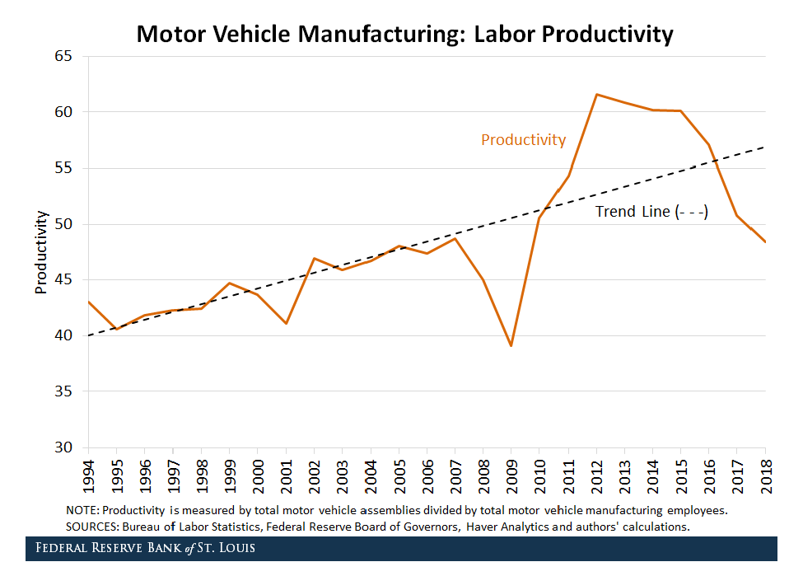
Mechanization in U.S. Motor Vehicle Manufacturing

Slide 27
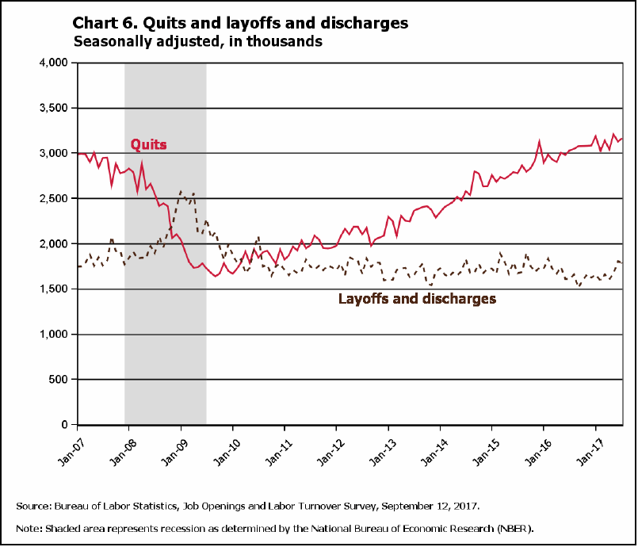
Churn in U.S. Employment
Monthly Rates
"In July 2017, there were 3.2 million quits and 1.8 million layoffs and discharges."
27

Slide 28
Jobs: Changing Sectors
1800s: self-employment common.
Late 1800s: firms grow larger.
More managerial employees, including specialized engineers.
1900s: majority employed by firms.
On farm in 1900: 40%; in 2000: 2%.
Factories: rapid mechanization lowers employment and cost per unit output.
Services: growth in employment in retail, hospitality, medical services, finance.

Slide 29
Roles in the U.S. Economy
 |  | Own Firms?
 |  | No | Yes
Direct Work of a Large Number of Others? | No | Workers | Proprietors
 |  | Type of work: Defined, repetitive, monitored. Required skills widely available without special training. Share in the economy: 54%. | Type of work: Master craft or professional work. Requires professionally specific skills. Share in the economy: 12%.
 | Yes | Managers | Directors
 |  | Type of work: Design, policy, management, supervision, record keeping. Requires substantial scientific or social skill. Share in the economy: 29%. | Type of work: Freely chosen: possibly professional, managerial, or artistic. Access mainly inherited. Share in the economy: 5%.

Slide 30
Concentration of Income Has Fluctuated
1800s: early industrial economy's income quite concentrated.
1930-1970: depression and war stimulated social solidarity, reduction in concentration.
Since 1970: re-assertion of higher profit share.
2000s: Internet marketing and winner-take-all firms make higher profit margins, distribute less income to employees.

Slide 31
Distribution Changes in the U.S. and Europe: 1900s

Slide 32
The Mixed U.S. Economy
Slight majority in the U.S. work in big firms.
Also many for smaller firms.
Non-firm employment substantial.
Government, public schools, military, police, postal service, etc.
Don't maximize profits.
Employment governed by social standards.
Differ from firms in job security, wages, benefits.

Slide 33
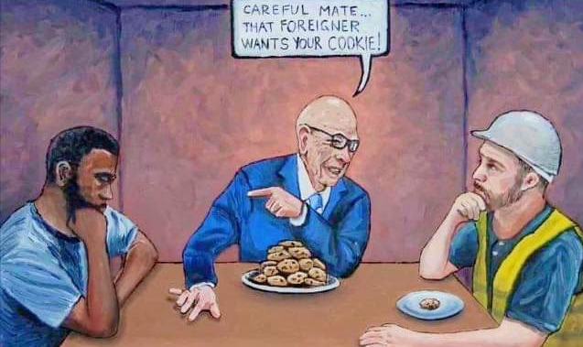
Dealing with Issues of Jobs and Income Concentration

Slide 34
Trade and Income Concentration
Trade not so important?
Trade growth 1950-1970 coexisted with low income concentration.
60% of U.S. jobs are in nontradables.
Change in trade small relative to the overall size of the economy.
Trade more important?
Global market access increases dominance of big firms with higher profit rates and lower shares for employees.
Economic change harder on employees than on owners.

Slide 35
Barriers At the Border?
Marginal to job insecurity and low incomes in across the economy.
Alternative to low-wage areas (domestic or foreign) is probably mechanization.
Keeping 1950s-style assembly operations probably not an option.
Border barriers eliminate higher paying jobs.
Damage from retaliation by other countries.
See the Federal Reserve calculations by Flaeen & Pierce on the USG's 2018 tariffs.

Slide 36
Internal Policy on Income Distribution and Concentration
Measures that offset the imbalance in power between big firms and individual employees: predistribution.
Legalizing unionization, minimum wage laws, regulation of workplace conditions.
Measures that redistribute income.
Unemployment insurance; Social Security, Medicare, Medicaid, and Obamacare; Earned Income Tax Credit; Trade Assistance for Workers.

Slide 37
Skills developed by today's class
Knowledge areas:
Regional trade agreements
NAFTA
Jobs and Income distribution
Questions?

