Slide 1
Topic:
Migration and Refugees

Slide 2
Skills developed by today's class
You will understand:
How international organizations help countries grapple with the difficulties of the current volume of movement of persons.
Ongoing efforts to strengthen international coordination mechanisms.

Slide 3
International Movement of Persons
Refugees: 27 million (2021, pre-Ukraine).
As defined by 1951 Convention:
Outside the home country.
Can't return due to "well-founded fear of being persecuted."
Refugee status conferred differently by different countries.
Migrants: as much as 281 million in 2020.
No internationally agreed definition.
Generally, persons away from their usual residence for more than a year.
Notes:
281 million figure from "Progress Declaration" of 2020 International Migration Review Forum (IMRF).

Slide 4
Refugees

Slide 5
The Refugee Challenge
Massive numbers.
Long lasting.
Refugees hosted by low-income countries.
Resettlement from low-income countries to industrialized countries is resisted.
International institutions are not designed to deal with these challenges.
Why?
Are they changing?

Slide 6
1918 Watershed Between Eras
1820-1914: large-scale migration to the Western Hemisphere by free, private choice.
After 1918, government policy took charge.
Sending countries: regime change.
Ethnic: replacement of multinational European empires by new countries based on ethnicity — "nationalism."
Reinforced antisemitism.
Ideological: e.g., Communist regimes.
Receiving countries became less welcoming.
Ethnic nationalism.
Economic depression.

Slide 7
Internationalization of Refugee Management
Ethnic and ideological refugees not welcome in previous homes, unwilling to return.
Many became "stateless."
Differing interests of sending and receiving countries required diplomacy.
Pre-1945 managing institutions.
League of Nations (Nansen) from 1920.
Allies' militaries after 1939 and UNRRA starting 1943.

Slide 8
Post-1945 Institutionalization
UN had to step forward to replace UNRRA when combat ends.
International Refugee Organization (IRO) approved by UNGA, December 1946.
First specialized agency created by UN.
"Non-permanent": host countries to take over when refugee numbers fell.
IRO's main task: ocean transportation of refugees to countries of resettlement.
IRO's permanent replacements, 1951.
UNHCR for diplomatic coordination.
PICMME (re-named ICEM) for transportation.

Slide 9
1951 Convention on Refugees
Refugees' problem was political, but danger was real.
Issue: what if country of origin wanted a political refugee to be repatriated?
Under the Convention, no.
Refugee was covered by the Convention if "persecuted" due to pre-1951 political changes.
Within Europe only.
Covered refugees to be treated like other immigrants (like "aliens generally").
Convention urged naturalization of refugees.

Slide 10
Refugee Rights Under the 1951 Convention
Not be returned to place of danger.
Not be penalized for illegal entry if cooperating with authorities.
Employment.
Housing, schooling, and social services.
Identity documents, right to travel, and access to judicial system.
Refugee must obey country's laws.

Slide 11
Contemporary Challenges
Violent disorder or extreme politics.
Suffering external invasion, war.
Armed rebellion; warlords and gangsters.
Repressive government; regime change.
Natural disasters.
Economic or environmental implosion.
Desertification.
Hyperinflation.
Population density; lagging living standards?
"Mixed motivation" migration becoming more common: both push and pull factors.

Slide 12
Receiving Countries
Developing countries receive most refugees.
Socioeconomic as well as humanitarian challenge.
Development not in UNHCR mandate.
UNHCR supports services in camps.
Majority of refugees go to cities where they live and work in the informal sector.
Don't receive usual refugee services.
Receiving countries' policies are diverse.
Many not willing or able to conform to 1951 Convention's standards.

Slide 13
UNHCR: Organizational information
Founded in 1950.
Headquarters: Geneva.
Staff: 18,879.
90% "in the field": mostly Africa, Middle East.
Over 70% locally recruited.
Expenditures: USD 5 billion.
Budget request is double actual funding.
Funding commitments only annual.
"Global Focus" webpage allows reader to drill down for data by region.

Slide 14
UNHCR: Operational Goals for Refugees
Access to protection.
Individual registration and documentation.
Security from violence and exploitation.
Access to basic needs: shelter, food and water, sanitation, electrical power.
Opportunities for schooling and livelihoods.
Voluntary return.
Or, in case of protracted refugee status, local settlement or resettlement in third countries.
Notes:
Source: UNHCR "Global Report 2017," p. 28.
http://reporting.unhcr.org/sites/default/files/gr2017/pdf/GR2017_English_Full_lowres.pdf

Slide 15
Responses to Current Challenges
Miliband on "The Refugee Crisis" (Oct 2016).
Refugees displaced for average of 17 years: "They are unlikely to go home."
Informally integrating into local economy.
Cash assistance should be used more.
Focus on refugees doesn't deal with:
Conflict resolution in sending countries.
Socioeconomic development receiving countries.
Non-refugee initiatives needed to complement traditional UNHCR approach.

Slide 16
Migration

Slide 17
Labor Mobility
Bhagwati, "Borders Beyond Control":
Three categories
Skilled workers
Many start as graduate students.
Illegal migration
Many originate as tourists.
Refugees
Temporary, but many for years.
Similar long-term outcomes in all three cases.
Benefits: diasporas and dual citizenship.
Potential benefits in labor productivity:
Double global GDP?

Slide 18
Policy on Migrant Workers
Not set multilaterally.
Convention on Migrant Workers adopted by UNGA in 1990 (based on ILO Conventions) with comprehensive rights.
Few receiving countries have ratified.
Receiving country policy decisions:
How many and which applicants to admit.
Length of stay.
Which jobs and social benefits accessible.
Concerns:
Impacts on business and other workers.
Social cohesion and security.

Slide 19
UN Survey (2013): National Policies on Migration
Tendency to encourage or discourage immigration? (pp. 31-32).
Relative emphasis on temporary vs. permanent immigration (pp. 36-37).
Assimilation or multiculturalism? (pp. 53-54).
Dual citizenship? (p. 71).
Promote overseas work as a development program (remittances)? (pp. 65-66).
Diaspora engaged with home countries? (p. 74).
Source: UN's International Migration Policies: Government Views and Priorities (2013)

Slide 20
Receiving Country Case: The U.S.
Permanent immigrants
Statutory annual quota: 675,000.
Sub-quota of 140,000 for employment.
Limit of 7% from any one country.
Emphasizes close family members.
Temporary workers
20 types of visas for temporary, nonimmigrant workers.
Refugees: annual quota set by President, including for resettlement.
Support from Office of Refugee Resettlement in HHS.

Slide 21
Sending Country Case: The Philippines
Filipinos and Filipinas have global success as nurses and ship workers, etc.
Almost 10% of the population has worked overseas.
2.4 million overseas in 2015.
Major source of income.
Between 10 and 20% of GNP.
Prepared by training institutes.
For example, nautical-marine institutes.
Encouraged and supported by the government.

Slide 22
The Philippine Overseas Employment Administration
Negotiates bilateral agreements with receiving countries.
Licenses recruitment agencies.
Pre-employment orientation and repatriation assistance.
Protects workers against abusive situations.
Collects fees.
Notes:
Source: http://poea.gov.ph/programs/programs&services.html.

Slide 23
Interstate Travel in an FTA: EU
EU citizens by treaty (2007) are entitled to:
Look for a job in another EU country.
Work there without a work permit.
Reside there for that purpose.
Stay after employment has finished.
Same employment treatment as nationals.
Large refugee influx in 2015 disrupted free movement policy within the "Schengen" (EU+) area.
Some national border barriers reimposed.
UK left the EU.

Slide 24
IOM: International Organization for Migration
Founded 1951: Intergovernmental Committee for European Migration (ICEM).
Globalized in the 1970s.
Drops "European" to become ICM in 1980.
IOM name adopted in 1989.
Creates the "Geneva Migration Group" with UNHCR, ILO, and others: 2003.
Re-named "Global Migration Group" (GMG) 2006.

Slide 25
IOM's Program
Assisting on immigration policy, law, and governance.
Assistance on negotiating bilateral labor agreements.
Support to regional cooperation between neighboring states.
Services to migrants.
Resettlement case-processing for Karen refugees in Canada.
Livelihood assistance to temporary workers returning from Spain to Colombia.
Publishes World Migration Report since 2000.

Slide 26
IOM's Organization
173 member states.
Headquarters: Geneva.
Global administrative center in Manila.
Staff: 13,800 as of 2019.
Ten-fold increase in the last 20 years.
97% based in over 400 field locations.
Mostly local.
Expenditures: USD 2 billion (2019).
Staff compensation: 30% of expenses.
Financing: over 90% from members' voluntary contributions.

Slide 27
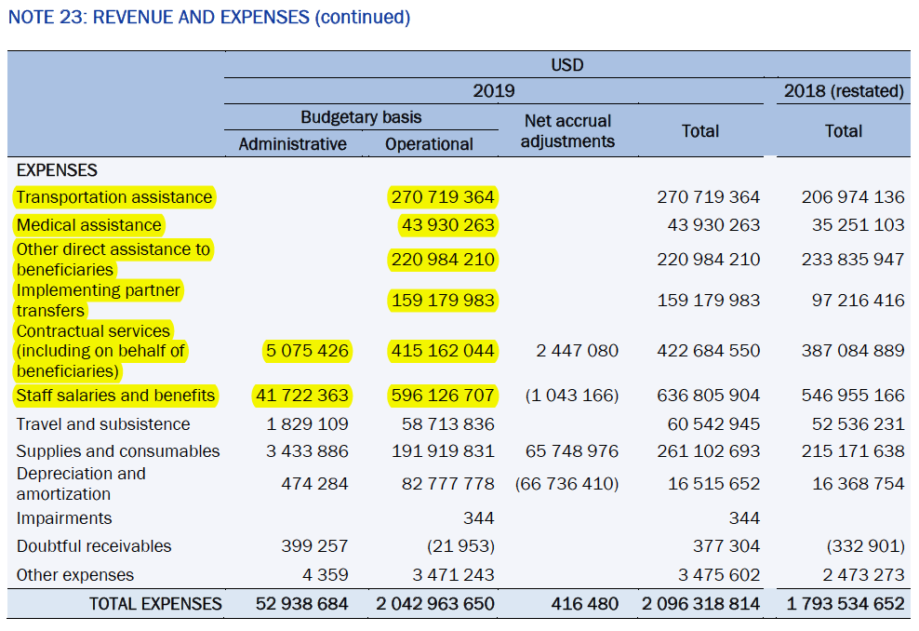
IOM's Expenses: 2019
Notes:
https://governingbodies.iom.int/system/files/en/council/111/C-111-3%20-%20Financial%20Report%202019.pdf
Page 51

Slide 28
Evolving Institutions

Slide 29
Growing Institutionalization
Expansion of UNHCR and IOM since 1990s.
Coordination through the UN.
2006: UN High-Level Dialogue on International Migration & Development.
2007-17: "State-led" Global Forum on Migration & Development.
2015: Syrian refugee crisis in Europe.
2016: UN heads-of-state Summit on Migrants and Refugees.
New York Declaration.
IOM joins UN system in 2016.
2018: Global Compact for Migration.

Slide 30
Global Compact for Migration
Adopted Dec 2018 by 164 countries.
U.S. and a dozen others did not sign.
Goals in 23 categories.
Envisages UN-supported capacity-building.
Technical assistance and start-up financing for GCM implementation.
Knowledge management.
IOM to coordinate UN Network on Migration.
Successor to Global Migration Group.
New "International Migration Review Forum."
2022 Forum requests UN SecGen to set indicators for reporting progress on goals.

Slide 31
Skills developed by today's class
You will understand:
How international organizations help countries grapple with the difficulties of the current volume of movement of persons.
Ongoing efforts to strengthen international coordination mechanisms.
Questions?

