Slide 1
Topic:
Climate
Change

Slide 2
Skills developed by today's class
You will understand the UNFCCC as a mechanism for international cooperation on climate change.
You will understand how countries design their contributions to controlling greenhouse-gas emissions.

Slide 3
Three key institutional steps.
The Convention adopted in 1992.
The Kyoto Protocol adopted in 1997.
The Paris Agreement adopted in 2015.

Slide 4
The Convention: UNFCCC
Adopted at the UN's "Earth Summit," 1992.
Result of process started by the WMO's "First World Climate Conference," 1979.
Governed by Conference of Parties (COP).
Established the UNFCCC's Secretariat and other "bodies."
Including the Subsidiary Body for Scientific and Technical Advice: SBSTA.

Slide 5
Issues Addressed through UNFCCC
Mitigation: reduce GHG emissions.
Developing countries' emissions would grow, but less than under "BAU."
Adaptation: by 1992, climate change was inevitable.
Loss & Damage beyond ability to adapt: potential liability and compensation.
Finance
Market mechanisms like emissions trading.
Assistance to developing countries.
Science and capacity building.

Slide 6
The Kyoto Protocol
Adopted 1997; entered into force 2005.
U.S. never ratified.
Required "binding" commitments on GHG emissions from developed (Annex 1) countries.
Targets (percentages) shown in Annex B.
Target date: 2012.
Extended by Doha Amendment (2012) to 2020.
Innovative mechanisms to encourage and finance reductions of emission.
Emissions trading.
"Clean Development Mechanism" to support developing countries' projects.

Slide 7
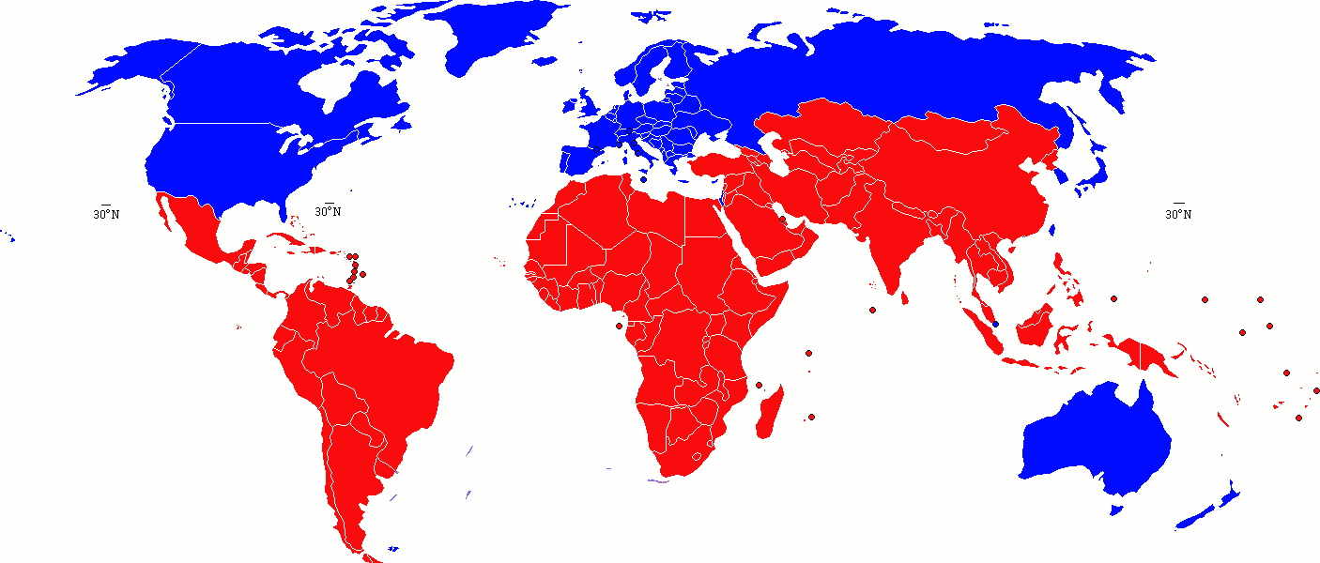
Annex 1
1997 Kyoto Protocol
Non-Annex 1
Binding Commitments for GHG cuts (2008-2012 vs. 1990 levels)
No Binding Commitments

Slide 8
Share of Emissions from Developing Countries

Slide 9
Kyoto Period Emission Trends
Global Rank in 2012 2012 relative to 2005
China +68.5%
USA -12.5%
Europe -10.7%
India +52.8%
Russia +3.0%
Japan +0.7%
Indonesia +37.2%
Mexico +16.2%
Brazil +25.8%
Notes:
Source: Pendzich and Allen presentation.

Slide 10
The Paris Agreement
Adopted at COP-21, December 2015.
"Nationally Determined Contributions" (NDCs) to global reduction of GHG emissions.
Best efforts instead of "binding" commitments.
To be updated every 5 years.
GHG emission inventories every 2 years.
Low-Emission Development Strategies by 2020.

Slide 11
Nationally Determined Contributions
Design guidance provided by the World Resources Institute and UNDP.
NDC must:
Include base year, target date, emissions covered, implementation plan, and scientific methods.
Defend its adequacy as a contribution.
Technical review by UNFCCC.
UNFCCC website portal contains all NDCs.

Slide 12
Intended NDCs: The Case of Peru
Mitigation
30% reduction goal.
10 pct pts depend on receiving aid.
Importance of "LULUCF": Land Use, Land-Use Change and Forestry.
Over half of Peru's emissions growth.
UNFCCC includes carbon sinks and REDD: Reducing Emissions from Deforestation.
Adaptation
Importance of tropical glaciers in the water regime.

Slide 13
UNFCCC Negotiation Process
Decisions reached by consensus of the annual COP.
Kyoto Protocol's sub-group is CMP.
Paris Agreement's sub-group is CMA.
Countries form negotiating blocks (some from the UN).
European Union.
African Group.
Like-Minded Developing Countries (LMDCs).
Least Developed Countries (LDCs).
Alliance of Small Island States (AOSIS).
Independent Alliance of Latin America and the Caribbean (AILAC).

Slide 14
UNFCCC Observers
Annual COP has 25,000 participants.
Largest of all UN gatherings.
1,200+ accredited groups.
Business and industry.
Environmental NGOs.
Local governments.
Research and academic institutions.
Religious bodies.
Indigenous peoples.
Accredited groups can attend and speak, but not participate in decision-making.

Slide 15
The Road to Paris and COP 2015
2005: Kyoto agreement enters in force.
2007: COP 13 (Bali) agreement to negotiate a long-term, post-Kyoto mechanism.
Creates "Ad-Hoc Working Group."
2011: COP 17 (Durban) sets 2015 as target for adoption of post-Kyoto agreement.
2012: CMP 8 (COP 18; Doha) extends Kyoto framework through 2020.
2013: COP 19 (Warsaw) calls for "intended" NDCs by March 2015, if possible.
2015: WRI and UNDP produce guidance for iNDCs.
2015: Paris Agreement at COP 21 confirms NDC implementation to begin in 2020.

Slide 16
UNFCCC Secretariat
Headquartered in Bonn, Germany.
About 450 staff.
Budget for 2018-19: EUR 59 million
Budget for staff costs: EUR 40 million.
Organizes negotiating sessions for members.
Including the COP, CMP, CMA.
Assists in reviewing the Parties' reports.
Assists Parties in implementation of agreements.
Maintains the registry for NDCs.

Slide 17
UNFCCC's Review Role
Technical reviews of Parties' plans.
To promote comparability of efforts.
More technically demanding for developed countries.
All published in UNFCCC's website.
Case: France
Review of "7th national communication" (NC) in 2018.
Recommendations for completeness and transparency: paragraph 111.

Slide 18
Technical Bodies: UN's IPCC
"Intergovernmental Panel on Climate Change"
UN scientific body founded in 1988 by WMO and UNEP.
Hundreds of volunteer scientists, selected from UN members' nominees.
Reports on knowledge about climate change.
Including reports requested by UNFCCC.
Special Report 2018 requested by COP 21.
Secretariat of 13 in Geneva under WMO.
Expenditures in 2017: CHF 5 million.

Slide 19
Technical Bodies: SBSTA
"Subsidiary Body for
Scientific and Technological Advice"
Composed of UNFCCC's Parties.
Interfaces with IPCC to get scientific information into UNFCCC processes.
Advises developing countries on impacts and adaptation.
Including Loss & Damage.
Involved in setting guidelines for Parties' reporting and reviewing reports.

Slide 20
Skills developed by today's class
You will understand the UNFCCC as a mechanism for international cooperation on climate change.
You will understand how countries design their contributions to controlling greenhouse-gas emissions.
Questions?

