Slide 1
Topic:
InternationalPayments
and the
IMF

Slide 2
Skills developed by today's class
You will understand the mechanism that the world community has set up to ensure that the payments system will not create barriers to international trade.

Slide 3
Payments in Foreign Currencies
Firms use banks to make payments in other currency areas.
Banks hold FX in branches or "correspondent" banks in the other currency areas.
Individual banks manage FX surpluses or deficits through the inter-bank FX market.
Monetary authority ensures that the market has FX for all the banks in its currency area.
Holds "Official International Reserves."
IMF facilitates borrowing by a monetary authority that is short of OIR.

Slide 4
Official International Reserves
Denominated in foreign currencies.
Available to the monetary authority.
Purposes:
Meet shortfalls in banks' stock of FX.
Intervene in currency markets to change prices (exchange rates).
Give assurance of FX availability, prevent panics.
A change in the amount of OIR is called "the Official Settlements Balance" or, commonly, "the Balance of Payments."
Notes:
Reference: IMF Manual on BOP, p. 111.
KOM 10th: p. 333.

Slide 5
Balance of Payments Concept
Changes in net financial position are relevant to a financially responsible entity because they affect the ability to meet future obligations.
Adult person: saving.
Business firm: profits.
Government: fiscal deficit.
Monetary authority: "Balance of Payments."
Responsible to its constituents for availability of foreign currencies.

Slide 6
Payments as a Global Problem
There are two parties to any transaction, so failure to make a cross-border payment affects at least two sovereigns.
An OIR shortage in one country is likely to affect counterparties in many countries.
Deficits in one country are "the other face of the coin" of surpluses in other countries.
All countries' policies are factors.
Globalized response via the International Monetary Fund (IMF).

Slide 7
Payments for What?
Purchases paid for in FX.
Goods and services (Balance of Trade).
Financial assets.
Called "investments."
Investment income received or paid in FX.
Unilateral transfers.
Changes in these payments affect the "Official Settlements Balance" — the change in the stock of OIR, or in other words the Balance of Payments.
Problems mainly relate to no. 1.b, above.
Notes:
References:
-- IMF Manual on BOP, p. 9.
-- KOM chapter 13, selected slides.

Slide 8
Sources of BOP Problems
High employment and national income.
Lots of imports => trade deficit => BOP deficit => dwindling reserves (OIR).
Falling interest rates or profits.
Global investors decrease loans to local borrowers.
OIR are spent paying off outside loans that are not replaced with fresh lending.
Risk of exchange-rate depreciation rises.
Makes wealth holders want to sell local currency in exchange for some of OIR.

Slide 9
Public Finance and the BOP
Causes of BOP problems.
Short duration.
Fiscal stimulus. Example: tax cut, more imports, a BOP deficit.
Investors sell local currency financial assets.
Long duration: Structural weakness.
Example: Pakistan's problem with fiscal and energy-sector management, which has been a continuous source of fiscal stimulus.
Public finance is critical to 1.a and 2.a.

Slide 10
BOP Deficit Management
Austerity: rein in aggregate demand.
Sacrifice employment and income.
Solve structural fiscal problems.
Devalue the currency.
Local-currency income buys less in other currencies, imports fall.
Less risk of further depreciation?
Will currency markets cooperate?
Borrow reserves from other central banks during the transition to a reduced deficit.
Including through IMF programs.
Notes:
In addition to getting reserves through the IMF, monetary authorities (central banks) also get FX reserves from other central banks, bilaterally or in regional groups.
A famous bilateral case was U.S. Fed provision of gold to the Bank of England in 1925.
Regional arrangements included the BIS's European role in the 1930s.
Also, the multilateralization of ASEAN's Chiang Mai Initiative recently. (ASEAN endorsed bilateral arrangements between members as early as 1977. These were expanded to include China, Japan, and South Korea, as ASEAN+3, in 2000 under the CMI. The parties agreed in 2009 to "multilateralize" the CMI by contributing to a common, regional fund.) CMI coordinates with the IMF but was established independently because it was felt that U.S. influence made the IMF less than fully dependable.
Central bank-to-central bank transactions are commonly structured as "swaps," where one reserve asset (a less liquid one) is temporarily exchanged for another (a more global reserve asset), with a calendar date set for reversing the swap.

Slide 11
The IMF At a Glance
Conceived at Bretton Woods, 1944.
Purpose is to protect cross-border trade by helping members deal with BOP problems.
About 190 country members.
2,900 staff, mainly at headquarters.
Annual administrative expenses USD 1.5 bn.
Mostly personnel.
Headquarters: Washington, DC.
"Resident Representatives" in many countries: small offices.
Regional Technical Assistance Centers.
Headed by the "Managing Director."
Notes:
IMF At a Glance.
Pre-Covid expenses (in SDRs) from 2019 Financial Statements, page 35.

Slide 12
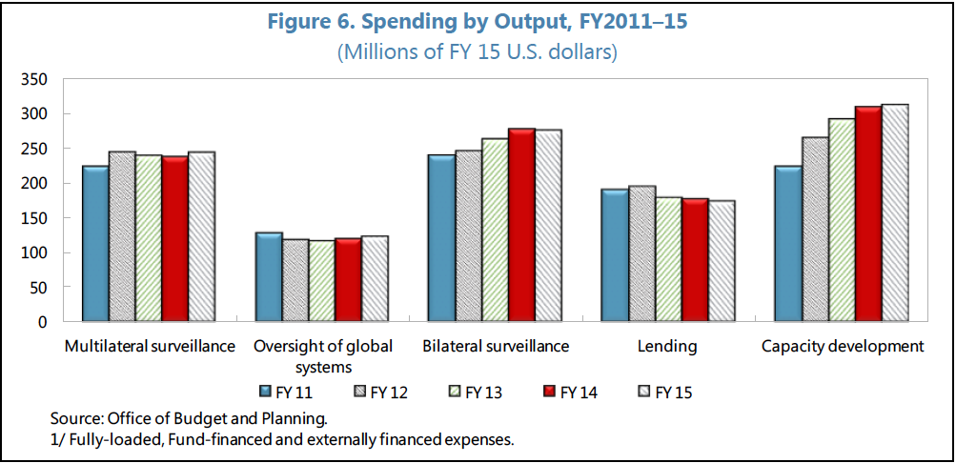
IMF Adminstrative Spending by Output
Notes:
FY2015 OUTTURN AND OUTPUT COST ESTIMATES, page 10.

Slide 13
The IMF's Informational Work
Monitoring for potential BOP problems.
"Article IV" consultation (IV.3.b).
All members, typically annually.
Reports reviewed by Executive Board.
Fiscal stance: "It's Mostly Fiscal."
Credit conditions.
Exchange-rate policies.
Technical assistance and training.

Slide 14
The IMF in BOP Crises
IMF arranges FX financing to meet temporary shortfalls.
IMF allows member who needs OIR to purchase FX with its local currency.
Other members with global reserve currencies ("freely usable currencies") agree to sell their currencies to the member with the OIR need.
Country adjusts fiscal, monetary, and exchange-rate policies to rebuild OIR.
Adjustment plans justify IMF financing.
IMF reviews implementation, quarterly.

Slide 15
"Stand-By Arrangement"
IMF's traditional "workhorse" facility to make FX available to members in need.
Short-term BOP problems that can be reversed in 12-24 months.
Borrower commits to targets for FX reserves and government fiscal results.
Funds from IMF are not spent: instead, they're held to create confidence and allow private financing to resume.
Repayment ("repurchase") in 3-5 years.

Slide 16
IMF Member Responsibilities
Pay "quota" in home currency to the IMF's pool of funds.
Refrain from imposing payment restrictions.
Refrain from charging different exchange rates to different buyers ("discriminatory" or "multiple" currency practices).
Furnish the IMF with information on the economy, trade, and reserves.
Notify the IMF about currency policies.
Cooperate with Article IV consultations.
Notes:
IMF Articles of Agreement.

Slide 17
IMF Institutional Governance
Board of Governors, one for each Member.
Voting depends on economic size ("quota").
See "IMF Members' Quotas and Voting Power, and IMF Board of Governors."
85% issue.
Super-majority of 85% required for wide range of IMF decisions.
U.S. quota is 16.5%
BRICS quota is 14.2%
Notes:
Brazil 2.22%, Russia 2.59%, India 2.63%, China 6.08%, and South Africa 0.63%. Total: 14.15%.

Slide 18
IMF Program Management
Executive Board of 24 Executive Directors.
EDs are elected by the Board of Governors to represent certain countries.
ED's vote has weight of those countries.
EDs are full-time employees, paid by the IMF.
Managing Director
Appointed by the Executive Board.
Chairs Executive Board.
Appoints and manages IMF's staff.
Notes:
https://www.imf.org/en/About/executive-board/eds-voting-power
IMF Factsheet: How the IMF Makes Decisions.
http://www.imf.org/external/np/exr/facts/govern.htm

Slide 19
IMF's Fiscal Affairs Department: FAD
20 senior staff, 100-200 professional staff.
Judging by group photo, assuming some away from the office "on mission."
At headquarters and in RTACs: Regional Technical Assistance Centers.
Main role is "capacity development": technical assistance and training.
Including in crises, to help draft plans.
Administrative costs covered in part by "thematic funds" donated by wealthy IMF member countries.
Notes:
FAD Factsheet.

Slide 20
FAD Emphases
Tax laws (policy)
Tax administration (staff, procedures, etc.).
Transition from border taxes and customs administration to more comprehensive taxes: VAT, sales taxes, and income taxes.
Combines industrial policy and public finance.
Governance: "Public Financial Management."
Interface between administration, legislature, and the public.
Expenditure management.
Energy "subsidies" a global problem.
Notes:
FAD Factsheet.

Slide 21
IMF's Original Mandate
Temporary, business-cycle BOP problems, typical of industrialized economies.
Fiscal and central-bank adjustment.
Exchange rates remain constant, or were adjusted sparingly.
System failed: too much pressure on exchange rates.
March 1973: Industrialized countries float FX rates, ending need for IMF assistance.

Slide 22
IMF's New Mandate
New reality: developing economies' "deep-seated" adjustment problems.
Following oil crises of the 1970s, commercial banks "recycled" OPEC's petrodollars by lending them to developing countries to allow them to continue importing oil.
Big growth in international banking.
Debt crisis.
Need for "structural adjustment" to re-balance imports and exports, given higher oil prices and debt-service payments.
IMF support during the process.

Slide 23
Prolonged IMF Programs
Developing economies do not solve "deep-seated" adjustment problems rapidly.
Don't meet IMF program targets, so programs longer and repeated.
Strategic issue for IMF.
Relaxation of IMF's lending standards?
Affects IMF's role as "seal of approval" for other lenders?
IMF duplicating World Bank's role in long-term development finance?
IMF programs not well designed?

Slide 24
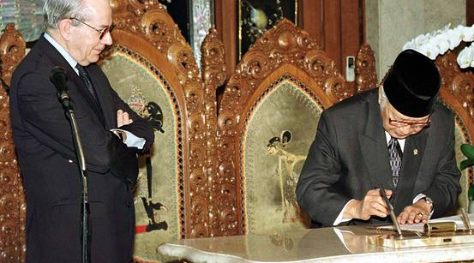
The IMF: An Image Problem

Slide 25
Case: The IMF in Pakistan
Pakistan's prolonged use of IMF resources.
Four 1-year SBAs in the 1970s.
Continuous IMF financing from 1980 to 2016, including use of longer-term Extended Fund Facility (EFF).
Same-old problems emerged again in 2017-18.
New 3-year EFF in July 2019.

Slide 26
Pakistan's Issues
FX reserve crises.
Banks couldn't get L/Cs (letters of credit) to pay the bills for imports, e.g., fuel.
Including when I was arriving in 2008 (Biden-Lugar aid bill under discussion).
Export growth weak.
Tax collections weak.
Can't finance public health or education.
Low tax bills amount to fiscal stimulus leading to high imports.
Energy sector: constant blackouts cripple industry, demoralize households.
(See "Prolonged Use" p. 16 and ch. 9.)

Slide 27
Pakistan-IMF: Extended Arrangement of 2019
Example of "Extended Fund Facility."
Parameters:
Disbursement in tranches over 39 months.
SDR 4.3 bn (USD 6 bn) potentially available.
Key sections:
"Letter of Intent" to the IMF from Pakistan's "authorities" (heads of central bank and finance ministry) showing the actions they will take to eliminate the need for IMF resources: page 63.
Quantitative Performance Criteria & Indicative Targets (page 84).
Structural Conditionality (page 85).
Notes:
Page references to September 2022 review document.

Slide 28
IMF September 2022 Report on Pakistan 2019-2022 EFF
FX reserves fell worryingly in 2022 (page 5).
Tax revenues low and missing targets (page 10).
Program with IMF supports unconditional cash transfers (UCT) to families via "BISP," but targets missed (page 15).
Energy sector still not coming closer to financing itself (page 20).
Notes:
Page references to September 2022 review document.

Slide 29
Skills developed by today's class
You will understand the mechanism that the world community has set up to ensure that the payments system will not create barriers to international trade.
Questions?

