Slide 1
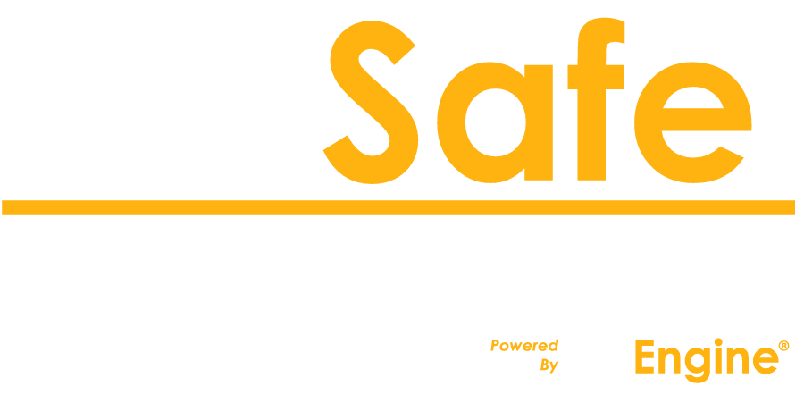
Basic Data Safety Practices That Can Prevent Malpractice Claims & Ethics Violations
Grant County Bar Association
Kim J. Brand
President
Founder

Slide 2
1. Threats vs Risks

Slide 3
1. Threats vs Risks
The ‘Bad’ things that can happen.
vs.
How much does it cost?

Slide 4
1. Threats vs Risks
2. Acts of God
Acts of Violence
Acts of Stupidity

Slide 5
1. Threats vs Risks
2. Acts of God
Acts of Violence
Acts of Stupidity
3. Defenses:
Backups
Systems
Policies
Training
Audits

Slide 6
4. The ‘Backup’ Goals
Recovery Point Objective - RPO
Recovery Time Objective - RTO
Saving the right stuff
Keeping backups safe

Slide 7
4. The ‘Backup’ Goals
Recovery Point Objective - RPO
Recovery Time Objective - RTO
Saving the right stuff
Keeping backups safe
Balance...
Peace of mind
Responsibility
Economy

Slide 9
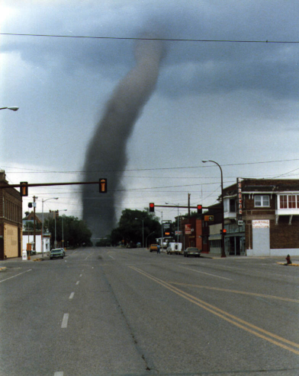

Slide 10
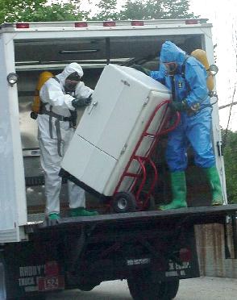

Slide 11
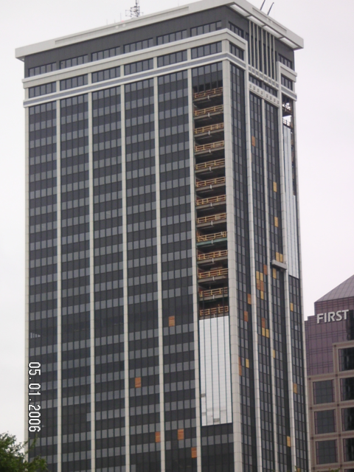

Slide 12
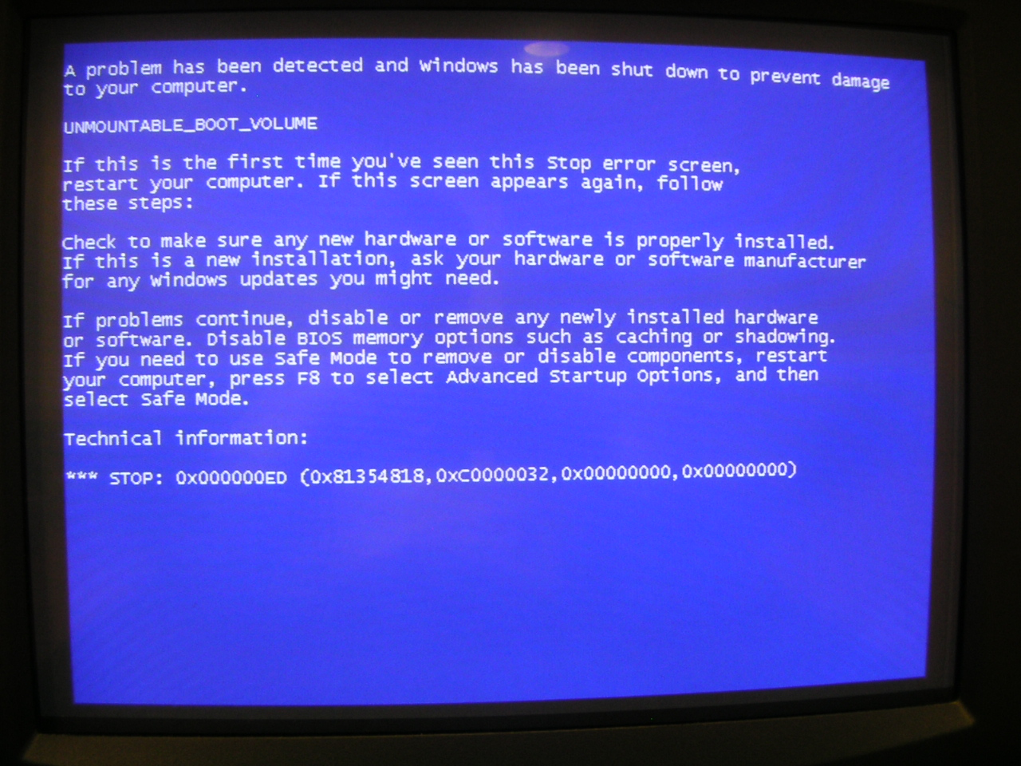

Slide 13
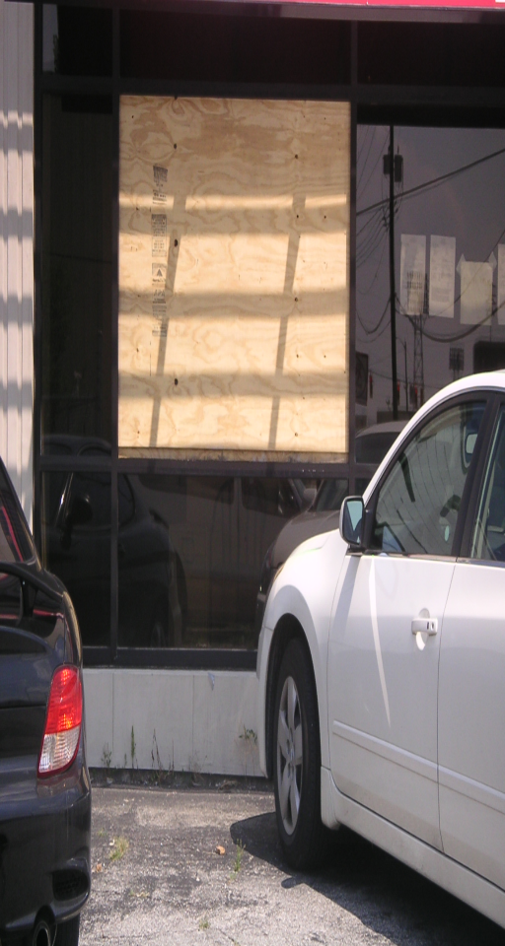

Slide 14
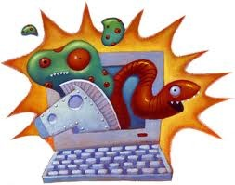
Viruses, Trojans and Malware – Oh my!

Slide 15
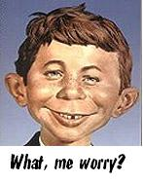

Slide 16
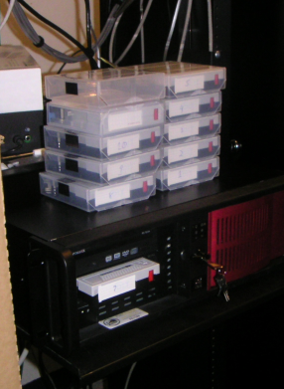

Slide 17
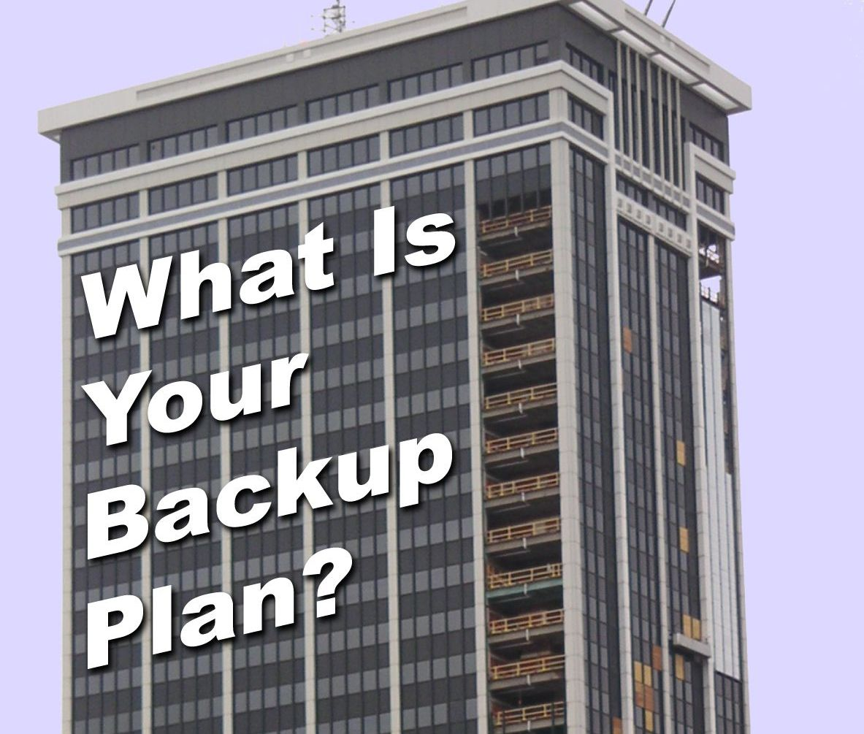

Slide 18
5. Where is your data?

Slide 19
5. Where is your data?
Office?
 PC
 Server
 Copier
Laptop?
Mobile device?
Cloud?

Slide 20
6. Security vs Safety…

Slide 21
6. Security vs Safety…
Intentional Acts
vs.
Unintentional Acts

Slide 22
6. Security and Safety…
 Passwords?
 Encryption?
At rest
In transit
Wireless Access
 Retention Policies?
 Remote Access?

Slide 23
6. Security and Safety…
Recommended password policies:
 8+ characters
 Letters & Numbers
 Mixed case: A-Z, a-z
 Special characters: $@*&!
 Changed 4x year
 No repeats for 1+ year

Slide 24
6. Security and Safety…
Recommended password policies:
 8+ characters
 Letters & Numbers
 Mixed case: A-Z, a-z
 Special characters: $@*&!
 Changed 4x year
 No repeats for 1+ year
Security ‘tokens’

Slide 25
Why is Backup hard?
 Lots more stuff in more places
 Different threats – different defenses
 Backup software is complicated
 Backup media is a security risk
 Bad organization habits
 Restore is needed infrequently;
. . . practice is risky!

Slide 26
Why is Backup hard?
 Lots more stuff in more places
 Different threats – different defenses
 Backup software is complicated
 Backup media is a security risk
 Bad organization habits
 Restore is needed infrequently;
. . . practice is risky!
Remember:
Backup is boring, Restore is EXCITING!

Slide 27
A special case: Laptops
 65% of PCs sold last year were laptops
 1:10 Lost or stolen
 Confidential information on the loose
 Difficult to sync with office servers
 Portable = Abused (dropped, kicked)
 No user serviceable parts inside
 Security policies difficult to enforce

Slide 28
Backup System Elements . . .
 Automated
 Regular (daily, weekly, continuous?)
 Tested: Right Stuff, Valid, Monitored
 Accessible: Offsite vs Onsite, Credentials, Encryption Keys
 Granular: Ability to recovery a single file
 Portable: Software, Hardware, Skills
Someone MUST CARE!

Slide 29
A “Simple System” . . . doesn't exist!
 Consider data size, type & location:
Docs, Databases, E-Mail, PCs, Laptops
Servers, Smartphones, ‘Open Files’
 Backup generations & retention issues
 Compliance & discovery issues
 Media life & custody
 Offsite: Cost & confidentiality issues
 Documentation & Support
Test, Train, Review, Repeat

Slide 30
Disaster Recovery
Must be able to duplicate the
“Value Stack”
 Hardware
 OS & Updates (Licenses)
 Configuration: Users, Groups, etc.
 Software & Services (Licenses)
 Data
Disaster Recovery is not Backup!

Slide 31
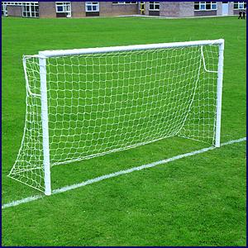
Let's Review
The Goals
RPO
RTO

Slide 32
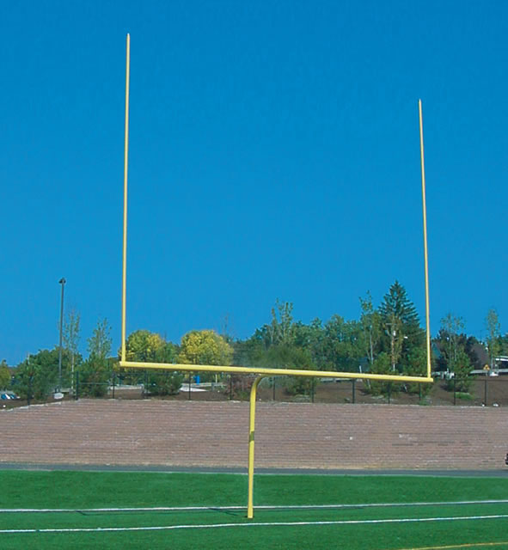
Let's Review
The Goals
RPO
RTO
Right Stuff
Safe & Secure
Value Stack

Slide 33
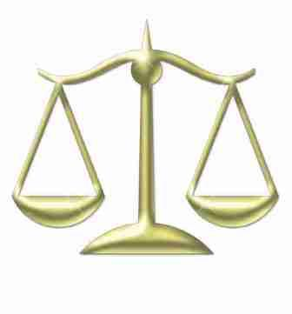
Let's Review
The Goals
RPO
RTO
Right Stuff
Safe & Secure
Value Stack
Balance
Economy
Responsibility
Peace of Mind

Slide 34
Kim recommends:
► Image hard drives: Symantec, Acronis, Comodo
► Offsite storage: Mozy, SugarSync, FileSafe!
► Written policies: P/W, retention, backup, Internet
► De-Crapify: Current, Archive, Media, E-Mail, etc.
► Encrypt laptop hard drives: Winmagic, TruCrypt
► Document: P/W, providers, licenses, network, etc.
► Update versions: OS, AV, Browser, Software
► Malwarebytes, OpenDNS, LastPass, LoJack

Slide 35
Quiz questions:
What is the Value Stack?

Slide 36
Quiz questions:
Four simple questions to ask to perform your own backup audit.

Slide 37
Quiz questions:
Four simple questions to ask to perform your own backup audit.
1. What programs do you use?
2. Where does that program store its data?
3. When/Where does that data get backed up?
4. If you discovered missing or corrupted data,
what would you do?

Slide 38
Quiz questions:
The 'Three Threats' data safety model

Slide 39
Quiz questions:
The 'Three Threats' data safety model
1. Acts of God
2. Acts of Violence
3. Acts of Stupidity

Slide 40
Quiz questions:
The difference between ‘Safety’ and ‘Security’?

Slide 41
Quiz questions:
The difference between ‘Safety’ and ‘Security’?
 Safety regards unintentional acts
 Security regards intentional acts

Slide 42
Quiz questions:
The one Most Important Thing you can do to keep your data safe:

Slide 43
Quiz questions:
The one Most Important Thing you can do to keep your data safe:
Put Someone in charge of
Data Safety & Security!

Slide 44
These slides and other resources
are available online at:
www.FileSafeServer.com
Thank You!

